Slide 1
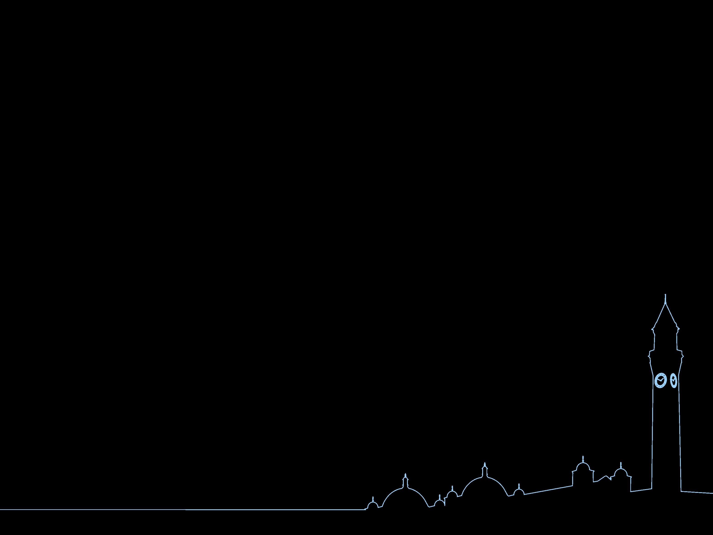
Using R for language research
A case study in corpus-based sociolinguistics
Dr Jason Grafmiller j.grafmiller@bham.ac.uk

Slide 2






data collection
Basic workflow
data cleaning
visualisation & analysis
writing up
R all the way down!

Slide 3
Case study: ‘BE sat/stood’
Alternation between present -ing and past participle forms of sit and stand with progressive meaning
"I'm sat on the bus next to him and it's not real," he tweeted.
I'm stood in the kitchen and there is a glare on my laptop screen.
"I’m sitting on the bus next to him and it's not real," he tweeted.
I’m standing in the kitchen and there is a glare on my laptop screen.

Slide 4
Aim of the study
Use large-scale language data sources, e.g. Twitter and other corpora, to explore the following questions:
What is the geographical distribution of BE sat/stood in UK (and beyond)?
What factors predict when a person uses “I’m sat” versus “I’m sitting”
When and where is BE sat/stood likely to have originated, and why?

Slide 5
Contemporary data sources
 | Time span | Description
UK Twitter Dialect Corpus¹ | 2014 | 1.8 billion words from 180 million tweets
Global Web-based English (GloWbE)² | 2012-2013 | 1.9 billion words from web domains in 20 countries
Spoken British National Corpus (BNC) 2014³ | 2012-2016 | 11.5 million words of spoken conversations around the UK
Bank of English⁴ | 1960-2004 | 550 million words of spoken and written English from 8 countries
¹Grieve at al. (2019); ²Davies (2013); ³Love et al. (2017)

Slide 6
Examples from Twitter
i'm 27 and i'm sat in a toilet getting drunk and talking to my little sister
Completely forgot about pancake day 🙃 I was sat eating curry for lunch when my wife notified me of this glorious event.
had a great view of this goal from where I was stood yesterday
i died when you were stood behind her doing those faces 😂😭
fuck school now i've been stood in the rain for 15 mins and i'm soaked

Slide 7
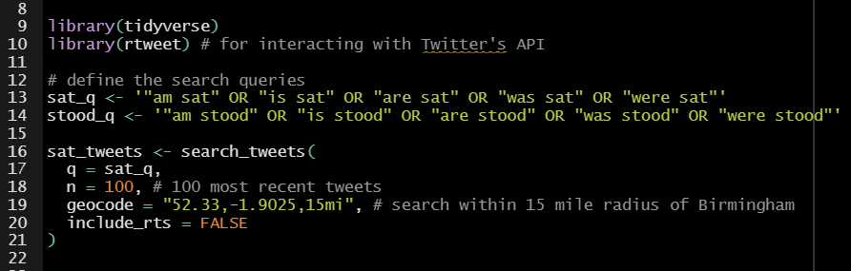
GitHub: R/twitter_examples.R

Slide 8
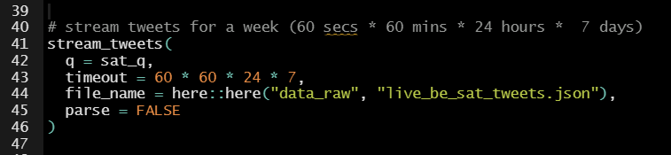
GitHub: R/twitter_examples.R

Slide 9
Datasets
sit
stand
 | BE sat | BE sitting | BE stood | BE standing
UK Twitter Dialect Corpus | 64,785 (59.9%) | 43,348 (40.1%) | 9361 (40.2%) | 13,931 (59.8%)
Global Web-based English (GloWbE) | 2236 (6.4%) | 32,461 (93.6%) | 827 (4.1%) | 19,450 (95.9%)
Bank of English | 479 (1.5%) | 31,774 (98.5%) | 259 (1.1%) | 22,849 (98.9%)
Spoken British National Corpus (BNC) 2014 | 273 (33.7%) | 537 (66.3%) | 66 (27.5%) | 174 (72.5%)

Slide 10

Data cleaning & feature annotation
combine datasets from corpora
remove POS-tags for readability
extract grammatical information:
Tense
Subject person
negation
post-modification
R packages
janitor (cleaning data)
vroom (fast reading/writing data)
stringr (string manipulations)
purrr (functional programming)
dplyr (data wrangling)

Slide 11
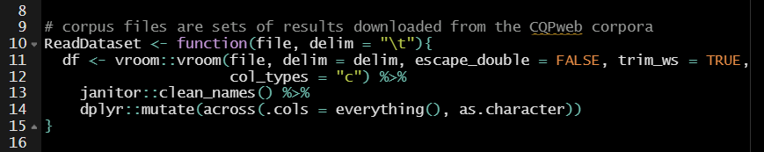
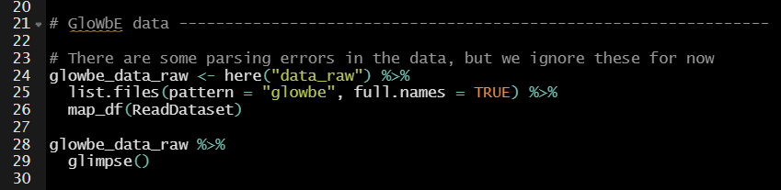
Raw data is in the form of multiple files downloaded from several corpora. Use custom function to collect related files into single dataframe
GitHub: plot_functions.R

Slide 12
Visualization & Analysis
Charts frequencies across global varieties
Map proportions of sat / sitting in UK Twitter data
Build predictive models of variation between sat / sitting
R packages
ggplot2 (basic plotting)
patchwork (combine plots)
rgdal, sp (spatial plotting)
lme4 (regression modeling)
effects (partial effects plots)

Slide 13
Global corpus of Web-based English (GloWbE) 2012 - 2013
3x more frequent in the UK than anywhere else
values beside bars show raw counts

Slide 14
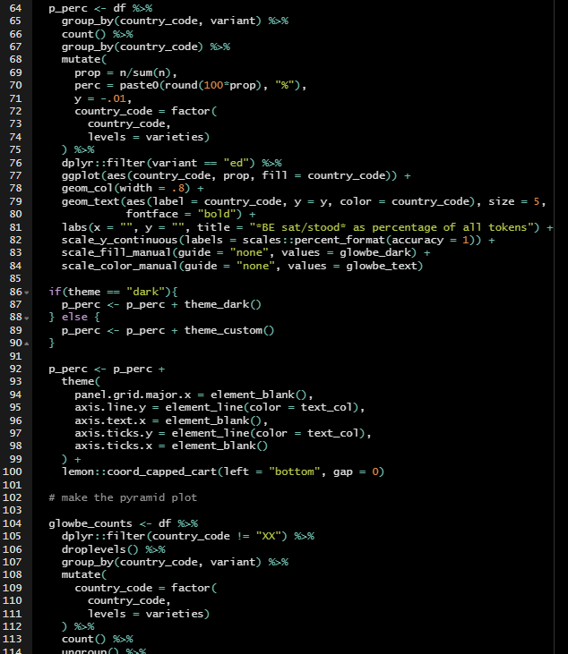

Create custom functions for plotting that I can change the colour palette quickly for, e.g. printing
I can also re-use them for other projects
GitHub: R/plot_functions.R

Slide 15
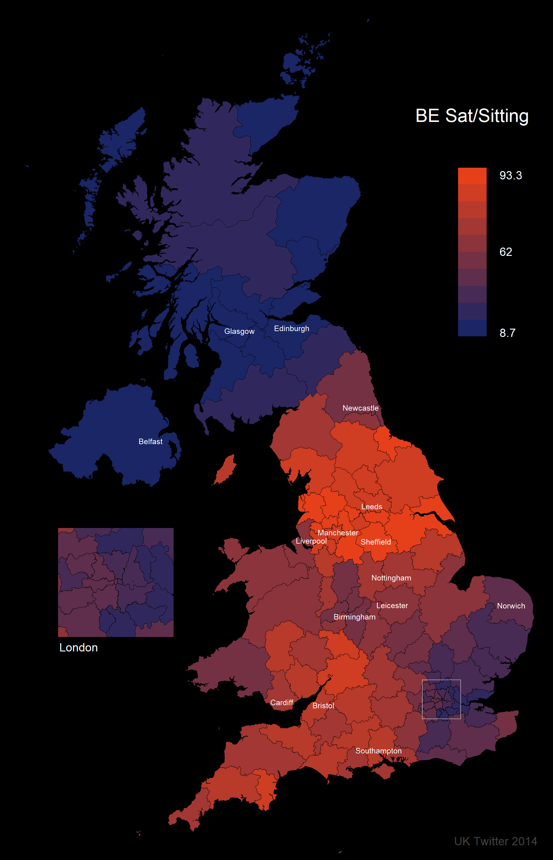
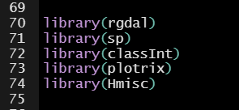
UK Twitter Dialect corpus 2014
R has lots of tools for spatial analysis and plotting (though some can be tricky to work with)

Slide 16
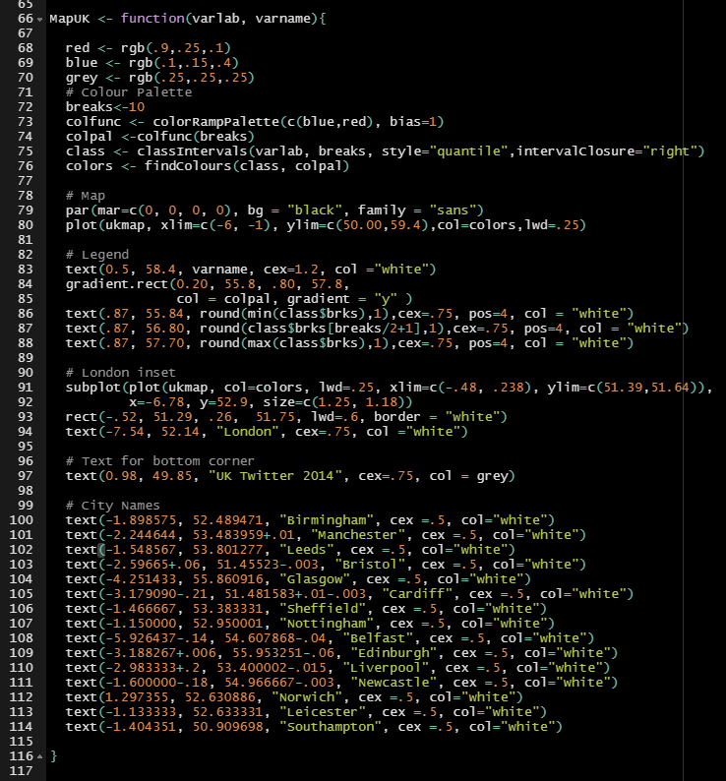
R has lots of tools for spatial analysis and plotting maps (though some can be tricky to work with)
GitHub: R/map_functions.R

Slide 18
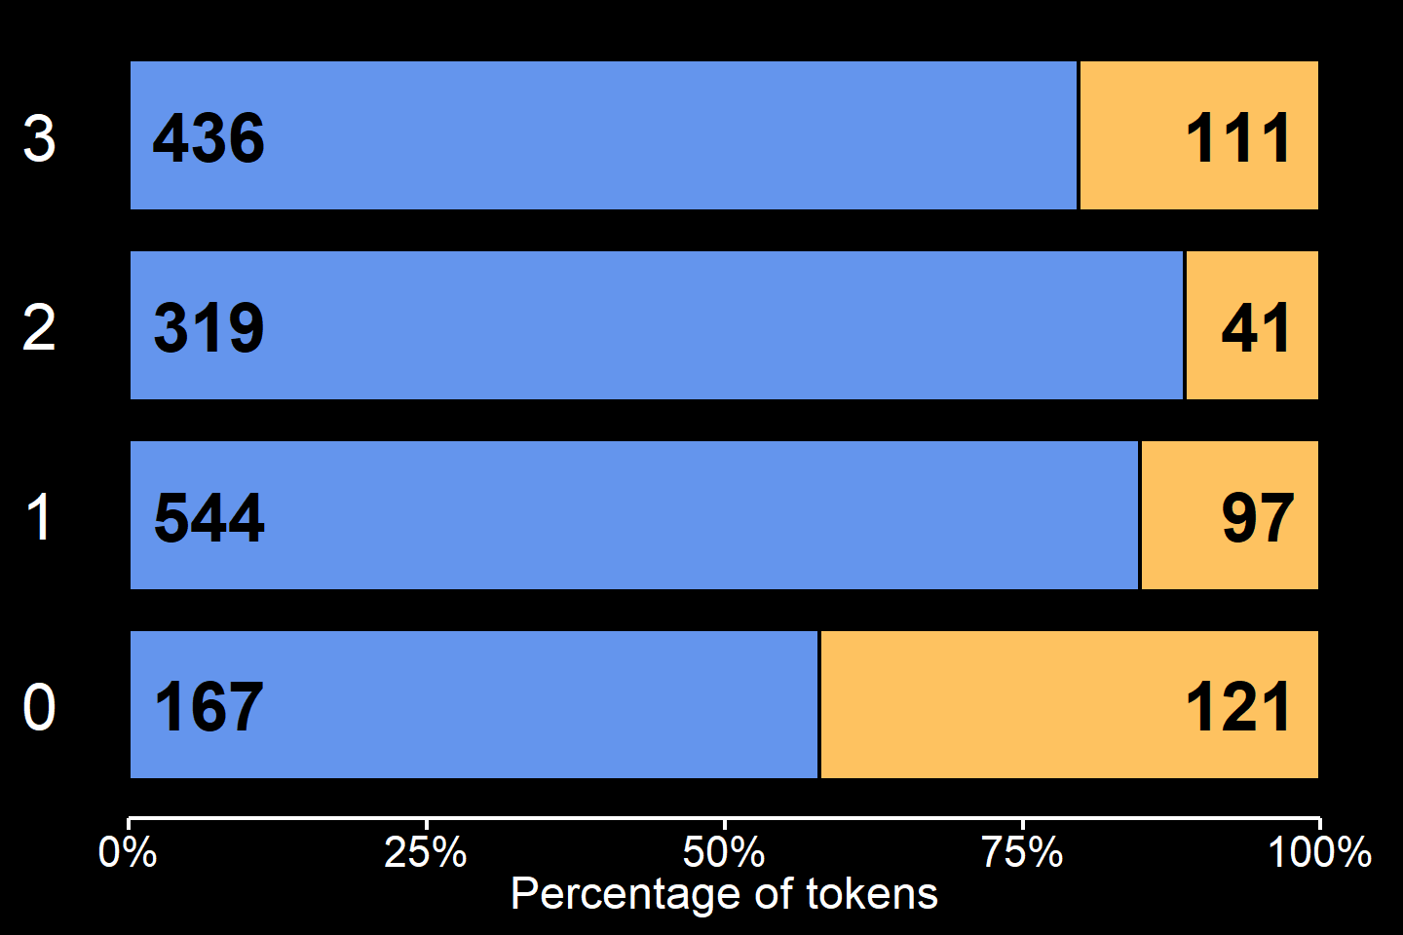
sat vs. sitting: Repetition avoidance?
We coded for the presence of a post-modifying -ing form following the main verb within a 4-word window
UK data from GloWbE Corpus
sitting
sat
drunk teenagers are sat in the dunes playing guitar
when they are sat at home chilling out
I've been sat there watching you all these years
Sheppard was stood watching as she pleaded for help
values inside bars show raw counts

Slide 19
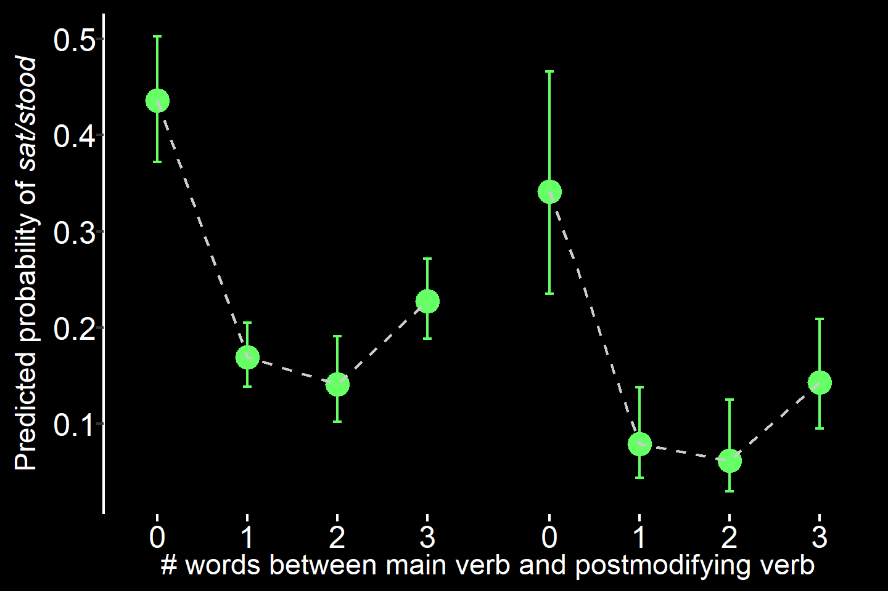
sat vs. sitting: Repetition avoidance?
We coded for the presence of a post-modifying -ing form following the main verb within a 4-word window
UK data from GloWbE Corpus
sat
stood
drunk teenagers are sat in the dunes playing guitar
when they are sat at home chilling out
I've been sat there watching you all these years
***
Sheppard was stood watching as she pleaded for help

Slide 20
R has tons of tools for machine learning and statistical modeling
GitHub: R/model_functions.R

Slide 21


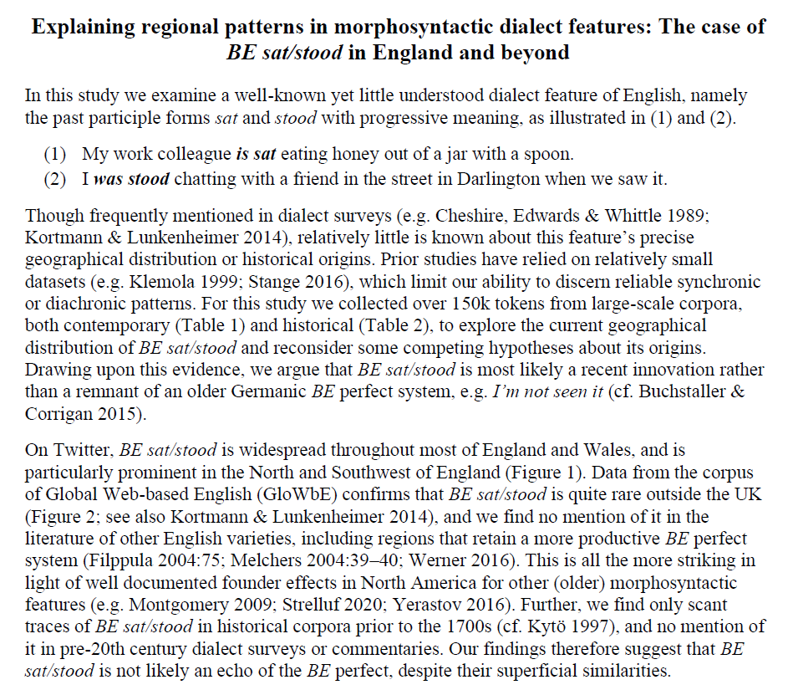
R Studio provides tools to create dynamic documents fully integrating data, analysis, visualizations, and text
Word, LaTeX, HTML
Web apps
Dashboards

Slide 22
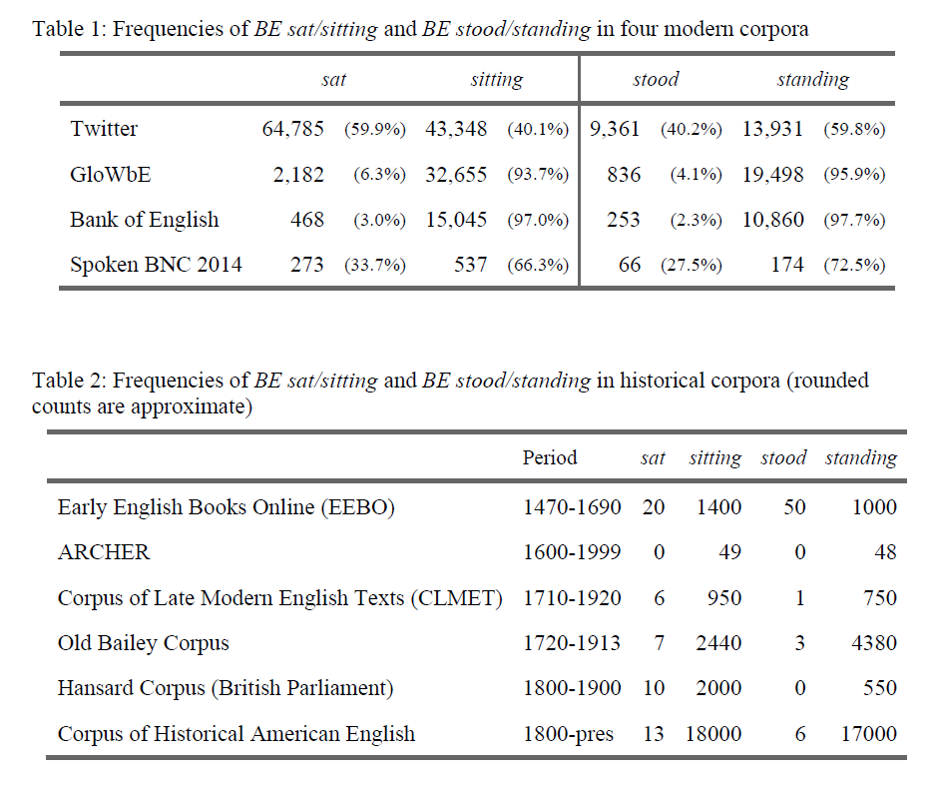
R Studio provides tools to create dynamic documents fully integrating data, analysis, visualizations, and text
Word, LaTeX, HTML
Web apps
Dashboards

Slide 23
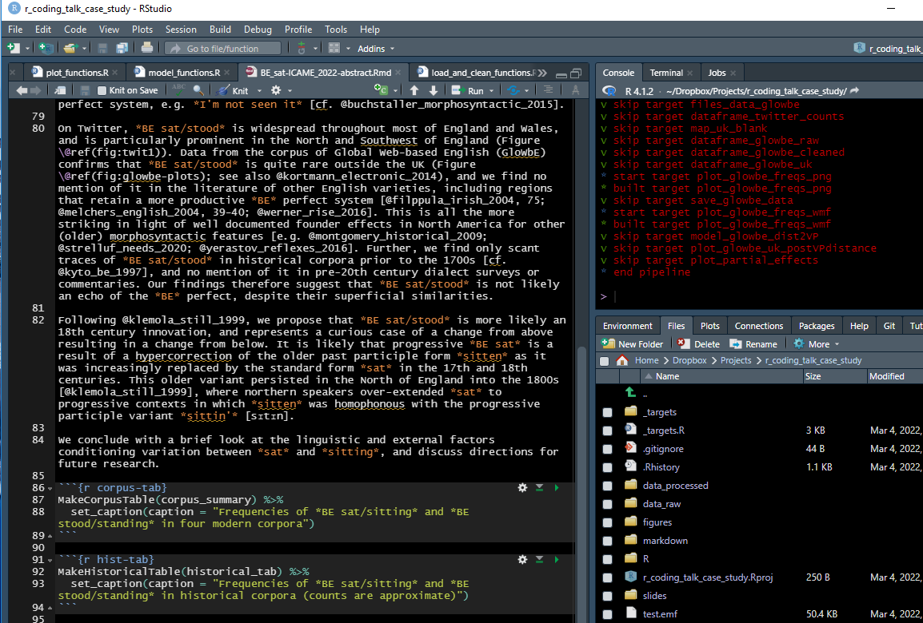

Slide 24
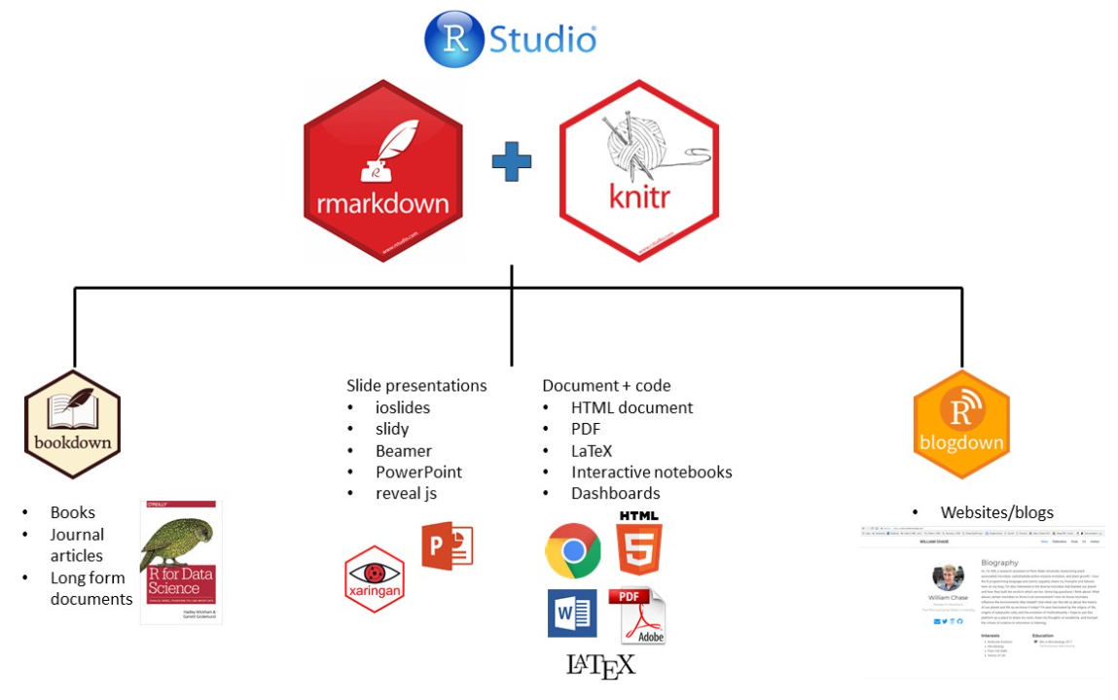
https://timotheenivalis.github.io/workshops/RforRSB/rmarkdown_notes.html

Slide 25
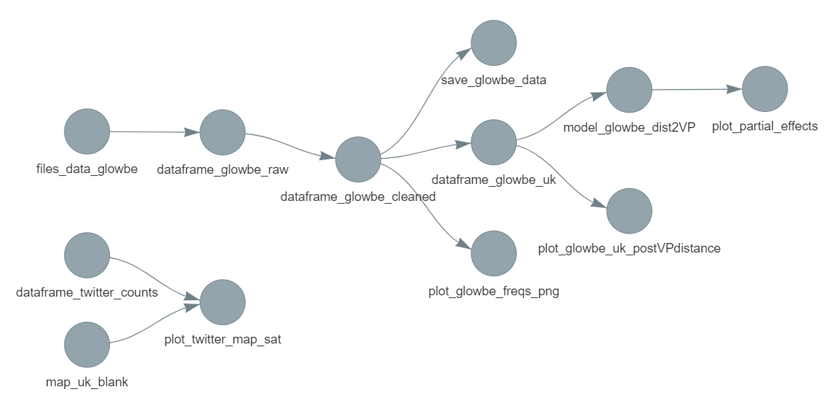
{targets} : pipeline toolkit for reproducible workflow in R
tar_make() tar_glimpse()

Slide 27

Thank You!
Slides, datasets and code for this presentation available on GitHub
jasongraf1/r_coding_talk_case_study
More information on the case study is available at our Open Science Framework repository:
https://osf.io/gst74/

