Slide 1
The role of proficiency and language experience in recognizing and speaking words in a second language
Kylee Cook
The Pennsylvania State University
Universitat Rovira i Virgili

Slide 2
General Goal
To discover the route taken when determining the translation from the L2 to the L1 in Spanish- English bilinguals
hola
hello

Slide 3
Bilingual Model
(Critical Route: L2 – L1)
L1
Lexical Link
L2
Semantic Link
Semantic Link
Concept
Revised Hierarchical Model
Kroll & Stuart, 1994

Slide 4
How does the model work?
2 Routes:
Lexical Route
Semantic Route
?
Predictions
L2 – L1: Low proficiency level
stronger lexical influence
(form) than semantic influence
High proficiency level
stronger semantic influence

Slide 5
How can we test the predictions of this model?
Translation Recognition Task

Slide 6
Decide whether
the second word
is the translation
of the first
“no”
“yes”
man
hambre
man
hombre
Critical Condition
(De Groot, 1992)
Translation Condition

Slide 7
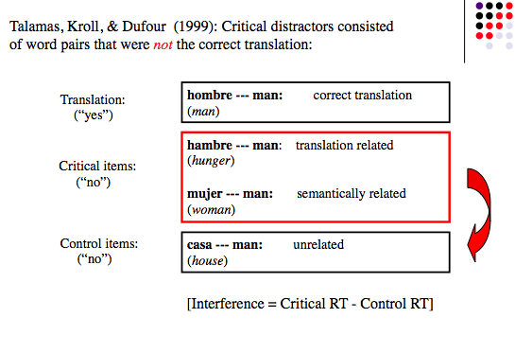
Item Conditions
form

Slide 8
Interference Effect
coat
Semantic Relation (R)
Semantic interference effect
hat
RT(R) – RT (NR) =
soldier
Unrelated Control (NR)

Slide 9
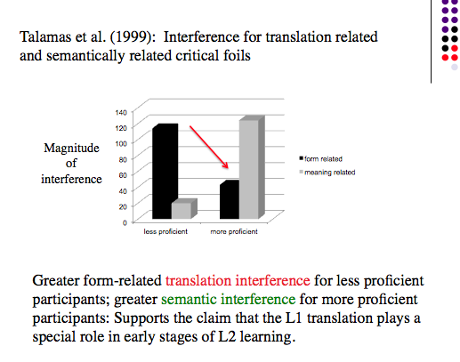
Previous Evidence
Notes:
Tested the model with reconocimiento de traducciones task

Slide 10
In Summary..
Talamas, et. al, (1999)
Moldovan, et. al, (in press)
SOA
Form
Semantic
Form
Semantic
Low
Proficiency
High

Slide 11
Specific goal
to determine if interference effects are observed in words which are semantically or form related
to observe if the pattern of interference effect is the same, using 300ms or 750ms for the SOA (the time the first word is presented to the time the second word appears)
the test the prediction of the bilingual model (RHM) using 2 different levels of proficiency, intermediate and high

Slide 12

Method
Participants:
A group of intermediate proficient bilinguals of Spanish (native) and English.
A group of highly proficient bilinguals of Spanish (native) and English
Tasks:
Translation Recognition
O Span
Flanker
Lexical Decision Task
Verbal Fluency

Slide 13
Measures of Cognitive Resources
Operation Span Task: Working Memory
presented with a numerical calculation, must determine if the equation is correct
after a certain number of equations are presented, must type the retained words
How many words can be retained while processing the equations?
Flanker Task: Executive Function
arrows presented in different contexts with other arrows pointing in the same or different direction
press a button to indicate the direction of the target arrow
Measures the participant’s ability to ignore irrelevant information while presented with a task

Slide 14
Lexical Decision Task
- Participants must decide if the word presented is part of the English vocabulary.
- Determines participant’s level of proficiency
Verbal Fluency Task
helps to determine the level of proficiency as well
given a category name, instructed to say aloud as many examples as possible of that category within 30 seconds in the specified language.
participants will complete half of of the trials in English and half in Spanish, and the order of the language will be counterbalanced.

Slide 15
apple, pear, banana ..
(2 sec)
Fruit
(30 sec)
+
STOP

Slide 16
Experimental Design
4 Lists consisting of 320 word pairs
160 correct translation
40 semantically related
40 semantically unrelated
40 form related
40 form unrelated

Slide 17
Example:
hat - sombrero
Form: hat – sendero
sombrero - trail
Control: hat – dulzura
sombrero - sweetness
Semantic: hat – abrigo
sombrero - coat
Control: hat – soldado
sombrero - soldier

Slide 18
L2 – L1
sombrero
Lexical Link
hat
sendero
L1
L2
Semantic Link
Semantic Link
Concept
Kroll & Stuart, 1994

Slide 19
SOA
(250ms)
(50ms)
300ms
hat
sendero
(500ms)
(250ms)
750ms
hat
dulzura

Slide 20
Expectations
SOA
300 ms
700 ms
Form
Semantic
Form
Semantic
?
Low
Proficiency
High
Notes:
300 has little time to access semantical meaning

Slide 21
New preliminary data from Spain
Here you are finding stronger semantic effects and the translation effect seems to
be small but also modulated by the SOA.

Slide 22
Again, in accuracy, there is a strong semantic effect – these participants
are much more likely to make an error (i.e., false alarm) when the words
are semantically related.

