Slide 1
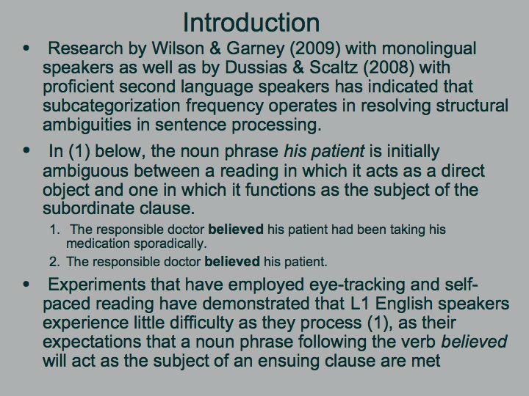
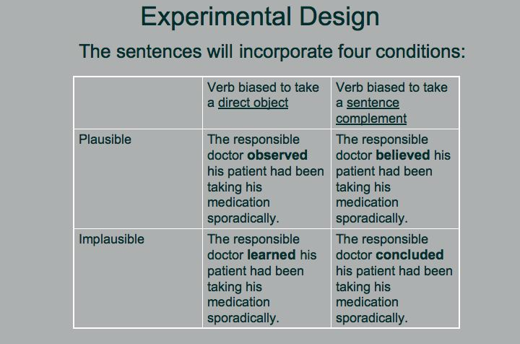
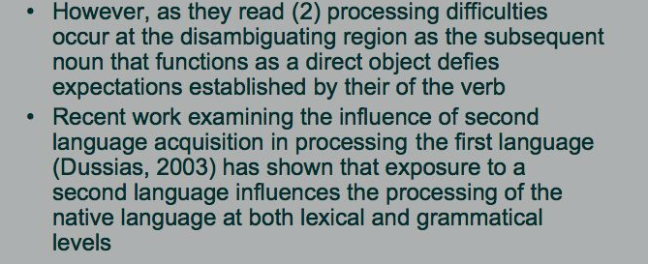
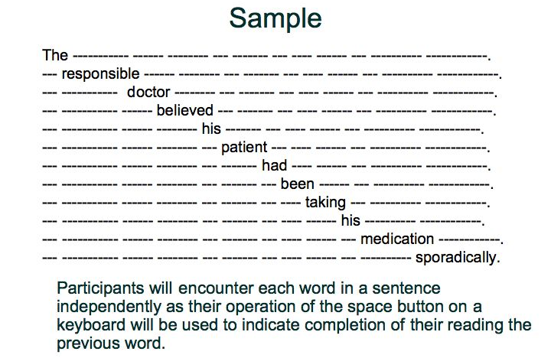
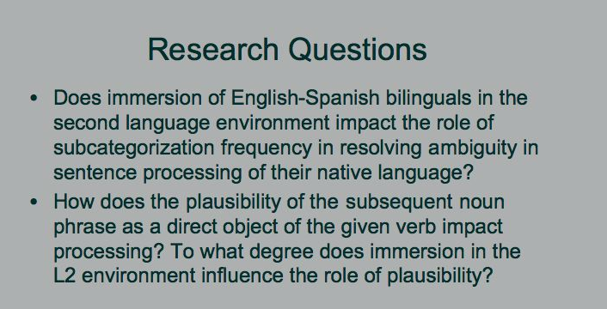
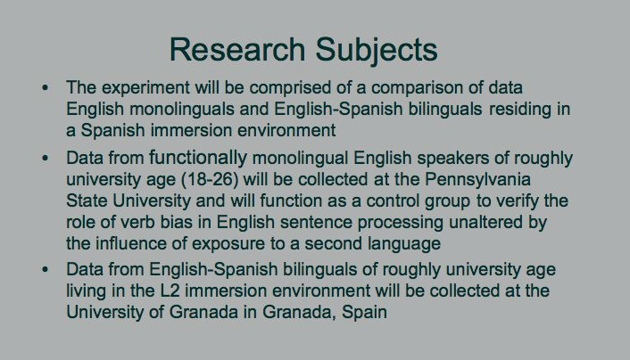
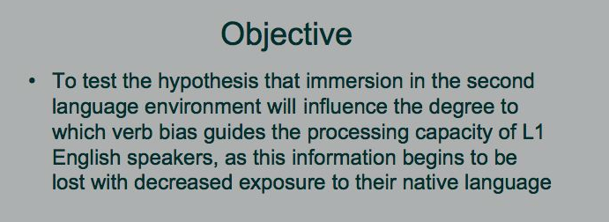
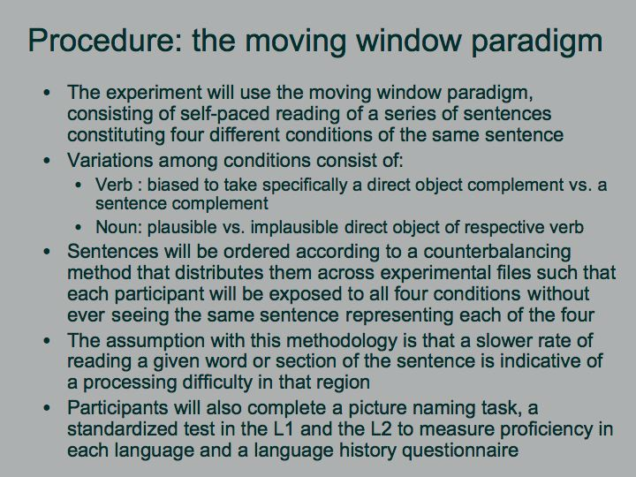
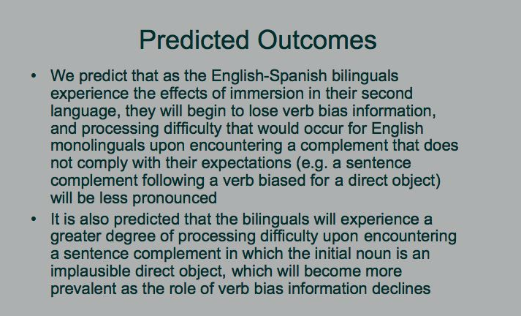
Processing of Verb Bias Information of English-Spanish Bilinguals within the L2 Environment
Sara Carter
Advisor: Giuli Dussias, Department of Spanish, Italian and Portuguese
Acknowledgments:
Professor Giuli Dussias
National Science Foundation (OISE 0968369). PIRE: Bilingualism, mind, and brain: An interdisciplinary program in cognitive psychology, linguistics, and cognitive neuroscience

