Slide 1
Lexical Triggering and Code-Switching in Spanish-English Bilinguals
Rachel Negron
Advisor: Janet van Hell

Slide 2
Code-Switching
the use of two languages in one utterance
habitual in the language processing of bilinguals
behavioral and EEG studies confirm switching is costly
in comprehension and production studies (Dussias, 2001; Moreno et al.,
2002; Proverbio et al., 2004; Van Hell & Witteman, 2009)
studies suggest such costs can be minimized based on the triggering hypothesis (e.g., Broersma & de Bot, 2009; Clyne, 2005)

Slide 3
Code-Switching
Spanish-English Bilinguals at Penn State are a population that code-switches frequently therefore we anticipate stronger results at Penn State than the Dutch-English Bilinguals in the Netherlands
Spanish-English Bilinguals are a population that code-switches infrequently (like Dutch-English Bilinguals) therefore we anticipate similar results to the Dutch-English studies
Catalan-Castilain CS may affect this theory

Slide 4
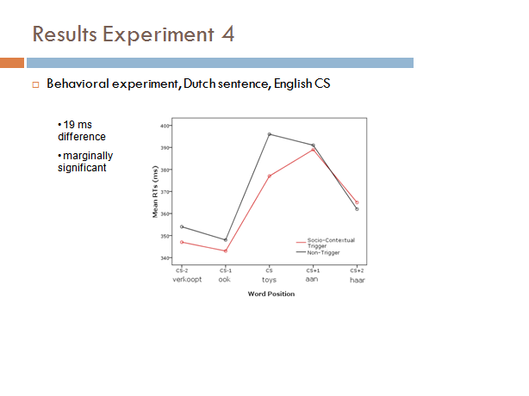

Slide 5
The Triggering Hypothesis
Language-ambiguous words like cognates can facilitate code-switching within a sentence (e.g., Broersma & de Bot, 2009; Clyne, 2005).
corpus studies prove that certain lexical elements –such as cognates- can trigger code-switches
switches are read faster when preceded by a cognate trigger than by a control word in a code-switched sentence

Slide 6
Examples
The players of Manchester United went in formation for the game. The directions from the offense (cognate with Spanish ofensa) about the upcoming partido (game) proved to be very useful.
The players of the Manchester United went in formation for the game. The directions from the player (noncognate with Spanish jugador) about the upcoming partido (game) proved to be very useful.
The players of Real Madrid went in formation for the game. The directions from the offense (cognate with Spanish ofensa) about the upcoming partido (game) proved to be very useful.
The players of Real Madrid went in formation for the game. The directions from the player (noncognate with Spanish jugador) about the upcoming partido (game) proved to be very useful.

Slide 7
Examples
During a hike along the Everglades National Park, Cindy keeps her eyes open for unique animals. A wild panther (cognate with Spanish pantera) bit a cute conejo (rabbit) which went by her fast.
During a hike along the Everglades National Park, Cindy keeps her eyes open for unique animals. A wild alligator (noncognate with Spanish cocodrilo) bit a cute conejo (rabbit) which went by her fast.
During a hike along the Chaco National Park, Cindy keeps her eyes open for unique animals. A wild panther (cognate with Spanish pantera) bit a cute conejo (rabbit) which went by her fast.
During a hike along the Chaco National Park, Cindy keeps her eyes open for unique animals. A wild alligator (noncognate with Dutch cocodrilo) bit a cute conejo (rabbit) which went by her fast.

Slide 8
During a hike along the Chaco National Park, Cindy keeps her eyes open for unique animals

Slide 9
A

Slide 10
wild

Slide 11
panther

Slide 12
bit

Slide 13
a

Slide 14
cute

Slide 15
conejo

Slide 16
which

Slide 17
went

Slide 18
by

Slide 19
her

Slide 20
fast.

Slide 21
Research Questions
How costly is code-switching for comprehension and can a congruent socio context reduce switching costs associated with code-switching?
Specifically, are code-switches read more easily when preceded by a congruent socio-contextual trigger than when preceded by an incongruent/neutral contextual trigger?
Are Spanish-English bilinguals living in the USA (a more frequent code-switching population) more sensitive to the manipulation? And how about Spanish-English bilinguals living in Spain?

Slide 22
Predictions and Aims
I will expand on the triggering hypothesis to observe whether a congruent socio context can reduce switching costs associated with code-switching.
Witteman (2008) observed very small socio-contextual triggering effects in Dutch-English bilinguals – a group of bilinguals that does not code-switch very frequently.

Slide 23
Predictions and Aims
The overarching goal is to achieve a more consistent image of the processes involved in code-switching. Are cognitive processes involved in code-switching universal and apply to all bilinguals, or do different types of bilinguals show unique patterns of code-switching?
The PIRE program, and the multiple sites with varying types of bilinguals, provides an excellent platform for a comparative approach.

Slide 24
Participants
Native Spanish speakers
Fairly proficient English speakers, measured by self-ratings and lexical decision task in English
students at least 18 years of age
Living in the US (Penn State) or in Spain (Tarragona)

Slide 25
Materials
100 sentences, half fillers, half containing a code-switch to English (25 congruent socio-context, 25 incongruent)
The code-switch is always a noun
The cognate and the code-switch are always presented in the same clause
There is a minimum of 2 words between cognate and the code-switch, and a maximum of 5 words between them.
The cognate and the code-switch are never in the first or last three words of a sentence
There are two versions of each experimental sentence: one with a cognate, and one without a cognate

Slide 26
Procedure
Code-Switching
Ospan (in Spanish)
Simon
Flanker
Lexical Decision (in Spanish and English)
Boston Naming (in Spanish and English)
The experimental testing will consist of one session (approx. 60 min.)
One practice block will be allotted for each task.

