Slide 1
Opentray
Jason Gunderson
&
Jon Kelly

Slide 2
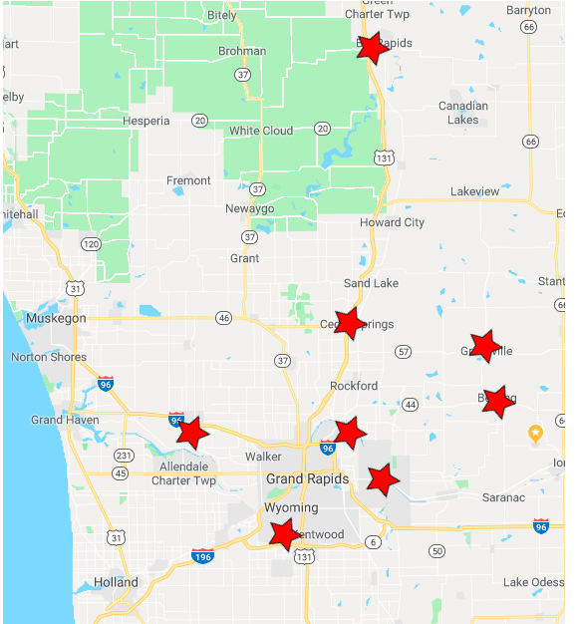
Metron Integrated Health System
Skilled Nursing
7 Facilities across West Michigan
1 field support technician
Once per week support

Slide 3
Dilemma!
Medicare or Medicaid
Profit margins Oversight
TrayCard
Free → Paid
No Support
Closed
No Backup
No Integration
Not Customize able
Not Intuitive
Abandoned

Slide 4


Dilemma!

Slide 5
Design Decisions
Centralized System
No Additional Software
Maintainable
Easy Setup
Easy To Backup and Restore
Exportable
Targeting Chrome and Firefox

Slide 6
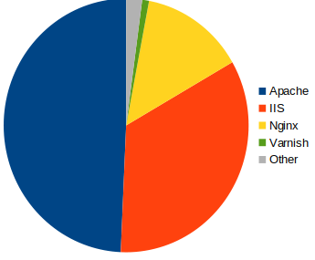
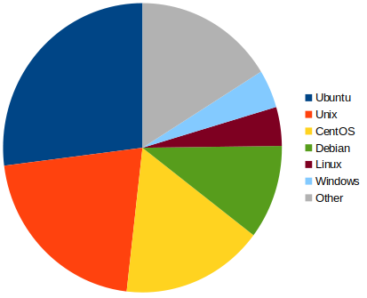
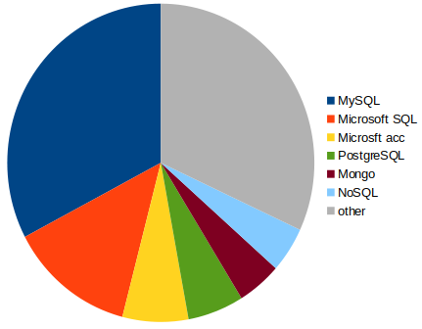
Design
Market Share
Apache2
Ubuntu
26.98%
MySQL
32.7%
49.3%

Slide 7

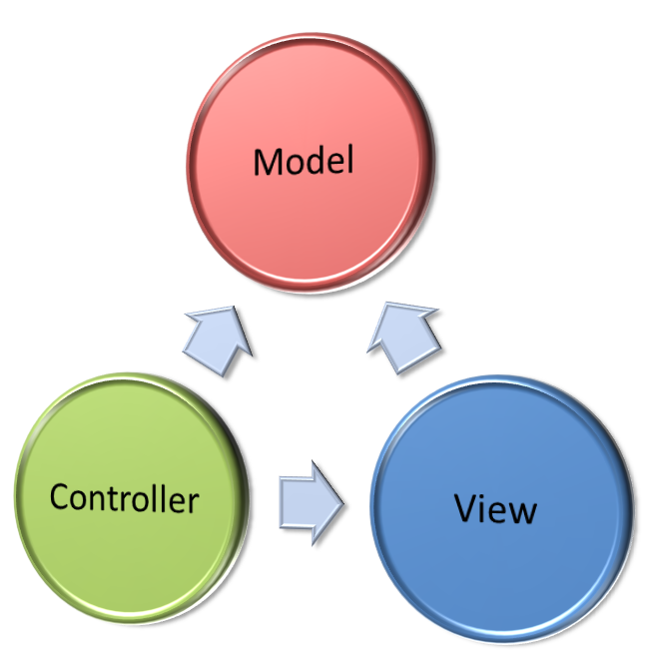


Design

Slide 8
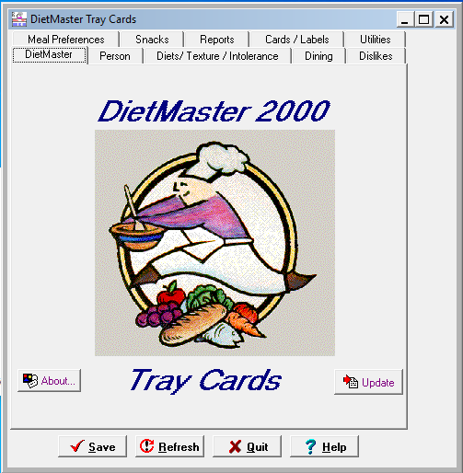
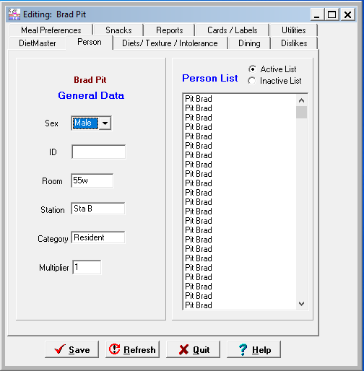
Implementation

Slide 9
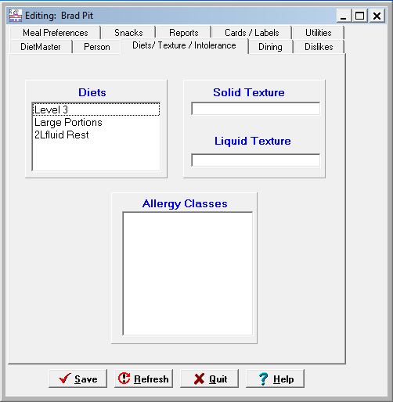
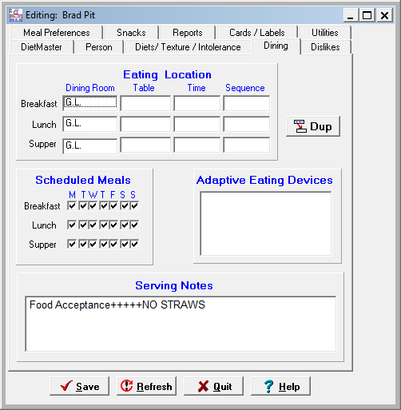
Implementation

Slide 10
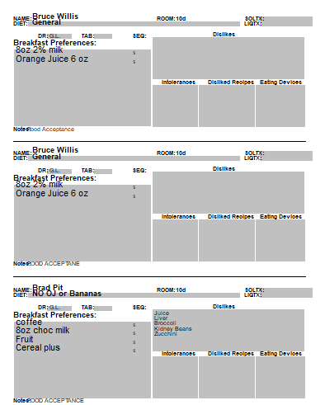
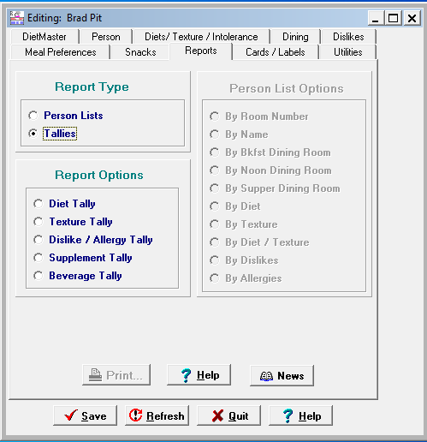
Implementation

Slide 11
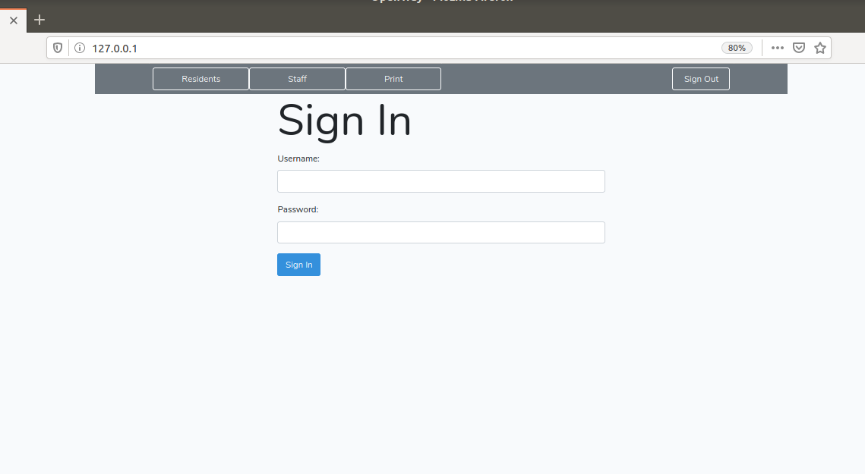
Implementation

Slide 12
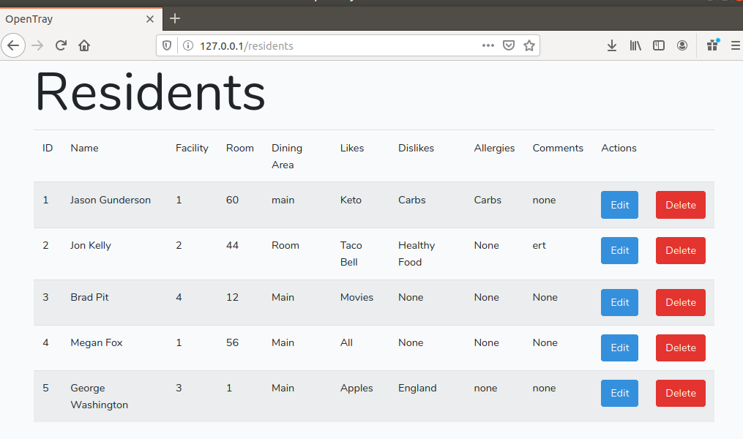
Implementation

Slide 13
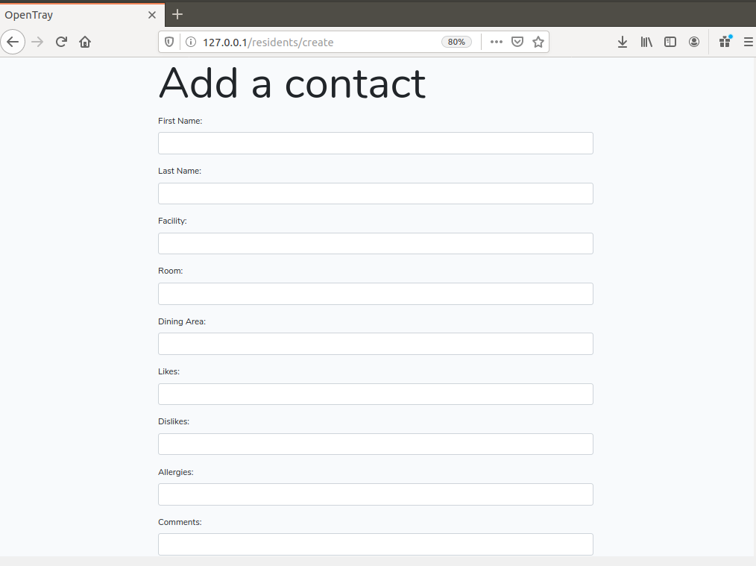
Implementation

Slide 14
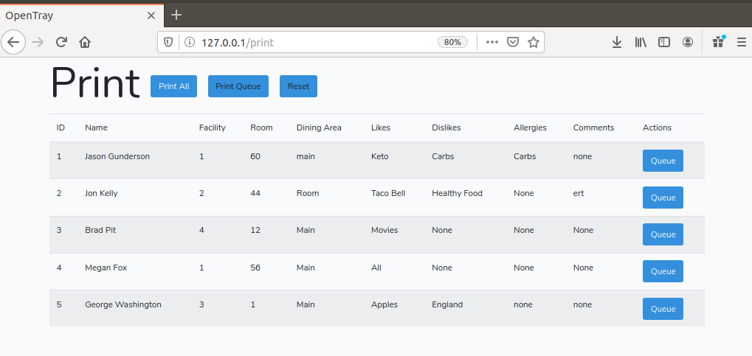
Implementation

Slide 15


Security

Slide 16
Security
Ubuntu 18.04LTS
  LTS (Long Term Support)
  Regular Security Patches
  Stable
NOT WEB FACING
Laravel
  Regular Security Patches
  Best Practices
Apache
  Regular Security Patches
  Best Practices

Slide 17





Testing
Laravel Dusk
Chrome
End User Testing
PHPUnit

Slide 18

Maintainability
Well Documented Software
Easy Backing Up and Restoring
Server to Server Backups

Slide 19
Summary
Clean and streamlined interface
Centralized system utilizing current infrastructure
Reliable, minimal downtime

