Slide 1
Opentray
Jason Gunderson
&
Jon Kelly

Slide 2
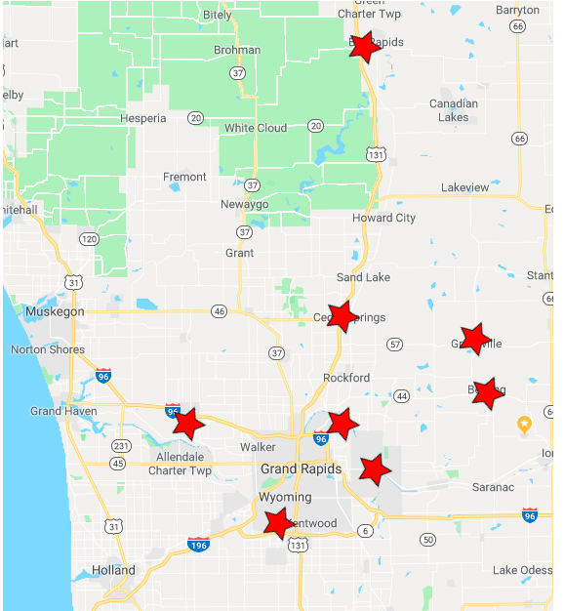
Metron Integrated Health System
Skilled Nursing
7 Facilities across West Michigan
Traycard
    Likes
    Dislikes
    Allergies
    Dining preferences
    Used 15 years
    Created 1997

Slide 3


Dilemma!
Medicare or Medicaid
Profit margins Oversight
One IT Tech
One Dietitian
Liaison
TrayCard
    Free → Paid
    No Support
    No Integration
    Not Intuitive
    Closed
    Not Customizable
    No Backup
    Abandoned

Slide 4



Dilemma!
Deployment
  Copy zip
  Extract to Documents
  Desktop .exe Shortcut

Slide 5
Design Decisions
Centralized System
No Additional Software
Maintainable
Easy Setup
Easy To Backup and Restore
Exportable
Targeting Chrome and Firefox

Slide 6
Design
Market share
Apache2
49.3%
Ubuntu
26.98%
MySQL
32.7%

Slide 7

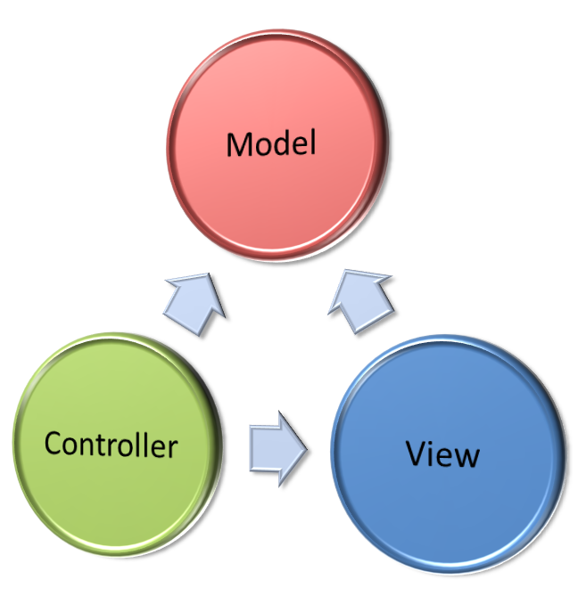


Design

Slide 8
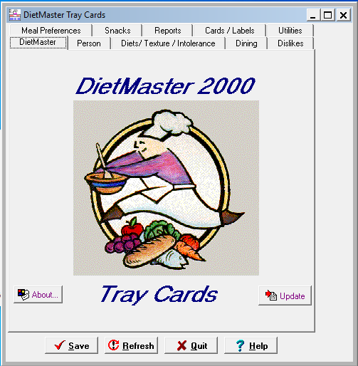
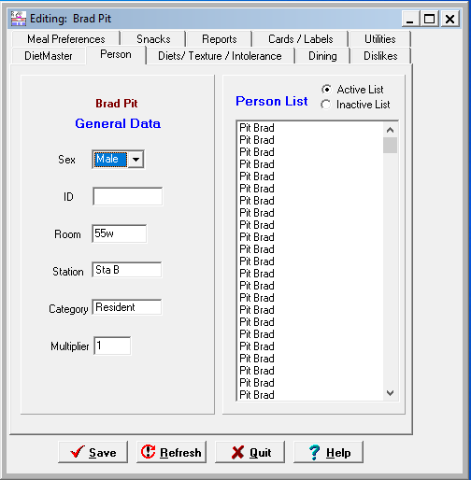
Implementation

Slide 9
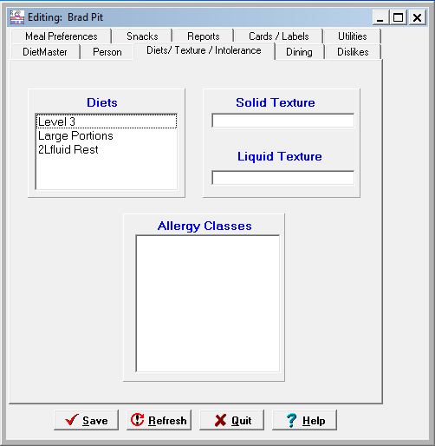
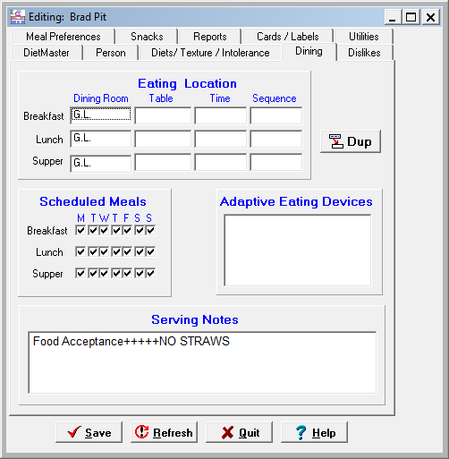
Implementation

Slide 10
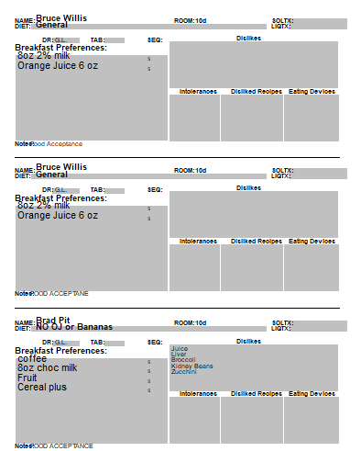
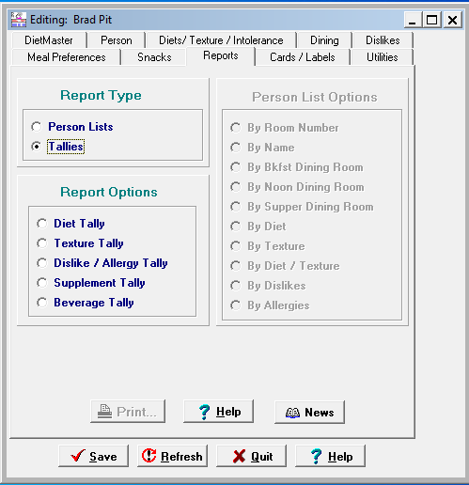
Implementation

Slide 11
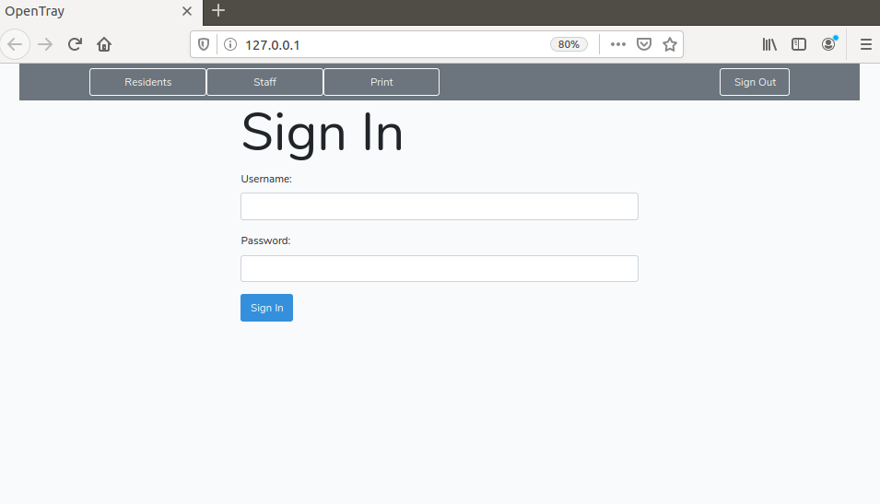
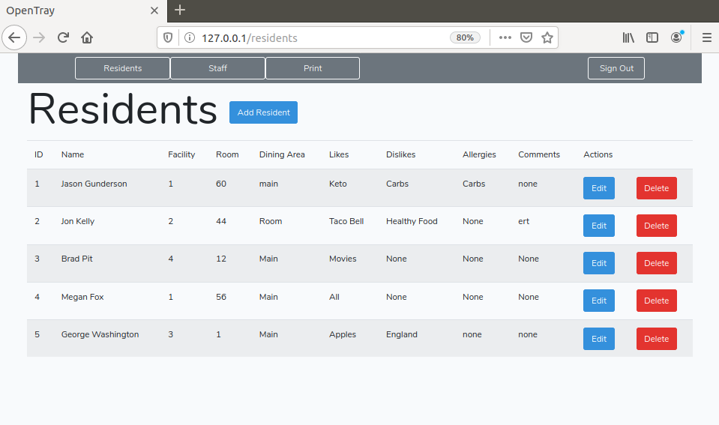
Implementation

Slide 12
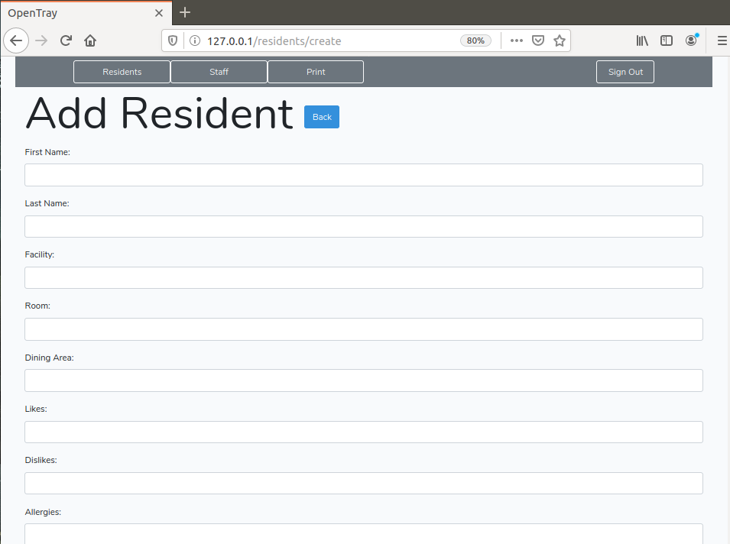
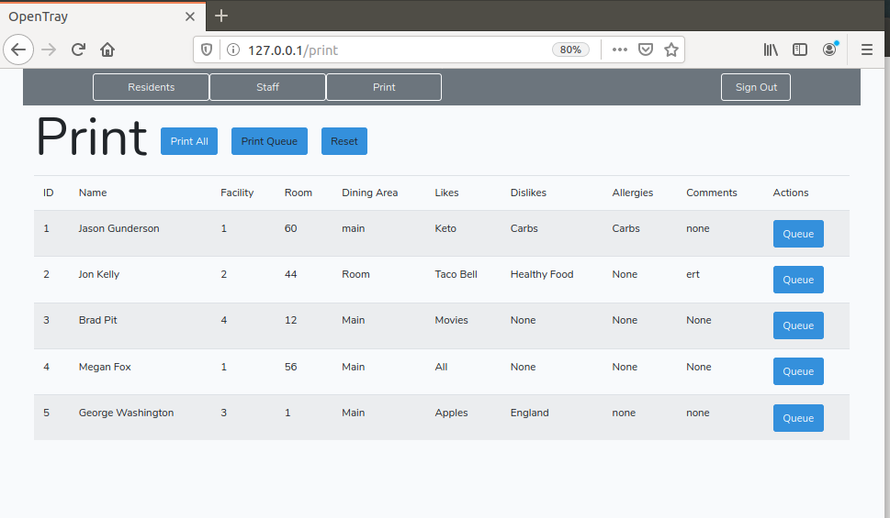
Implementation

Slide 13


Security

Slide 14
Security
Ubuntu 18.04LTS
  LTS (Long Term Support)
  Regular Security Patches
  Stable
NOT WEB FACING
Laravel
  Regular Security Patches
  Best Practices
Apache
  Regular Security Patches
  Best Practices

Slide 15




Testing
Laravel Dusk
Chrome
End User Testing
PHPUnit

Slide 16

Maintainability
Well Documented Software
Easy Backing Up and Restoring
Server to Server Backups

Slide 17
Summary
Clean and streamlined interface
Centralized system utilizing current infrastructure
Reliable, minimal downtime

