Slide 1
Open Data Initiative
Status on Data Release and Data Governance
Notes:
GovTech and Code for America has ranked cities across 17 types of data. While the “best” municipality using open data is still yet to be known, a new census has identified 36 cities making progress opening their data. The census, officially named the U.S. Open Data Census, has scored 36 cities based on the type and quality of their open data efforts. San Francisco was listed with the highest score, and was followed by Sacramento, Calif., in second place and Salt Lake City in third.

Slide 2


Open Data Defined
Making public data broadly accessible and usable by humans and machines, free of any technological, legal or usability barriers
This movement that benefits all actors in the modern society and economy
An Citizens
Legal Constraints
Publishable Data

Slide 3
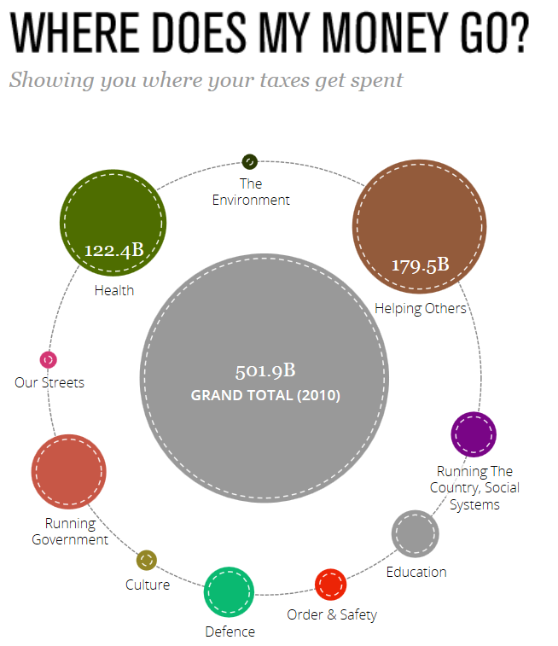
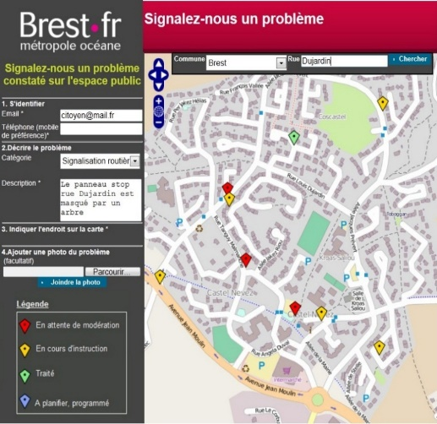
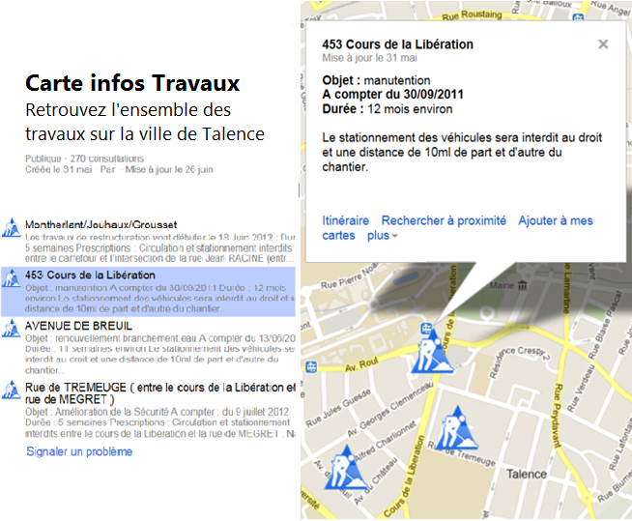
Open Data Defined
Residents want to participate in Government and decisions making.
Un droit opposable du citoyen
Loi du 17 juillet 1978
Décret du 30 décembre 2005
Enhance the transparency, readability, and the accountability of government agencies
Promote connections with citizens for the life of the city
Shorten information time and rely on multi-channel
Notes:
http://www.odata.org

Slide 4



Open Data Value Proposition
How does opening data make City Government work better?
Programs and services collaboration to gather data
De-silo programs and services
Accountability and Value for Money
Strengthen the involvement of the civil servants in their daily work
Streamlining the data supply chain
Produce multichannel enriched data in real-time
Creation of new management tools
Create data driven “dashboards” for fact-based decisions and performance
Notes:
http://www.odata.org

Slide 5
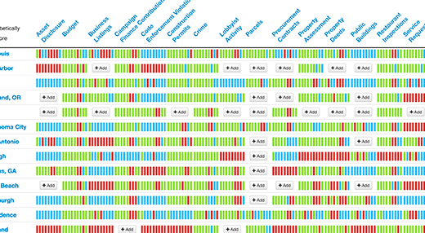
National Census of Open Data
Notes:
Number of Cities: 94
Number of datasets: 821
Number of open datasets: 201
Percentage open: 24%

Slide 6
List of Data Sets Recommended for US Cities
Asset Disclosure
Budget
Business Listings
Campaign Finance Contributions
Code Enforcement Violations
Construction Permits
Crime
Lobbyist Activity
Parcels
Procurement Contracts
Property Assessment
Property Deeds
Public Buildings
Restaurant Inspections
Service Requests (311)
Spending
Transit
Zoning
Web Analytics
Notes:
There are 19 recommended data sets. Not all of these are controlled by the City. Where these data are kept by the County, the consultant has made arrangements to release the County Data.

Slide 7
Data Release Process
Data readiness assessment: informal discussion between open data team lead and data steward or data steward’s representative
Data inventory: Listing of the data products produced that comply with open data policy and data restriction policy. Valuation is set as to whether the data meet the criteria as high value and complies with policy as to fitness of publication. Data lifecycle is also noted.
Data staging: Data are mined using open data team resources. Data are then checked for PII and staged on the data portal as a restricted data set. Data are also checked for compliance with restricted data policy.
Data QA: Data Steward (or designated representative) is engaged to preview the data and make any recommendations regarding the fitness of the data for publication. Steward also acts as SME regarding the data and any dashboards or reuse associated with the data.
Data Release Date: Data Steward and open data team agree upon release date (Embargo date)
Data Release: Data is released to the public on agreed upon date.
Data Refresh Cycle is established and data is refreshed according to the latest data sets available. This is done programmatically by the open data team.

Slide 8
City Departments: Impact
Each department will have a data contact person
Only data that matches the initiatives open data definitions will be allowed
NO data exposing a person’s identity
NO data that compromises public safety or City operations
High value open data sets in machine readable format
Cooperation in building and maintaining a comprehensive data catalog

Slide 9
Maturity Model for Open Data
Level 1
Status Quo
Level 2
Catalogue Phase
Level 3
A first interactive experience
Level 4
An full Open Data experience
Level 5
An Open Data ecosystem
Downloadable Excel and CSV spreadsheets ,and PDF files
Clumsy Websites without any real true user experience
Catalogue(s) of documented downloadable files in various format (CSV​​, XLS, SHP, ZIP, PDF)
Manual data publishing
Interactive data tables, basic data visualizations (charts & maps), social sharing
Manual data publishing
Consumer style Web experiences
Dashboards, data mashups, data-driven story telling & visualization, apps
Developer-ready APIs and resources
Automated data publishing, update, and distribution
Experience design
Data for fact-based decisions and performance
Crowd-sourced data: human sensor network, IoT
Plug-and-play portable apps
Compelling integrated experiences with solutions for ISVs and CSVs
Real-time, open, data ecosystems

