Slide 1
ECE5650:
Network Programming
Socket Programming with TCP
Socket Programming with UDP
Build Web Server
2: Application Layer

Slide 2
Socket programming
Goal: learn how to build client/server application that communicate using sockets
Socket API
introduced in BSD4.1 UNIX, 1981, as a special type of file, representing one end of comm
explicitly created, used, released by apps
client/server paradigm
two types of transport service via socket API:
  unreliable datagram
  reliable, byte stream-oriented
socket
a host-local,
application-created,
OS-controlled interface (a “door”) into which
application process can both send and
receive messages to/from another application process
2: Application Layer

Slide 3
Operations on a socket:
Client Socket
  connect to a remote machine
  send and receive data
  close a connection
Server Socket
  Bind to a port
  listen for incoming data
  accept connections from remote machines on the bound port
  send and receive data
  Close a connection
2: Application Layer

Slide 4
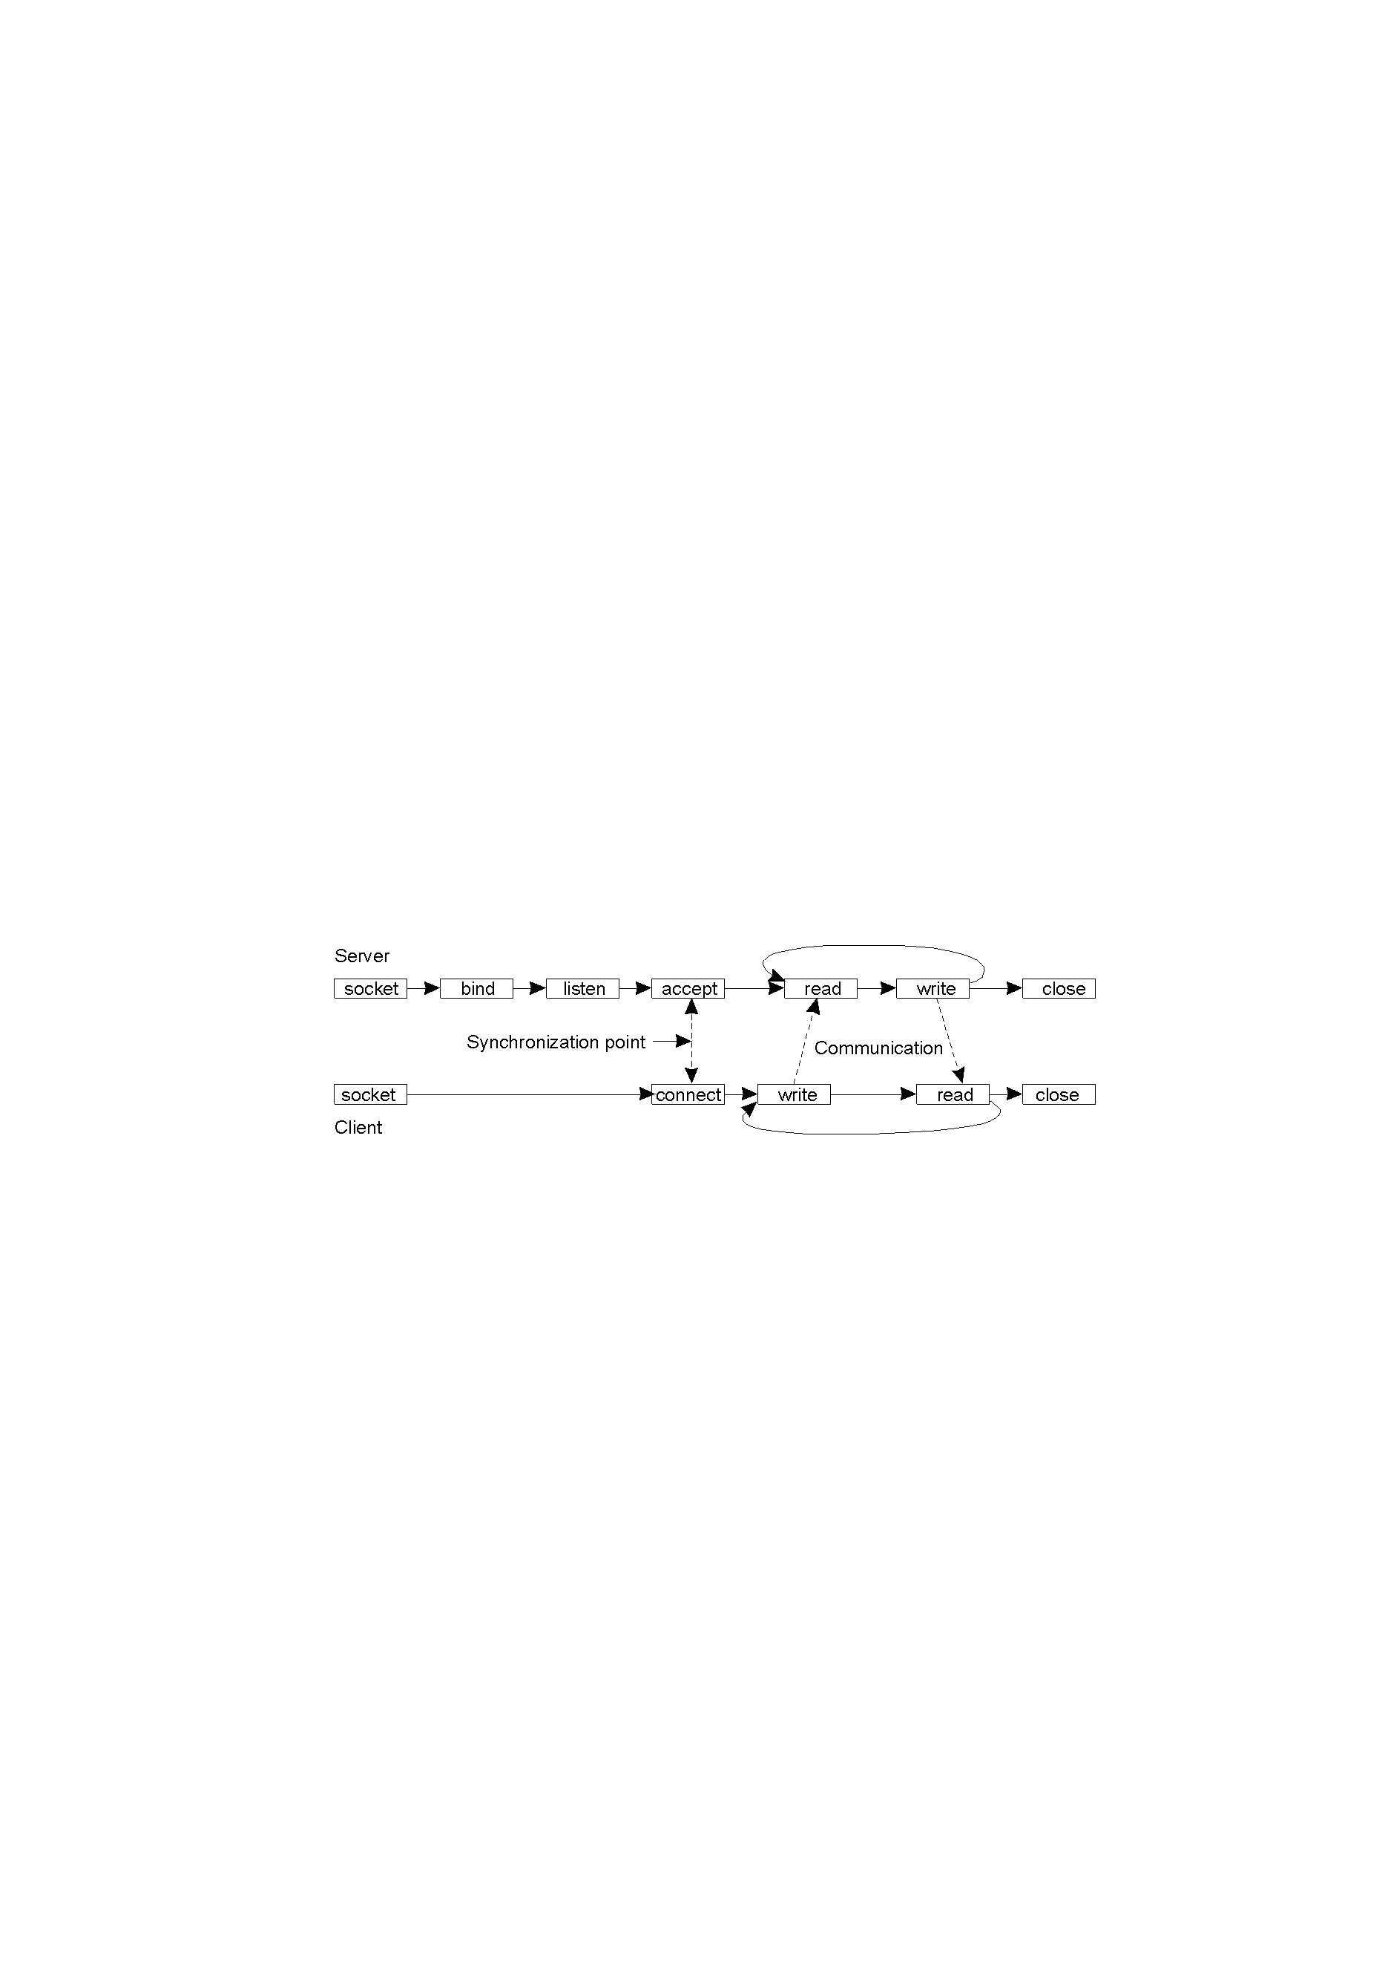
Berkeley Sockets
Connection-oriented communication pattern using sockets.
2: Application Layer

Slide 5

Socket-programming using TCP
Socket: a door between application process and end-end-transport protocol (UCP or TCP)
TCP service: reliable transfer of bytes from one process to another
controlled by
application
developer
controlled by
application
developer
process
process
socket
socket
TCP with
buffers,
variables
TCP with
buffers,
variables
controlled by
operating
system
controlled by
operating
system
internet
host or
server
host or
server
2: Application Layer

Slide 6
Socket programming with TCP
Client must contact server
server process must first be running
server must have created socket (door) that welcomes client’s contact
Client contacts server by:
creating client-local TCP socket specifying IP address, port number of server process
When client creates socket: client TCP establishes connection to server TCP
When contacted by client, server TCP creates new socket for server process to communicate with client
  allows server to talk with multiple clients
  source port numbers used to distinguish clients (more in Chap 3)
application viewpoint
TCP provides reliable, in-order
transfer of bytes (“pipe”)
between client and server
2: Application Layer

Slide 7
Stream jargon (in Java)
A stream is a sequence of characters that flow into or out of a process.
An input stream is attached to some input source for the process, e.g., keyboard or socket.
An output stream is attached to an output source, e.g., monitor or socket.
High-level steps when programming TCP sockets:
1) Open a socket.
2) Open an input or output stream to the socket.
3) Read from and write to the stream.
4) Close the streams.
5) Close the socket.
High-level steps when programming UDP sockets (steps 2&4 used in TCP not needed):
1) Open a socket.
2) Read from and write to the socket.
3) Close the socket.
2: Application Layer

Slide 8

Socket programming with TCP
Example client-server app:
1) client reads line from standard input (inFromUser stream) , sends to server via socket (outToServer stream)
2) server reads line from socket
3) server converts line to uppercase, sends back to client
4) client reads, prints modified line from socket (inFromServer stream)
Client
process
client TCP socket
2: Application Layer

Slide 9
Client/server socket interaction: TCP
Server (running on hostid)
Client
create socket,
port=x, for
incoming request:
welcomeSocket =
ServerSocket()
TCP
connection setup
create socket,
connect to hostid, port=x
wait for incoming
connection request
connectionSocket =
welcomeSocket.accept()
clientSocket =
Socket()
send request using
clientSocket
read request from
connectionSocket
write reply to
connectionSocket
read reply from
clientSocket
close
connectionSocket
close
clientSocket
2: Application Layer

Slide 10
Example: Java client (TCP)
import java.io.*;
import java.net.*;
class TCPClient {
public static void main(String argv[]) throws Exception
{
String sentence;
String modifiedSentence;
BufferedReader inFromUser =
new BufferedReader(new InputStreamReader(System.in));
Socket clientSocket = new Socket("hostname", 6789);
DataOutputStream outToServer =
new DataOutputStream(clientSocket.getOutputStream());
Create
input stream
Create
client socket,
connect to server
Create
output stream
attached to socket
2: Application Layer

Slide 11
Example: Java client (TCP), cont.
Create
input stream
attached to socket
BufferedReader inFromServer =
new BufferedReader(new
InputStreamReader(clientSocket.getInputStream()));
sentence = inFromUser.readLine();
outToServer.writeBytes(sentence + '\n');
modifiedSentence = inFromServer.readLine();
System.out.println("FROM SERVER: " + modifiedSentence);
clientSocket.close();
}
}
Send line
to server
Read line
from server
2: Application Layer

Slide 12
Example: Java server (TCP)
import java.io.*;
import java.net.*;
class TCPServer {
public static void main(String argv[]) throws Exception
{
String clientSentence;
String capitalizedSentence;
ServerSocket welcomeSocket = new ServerSocket(6789);
while(true) {
Socket connectionSocket = welcomeSocket.accept();
BufferedReader inFromClient =
new BufferedReader(new
InputStreamReader(connectionSocket.getInputStream()));
Create
welcoming socket
at port 6789
Wait, on welcoming
socket for contact
by client
A new dedicated conn.
socket is created
Create input
stream, attached
to socket
2: Application Layer

Slide 13
Example: Java server (TCP), cont
Create output
stream, attached
to socket
DataOutputStream outToClient =
new DataOutputStream(connectionSocket.getOutputStream());
clientSentence = inFromClient.readLine();
capitalizedSentence = clientSentence.toUpperCase() + '\n';
outToClient.writeBytes(capitalizedSentence);
}
}
}
Read in line
from socket
Write out line
to socket
End of while loop,
loop back and wait for
another client connection
2: Application Layer

Slide 14
Socket programming with UDP
UDP: no “connection” between client and server
no handshaking
sender explicitly attaches IP address and port of destination to each packet
server must extract IP address, port of sender from received packet
UDP: transmitted data may be received out of order, or lost
application viewpoint
UDP provides unreliable transfer
of groups of bytes (“datagrams”)
between client and server
2: Application Layer

Slide 15
Client/server socket interaction: UDP
Server (running on hostid)
Client
create socket,
port=x, for
incoming request:
create socket,
clientSocket =
DatagramSocket()
serverSocket =
DatagramSocket()
Create, address (hostid, port=x,
send datagram request
using clientSocket
read request from
serverSocket
write reply to
serverSocket
specifying client
host address,
port number
read reply from
clientSocket
close
clientSocket
2: Application Layer

Slide 16

Example: Java client (UDP)
Client
process
Input: receives packet (TCP received “byte stream”)
Output: sends packet (TCP sent “byte stream”)
client UDP socket
2: Application Layer

Slide 17
Example: Java client (UDP)
import java.io.*;
import java.net.*;
class UDPClient {
public static void main(String args[]) throws Exception
{
BufferedReader inFromUser =
new BufferedReader(new InputStreamReader(System.in));
DatagramSocket clientSocket = new DatagramSocket();
InetAddress IPAddress = InetAddress.getByName("hostname");
byte[] sendData = new byte[1024];
byte[] receiveData = new byte[1024];
String sentence = inFromUser.readLine();
sendData = sentence.getBytes();
Create
input stream
Create
client socket
Translate
hostname to IP
address using DNS
2: Application Layer

Slide 18
Example: Java client (UDP), cont.
Create datagram with data-to-send,
length, IP addr, port
DatagramPacket sendPacket =
new DatagramPacket(sendData, sendData.length, IPAddress, 9876);
clientSocket.send(sendPacket);
DatagramPacket receivePacket =
new DatagramPacket(receiveData, receiveData.length);
clientSocket.receive(receivePacket);
String modifiedSentence =
new String(receivePacket.getData());
System.out.println("FROM SERVER:" + modifiedSentence);
clientSocket.close();
}
}
Send datagram
to server
Read datagram
from server
2: Application Layer

Slide 19
Example: Java server (UDP)
import java.io.*;
import java.net.*;
class UDPServer {
public static void main(String args[]) throws Exception
{
DatagramSocket serverSocket = new DatagramSocket(9876);
byte[] receiveData = new byte[1024];
byte[] sendData = new byte[1024];
while(true)
{
DatagramPacket receivePacket =
new DatagramPacket(receiveData, receiveData.length);
serverSocket.receive(receivePacket);
Create
datagram socket
at port 9876
Create space for
received datagram
Receive
datagram
2: Application Layer

Slide 20
Example: Java server (UDP), cont
String sentence = new String(receivePacket.getData());
InetAddress IPAddress = receivePacket.getAddress();
int port = receivePacket.getPort();
String capitalizedSentence = sentence.toUpperCase();
sendData = capitalizedSentence.getBytes();
DatagramPacket sendPacket =
new DatagramPacket(sendData, sendData.length, IPAddress,
port);
serverSocket.send(sendPacket);
}
}
}
Get IP addr
port #, of
sender
Create datagram
to send to client
Write out
datagram
to socket
End of while loop,
loop back and wait for
another datagram
2: Application Layer

Slide 21
User-Defined Socket and ServerSocket
class SSLServerSocket extends ServerSocket {
…
public Socket accept() throws IOException {
SSLSocket s = new SSLSocket(…) {}
}
…
}
class SSLSocket extends java.net.Socket {
…
public SSLSocket(…) {
super();
…
}
}
2: Application Layer

Slide 22
Multithreaded Server:
Serving Multiple Clients Concurrently
Client 1 Process
Server Process
Server
Threads
Internet/Switch
Client 2 Process
2: Application Layer

Slide 23
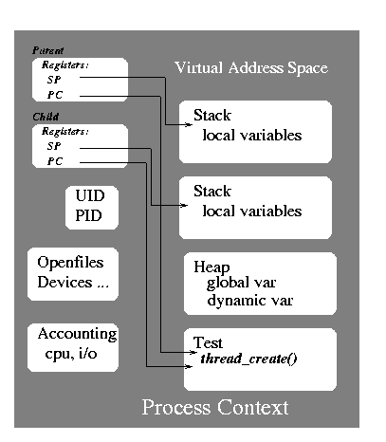
Multithreaded Process
A thread of control is a sequence of instructions being executed within the context of a process. It has its own program counter and stack.
A traditional process has a single thread of control
A MT process has two or more threads within the same context. They share the same set of open files, child processes, timers, etc
Each thread has its own id.
2: Application Layer

Slide 24
Java Thread Basics
Create a thread by extending Thread
Create a thread by implementing Runnable interface
public class MyEx1 {
public static void main() {
Foo t;
t = new Foo();
t.start();
}
}
class Foo extends Thread {
public void run() {… }
}
public class MyEx2 {
public static void main() {
Thread t =
new Thread( new Bar());
t.start();
}
}
class Bar implements Runnable {
public void run() {… }
}
2: Application Layer

Slide 25
Java Thread Basic
Thread thr = new Thread(“Thread Name”);
Thread thr = new Thread(myRunnable, “Name”);
thr.stop(); //the calling thread will exit
thr.yield(); // the calling thread will yield control of CPU
thr.join(); //wait for a thread to exit
How to synchronize the execution of multiple threads?
→:leave for your own exploration
2: Application Layer

Slide 26
A Tiny Multithreaded Web Server
// Support HTTP protocol: GET /path/filename
// java.TinyHttpd 1234
import java.net.*;
import java.io.*;
import java.util.*;
public class TinyHttpd {
public static void main( String argv[] ) throws IOException {
ServerSocket ss = new ServerSocket(
Integer.parseInt( argv[0] );
while ( true ) {
Socket sk=ss.accept();
new TinyHttpdConnection(sk).start();
}
}
2: Application Layer

Slide 27
class TinyHttpdConnection extends Thread {
Socket client;
TinyHttpdConnection ( Socket client) throws SocketException {
this.client = client;
setPriority( NORM_PRIORITY -1 );
}
public void run() {
try {
BufferedReader in = new BufferedReader(
new InputStreamReader(
client.getInputStream(), “8859_1” );
OutputStream out = client.getOutputStream();
PrinterWriter pout = new PrintWriter(
new OutputStreamWriter(out, “8859_1”), true );
String request = in.readLine();
System.out.println( “Request “+ request );
2: Application Layer

Slide 28
public void run() {
try { … …
StringTokenizer st = new StringTokenizer( request );
if ( (st.countToken() >=2 ) && st.nextToken().equals(“Get”) ) {
if ( (request = st.nextToken()).startsWidth(“/”)
request = request.substring( 1 );
if ( request.endsWith(“/”) || request.equals(“”) )
request = request + “index.html”;
try {
FileInputStream fis = new FileInputStream( request );
byte []data = new byte[ fis.available() ];
fis.read( data );
out.write( data );
out.flush();
} catch (FileNotFoundException e) { … }
else { …}
client.close();
} catch ( IOException e) { … }
}
2: Application Layer

Slide 29
Secured web server
// HTTP protocol: GET /path/filename [options]
// java.TinyHttpd
public class TinyHttpd {
public static void main( String argv[] ) throws IOException { System.setSecurityManager(
new TinyHttpdSecurityManager() ); ServerSocket ss = new ServerSocket(
Integer.parseInt( argv[0] );
while ( true )
new TinyHttpdConnection( ss.accept() ).start();
}
}
2: Application Layer

Slide 30
Summary
Definition of a Socket:
  (IP + port) makes a means for programs to network
  controlled mainly by OS
TCP sockets: 5 Steps needed to read/write from/to :
  open socket, define input/output stream, read/write to streams, close streams, close socket
UDP sockets: 3 Steps needed to read/write from/to:
  open socket, read/write to sockets, close socket
TCP Socket:
  TCP Server must be up before client establishes a client socket because handshaking is required.
  IP address and port of server needed for client to establish a socket.
  Client Socket port is determined by OS.
UDP Socket
  UDP Server may not be up before client establishes a client socket because handshaking is not required.
  Programmer can specify a port for client socket otherwise it is determined by the OS.
2: Application Layer

