Slide 1
IP security over ATM
CS 329
Hwajung Lee
Computer and Communications Security
The George Washington University

Slide 2
Survey on ATM, IP, and IPsec

Slide 3
Why ATM?
High capacity
Scalability of link bandwidth and switch capacity
Ability to support multiservice traffic.
Costs
  1-Gbps routers : about $187,000
  5-Gbps ATM switch : about $ 41,000

Slide 4
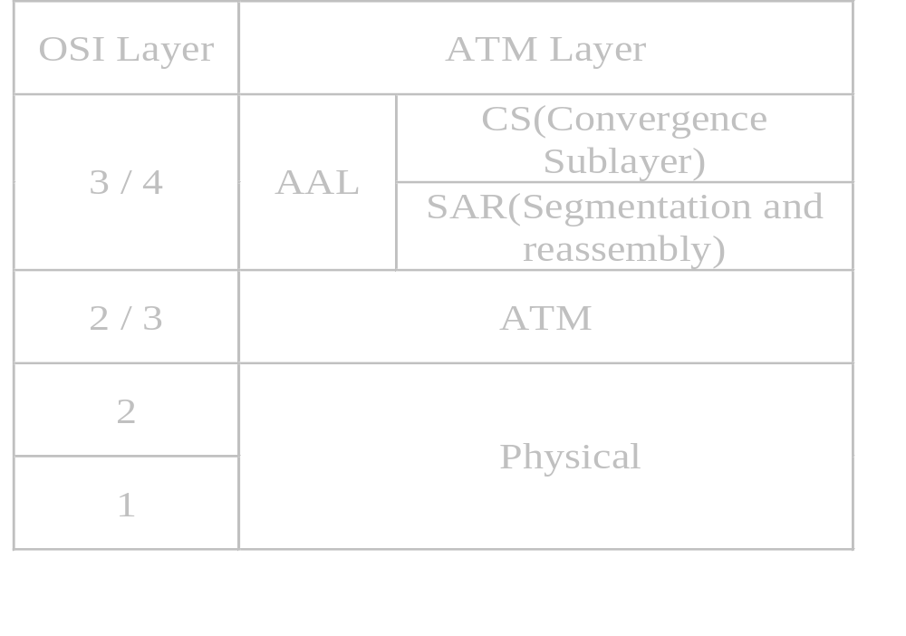
ATM

Slide 5
ATM
AAL in ATM
  Connection oriented
    Constant bit rate, Real time : AAL 1
    Variable bit rate, Real time : AAL 2
    Variable bit rate : AAL 3/4*, AAL 5
  Connectionless
    Variable bit rate : AAL 3/4*, AAL 5
    * : Multiplexing, overhead

Slide 6
Threats to ATM networks
Eavesdropping
  Equipment to tap a fiber optics cable < $2000
  IPv6 ESP(Encrypted Security Payload)
Spoofing
  IPv6 AH(Authentication Header)
Denial of Service
  Fake connection release signal
  IPv6 ESP

Slide 7
Threats to ATM networks(Con’t)
Stealing of VCs(Virtual Channels)
  If A and B alter VPI/VCI in switching table back and forth (Different QoS)
Traffic Analysis
  Encryption doesn’t affect Cell header
  Attacker can encode signalling data
VCI/VPI
User 1
User 2
Switch A
VCI/VPI
Switch B

Slide 8
Why IP?
No less capable of supporting real-time and multimedia applications than ATM
IP multicast for multimedia
Conferencing applications

Slide 9
IP Security
Draft-ietf-ipsec-arch-sec-07.txt
RFC 1825
http://www.ietf.org

Slide 10
IP Security
Two modes for AH and ESP
  Transport mode
    provide protection primarily for upper layer protocol.
  Tunnel mode
    protocols are applied to tunneled IP packets.

Slide 11
IP Security
Basic Components
  AH(Authentication Header)
    Data origin authentication, connectionless integrity
    Access control
    Optional anti-replay service(partial sequence integrity) to help counter denial of service.
    No Confidentiality
    Authentication for selected portions of the IP header

Slide 12
IP Security
SA(Security Associations)
  Simplex “connection” that affords security service to the traffic carried by it.
  Security services are afforded to an SA by the use of AH, or ESP, but not both.
  Identified by SPI(Security parameter Index), IP destination address, and a security protocol(AH or ESP) identifier.

Slide 13
IP Security
Two types of SAs
  Transport mode SA
    Security Association btw two hosts
    ESP : only for higher layer protocol, not IP header.
    AH : protection includes IP header.
  Tunnel mode SA
    SA btw Security gateways (MUST)
    SA btw a host and Security gateway (MUST)
    Solve fragmentation and reassembly problem.

Slide 14
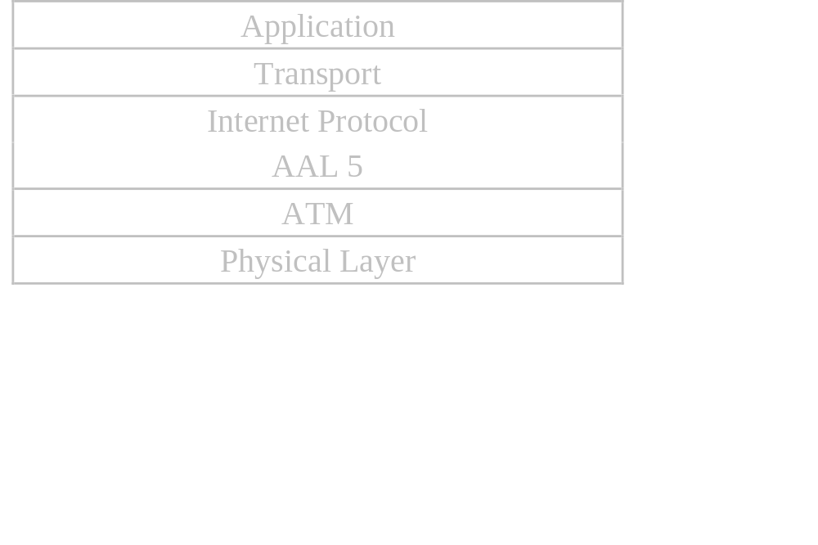
Applicable IPv6 Functions
Goal of IPv6
  Fast, flexible, protocol with plenty of address space.
IP over AAL 5(ATM Adaptation Layer 5)

Slide 15
Applicable IPv6 Functions
Where IPsec May be implemented?
  Integration of IPsec into the native IP implementation.
  Bump-in-the-stack(BITS)
    Underneath IP implementations
    Usually in host.
  Bump-in-the-wire(BITW)
    Outboard crypto processor
    Either a host or a gateway(or both)

Slide 16
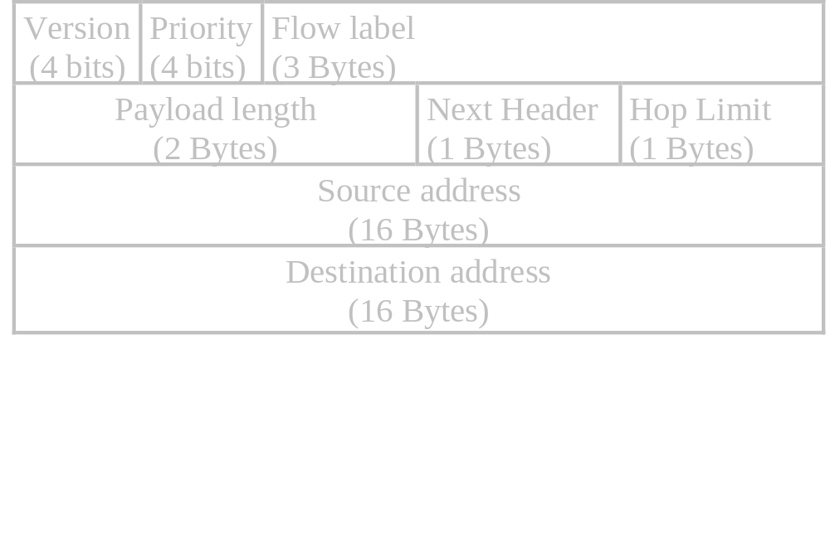
Applicable IPv6 Functions Header
Header

Slide 17
Applicable IPv6 Functions Header
Version
  6:IPv6
  4:IPv4
Priority
  0<…<7 : capable of slowing down(congestion)
  8<…<15: Real time traffic
  Std Suggestion : 1(News), 4(FTP), 6(Telnet)

Slide 18
Applicable IPv6 Functions Header
Flow label
  To allow a source and destination to set up a pseudoconnection with particular properties and requirements.
  (Flow number, Src address, Dst Address)
Payload length
  Exclude 40 bytes header.
  cf. IPv4 : Total length

Slide 19
Applicable IPv6 Functions Header
Next header
  Which of the six extension header, if any, follows this IP header.
  If this header is the last IP header, the Next header field tells which transport protocol handler (e.g.,TCP, UDP) to pass the packet to.
Hop limit
  cf. IPv4:Time to live

Slide 20
Applicable IPv6 Functions Header
Source address, Destination address
  16 Bytes
  For IPv4 : 80 zeros + IPv4 address
  Notation
    8000:0000:0000:0000:0123:4567:89AB:CDEF
    8000::123:4567:89AB:CDEF
    For IPv4, ::192:31:20:46

Slide 21
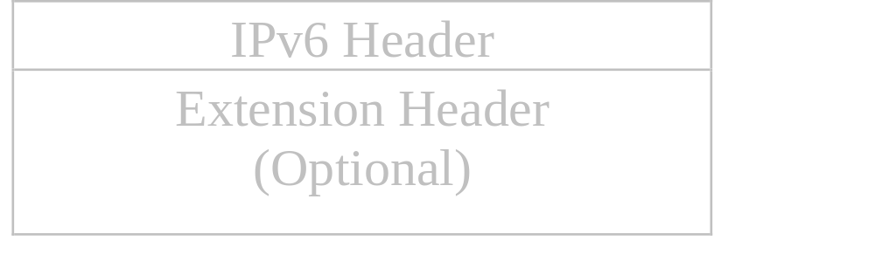
Applicable IPv6 Functions Extension Header
Extension Header
  Six kinds of extension header.
  Must appear directly after the fixed header.

Slide 22
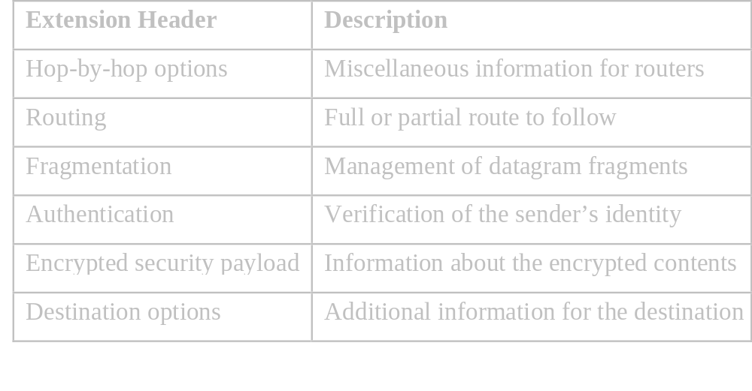
Applicable IPv6 Functions Extension Header
Extension Header (Con’t)
  Preferably in the order listed.

Slide 23
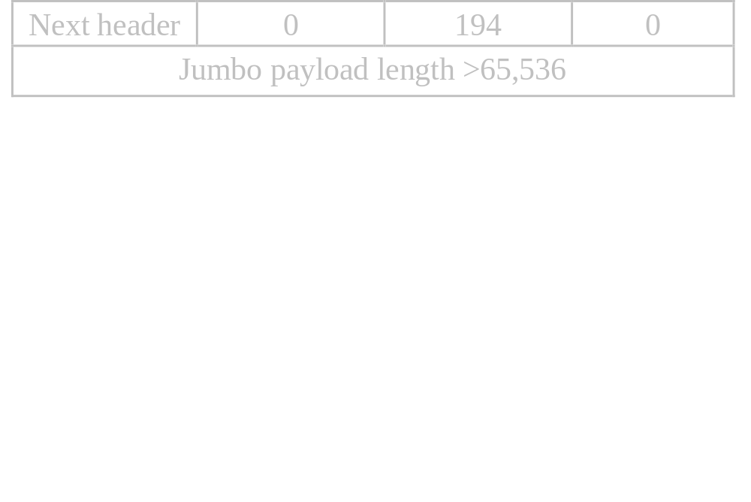
Applicable IPv6 Functions Extension Header
Hop-by-hop header
  Support of “Jumbograms” (diagrams exceeding 64K)

Slide 24
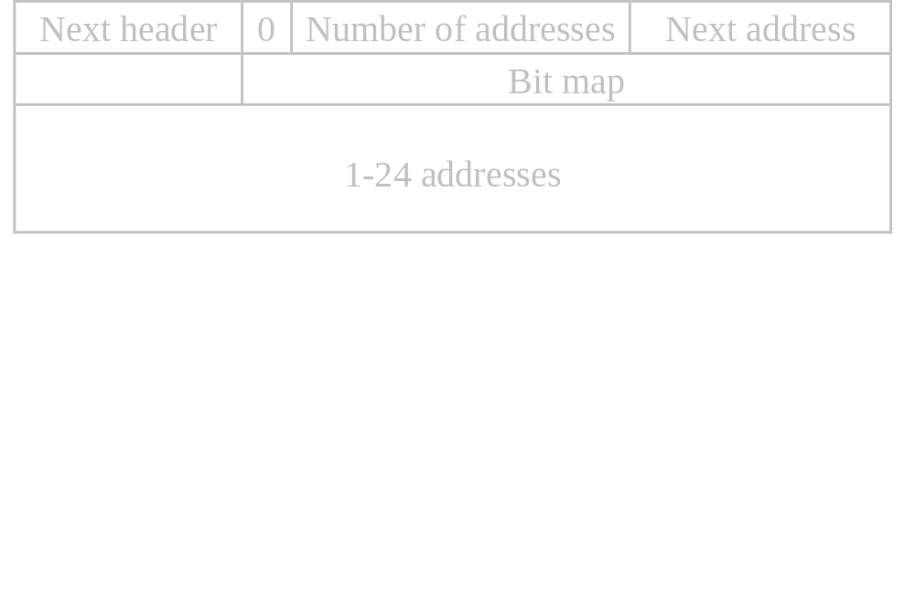
Applicable IPv6 Functions Extension Header
Routing header
  Lists one more routers that must be visited on the way to the destination
    Strict routing
    Loose routing

Slide 25
Applicable IPv6 Functions Extension Header
Fragment header
  Datagram identifier, fragment number, a bit telling whether more fragment will follow.
  IPv6 : Only the source host can fragment a packet. Cf. IPv4

Slide 26
Applicable IPv6 Functions Extension Header
Destination option header
  Fields that need only be interpreted at the destination host.
  Not used yet.

Slide 27
Applicable IPv6 Functions Extension Header
Authentication Header (AH)
  Data origin authentication, connectionless integrity
  Optional anti-replay service(partial sequence integrity) to help counter denial of service.
  No Confidentiality

Slide 28
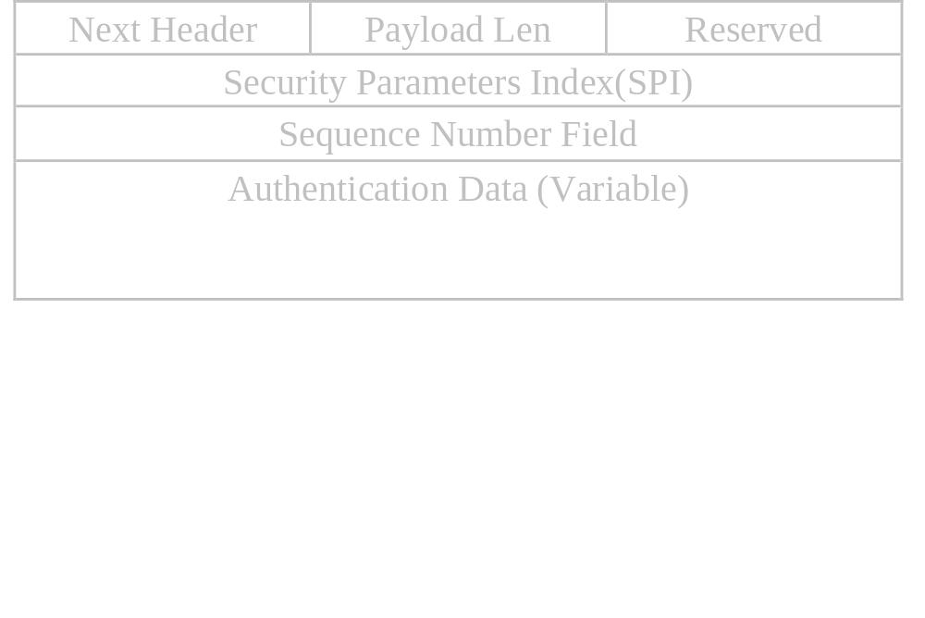
Applicable IPv6 Functions Extension Header
Authentication Header (AH)

Slide 29
Applicable IPv6 Functions Extension Header
Authentication Header - To send
  Constructs a packet (IP header + Payload)
  Pads out the packet with zeros to multiple of 16 bytes
  Computes cryptographic checksum (default : MD5)

Slide 30
Applicable IPv6 Functions Extension Header
ESP(Encapsulating Security Payload)
  Confidentiality(encryption)*
  Data origin authentication < that of AH
    Not include outer IPsec header
  Connectionless integrity
  An anti-replay service

Slide 31
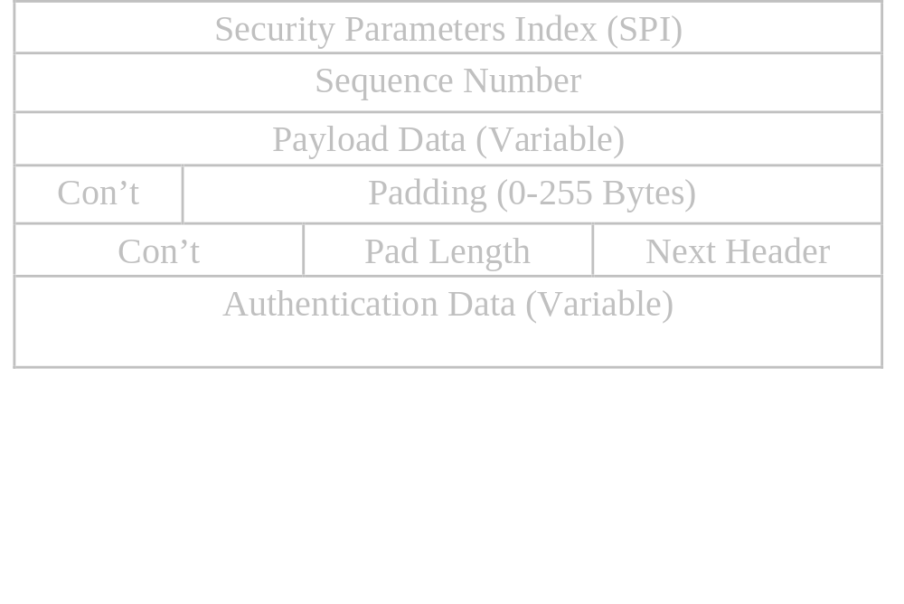
Applicable IPv6 Functions Extension Header
ESP(Encapsulating Security Payload
  ESP payload padding
    To hide the size of the packets.
  Encryption Algorithm : DES (Default)

Slide 32
IP Security over ATM

Slide 33
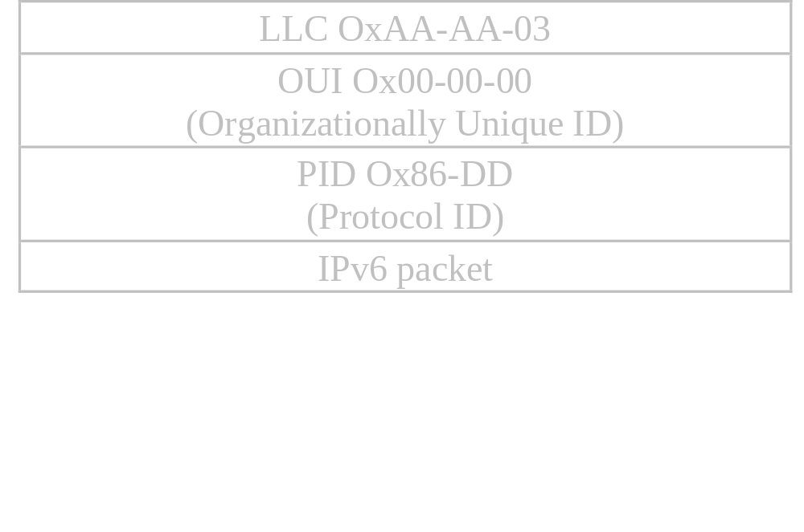
IPv6 over ATM
IPv6 packet encapsulation
  PVC (Permanent Virtual Circuit) environment
    Default : LLC encapsulation (RFC 1483)

Slide 34
IPv6 over ATM
IPv6 packet encapsulation(Con’t)
  PVC environment (Con’t)
    Optional null encapsulation
      IPv6 packet is passed directly to the AAL5 layer
      Both ends of the PVC must be configured to use null encapsulation.

Slide 35
IPv6 over ATM
IPv6 packet encapsulation(Con’t)
  SVC (Switched Virtual Circuit) environment
    Default : LLC encapsulation

Slide 36
IPv6 over ATM
IPv6 packet encapsulation(Con’t)
  SVC environment (Con’t)
    Unicast Packet Encapsulation

Slide 37
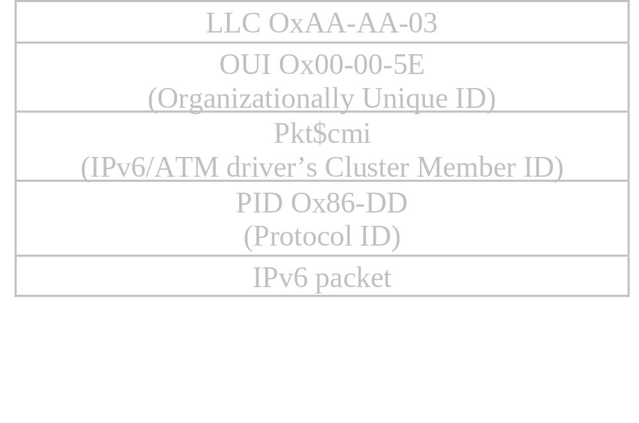
IPv6 over ATM
IPv6 packet encapsulation(Con’t)
  SVC environment (Con’t)
    Multicast Packet Encapsulation

Slide 38
IPv6 over ATM
IPv6 packet encapsulation(Con’t)
  SVC environment (Con’t)
    Optional null encapsulation
      IPv6 packet is passed directly to the AAL5 layer
      Both ends of the SVC must be configured to use null encapsulation.

Slide 39
IPv6 over ATM
MTU(Maximun Transmission Unit) Size
  9180 Octets (Default), RFC 1626
  Other values may be used

Slide 40
IPv6 over ATM
Neighbor Discovery Protocol
  Must not discard a Neighbor Solicitation message nor a Neighbor Advertisement without a link layer address option or with an unknown format.

Slide 41
Conclusions
Despite the fundamental difference between ATM(Connection oriented service) and IP(Connectionless service), IPv6 can be used for ATM security without modifying basic IPv6 concepts. AAL 5 plays a crucial role in that connection.

Slide 42
Thank you.

