Slide 1
Survivable Logical Topology Design in WDM Optical Ring Networks
Hwajung Lee, Hongsik Choi,
Suresh Subramaniam, and Hyeong-Ah Choi*
The George Washington University
Supported in part by
DARPA under grant #N66001-00-18949
(Co-funded by NSA)
DISA under NSA-LUCITE Contract
NSF under grant ANI-9973098

Slide 2
Outline
Introduction – Network Survivability
Motivation
Problem Formulation
Problem Complexity
Heuristic Algorithm
Numerical Results
Concluding Remarks

Slide 3
Network Survivability
Introduction
To guarantee for users to use the network service without any interruption.
Each layers have their own fault recovery functions.
Fault propagation
IP
ATM
IP
IP
SONET/
SDH
SONET/
SDH
ATM
IP
WDM Optical Network
Physical Fiber Plant

Slide 4
Motivations
Survivable Logical Topology
Logical topology (Upper Layer) is called survivable if it remains connected in the presence of a single optical link failure.
  Faulty Model : Single optical link failure.

Slide 5

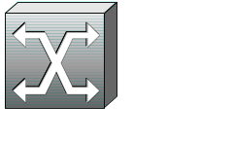
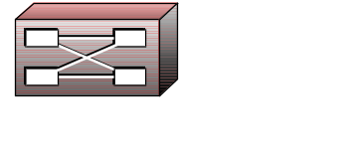
Motivations
Survivable Logical Topology
0
1
Optical Layer
= Physical Topo.
Upper Layer
= Logical Topology
Survivable
Desirable!
5
2
0
1
4
3
4
3
0
1
2
5
Not Survivable
Map each connection request
to an optical lightpath.
5
2
4
3
Electronic layer is connected
even when a single optical link fails

Slide 6


Motivations
Survivable Logical Topology
Sometimes, there is no way to have a Survivable
Logical Topology Embedding
on a Physical Topology.
Electronic Layer
= Logical Topology
Optical Layer
= Physical Topo.
e₁
a
b
…
…
…
a
…
e₂
d
c
c
d
…
…
b
2-Edge Connected

Slide 7
Survivable Logical Topology Design Problem
(SLTDP)
Problem Formulation
Given
  a physical topology, and
  a logical topology = a set of connection requests.
Objectives
  Find a route of lightpath for each connection request, such that the logical topology remains connected after a single link failure if possible.
  Otherwise, determine and embed the minimum number of additional lightpaths to make the logical topology survivable.

Slide 8
Problem Complexity
Problem Complexity
Survivable LT design possible
  Completely connected (i.e., (n-1)-edge connected)
NO survivable LT design when logical topology G is
  2-edge connected
  3-edge connected
  4-edged connected
Degree Constraints
  Survivable LT design possible when min.degree >=⎡ ⎤
  No survivable LT design for min. degree <= ( -1)
2n
3
n
2

Slide 9
Problem Complexity
Complete Graph
: Survivable
1
1
5
2
2
5
3
4
3
4

Slide 10
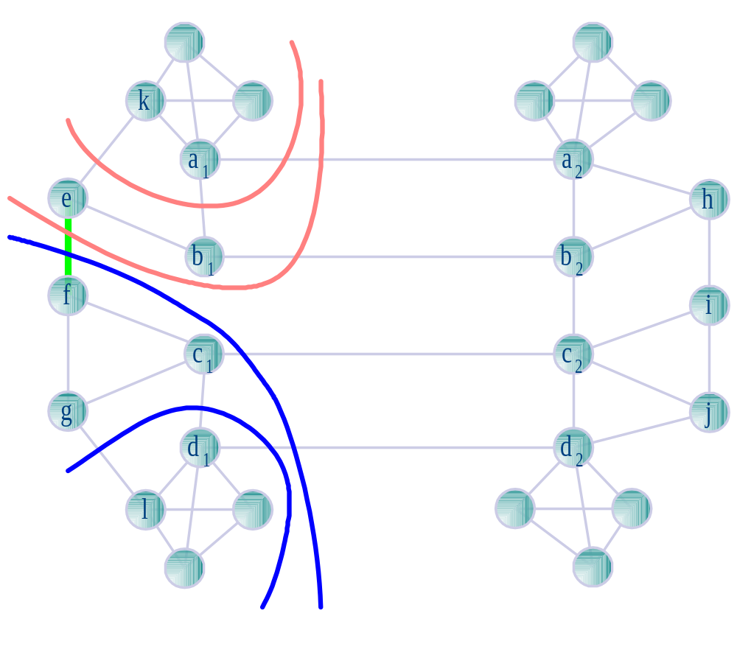
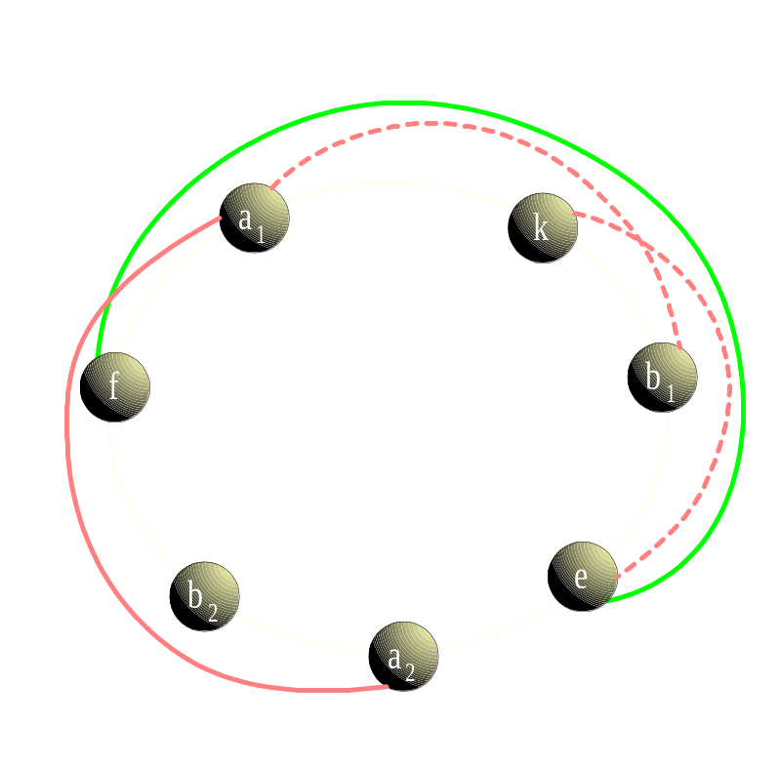
Problem Complexity
3-edge Connected Graph
: not Survivable

Slide 11
Problem Complexity
4-edge Connected Graph
: not Survivable
b
1
b
2
e
a
1
b
e
2
1
b
b
3
b
4
4
3
b
c
c
e
2
1
2
1
b
a
a
e
4
C
1
1
2
3
a
c
3
c
4
3
C
2
a
C
4
3
d
d
c
C
1
2
d
1
4
a
3
a
4
3
d
c
2
d
3
d
4
4
d
1
c
3
e
e
d
2
a
c
1
2
2
4
e
3
e
4

Slide 12
s_{i} ≥ +i (L); s_{i} ≥ - I + n -1(R) t: highest index in L ∩ smallest_component
4 cases: t ≤ -1; t ≥ ; ≤ t ≤ -2; t= -1
Problem Complexity
Shortest Path Routing
: Survivable if (minimum d ≥ ⎡ ⎤ )
2n
3
n
6
n
6
n
4
n
3
n
4
n
3
n
3
Number of Nodes = b
Number of Nodes = b
...
n/2-1
n/2
...
n/3-1
2n/3
...
...
j
n-j-1
...
n/4+1
L
n/4
R
...
. . .
...
n/2+j
0
n-1

Slide 13
Problem Complexity
Shortest Path Routing
: not Survivable if (minimum d ≤ -1 )
n
2
...
...
...
: V_{odd}
...
...
: V_{even}
0
n-1
K
Graph
0
n-1
K
Graph
n/2-1
n/2-1

Slide 14
Heuristic Algorithm based on Shortest Path Routing
Heuristic Algorithm
Assign logical links to lightpaths.
Cut each optical link
and Calculate the # of Components.
Find an optical link (x,y) with the maximum # of components.
Add an additional lightpath without using (x,y).
Repeat the above procedure
until the logical topology being survivable.

Slide 15
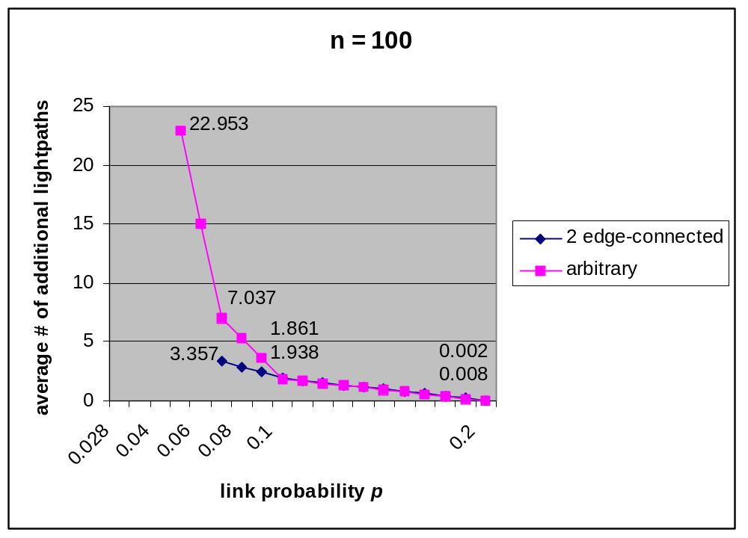
Numerical Results
# of Simulations = 1000
Numerical Results

Slide 16
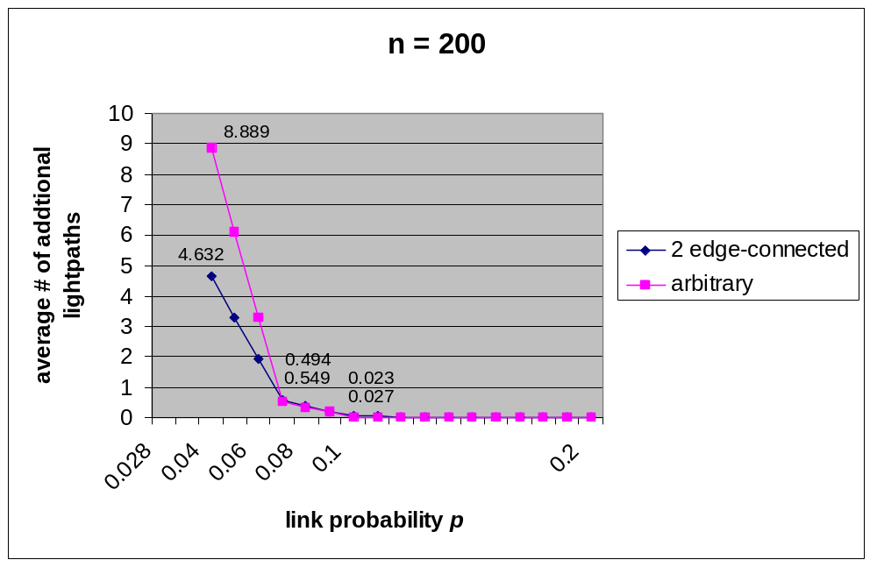
Numerical Results
# of Simulations = 1000
Numerical Results

Slide 17
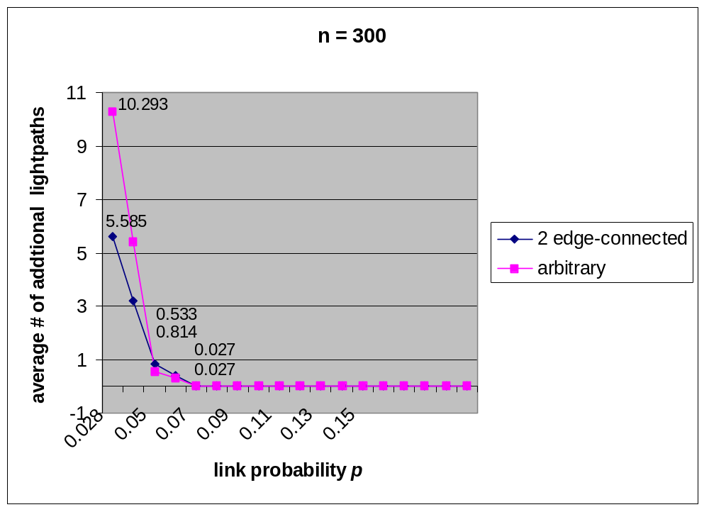
Numerical Results
# of Simulations = 1000
Numerical Results

Slide 18
Concluding Remarks
Concluding Remarks
Survivable LT design in WDM ring network
Determine if survivable design possible from G
  Degree constraint : -1,
  Edge-connectivity constraint
Heuristic algorithm: almost optimal
Further Research
  Tighter bounds
  WDM mesh topology
  Reconfiguration of Survivable Logical Topology
n
2
2n
3

