Slide 1

ATM Firewall Routers with Black Lists
Hwajung LEE
The George Washington University
School of Engineering and Applied Science
Electrical Engineering and Computer Science
Computer and Communications Security

Slide 2



Overview of Firewalls
Router
HOST
Firewall
HOST
<Figure 1> Overview of Firewalls

Slide 3


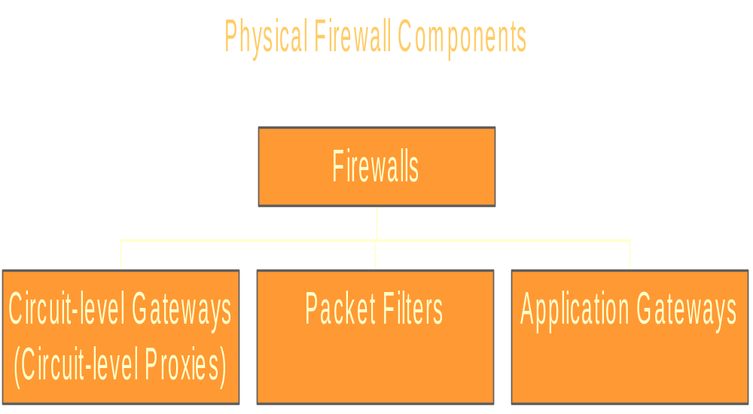
Overview of Firewalls

Slide 4
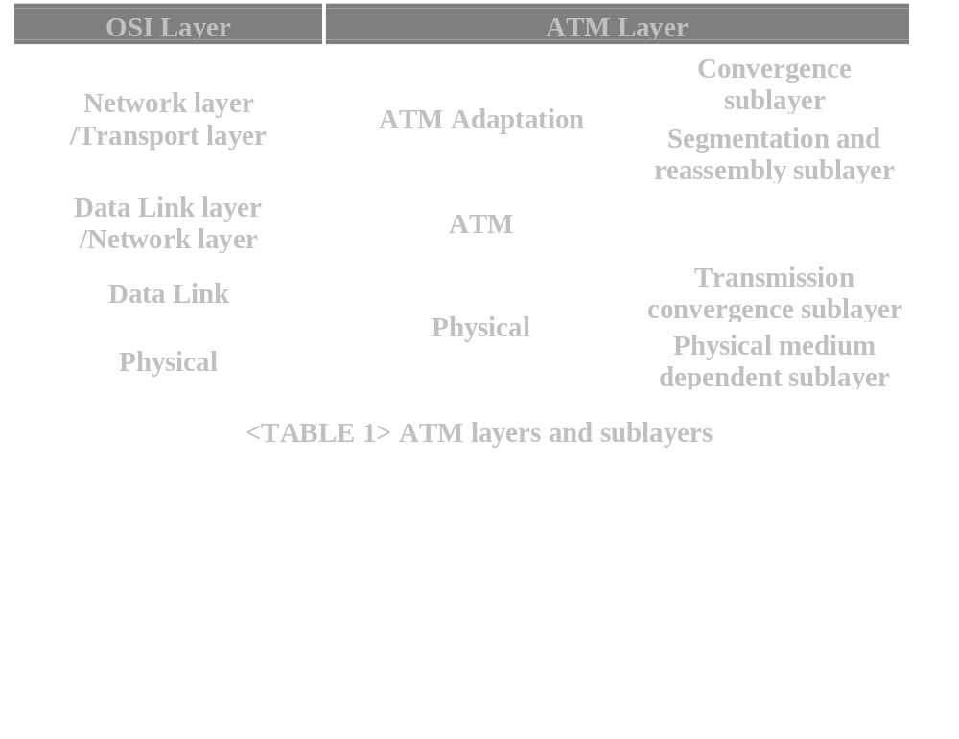
Overview of ATM

Slide 5
Overview of ATM
ATM (Asynchronous Transfer Mode)
ATM cells
  Fixed-size packets
Cell Switching (Connection-Oriented)
  cf. Circuit Switching, Packet Switching
5Byte Header
48 Byte Payload

Slide 6
ATM Routing
Application
Layer
Application
Layer
AAL
AAL
AAL
ATM
ATM
ATM
Physical
Layer
Physical
Layer
Physical
Layer
Host A
Router
Host B

Slide 7
ATM Firewall Routers with Black Lists
ATM (Asynchronous Transfer Mode)
Basic Concepts
  High Speed : 155.52Mbps, 622Mbps
  If firewalls protect a host or domain,
  firewalls can be a bottleneck.
  => Each Router shares firewall loads

Slide 8
ATM Firewall Routers with Black Lists
Basic Concepts : ATM Signalling
(ITU-T Q.2931)
  <Step 1> Connection SETUP *
    With Source Address, Destination Address
  <Step 2> Communicate
  <Step 3> Connection RELEASE

Slide 9
ATM Firewall Routers with Black Lists
Basic Concepts : ATM Addressing
  CCITT (now ITU-T) E.164
    NDC : National destination code
    N(s)N : National (significant) number
    SA : Sub-address
    SN : Subscriber number
    <Figure 2> E.164
  => Hierarchical Topology
N(s)N
NDC
S N
SA

Slide 10
ATM Firewall Routers with Black Lists
Firewall Routers
Host
FR 3
FR 2
Domain D
Domain C
FR 1
HOST A
HOST B
<Figure 3>Logical ATM Topology based on CCITT(now ITU-T) E.164

Slide 11
ATM Firewall Routers with Black Lists
Black List Cells (based on Q.2931)
Black List
Destination Address
Source Address
(Message Type)
Black List CAMs (Content Addressable Memory)
Destination Address
Source Address
Why CAM? For speed up.

Slide 12
ATM Firewall Routers with Black Lists
Black List Cells
Black List
Destination Address
Source Address
Black List CAMs
Source Address
Destination Address

Slide 13
ATM Firewall Routers with Black Lists
Scenario 1
  Protected Host A, Unauthorized Host B
Scenario2
  Protected Host A, Unauthorized Domain C
Scenario 3
  Protected Domain D, Unauthorized Domain C

Slide 14
ATM Firewall Routers with Black Lists
Scenario 1 : Protected Host A, Unauthorized Host B
1. Host A sends a Black List Cell to FR 1
2. FR 1 saves it to its Black List CAM
3. Host B requests a Call SETUP to Host A
4. FR 1 receives it & Searches its Black List CAM
If exists -> Discards the Call SETUP Message
& Sends an Alarm Signals to Host A
Else -> Passes the Call SETUP Message

Slide 15
ATM Firewall Routers with Black Lists
Scenario 2 : Protected Host A, Unauthorized Domain C
1. Host A sends a Black List Cell to FR 2
2. FR 2 saves it to its Black List CAM
3. Host in Domain C requests a Call SETUP to Host A
4. FR 1 receives it & Searches its Black List CAM
If exists -> Discards the Call SETUP Message
& Sends an Alarm Signal to Host A
Else -> Passes the Call SETUP Message

Slide 16
ATM Firewall Routers with Black Lists
Scenario 2 : Protected Host A, Unauthorized Domain C
5. FR 2 receives it & Searches its Black List CAM
If exists -> Discards the Call SETUP Message
& Sends an Alarm Signal to Host A
Else -> Passes the Call SETUP Message

Slide 17
ATM Firewall Routers with Black Lists
Scenario 3 : Protected Domain A, Unauthorized Domain C
1. Host A sends a Black List Cell to FR 2
2. FR 2 saves it to its Black List CAM
3. Host in Domain C requests a Call SETUP to Host in Domain A
4. FR 1 receives it & Searches its Black List CAM
If exists -> Discards the Call SETUP Message
& Sends an Alarm Signal to Host A
Else -> Passes the Call SETUP Message

Slide 18
ATM Firewall Routers with Black Lists
Scenario 2 : Protected Host A, Unauthorized Domain C
5. FR 2 receives it & Searches its Black List CAM
If exists -> Discards the Call SETUP Message
& Sends an Alarm Signal to Host A
Else -> Passes the Call SETUP Message

Slide 19
ATM Firewall Routers with Black Lists
Give Authority to unauthorized Party
Scenario 4 : Protected Host A, Unauthorized Host B
1. Host A sends a Permit Cell to FR 1
2. FR 1 saves it to its Black List CAM

Slide 20
ATM Firewall Routers with Black Lists
Black List Cells
Scenario 2 : Protected HOST A, Unauthorized Domain C
Black List
~.~.*.*
Source Address
(Message Type)
Destination Address
Scenario 3 : Protected Domain D, Unauthorized Domain C
Black List
~.~.*.*
~.~.*.*
(Message Type)
Destination Address
Source Address

Slide 21
Conclusions
Advantages
  Domain Protection & Host Protection
  Alarm Signals
  Low Overheads (Time Delays, Traffic Loads)
  Strong Protection
  with List of Authorized User Cells,
  List of Authorized User CAMs

Slide 22
Conclusions
Disadvantages
  Fake Black List Cells
  Common problems of Network Management Signals
Future Works
  How to prevent Fake Black List Cells

Slide 23
The End
Thank you.

