Slide 1
Demand Forecasting
An Overview of Latest Research

Slide 2
Presentation Knowledge Assumptions
To make it through all material this presentation will assume comfortability with the following concepts:
Neural Networks
Embeddings
RNN’s
Attention Models
CDF’s, PDF’s, and common distributions

Slide 3
Nuances of Demand Forecasting
Low volume at low levels
Full product profiles
Intermittent demand
Feature Representation
Cold start problem
Product ID vs Attribution/Description trade-off
Consumer behavior/Trends
Feature breakdown in prediction interval
Dependent Multivariate Time Series
Cannibalism
Co-Buy
Business Desires
Inference
Risk assessment
Generalizable Results

Slide 4
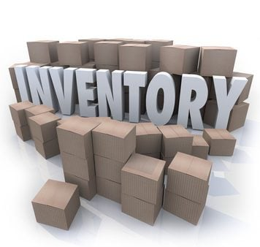

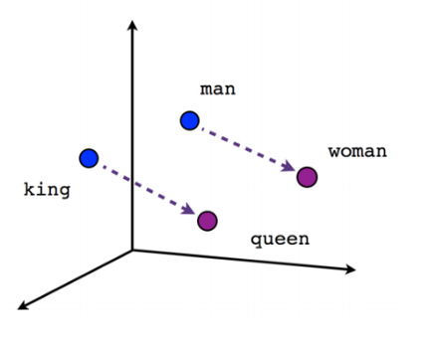
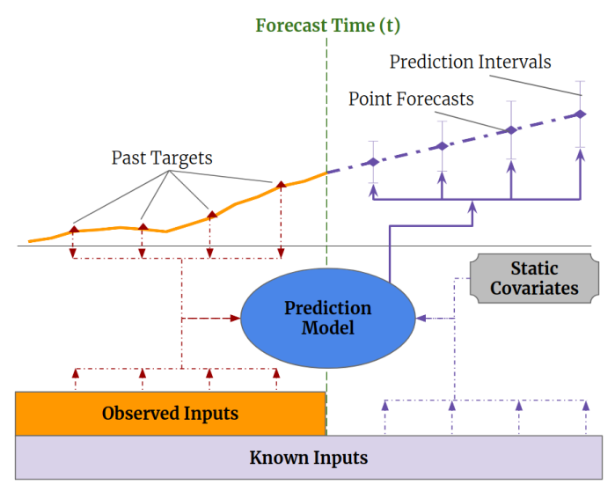
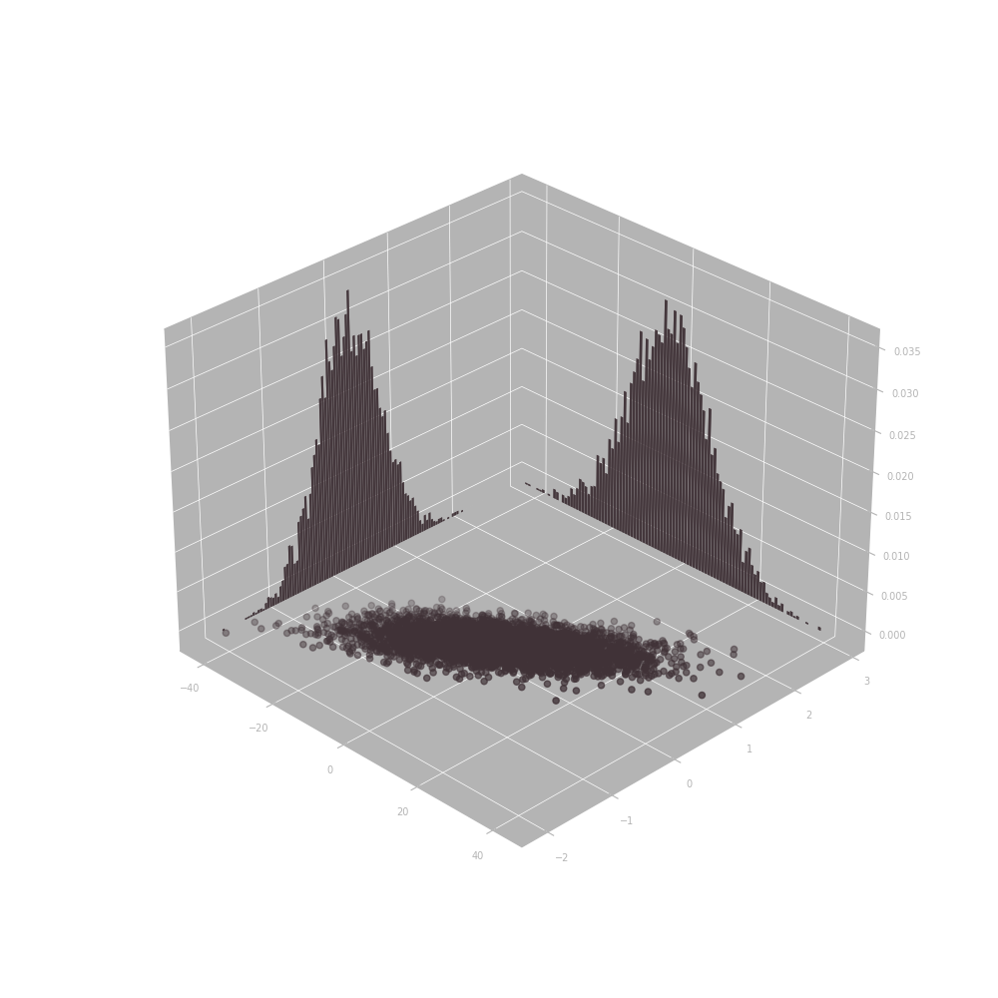
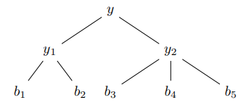

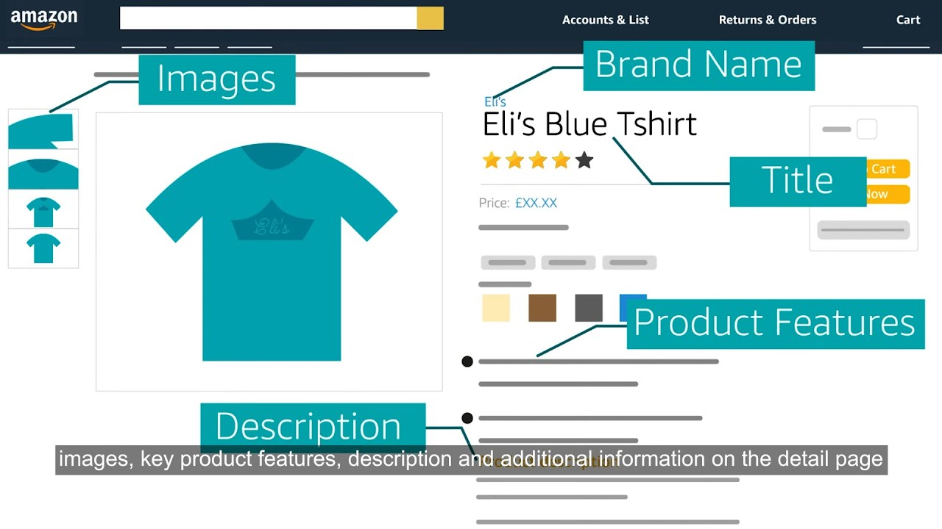

The Big Picture
“Conditional Independence”
DeepAR
Temporal Fusion Transformers
Dependency Modeling
DeepVAR/LR Gaussian Copula
Conditioned Normalizing Flows
E2E Hierarchical Time Series
Feature Representation
Modeling
Distributional Assumption/Enforcement
Hierarchical Enforcement
Embeddings
Product Features
Not an exhaustive list

Slide 5
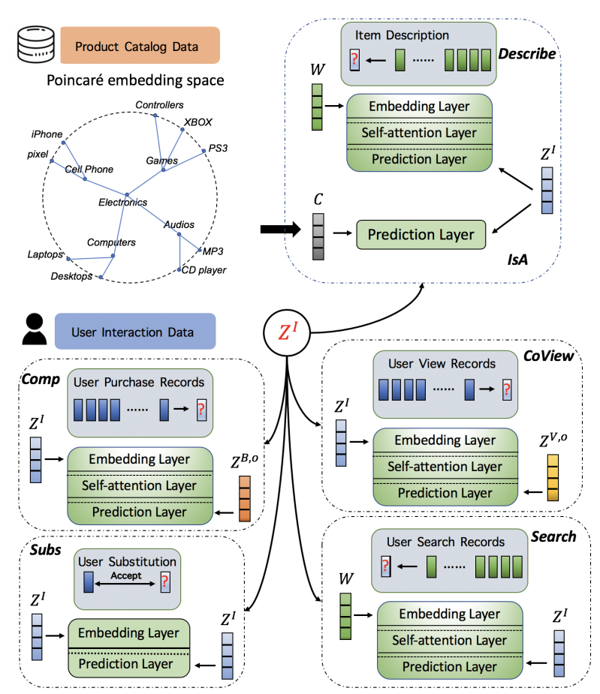
Feature Representation
Both products and locations can be represented with either an ID, attribution or an embedding
ID Representation
Attribution
Embeddings
Pros:
- Strong performance on high volume, long history styles
Cons:
- Poor generalizability to new ID’s
Pros:
- Generalizability within shared attribution
Cons:
- Will tend to the average of a group
Pros:
Flexibility in pre-train / freezing strategies
Can offer individuality and group-based information
Cons:
- Worse Explainability
- More work to maintain

Slide 6
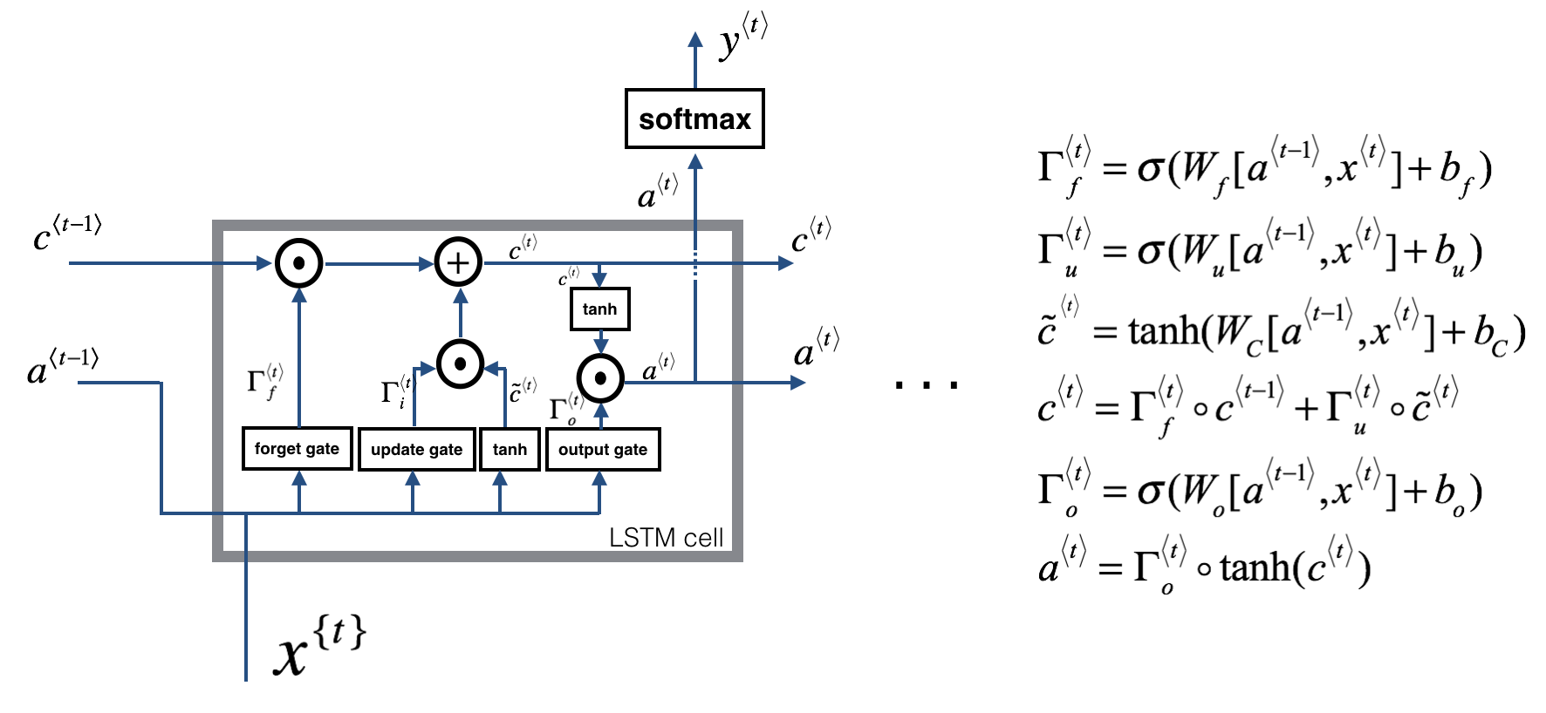
Base Models
RNN’s
LSTM

Slide 7
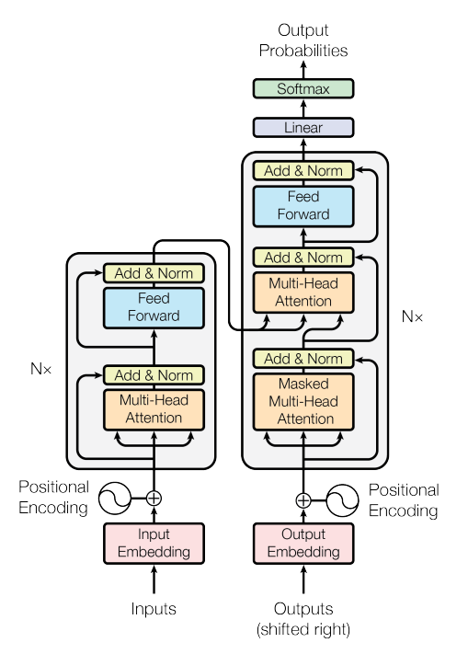
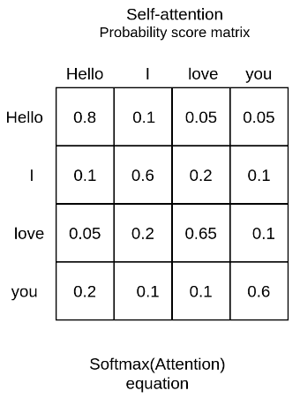
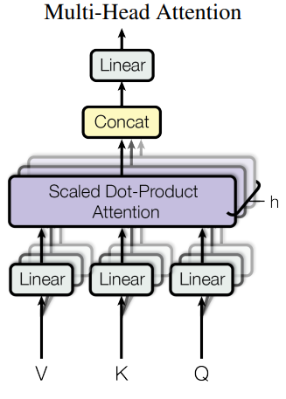
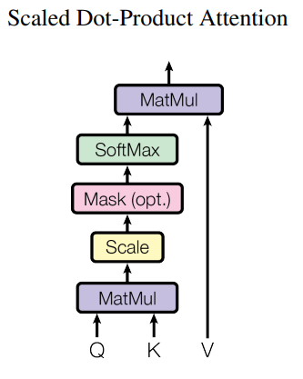

Base Models
Transformers
Multi-Head Attention
Could perform better on longer input/prediction intervals
Possible run-times and suitability for density estimators

Slide 8
”Conditional Independence”
DeepAR
Temporal Fusion Transformer

Slide 9
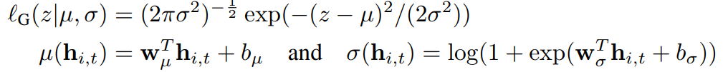
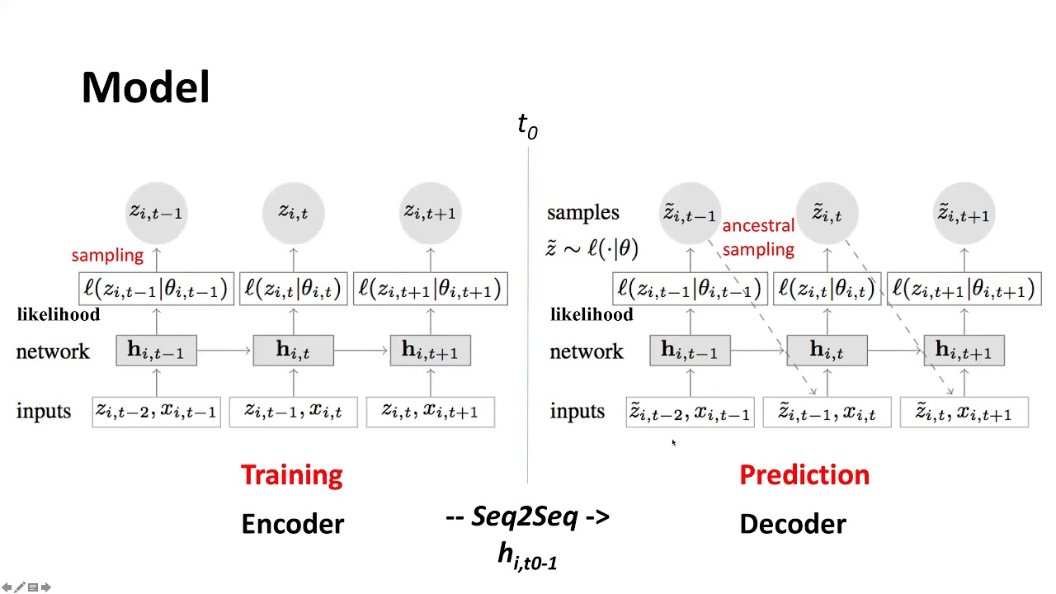
Autoregressive Recurrent Networks (DeepAR)
LSTM
Dynamically scales sales for each time series
Shared parameters across all time series
Outputs are transformed into distributional parameters
Pros:
- Simple yet powerful
- No restrictions on distributional output
Cons:
- Lacks Inference
- Low Performance
- Poor Feature Representation

Slide 10

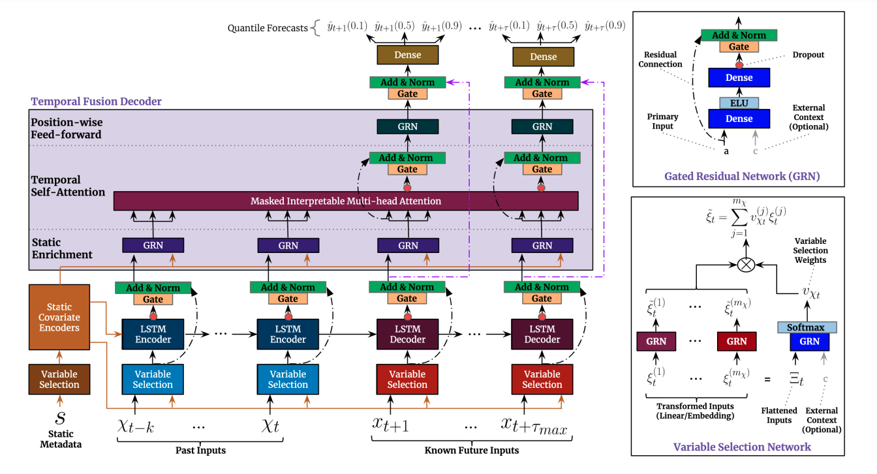
Temporal Fusion Transformer
Combining many concepts including LSTM, Attention and more
Pros:
- Some Feature Representation logic
- Works on large variety of data (AutoML vibes)
- Increased level of inference
Cons:
- Conditional Independence Assumption

Slide 11
Dependency Modeling
Forecasting with Gaussian Copula
Forecasting via Normalizing Flows

Slide 12
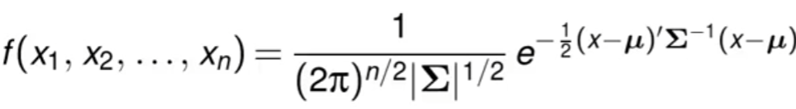
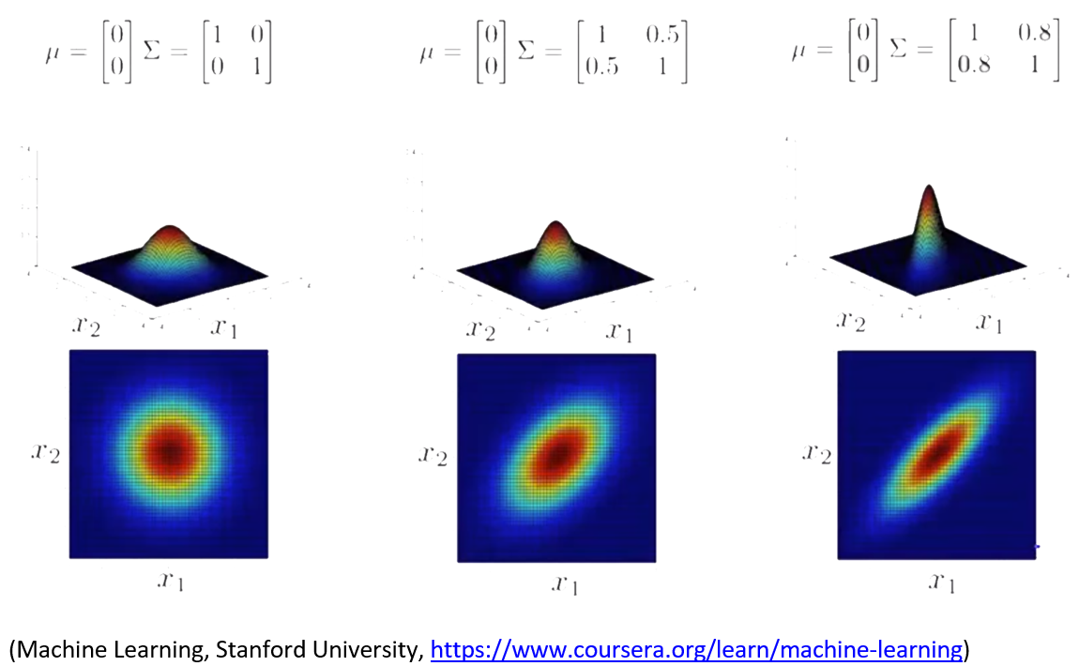
Multivariate (Joint) Distribution
One distribution to model all time series.
What is a Multivariate Distribution?
Ex. Gaussian

Slide 13
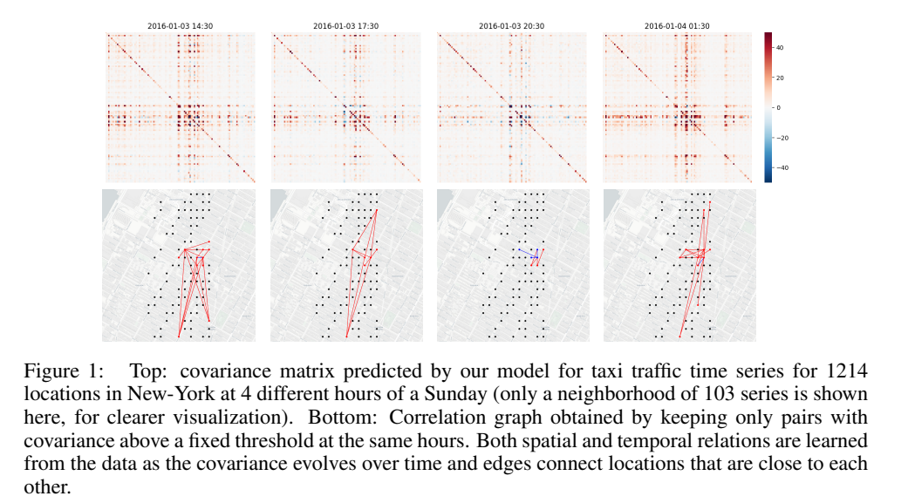
Forecasting With Low-Rank Gaussian Copula Processes
Vec-LSTM
Model all time series as one multi-output LSTM
Possible distributions:
Independent
Low-Rank Copula
Full-Rank
Gaussian Process
A shared LSTM is unrolled for each time series separately and rejoined into a single joint distribution
Data can be transformed using mean-scaling or a copula

Slide 14
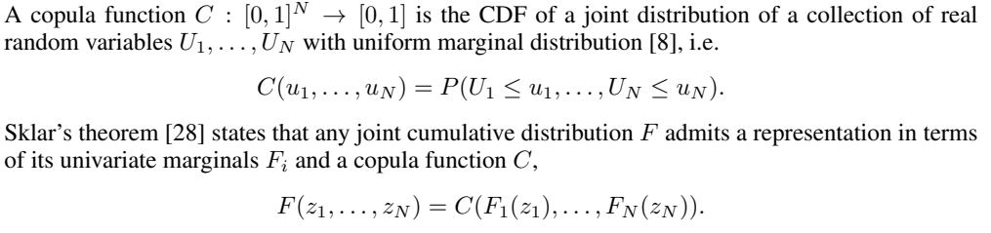
Copulas
Also known as “The formula that killed wall street”

Slide 15
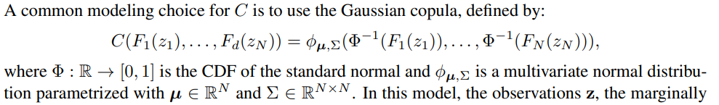


Copulas
Estimate the empirical CDF:
Where m is the number of past observations for the given time series (assumes stationary distribution)
The implementation uses a piece-wise linear interpolation such that the gradient is tractable. Current implementation of this limit's forecasts to no higher than max of its historic

Slide 16
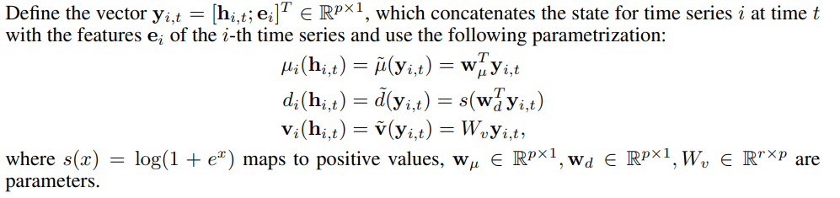
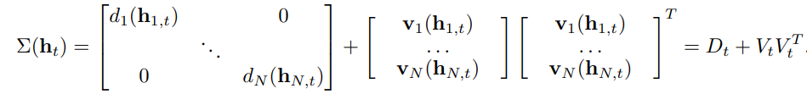
Multivariate Gaussian Estimation
Brings evaluation of the likelihood from O($N^{3}$) operations to O(${Nr}^{2}+ r^{3}$ ) where r is the rank of V

Slide 17

Low-Rank Gaussian Processes
Unroll a shared LSTM for all Time Series
Estimate the marginal CDF for each and use a Gaussian Copula to join them
Optimize the parameters of the Low-Rank Gaussian Distribution
Treat the transformed observations as a Gaussian Process evaluated at $y_{i, t}$
- This allows for batches of size $B≪N$
Pros:
- Multi-Layer Feature Representation
- Dependency modeling in a reduced fashion
- Batch Training and its introduction of randomness to the model
Cons:
- Cold Start Problem
- Flexibility Concerns on Marginals
- Bound constraints on predictions (can be rectified after the fact)
- Limited to second order dependencies

Slide 18
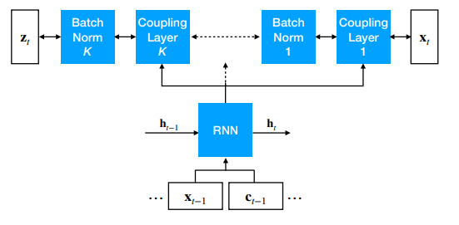
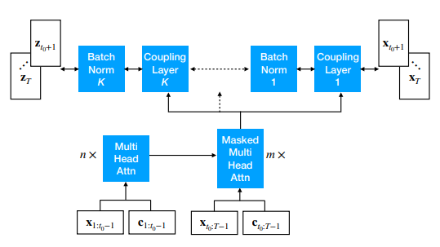
Forecasting Via Conditioned Normalizing Flows
All time series are fed through a base model together and their output is passed through K layers of a normalizing flow.
Base Models
LSTM
Transformer
Density Estimation (Via Normalizing Flows)
Real NVP
MAF

Slide 19
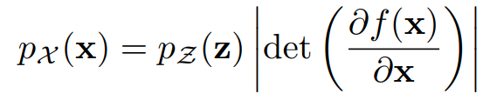

Normalizing Flows
A mapping from ${X= R}^{D}$ to $Z= R^{D}$ using $f: X→Z$
X is a random sample from a known distribution (e.g. isotropic gaussian)
$f$ is a composition of bijective functions
This transformation can be represented as:
Where $z= f^{−1}(x)$ and the Jacobian of $f$ at $x$ can be thought of as capturing the shrinkage/expansion of the density
An important task is keeping the determinant tractable in $O(D)$ time (e.g. triangular matrices)

Slide 20


Real NVP
Developed the “Coupling Layer” where part of the input is unchanged, and the other part is transformed via functions of the un-transformed variables
This transformation can be represented as:
Where $s$ and $t$ are neural networks such that $s, t: R^{d}→R^{D−d}$ (these functions need not be invertible and can have additional input).
Stacked coupling layers allow for $1:d$ to be changed for each layer and batch normalization is applied allowing for more stability and a deeper stack

Slide 21

Masked Autoregressive Flow (MAF)
An autoregressive model whose conditionals are parametrized as single Gaussians
Where $μ$ and $α$ are unconstrained scalar functions of $x_{1:i−1}$
Data can be generated via:
$f_{μ_{i}},f_{α_{i}}$ are estimated using MADE (Masked Autoencoder)
Backward transformation to $x$ from $z$ can be a useful diagnostic for density fit
Real NVP can be seen as a special case of MAF

Slide 22
Forecasting Via Conditioned Normalizing Flows
All time series are fed through a base model together and their output is passed through K layers of a normalizing flow.
Base Models
LSTM
Transformer
Normalizing Flows
Real NVP
MAF
Pros:
- Not limited to second order
- Possibility for new flows to replace MAF
Cons:
- Unaware of flows to model discrete ordinal data
- Must dequantize the data
- Concerns on inference

Slide 23
Hierarchical Modeling
E2E Hierarchical Probabilistic Forecasting

Slide 24
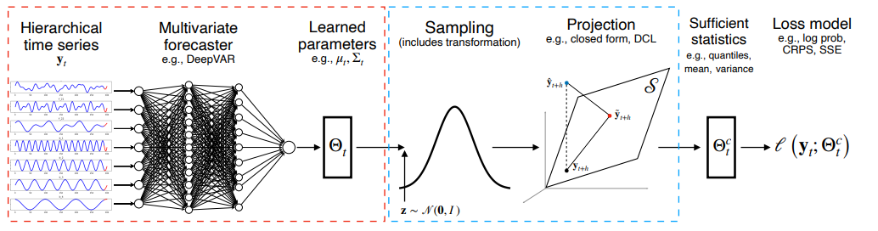
Hierarchical Forecasting
The ability to model higher aggregations simultaneously while maintaining coherence across levels
Can either be two-stage (via reconciliation) or end to end structure
Projection is done via a matrix in similar form to factor effects in regression

Slide 25

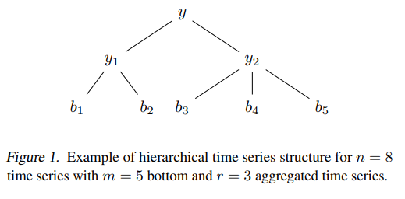


Hierarchical Forecasting
Projection is done onto the null space via:
Where $A=$
Pros:
- Coherent forecasts
Cons:
- Restricted to distributions with reparameterization tricks

Slide 26
Future work
Extension of Vec-LSTM to a Multivariate Negative Binomial
A normalizing flow for ordinal data
Consider Normalizing Flows with TFT as the base model
Possible Future Research
Autoregressive Quantile Flows
https://openreview.net/forum?id=z1-I6rOKv1S
Multivariate Neg Binomial
https://users.math.msu.edu/users/valdezea/MNB-Amsterdam2013.pdf
Graph Augmented Normalizing Flows for Anomaly Detection
https://openreview.net/pdf?id=45L_dgP48Vd

Slide 27
Acknowledgements/References
Poincare Embeddings
https://arxiv.org/pdf/1705.08039.pdf
Product Knowledge Graph Embedding for E-commerce Walmart Labs
https://arxiv.org/pdf/1911.12481.pdf
DeepAR
https://arxiv.org/pdf/1704.04110.pdf
Temporal Fusion Transformers for Interpretable Multi-horizon Time Series Forecasting
https://arxiv.org/pdf/1912.09363.pdf
High-Dimensional Multivariate Forecasting with Low-Rank Gaussian Copula Processes
https://arxiv.org/pdf/1910.03002.pdf
Copulas
https://www.youtube.com/watch?v=gzUxg0OUHU4
https://www.youtube.com/watch?v=R_7Qvbrb0jE
https://citeseerx.ist.psu.edu/viewdoc/download?doi=10.1.1.174.3325&rep=rep1&type=pdf low rank approx.
https://moodle2.units.it/pluginfile.php/24257/mod_resource/content/1/Rasmussen_Williams_2006_Gaussian_processes_for_machine_learning.pdf To Read
MULTIVARIATE PROBABILISTIC TIME SERIES FORECASTING VIA CONDITIONED NORMALIZING FLOWS
https://arxiv.org/pdf/2002.06103.pdf
https://pyro.ai/examples/normalizing_flows_i.html
https://www.youtube.com/watch?v=i7LjDvsLWCg normalizing flows
https://arxiv.org/pdf/1605.08803.pdf Real NVP
https://arxiv.org/pdf/1705.07057.pdf MAF
https://arxiv.org/pdf/1502.03509.pdf MADE
https://lilianweng.github.io/posts/2018-10-13-flow-models/#:~:text=Masked%20Autoregressive%20Flow%20(MAF%3B%20Papamakarios,Flow%20(IAF)%20introduced%20later. flow models
End-to-End Learning of Coherent Probabilistic Forecasts for Hierarchical Time Series
http://proceedings.mlr.press/v139/rangapuram21a/rangapuram21a.pdf

