Slide 1
Advanced Computer Graphics
Fall 2022

Slide 2
Grading
Programming assignments
Paper study and reports (flipped classroom)
Final project
No written exams

Slide 3
Some Advice
This course involves a lot of programming in C or C++.
Do not take this course if:
  You are not comfortable about your programming

Slide 4
Topics
Ray Tracing
Radiosity
Monte Carlo path tracing
Real-time global illumination
GPU programming

Slide 5
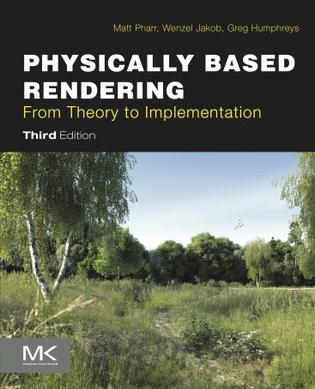
Textbook?
Physically Based Rendering, 3rd Ed., by Matt Pharr and Greg Humphreys.
  Online edition at http://www.pbr-book.org/
  eBook available at the NTNU Library

Slide 6
Reference?
Many computer graphics books (e.g. 3D Computer Graphics by Alan Watt ) cover:
  Ray tracing
  Radiosity
  Monte Carlo path tracing
SIGGRAPH Courses (available in ACM DL):
  Monte Carlo path tracing
  Photon Map
  Real-time global illumination
  OpenGL programming

Slide 7
Short Film Festival
I will show a short film at the beginning of each class, so don’t be late!

Slide 8
Photorealistic Rendering vs. Interactive 3D Graphics
(An Introduction to Digital Image Synthesis)

Slide 9
How Do You Draw a Picture (Without a Computer)?
What is your subject?
Viewing Parameters:
  Camera, Picture Frames, Resolutions
Many ways to specify it:
  eye, focus length, image plane
  eye, direction, FOV, up vector

Slide 10
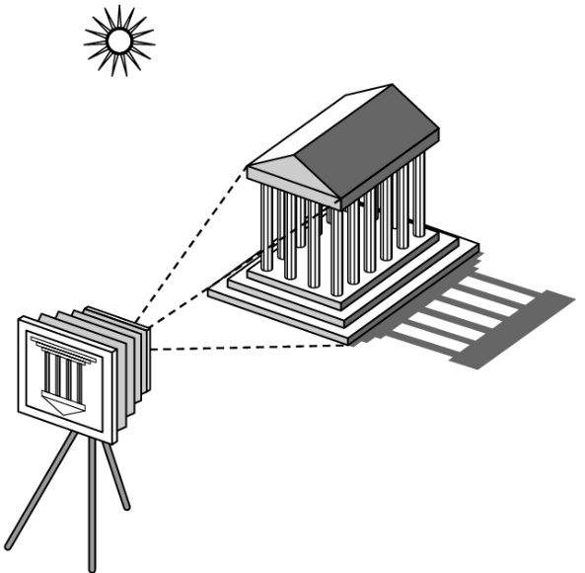
Elements of Image Formation
Objects
Viewer
Light source(s)
Attributes that govern how light interacts with the materials in the scene
Note the independence of the objects, viewer, and light source(s)

Slide 12
3D to 2D Projection
OK, so we can map a 3D point (or vertex) to 2D image.
But what about a 3D surface?
Polygons are made from points.
Actually, we only need triangles!

Slide 13
Scan Conversion
Also called rasterization.
The 3D to 2D Projection gives us 2D vertices (points).
We need to fill in the interior.

Slide 14
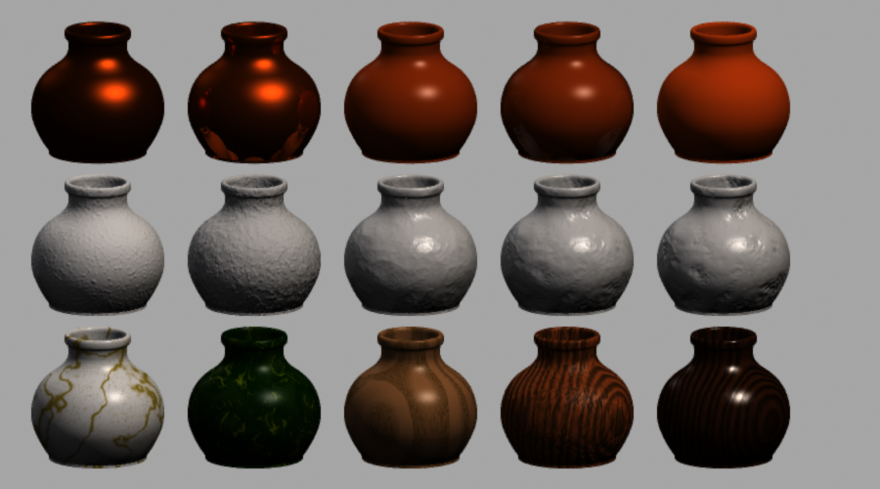
Shading

Slide 15
3D Graphics Pipeline
The above can be implemented in hardware.
Z Buffer to detect hidden surfaces.
Other transformations not mentioned here: Modeling and Viewing.
Typical 3D graphics APIs such as OpenGL and DirectX

Slide 16
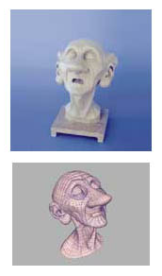
“…But They Don’t Look Real.”
Most things are not flat or simple geometry like spheres and
cones.
We need correct surface colors and shapes (and more)

Slide 17
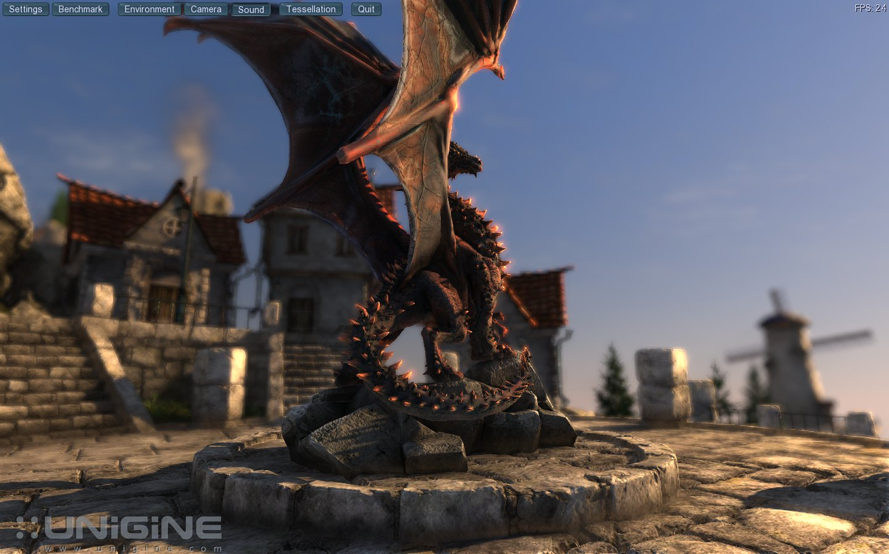
We also need correct lighting.
Textures help, but not enough.
Even simple things like CD can be challenging.

Slide 18
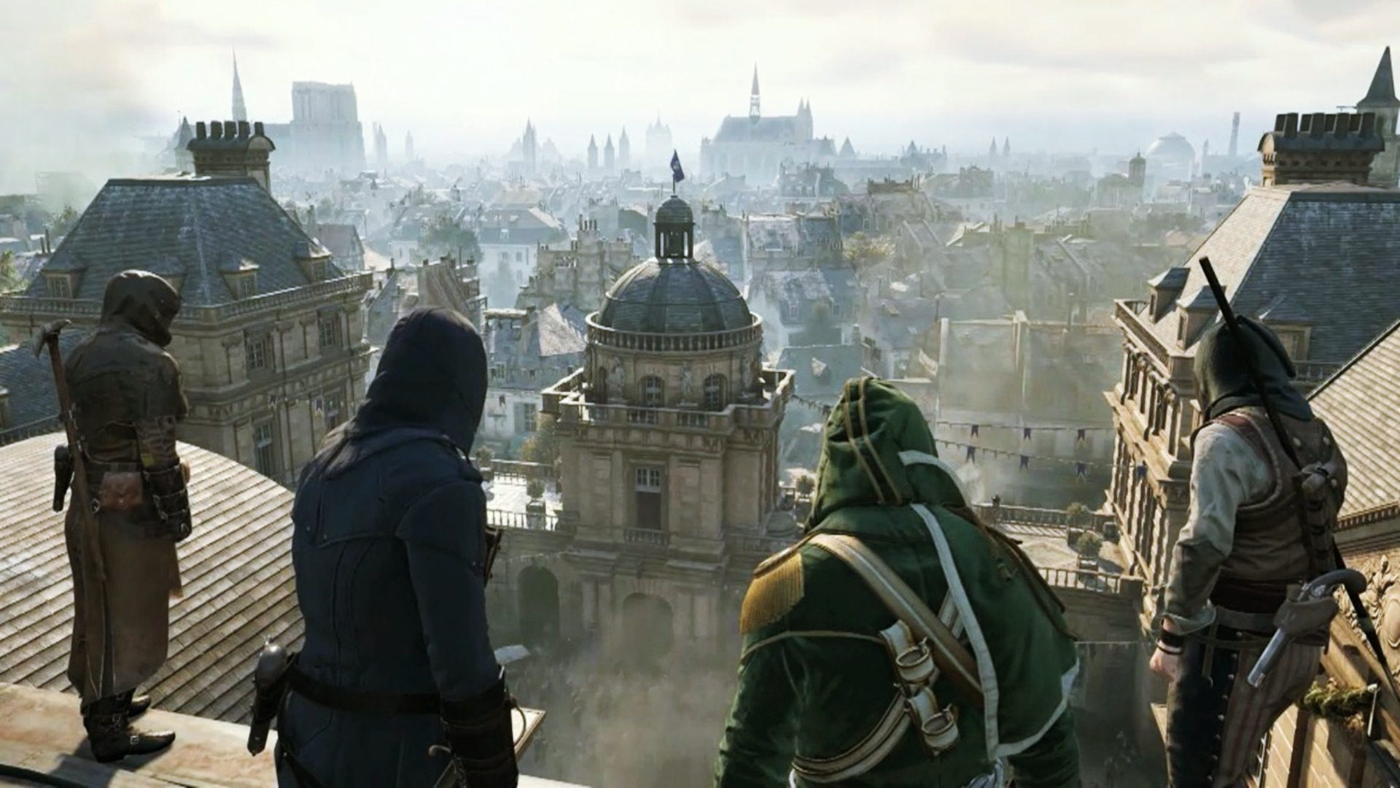
Real-time Graphics
They’re becoming darn good!
From: Assassin’s Creed Unity, Ubisoft

Slide 19
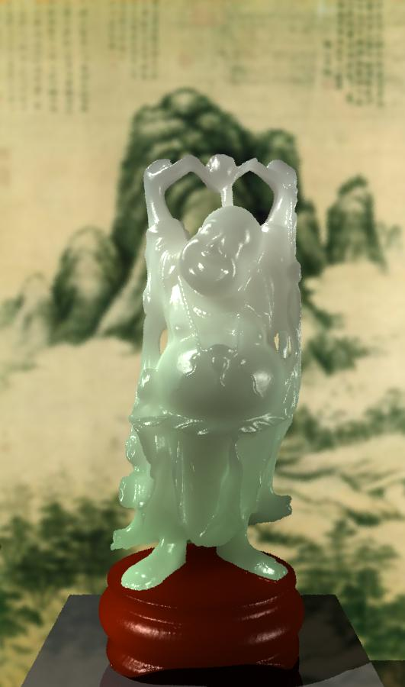
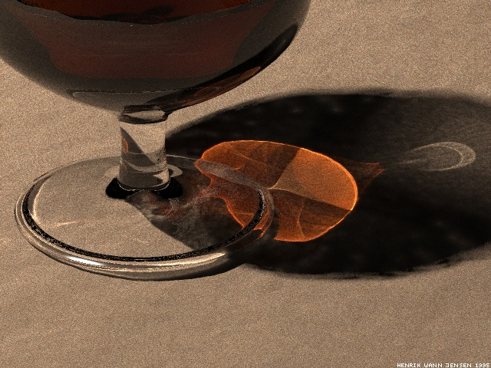
But…
Some effects are hard to do in hardware, such as the caustics and subsurface scattering

Slide 20
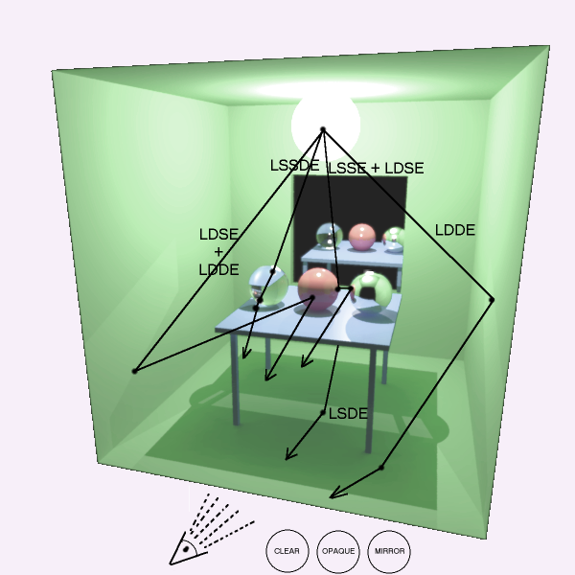
A Different View: Ray Tracing

Slide 21
Actually inverse ray tracing.

Slide 22
Further Readings
Ray Tracing Essentials Part 2: Rasterization versus Ray Tracing
十分鐘看懂光線追蹤到底是怎麼追的？

