Slide 1
Distributed Ray Tracing

Slide 2
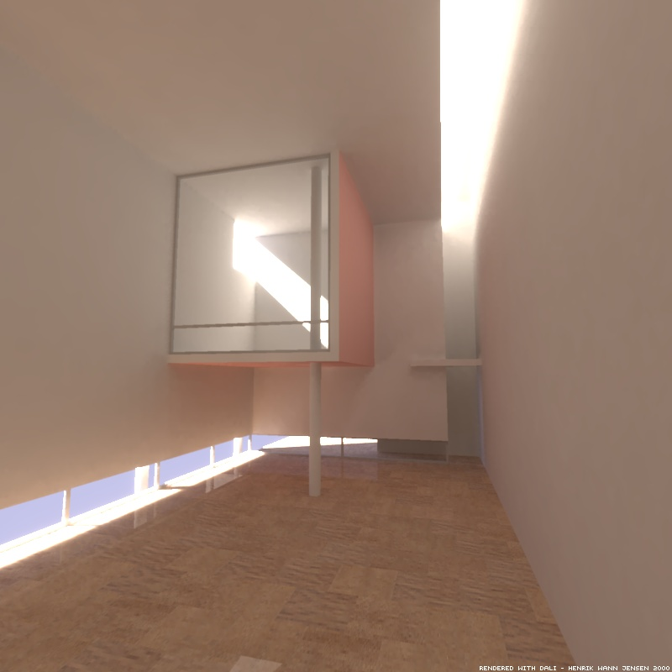
Can you get this with ray tracing?

Slide 3
Ray Tracing Revisited
The reflected intensity (or color) at a surface point is computed by:
  Local reflection model (no interaction with other objects): ambient, diffuse, and specular.
  Global model: perfect reflection and refraction.
What if we spawn many reflected rays?

Slide 4
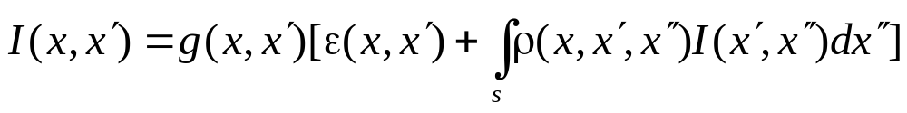
Rendering Equation
g() is the “visibility” function
ρ() is related to BRDF:
From Watt’s p.277

Slide 5
How to Solve It?
We must have:
  ε(): model of the light emitted
  ρ(): BRDF for each surface
  g(): method to evaluate visibility
Integral evaluation →Monte Carlo
Recursive equation → Ray Tracing
The problem is view independent

Slide 6
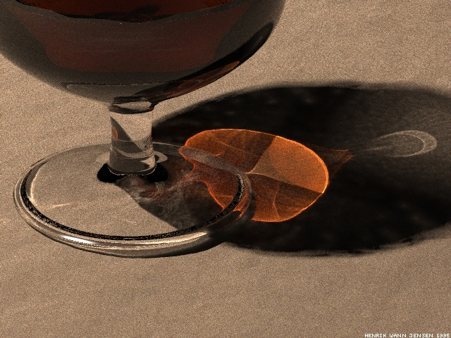
Global Illumination Algorithms
Radiosity (topic of the next lecture).
Distributed Ray Tracing.
Photon Mapping
Monte Carlo Path Tracing

Slide 7
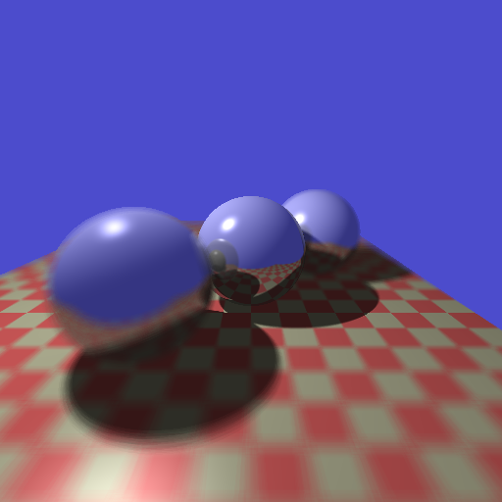
Distributed Ray Tracing
Distribute a group of rays at a hit point to sample the “reflection lobe” (similar to a 2D slice of BRDF).
May also distribute rays along camera aperture, time, and pixel region to produce effects of depth of fields, motion blur, and anti-aliasing.

Slide 8
Why Distributed Ray Tracing?
Anti-Aliasing
Features
  Gloss (fuzzy reflections)
  Fuzzy translucency
  Penumbras (soft shadows)
  Depth of field
  Motion blur

Slide 9
Anti-Aliasing
Supersampling
Jittering – Stochastic Method
6 | 10 | 2 | 13
3 | 14 | 12 | 8
15 | 0 | 7 | 11
5 | 9 | 4 | 1
eye

Slide 10
Gloss
normal
normal
R
R
I
I
surface
surface

Slide 11
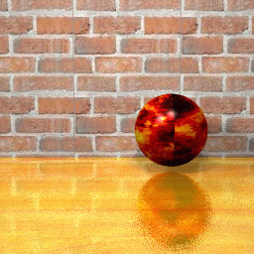

Fuzzy Reflection
4 rays, 37 seconds
64 rays, 956 seconds

Slide 12
Translucent
normal
normal
I
I
surface
surface
T
T

Slide 13
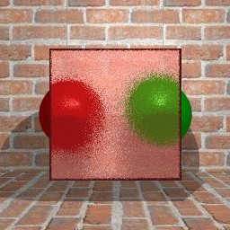
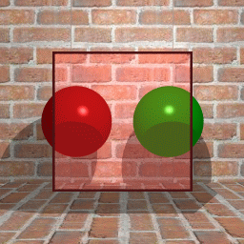
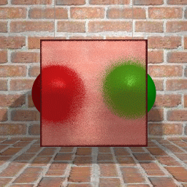
4 rays
16 rays

Slide 14
Penumbra (Soft Shadow)
eye
eye
surface
surface
Hard Shadow
Soft Shadow

Slide 15
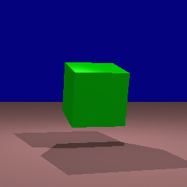
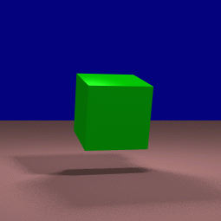
Soft shadow - cube
Without penumbra
With penumbra

Slide 16
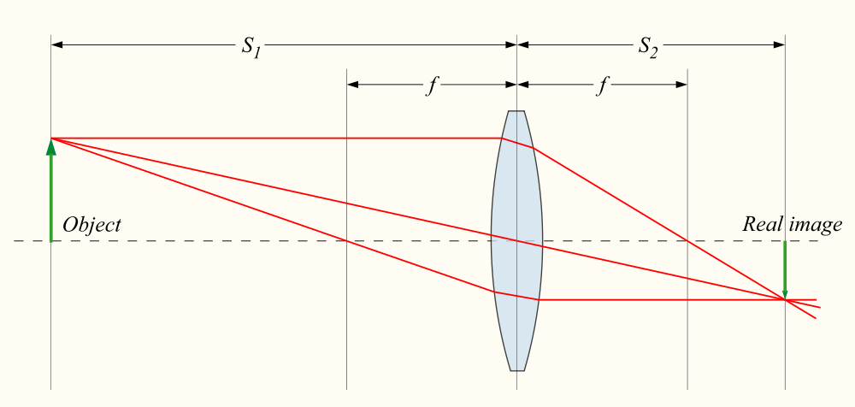
A Quick Review of Optics
Assuming
  Object is at distance S1
  The light from the object converges at distance S2
  Focal length is f
  (Note that the focus distance is S1)
Source: http://commons.wikimedia.org/wiki/File:Lens3.svg

Slide 17
How to compute S2 from S1 and f?
Facts:
  Horizontal rays toward the lens converge at distance f
  Object : image = S1 : S2 = (S1-f) : f
Thus, S2 = S1 * f / (S1-f)

Slide 18
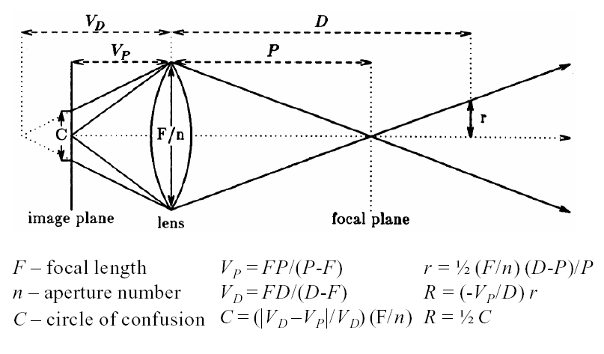
Depth of Field

Slide 19
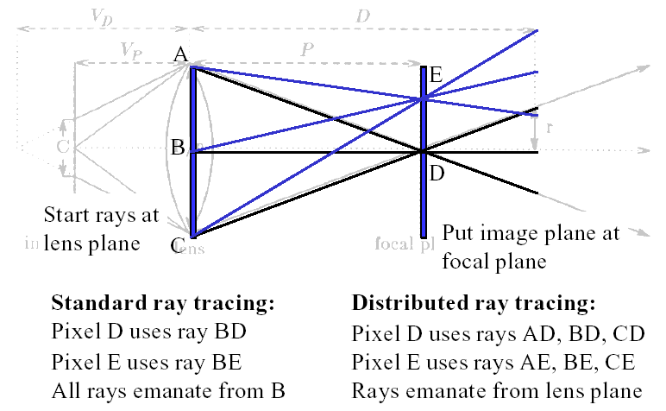
Depth of Field

Slide 20
Depth of Field -- Summary
Step 1: Determine the size of the lens.
Step 2: Place the image plane at the focal distance. (Remember that we can place the image plane at any distance?)
Now, the rays from A/B/C in the previous slide see the same point only if the object is at the focal distance!
But…How do we determine the size of the lens?

Slide 21
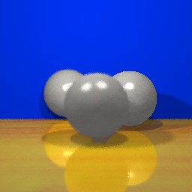

Depth of Field
F-Stop = 5.8
F-Stop = 2.8

Slide 22
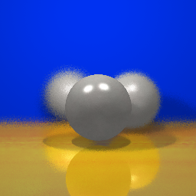
Depth of Field
Focal Distance = 13
Focal Distance = 11

Slide 23
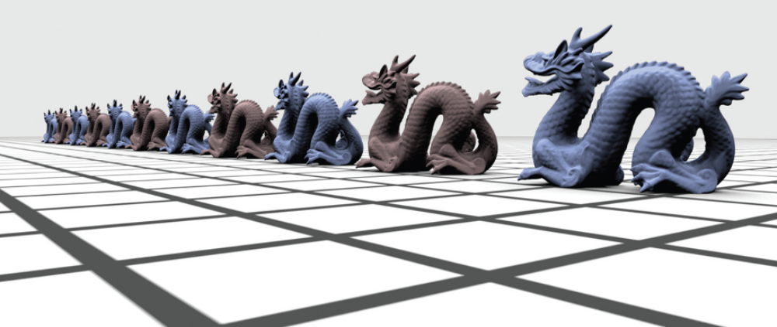
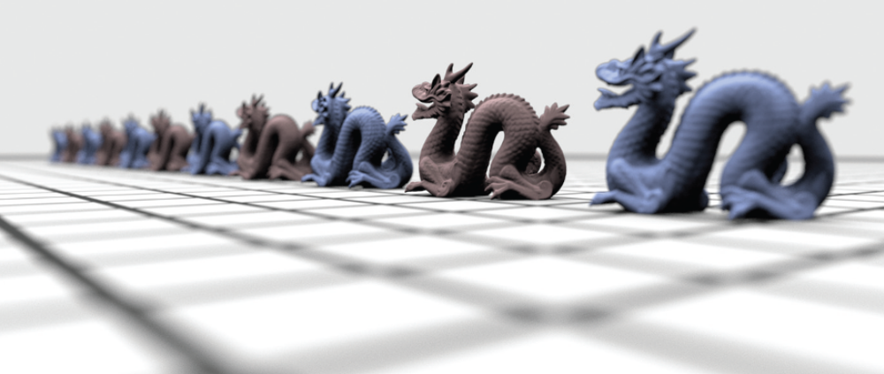

Slide 24
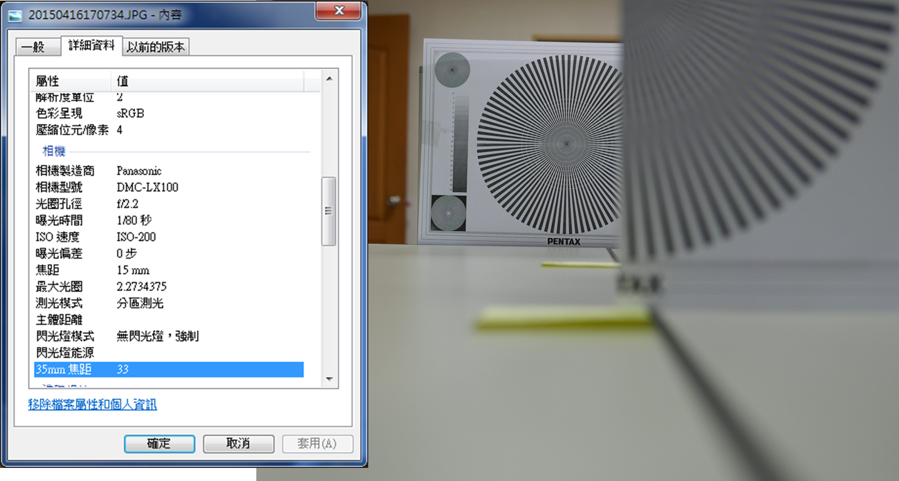
Exercise
Camera focal length is 15 mm (equivalent to 33 mm in 35mm SLR cameras).
CMOS sensor: 4/3 inch format
Aperture: f/2.2 (i.e. 15 mm/2.2)
Distance: front paper at 20cm, back paper (in focus) at 60 cm

Slide 26
Motion Blur
Sampling in time
Each element in the cell stands for a time slice
Jitter time slice to the current time
Move object via the current time slice
6 | 10 | 2 | 13
3 | 14 | 12 | 8
15 | 0 | 7 | 11
5 | 9 | 4 | 1
Current time = Time Slice + Jitter Time
e.g. time slice at left-upper = 6 + rand()

Slide 27
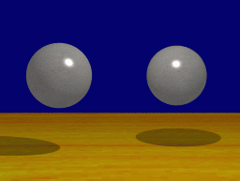
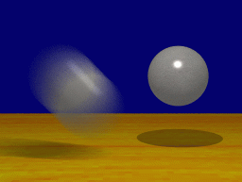
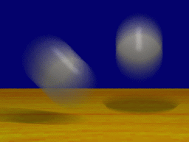
Motion Blur

Slide 28
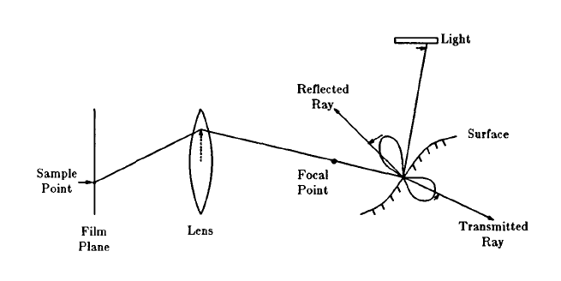
Typical Distributed Ray Path

Slide 29
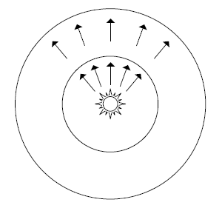
What Is Light Intensity?
The power of light source
  E.g., wattage of a light bulb.
  Flux (Φ) measured in watts (W) or joules/second
Does it change with distance?
  Another radiometric quantity needed here.
  Next slide: Irradiance (E)

Slide 30
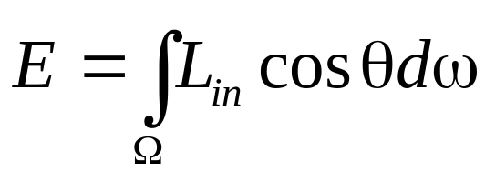
Radiance and Irradiance
Irradiance E
  Area density of flux.
  Measured in W/m²
  E = Φ / 4πr²
Radiance L
  Light energy density
  Measured in W/(sr-m²)
  Remains constant along rays
From Watt’s p.278

Slide 31
Further Reading
See Pharr’s 5.2 (1st Ed.) or 5.4.1 (2nd Ed.) for more detail.
Also discussed in “Computer Graphics: Principles and Practice” Section 26.7 (2nd Ed. By Hughes & van Dam et al.)

Slide 32
Sanity Check
Q1: What do you mean when you say light A is “brighter” than light B?
  Or the same light at rooms of different size?
  Radiance or irradiance
Q2: Does object A look brighter at a closer distance?
  Radiance or irradiance?
In short, irradiance is about the amount of the energy, but not necessarily what we perceived.
Notes:
Answer to Q1: Light power strength is flux. The light in a larger room feels dimmer because the irradiance is weaker. However, when we compute the reflectance from a surface in the room, we are computing the radiance, even though the irradiance on the surface depends on the light power and the distance. (This leads to the answer to Q2.)

Slide 33
Exercise on Direct Lighting
Q3: What is the f(x) for direct lighting?
Q4: What is the contribution of the light spheres? Does it change with the distance?
Notes:
Ans: Let’s assume the light sphere has radius r and its distance to the surface is d. The probability of the sample ray hits the sphere is proportional to r^2, but its intensity is 1/r^2. So the integral is the same (independent of r).
Now let’s look at d. When the r is fixed, whenever the sample ray hits the light sphere, its intensity should be the same. That means the radiance! (But the integral will decrease by 1/d^2.)

Slide 34
More Sanity Checks
Same object forms images at two cameras, one at 1M distance, one at 2M.
  How much flux hit a pixel at each camera?
  Does the pixel capture flux, irradiance, or radiance?

