Slide 1
Sparse Feature Circuits
Discovering and Editing Interpretable Causal Graphs
in Language Models
100
instead of
1,500
feature nodes
neurons
explain most of the agreement behavior of Pythia-70M
Samuel Marks, Can Rager, Eric J. Michaud, Yonatan Belinkov, David Bau, Aaron Mueller
Northeastern University, MIT, Technion. ICLR 2025, oral. arXiv 2403.19647.
Notes:
Today we are reading Sparse Feature Circuits, by Marks, Rager, Michaud, Belinkov, Bau and Mueller, accepted as an oral at ICLR 2025. The large number on the left is what I want you to hold in mind for the whole session: to explain most of Pythia-70M's verb agreement behavior, the paper needs about one hundred feature nodes, while doing the same job with neurons takes about one thousand five hundred. That fifteen-fold difference does not come from a better search algorithm, it comes from changing the unit of analysis. The whole session today is about why changing the unit matters that much, and what it lets you do afterwards.

Slide 2
Opening
You want to strip gender out of a classifier,
but the data never tells you it is wrong
01
The classifier is predicting from gender
A classifier reads a biography to predict a profession, and the signal it latches onto is gender.
02
Gender predicts the label 100% of the time
Training data holds only male professors and female nurses, so gender matches the label exactly.
03
No example says the signal is wrong
Every standard debiasing method needs data in which the spurious signal
predicts worse than the target signal. Here no such example exists.
The paper takes its disambiguating signal elsewhere: from a person who opens
the model, reads what is inside, and points at what should not be there.
02
Notes:
Before the method, I want to set out a concrete situation, because it is what this paper ultimately solves. Suppose you have a classifier that reads biographies to predict a profession, and you find it is predicting from gender rather than from the content of the job. You want to strip that signal out. The problem is on the second line: your training data holds only male professors and female nurses, so gender predicts the label one hundred percent of the time. The two signals coincide exactly. And this is where every standard debiasing method stops, because all of them need data in which the unwanted signal predicts worse than the target signal. There is not a single example that tells the model it is wrong. This paper takes its disambiguating signal from somewhere else entirely, written in the bottom box: from a person opening the model, reading what is inside, and pointing at what should not be there. For that to be possible, the inside of the model has to be readable, and that is why most of today is about the unit of analysis.

Slide 3
Part 1. The problem
Two earlier lines of work,
each breaking at a different point
01
Circuits over coarse components, 2022-2023
Induction heads (Olsson 2022), ROME (Meng 2022), IOI circuit (Wang 2023), ACDC (Conmy 2023).
Where it breaks. Heads and neurons are polysemantic, so labels put on them are unusable downstream.
02
Fine-grained units but supervised, 2018-2023
TCAV (Kim 2018), probing (Belinkov 2022), causal abstraction (Geiger 2023),
representation engineering (Zou 2023).
Where it breaks. Only works when you already know what to look for, so it misses unanticipated behavior.
Neither line explains many unanticipated behaviors at scale.
03
Notes:
To see what is new in this paper, you need the two lines of work that came before it. The first is circuits over coarse components: Olsson's induction heads in 2022, Meng's ROME the same year, Wang's IOI circuit in 2023, and Conmy's ACDC also in 2023. These works trace behavior to attention heads or MLP modules, and they do a good job of pointing out which parts take part. Where it breaks is that those parts are polysemantic: one head serves several different functions, so the label you attach to it is of no further use. You cannot switch off head seven to remove a bias, because that head also does other work. The second line goes the other way, using finer units but requiring supervision: Kim's TCAV in 2018, the probing literature Belinkov surveyed in 2022, Geiger's causal abstraction, Zou's representation engineering. This group fits the model's internals to a hypothesis stated by the researcher, on data written by the researcher, so it only runs when you already know what to look for. Put the two failures together and you get the line at the bottom: neither line explains many unanticipated behaviors at scale. Those are exactly the two conditions the paper sets for itself.

Slide 4
Part 1. The problem
The neurons with the largest causal effect
are harder to read than random neurons
The residual stream has d = 512 dimensions, more concepts than d
Sampling
Neuron
SAE feature
concept A
Random
32.6
52.8
concept B
neuron 7
Top-30 on agreement
30.2
62.3
polysemantic
concept C
Top-30 on Bias in Bios
36.0
81.5
Each basis direction takes contributions from several concepts, so it
fires on contexts that have nothing to do with each other.
Crowdworkers score 0-100 on the top-activating
contexts of each unit. Marks et al. 2024, App. F.
Elhage et al. 2022, Toy Models of Superposition
For features, the units that matter most causally are also easier to read; for neurons it is the reverse.
04
Notes:
Now I will explain why the neuron is not the right unit, because this underlies everything that follows. Look at the diagram on the left. Pythia-70M's residual stream has five hundred and twelve dimensions, but the model needs to represent far more concepts than that. Elhage and colleagues showed in 2022 that the network solves this by assigning each concept a direction in that space, and those directions are not orthogonal to each other. The consequence is on the arrow: each coordinate axis, that is each neuron, takes contributions from several concepts, so it fires on contexts that have nothing to do with each other. That is polysemanticity. The table on the right is the quantitative evidence. Crowdworkers rate interpretability on a scale from zero to one hundred. Random neurons get thirty-two point six, while random SAE features get fifty-two point eight, about twenty points more. But the more striking part is reading the table down the columns. For neurons, the ones with the largest causal effect on the agreement task score only thirty point two, which is harder to read than a random neuron. For features it is exactly the reverse: features inside the circuit score sixty-two point three on agreement and eighty-one point five on Bias in Bios. In other words, this is not a matter of not having tried hard enough. The unit of analysis is wrong.

Slide 5
Part 1. The problem
Two challenges to solve at once
01
Unit of analysis
Fine-grained yet interpretable. Neurons rarely are;
directions found by probing need a hypothesis up front.
02
Search cost
Pythia-70M has 6 layers × 4 submodules × 32,768 features × each token position.
Patching one node at a time is infeasible.
The paper's definition
“Neuron” means a basis-aligned direction in a hidden space, not necessarily one behind a nonlinearity.
05
Notes:
From there the paper states two challenges to be solved at once, and I stress at once. The first is the unit of analysis: fine-grained and still interpretable. Neurons are fine-grained but rarely interpretable, as we just saw, while directions found by probing are interpretable but need a hypothesis up front, so they are no use for behavior nobody has thought of. The second challenge is cost. Pythia-70M alone has six layers, four submodules per layer, thirty-two thousand seven hundred and sixty-eight features per submodule, multiplied again by each token position. Running patching separately for each node is infeasible. Solving one challenge without the other does not give you a method. A small note in the bottom box: when the paper says neuron, it means it broadly, as a basis-aligned direction in a hidden space, not necessarily one standing behind a nonlinearity. I mention it so that the later comparison between features and neurons is a fair one.

Slide 6
Part 1. The problem
Three lines matured at once,
SFC is where they meet
Circuit analysis
Zoom In 2020, Math Framework 2021, induction heads 2022, IOI 2023, ACDC 2023
Interpretable units
SFC
Toy Models of Superposition 2022, Towards Monosemanticity 2023, Gemma Scope 2024
03/2024
Gradient approximation
ICLR 2025, oral
Integrated Gradients 2017, attribution patching 2022, EAP 2023, AtP* 2024
Three preconditions met at once: SAEs good enough and public, attribution patching
shown accurate enough, and AI-safety demand for removing unwanted signals.
06
Notes:
Before the method I will spend a minute on context, because it answers why this paper appeared in March 2024 and not earlier. Three lines were running in parallel. Circuit analysis runs from Zoom In in 2020, through the Mathematical Framework in 2021, induction heads in 2022, IOI and ACDC in 2023. The interpretable-unit line runs from Toy Models of Superposition in 2022, through Towards Monosemanticity at the end of 2023, to Gemma Scope in 2024. The third line handles cost, from Integrated Gradients in 2017, attribution patching in 2022, EAP in 2023 and AtP star in 2024. Sparse Feature Circuits is where the three meet, and three preconditions did mature at the same time, as the bottom line records: SAEs had become good enough and public, attribution patching had been shown accurate enough, and there was AI-safety motivation for removing an unwanted signal when no disambiguating data exists. Without any one of the three, this paper could not have been written then.

Slide 7
Part 2. Method
An SAE splits an activation into
a sparse sum of learned directions
$$x=\overset{ˆ}{x}+ϵ\left(x\right)=\sum_{i=1}^{d_{SAE}}{f_{i}\left(x\right)v_{i}}+b+ϵ\left(x\right)$$
v_i
feature vector, unit column of W_D
b
bias
f_i(x)
activation level, nonnegative and sparse
ε(x)
what the SAE fails to reconstruct
Pythia-70M
Gemma-2-2B
SAEs trained by the authors, ReLU encoder plus L1 penalty
width 64 times d, i.e. 32,768 features
SAEs for embedding, attn, MLP, residual
Gemma Scope, JumpReLU encoder, width 16384
the release with L0 closest to 100
no embedding SAE, that one is only 4000-dimensional
Only 12 to 44% of the Pythia SAE features are alive; most are dead features.
07
Notes:
Now the first component of the solution, the sparse autoencoder. The formula in the middle says an activation x decomposes into three parts added together. Let me name each symbol first. v sub i is the feature vector, a column of the decoder matrix constrained to be a unit vector, so it is a direction. f sub i of x is that feature's activation level on this input, always nonnegative and forced to be sparse. b is the bias. And epsilon of x is what the SAE fails to reconstruct, called the SAE error. Read as a whole, the formula says the activation equals a weighted sum of learned directions, plus a bias, plus a residual. The two sets of SAEs used in the paper differ considerably. For Pythia-70M the authors trained their own, a ReLU encoder with an L1 penalty, width sixty-four times the model dimension, with SAEs for embedding, attention, MLP and residual stream. For Gemma-2-2B they use the existing Gemma Scope, a JumpReLU encoder, width sixteen thousand three hundred and eighty-four, choosing the release with L0 closest to one hundred, and no embedding SAE because that one has only four thousand dimensions. One number worth remembering on the last line, because it is a real limit of the tool: in the SAE set the group trained for Pythia, only twelve to forty-four percent of features are alive, and most of the rest are dead features.

Slide 8
Part 2. Method
Keeping ε as a node is where the paper
departs from earlier work
The usual way
The paper's way
Discard the residual, accept error that
compounds layer by layer. Clean circuit,
but not faithful.
Put ε in the graph as its own kind of
node, drawn as a triangle and labeled
by position.
ε(x) = x - x_hat
The cost. An error node is a 512- or 2,304-dimensional vector, unreadable.
What it buys. A large indirect effect on an error node is quantitative
evidence of how much the SAE is still missing.
Figure 3 measures it: dropping residual-stream error nodes breaks the model, while
dropping attn and MLP error nodes matters far less.
08
Notes:
This page is the paper's own design decision, and in my view the most substantial methodological contribution. When an SAE reconstructs an activation there is always error, and that residual is epsilon. The usual way, on the left, is to throw it away. The circuit then looks clean, but it is not faithful, and the error compounds layer by layer. The paper's way, on the right, is to put epsilon into the graph as its own kind of node, drawn as a triangle and labeled by its position. The trade-off is explicit. The cost is that an error node has five hundred and twelve or two thousand three hundred and four dimensions, unreadable and uninterpretable. What it buys is that a large indirect effect on an error node is quantitative evidence of how much the SAE is still missing. In other words, the paper turns the unexplained part into a measurable quantity instead of hiding it. And they do measure: Figure 3 shows that dropping residual-stream error nodes breaks the model, while dropping attention and MLP error nodes matters far less. The implication is that the residual stream still holds a great deal the SAE has not encoded, and the paper draws that as its own line on the plot rather than concealing it.

Slide 9
Part 2. Method
Indirect effect measures how much the model
changes when a node is forced to another value
$$IE\left(m;a;x_{clean},x_{patch}\right)=m\left(x_{clean}∣do\left(a=a_{patch}\right)\right)−m\left(x_{clean}\right)$$
The paper's example: x_clean is “The teacher”, x_patch is “The teachers”, and m is log p(are) minus log p(is).
do(·) is Pearl's intervention operator: force a to that value and cut every cause of a.
Patching
Zero-ablation
Mean-ablation
a := a_patch
a := 0
a := mean
Used when a contrast pair exists.
Section 3, subject-verb agreement.
Used when there is a single input.
Sections 4 and 5 of the paper.
Mean taken per token position,
used to measure faithfulness.
09
Notes:
The second component is how to measure a node's effect. The formula in the middle is the definition of indirect effect, imported unchanged from Pearl's causal mediation analysis of 2001. Read it like this: run the model on the clean input, then force node a to the value it takes on the contrast input, and take the difference of the metric between the two runs. The do notation is the intervention operator, and the important point is that it differs from conditioning: it says force a to this value and cut every cause of a. The paper's concrete example is on the line under the formula: the clean input is The teacher, the contrast input is The teachers, and the metric is log probability of are minus log probability of is. The three boxes at the bottom are three ways of disabling a node, and the paper uses all three in three different places. Patching, replacing with the value from another input, is used when a contrast pair exists, that is the subject-verb agreement section. Zero ablation, forcing to zero, is used when there is only one input, that is the SHIFT section and the large-scale section. Mean ablation, replacing with a mean computed per token position, is used to measure faithfulness. The reason for using the mean in faithfulness is that it represents the model's performance when it knows about the task but nothing about the specific input, whereas zero ablation would push the model off the data distribution.

Slide 10
Part 2. Method
Two forward passes and one backward
pass for every node at once
$${\hat{IE}}_{atp}={\left.∇_{a}m\right|}_{a=a_{clean}}⋅\left(a_{patch}−a_{clean}\right)$$
Exact patching
One forward pass per node. ACDC does this per edge, so cost scales with the edge count.
Attribution patching
Two forward passes plus one backward pass for all nodes at once, independent of node count.
First-order Taylor expansion of the indirect effect. Nanda 2022, Syed 2023, Kramár 2024.
The approximation holds only when m is near-linear around a_clean, so it fails for large differences.
10
Notes:
That definition is elegant but not runnable, because computed directly each node needs a forward pass. This page is how the paper makes it run. The formula is the first-order Taylor expansion of the indirect effect: take the gradient of the metric with respect to the node at the clean point, then multiply by the difference between the contrast value and the clean value. It originates in Nanda's 2022 blog post, with further analysis by Syed in 2023 and Kramar in 2024. The cost comparison is the point to stress. Exact patching costs one forward pass per node, and ACDC does exactly that per edge, so its cost scales with the number of edges. Attribution patching costs only two forward passes plus one backward pass for all nodes at once, independent of the number of nodes. That is the jump that makes scanning thirty-two thousand features times four submodules times six layers times each token position feasible. The last line is the condition for the approximation to hold, and it leads straight into the next page: a first-order expansion is only right when the metric is near-linear around the clean point, so it fails when the difference between the two values is large.

Slide 11
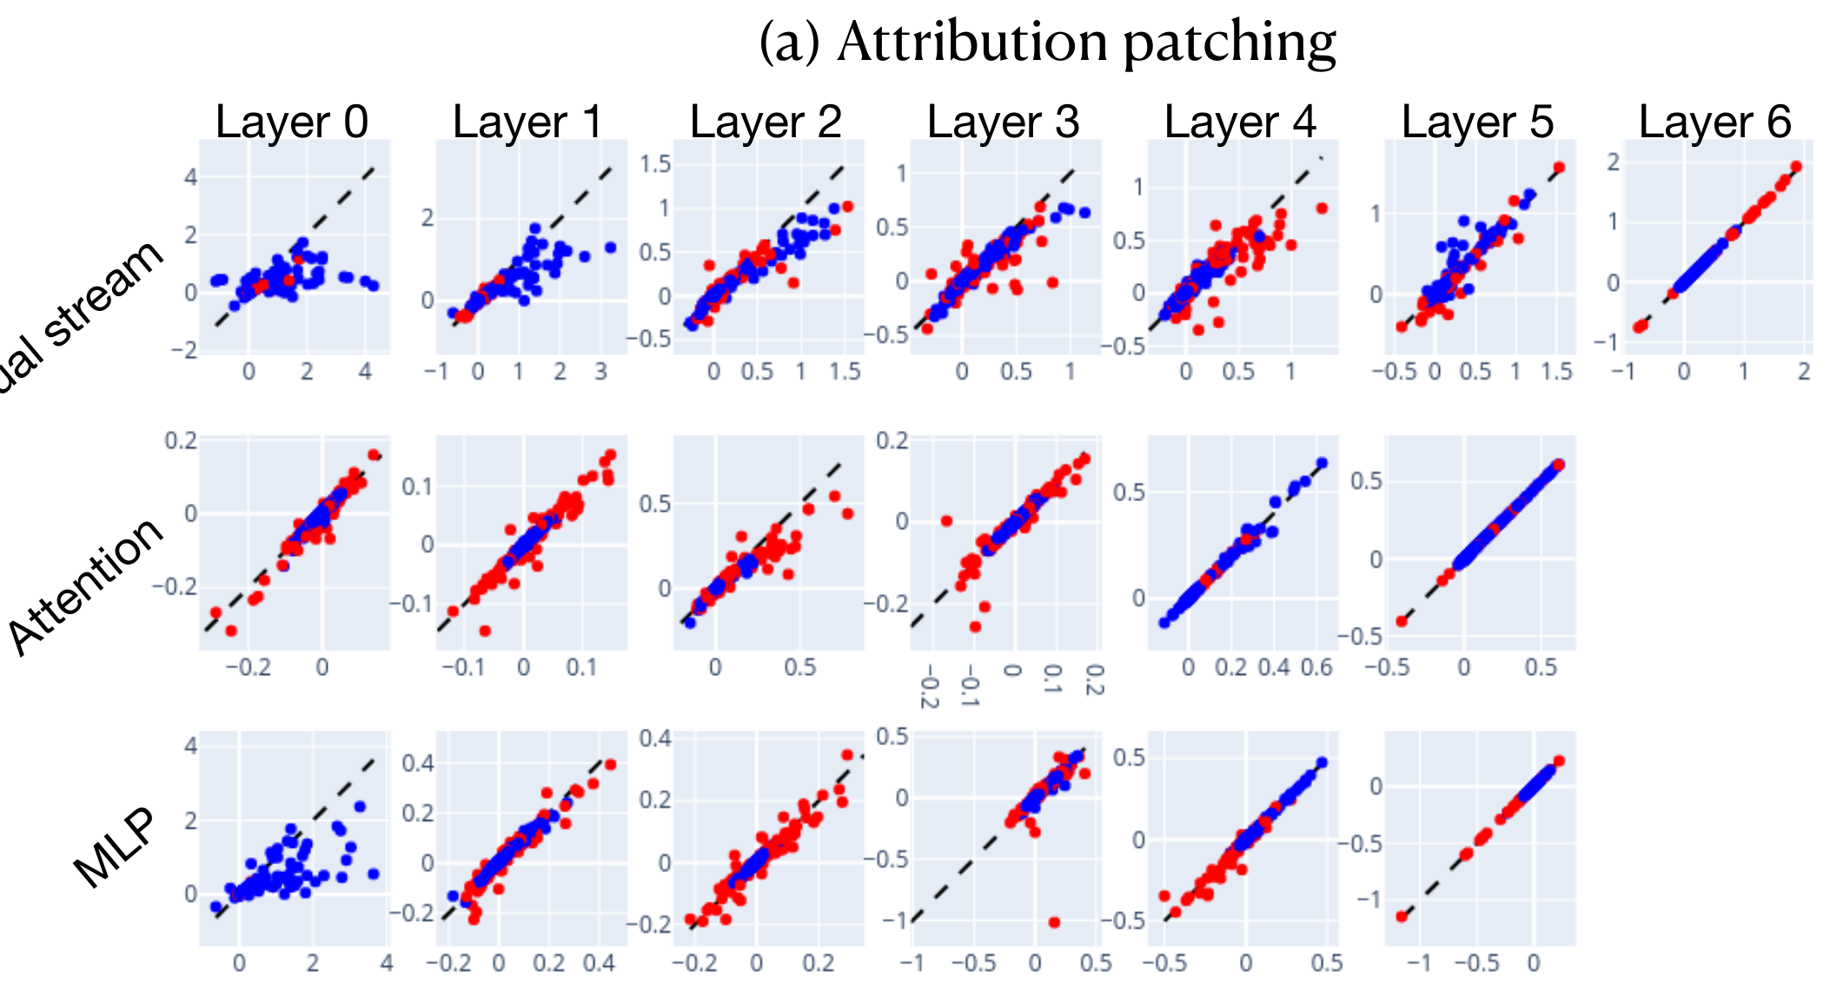
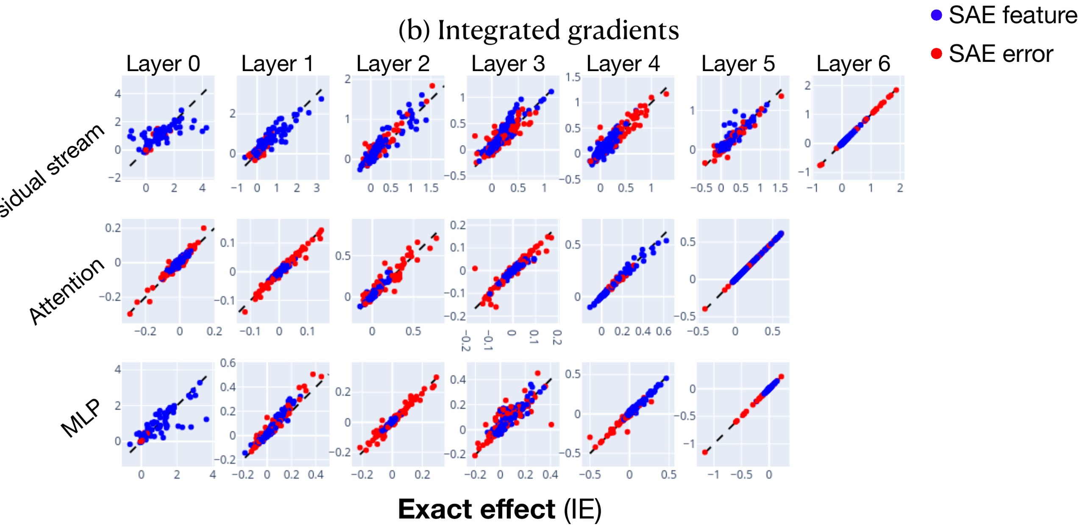
Part 2. Method
Attribution patching underestimates
at MLP layer 0 and early residual layers
Attribution patching
Integrated gradients
Layer 0 cell, residual stream row: points sit
well below the diagonal, under the true IE.
Same cell, points hug the diagonal. Averages the
gradient over 10 interpolation points, 10× the cost.
11
Notes:
What I like about this paper is that they do not assume the approximation holds, they measure it. These two plots are Figure 25, run on thirty inputs from the across relative clause set. How to read them: the horizontal axis is the true indirect effect, the vertical axis is the approximate value, each point is an SAE feature or an SAE error at one token position, and the diagonal is where the approximation matches exactly. Look at the left plot first, attribution patching. Most cells hug the diagonal fairly closely, but look at the cell I have circled, Layer 0 in the residual stream row. The points sit well below the diagonal, meaning the approximation underestimates the true value. The same happens in the MLP layer 0 row. Now look at the right plot, integrated gradients on exactly that data, and in that same cell the points are back on the diagonal. There is a clear reason it fails precisely there: the early layers are where activations vary most between different tokens, so the difference between contrast and clean values is largest, so the first-order expansion is worst. Integrated gradients averages the gradient over ten points along the interpolation path between the two values, so it avoids that trap. The cost is ten times higher, and the paper chooses to pay it, so every main experiment in the paper uses integrated gradients.

Slide 12
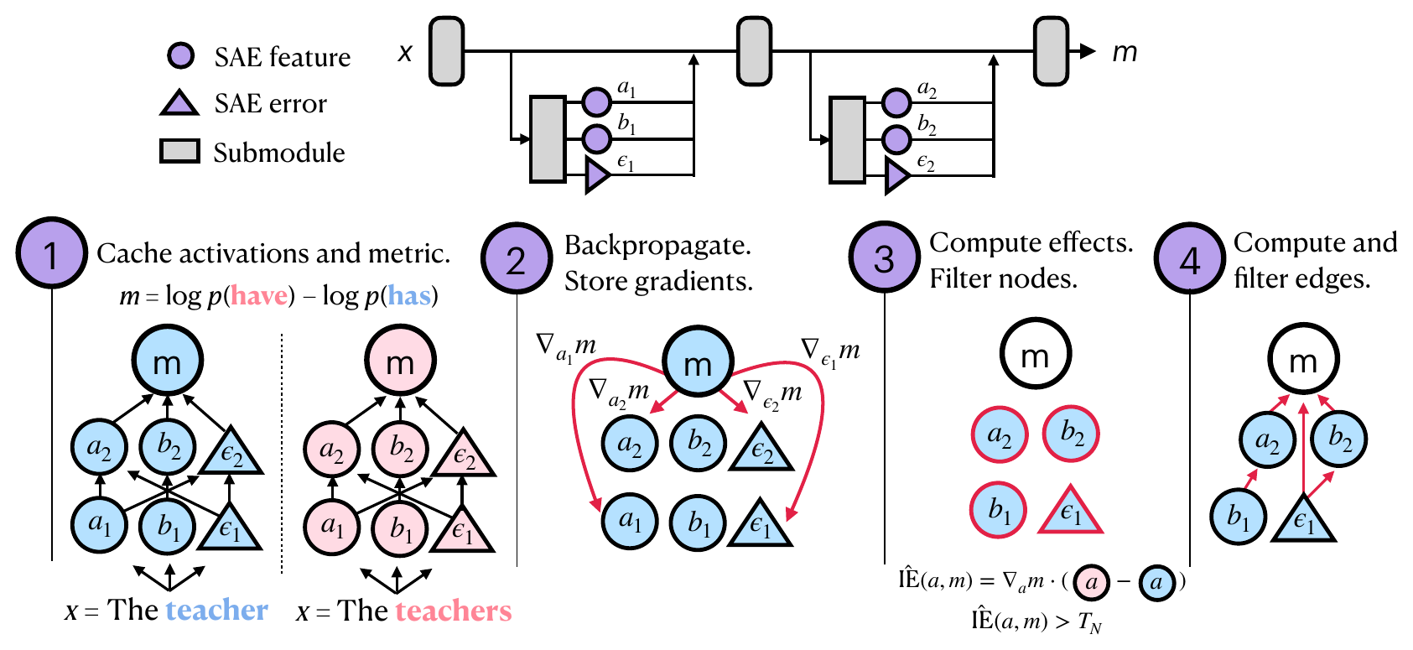
Part 2. Method
Four steps, and two filtering thresholds
1. Cache activations and metric
2. Backprop, store gradients
3. Node effects, filter by T_N
4. Edge effects, filter by T_E
An edge weight is the effect of u on m
through the direct path to d only, cutting
every detour through intermediate nodes.
Templatic data keeps token positions fixed;
non-templatic data sums effects across
positions before taking the mean.
Figure 2, Marks et al. 2024, page 4
The pipeline is tractable because step 2 costs one backward pass for all nodes.
12
Notes:
Now everything is assembled into a pipeline, and this is the paper's most important figure. Step one, run the model on both the clean and the contrast input, and cache every f and epsilon value at every submodule that has an SAE, along with the metric. Step two, backpropagate once and store the gradient of the metric with respect to each f and each epsilon. One backward pass for all of them, which is why this pipeline is runnable at all. Step three, compute the effect for each node, average over the dataset, then keep the nodes whose absolute value exceeds the threshold T sub N. Step four does the same for edges with threshold T sub E. Two details worth adding from the right column. First, an edge's weight is not the upstream node's total effect on the metric, but only the effect travelling the direct path to the downstream node, cutting every detour through intermediate nodes. Second, aggregation across token positions depends on the data: with templatic data, sentences sharing one template, they keep positions fixed and treat the same feature at two positions as two different nodes, while with non-templatic data they sum effects across positions first and only then average over examples.

Slide 13
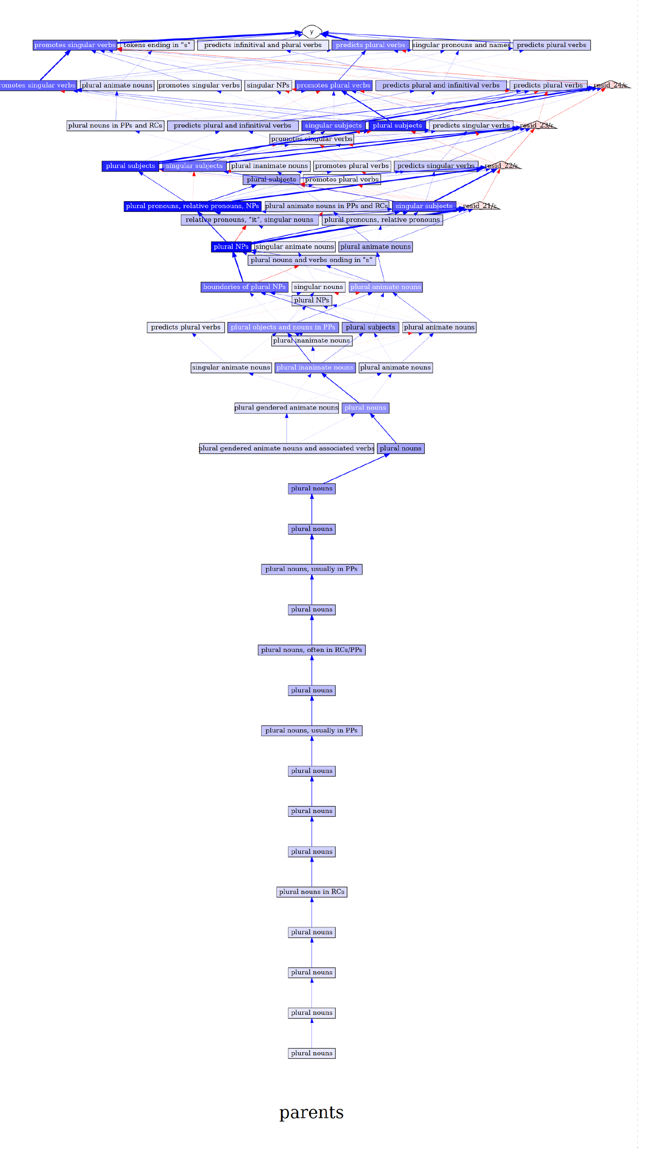
Part 2. Method
Three tricks that make autograd
see exactly what it needs to see
(a) Intervening in the forward pass. After computing f_i(x) and ε(x), reassign x. Numerically
x is unchanged, but the computation graph now holds f_i and ε as variables.
(b) Stop-gradient on ε. Computing ε directly as x minus x_hat makes the
gradient of f_i cancel entirely. Fixed with x_d = x_hat + stopgrad(x_u - x_hat).
(c) Pass-through gradient. The stop-gradient in (b) blocks gradient flowing back
to upstream nodes, so the paper intervenes in the backward pass to restore it.
(d) Jacobian-vector product. When d is an SAE error, the naive way costs O(d_model)
backward passes; a gradient identity brings it down to two.
T_N and T_E are tuned by hand until the circuit is small enough to annotate.
Full within-RC circuit of Gemma-2-2B,
with T_N = 0.5 and T_E = 0.05
13
Notes:
This page is easy to skip when reading the paper, but without it the method simply does not run. Trick a: after computing f and epsilon, they reassign x to that very sum. Numerically x does not change at all, but after the assignment PyTorch's computation graph contains f and epsilon as variables, so the backward pass generates gradients for them automatically. Trick b deals with a trap: if you compute epsilon directly as x minus x hat, then when you take the gradient with respect to f the two terms cancel and the gradient is exactly zero. They fix it by wrapping the residual in a stop gradient. Trick c repairs the consequence of b: the stop gradient blocks gradient from flowing back to upstream nodes, so they intervene in the backward pass to restore the right value. Trick d is a matter of performance: when the downstream node is an SAE error, computing the edge weight naively costs as many backward passes as the model has dimensions, but a gradient identity brings it down to two. The figure on the right is there so you can see what the pipeline's real output looks like: this is the full within relative clause circuit of Gemma-2-2B, with T sub N at zero point five and T sub E at zero point zero five. Nobody can read this by eye, and that is exactly why those two thresholds have to be tuned by hand until the circuit is small enough for a person to sit down and annotate.

Slide 14
Part 3. Subject-verb agreement
Four variants, each pair differing only
in the grammatical number of the subject
Structure
Example input
Metric
Simple
The parents
p(is) - p(are)
Within RC
The athlete that the managers
p(likes) - p(like)
Across RC
The athlete that the managers like
p(do) - p(does)
Across PP
The secretaries near the cars
p(has) - p(have)
Data adapted from Finlayson et al. 2021, which also found that models handle
simple agreement differently from agreement across relative and prepositional clauses.
14
Notes:
The first experiment tests the method on a well-studied task, verb agreement with the number of the subject. There are four variants, ordered by increasing syntactic difficulty. Simple is the easiest case, the subject stands right before the verb, and the metric is the difference in log probability between is and are. In within relative clause the verb sits inside the relative clause. In across relative clause the model has to carry the number of the main subject across an intervening relative clause. In across prepositional phrase it carries it across a prepositional phrase. The point to stress is that each input pair differs in exactly one thing, the grammatical number of the subject, so whatever effect is measured traces back to exactly that. The data is adapted from Finlayson and colleagues in 2021, which is also the work that found models handle simple agreement differently from agreement across relative and prepositional clauses. In a moment we will see this paper confirm that at the feature level.

Slide 15
Part 3. Subject-verb agreement
Three criteria, and one methodological
choice worth questioning
01
02
03
Interpretability
Faithfulness
Completeness
Crowdworkers score 0-100 on
the top-activating contexts
of each unit.
The share of model performance
the circuit explains. Ideally 1,
and it can exceed 1.
Measured by the faithfulness of
the complement M minus C. Ideally 0.
$$faithfulness\left(C\right)=\frac{m\left(C\right)−m\left(∅\right)}{m\left(M\right)−m\left(∅\right)}$$
The paper drops a third of the circuit at early layers when evaluating, because early components
bind to tokens that the train and test splits do not share. This choice is open to question.
15
Notes:
Once you have a circuit you have to answer whether it is any good, and the paper uses three criteria. The first is interpretability, measured by having crowdworkers rate from zero to one hundred the text passages that activate each unit most strongly, which is exactly the table we saw on page four. The second is faithfulness, and the formula in the middle says what it is: take the metric value when only the circuit is kept and everything outside it is mean-ablated, subtract the value when everything is ablated, and divide by the difference between the full model and everything ablated. In plain terms it is the share of the model's performance the circuit explains, ideally one. One detail worth knowing is that faithfulness can exceed one, if the circuit performs better than the full model, and that has been seen in other circuit papers. The third is completeness, measured by the faithfulness of the complement, what is left after the circuit is removed, ideally zero, meaning the remainder cannot do the task. The last line is something I think should be said plainly: when evaluating, the paper drops a third of the circuit at the early layers. Their stated reason is that early-layer components bind to specific tokens, and the train and test splits do not share tokens, so that part cannot be evaluated on held-out data. It is a defensible methodological choice but open to question, and the paper does not report faithfulness with the full circuit kept.

Slide 16
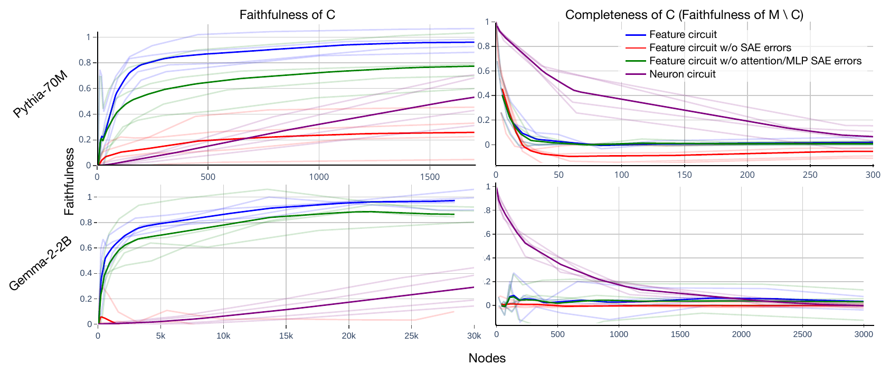
Part 3. Subject-verb agreement
100 nodes instead of 1,500 neurons
Pythia-70M
about 100 feature nodes
versus about 1,500 neurons
Gemma-2-2B
about 500 versus 50,000
a gap of about 100×
The red line drops all error nodes:
it collapses. Removing residual-stream
error nodes breaks the model.
Figure 3, Marks et al. 2024, page 5. Top row Pythia-70M, bottom row Gemma-2-2B.
Ablating a few nodes in the feature circuit wipes out task ability, even with every SAE
error node kept. With neurons it takes hundreds to thousands of nodes.
16
Notes:
This is the main result of the first experiment. The horizontal axis in all four panels is the number of nodes in the circuit, the vertical axis is faithfulness in the left column and completeness in the right, the top row is Pythia-70M and the bottom row Gemma-2-2B. Look at the blue line, the feature circuit, and the purple line, the neuron circuit. For Pythia the feature line is close to saturation at about one hundred nodes, while the neuron line needs about one thousand five hundred to reach the same level, a gap of about fifteen times. For Gemma the gap widens: about five hundred versus about fifty thousand, a factor of roughly one hundred. The completeness column on the right is also worth looking at: ablating just a few nodes in the feature circuit wipes out the ability to do the task, and that holds even with every SAE error node kept, whereas with neurons it takes hundreds to thousands of nodes. The paper raises a caveat about the comparison, and I think it is worth repeating: an SAE error node is a coarse, high-dimensional vector and is not directly comparable to one neuron. That is why they add two control lines, and the red line, the circuit with all error nodes removed, drops right down. That is again evidence for what was said on page eight: the residual stream holds a great deal the SAE has not yet encoded.

Slide 17
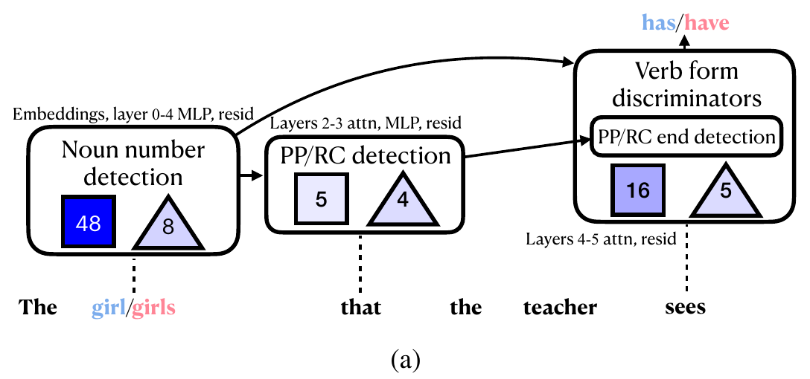
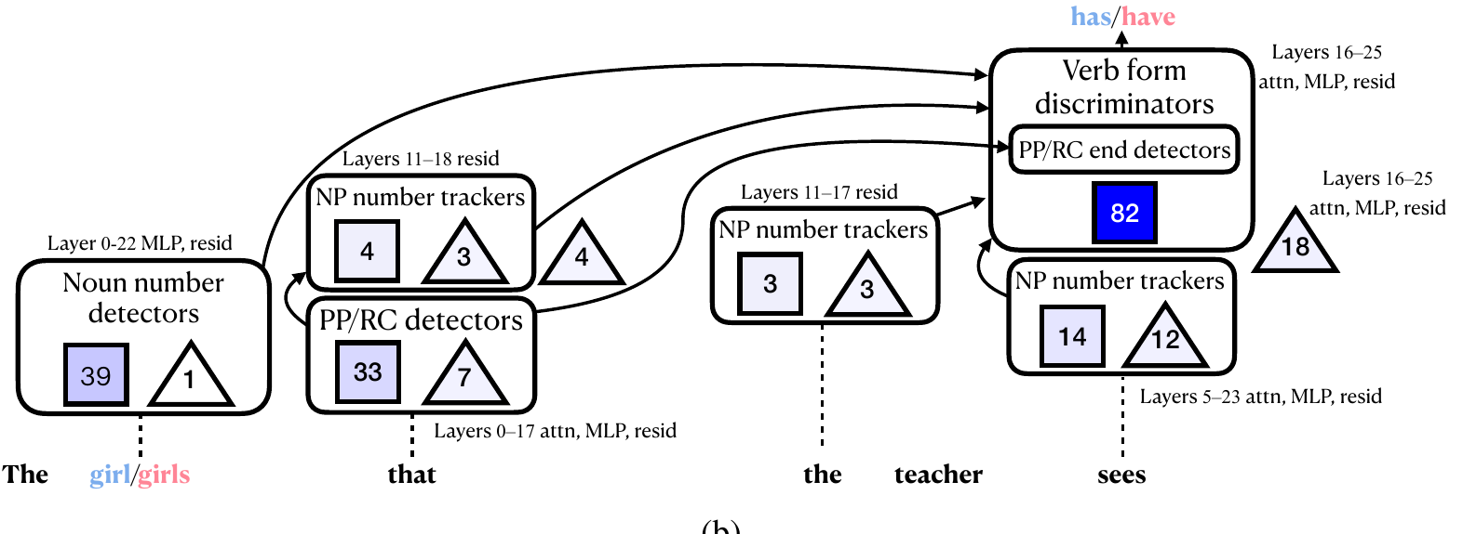
Part 3. Subject-verb agreement
Both models pick the verb form
through two parallel paths
Pythia-70M, 86 nodes, faithfulness 0.21
Gemma-2-2B, 223 nodes, faithfulness 0.21
Path 1: features detect the number of the main
subject and promote the matching verb form.
Path 2: number crosses PP/RC boundary detectors.
A third type, the NP number tracker: stays
active on every token until the noun phrase ends.
Example: feature resid 12/13561.
Across-RC and across-PP overlap heavily; simple and within-RC overlap much less.
17
Notes:
The numbers are convincing, but the real question is what the circuit can be read to say. These two figures summarize the across relative clause circuit, Pythia on the left with eighty-six nodes, Gemma on the right with two hundred and twenty-three, both at faithfulness zero point two one. The thresholds were chosen deliberately so the circuit is small enough for hand annotation while faithfulness stays above zero point two. How to read the figures: a square is the number of feature nodes in a group, a triangle the number of SAE error nodes, and the shading shows total indirect effect. What the algorithm reads out is two parallel paths, and both models use them. On the first path, features detect the number of the main subject and then directly promote the matching verb form. The second path starts in the same place but carries the number information to the end of the relative clause through a group of features that detect prepositional phrase or relative clause boundaries. Gemma has a third type that Pythia lacks, the NP number tracker: it detects the number of the head noun in a noun phrase and stays active on every token until that noun phrase ends, strongest at the last token. A concrete example is feature resid twelve slash thirteen thousand five hundred and sixty-one, and the nice part is that it does not fire on a singular distractor noun sitting inside a plural noun phrase. The last line confirms Finlayson again: across relative clause and across prepositional phrase overlap heavily, meaning the model handles two different syntactic structures with nearly the same mechanism, while simple and within relative clause overlap much less.

Slide 18
Part 4. SHIFT
The problem is that the signal is
unwanted, not that it predicts poorly
Disambiguating data
Data in which the unwanted signal predicts the label worse than the target signal does.
01
Class inputs come from different sources
Zech et al. 2018: a pneumonia detector learned the scanner signature of each hospital.
02
RLHF with easy-to-hard domain shift
“Approved by the supervisor” and “actually desirable behavior” predict the reward label equally well.
03
The reason in principle
What is wrong with the signal is that it is unwanted, not that it predicts poorly.
18
Notes:
Now to the part that in my view makes the paper valuable, because it turns a circuit from a picture into a tool. Back to the opening situation. The key notion in the top box is disambiguating data: data in which the unwanted signal predicts the label worse than the target signal does. Nearly every earlier method for spurious correlations needs it in some form. The paper gives three reasons that assumption can fail. First, the inputs of different classes may come from different data sources, and the classic example is Zech and colleagues in 2018, where a pneumonia detector turned out to be learning the X-ray scanner signature of each hospital. Second, in reinforcement learning from human feedback with an easy-to-hard shift, approved by the supervisor and actually desirable behavior predict the reward label equally well, so nothing disambiguates them. Third, and this is the reason in principle, what is wrong with an unwanted signal is that it is unwanted, not that it predicts poorly. That is the sentence I want you to keep, because it is why SHIFT has to find its disambiguating signal somewhere else entirely.

Slide 19
Part 4. SHIFT
Sparse Human-interpretable
Feature Trimming, four steps
01
02
03
04
Compute the feature circuit
that explains the classifier's
accuracy on D.
A human inspects each
feature in the circuit and
judges task relevance.
Ablate the features
judged irrelevant to
get C prime.
Optional: fine-tune C
prime on D itself to
recover performance.
Step 2 is the only place a human is needed, and where the disambiguating signal enters. Annotators
browse features on Neuronpedia, which uses extra unlabeled data, but adds no labeled
data beyond the ambiguous set.
19
Notes:
SHIFT stands for Sparse Human-interpretable Feature Trimming, and it has only four steps. Step one, use exactly the method from part two to compute a feature circuit, except this time the circuit explains the classifier's accuracy on the data, with the metric being the negative log probability the classifier assigns to the correct label. Step two, a person inspects each feature in the circuit and judges whether it is relevant to the task. Step three, ablate the features judged irrelevant, giving a new classifier. Step four is optional, fine-tuning that new classifier on the original data. The reason for step four is that step three removes the dependence on the unwanted signal but can also damage performance on the wanted signal, and step four restores it. The point to stress is in the bottom box: step two is the only place a human is needed, and also where the disambiguating signal enters. Annotators browse features through the Neuronpedia interface, so they do use additional unlabeled data, but no labeled data beyond the ambiguous set.

Slide 20
Part 4. SHIFT
Ambiguous set: male professors and female nurses
Ambiguous set
Balanced set
Only biographies of male professors
(label 0) and female nurses (label 1).
Gender predicts the label 100%.
Equal numbers of male professors, male
nurses, female professors, female nurses.
Used only to measure, never to build.
Using the ambiguous set alone, produce a profession classifier that works on the balanced set.
Classifier
Resulting circuit
Mean-pool the residual stream at one layer over non-
padding tokens, then train a linear head by logistic
regression. Pythia uses layer 4. Gemma has several
equally good layers, so this one choice uses the balanced
set to pick layer 22, where the baseline generalizes worst.
Pythia: 67 features, 55 ablated. Gemma: 46 features, 43 ablated.
Gemma Scope also has a BOS feature: it fires only on
the BOS token, large indirect effect but not
interpretable, so it is excluded from annotation,
from SHIFT and from the feature skyline.
20
Notes:
The experiment uses the Bias in Bios dataset from De Arteaga in 2019, professional biographies with profession as the target label and gender as the spuriously correlated label. The paper cuts out two subsets. The ambiguous set holds only biographies of male professors labeled zero and female nurses labeled one, so gender predicts the label one hundred percent of the time, the worst case that can be constructed. The balanced set has equal numbers of all four groups and may only be used for measurement, never to build the classifier. The rule in the middle of the page is what makes the problem hard: you may use only the ambiguous set, and you must produce a profession classifier that works on the balanced set. Technically, the classifier is built by averaging the residual stream at one layer over non-padding tokens and training a linear head by logistic regression. Pythia uses layer four, chosen by accuracy on the test split of the ambiguous set itself. For Gemma several layers perform equally well, so for this one choice they use the balanced set to pick layer twenty-two, the layer where the baseline generalizes worst and therefore leaves the most room to improve, and they state explicitly that they never tune hyperparameters on SHIFT's performance on the balanced set. The right column is the scale of the annotation work: Pythia's circuit has sixty-seven features and the annotator removed fifty-five, Gemma's has forty-six and forty-three were removed. With Gemma Scope there is one further snag, the BOS features, which fire only on the sentence-start token and have a large indirect effect but are not interpretable, so they are excluded from annotation, from SHIFT and from the feature skyline as well.

Slide 21
Part 4. SHIFT
Read the table as four comparisons
Accuracy on the balanced set. In the Gender columns, closer to 50 is better, since 50 means chance.
The four pairs: SHIFT+retrain vs Oracle, Random vs Original, SHIFT vs Feature skyline, Neuron skyline vs Original.
Method
Pythia Prof
Pythia Gender
Pythia Worst
Gemma Prof
Gemma Gender
Gemma Worst
Original
61.9
87.4
24.4
67.7
81.9
18.2
CBP
83.3
60.1
67.7
90.2
50.1
86.7
Random ablation
61.8
87.5
24.4
67.3
82.3
18.0
SHIFT
88.5
54.0
76.0
76.0
51.5
50.0
SHIFT + retrain
93.1
52.0
89.0
95.0
52.4
92.9
Neuron skyline
75.5
73.2
41.5
65.1
84.3
5.6
Feature skyline
88.5
54.3
62.9
80.8
53.7
56.7
Oracle
93.0
49.4
91.9
95.0
50.6
93.1
21
Notes:
This is the main results table, and I suggest you do not read it by rows. Read it as four comparisons. First, every number is measured on the balanced set, and in the Gender columns closer to fifty is better, because fifty means the classifier is guessing at random about gender. Comparison one, SHIFT plus retrain against Oracle: ninety-three point one versus ninety-three point zero on Pythia, and ninety-five point zero versus ninety-five point zero on Gemma. The Oracle is a classifier trained on the true labels of the balanced set, while SHIFT never sees a label outside the ambiguous set. The two numbers are equal. Comparison two, random ablation against original: sixty-one point eight versus sixty-one point nine. Ablating the same number of features but choosing them at random changes nothing. So the effect does not come from ablating, it comes from choosing the right thing to ablate. Comparison three, SHIFT against the feature skyline in Pythia's worst-group column: seventy-six point zero versus sixty-two point nine. The feature skyline is allowed to look at the balanced set to pick the features that most affect gender accuracy, while the annotator is not. The human wins. Comparison four, the neuron skyline in Gemma's worst-group column: five point six, while the original with nothing done is eighteen point two. Ablating neurons, even neurons chosen by looking at the answers, makes everything worse than doing nothing. One note on the CBP baseline: it is strong on Gemma with ninety point two and eighty-six point seven, but it needs to know the task in advance in order to write twenty keywords, while SHIFT does not.

Slide 22
Part 4. SHIFT
Same high causal effect,
one readable and one not
attn 3/22029
a neuron from the same task
Gerda Gilboe (5 July 1914 to 11 April 2009) was a
Danish actress and singer. She appeared in 18 films
between 1943 and 2003. Gilboe was born in 1914;
she was the daughter of a blacksmith.
endoftext endoftext endoftext endoftext 477 F
Dorsomedial hypothalamic lesions alter intake of an
imbalanced amino acid diet in rats.
OS 10. TiO2 nanotubes for bone regeneration.
Fires on female-associated words in biographies of
women, and promotes words like husband, née.
The annotator reads this and ablates it.
Fires at sentence starts and ends, more strongly on
tokens in sentences with capitals or digits. Nothing
says what it contributes to gender or profession.
With no basis for choosing which neurons to ablate, the paper drops neuron SHIFT. The neuron skyline
sees the balanced set and still loses: worst-group Gemma 5.6, below Original at 18.2.
22
Notes:
This page explains why comparison four turns out the way it does, and I think it is the strongest visual evidence in the paper. On the left is an SAE feature, attention layer three feature twenty-two thousand and twenty-nine, taken from the Bias in Bios task itself. The highlighted tokens are where it fires strongly, and you can see it at once: it fires on female-associated wording in biographies of women, and it also promotes words like husband and nee. Having read that, the annotator can conclude it contributes to the gender spurious correlation, and ablate it. On the right is a neuron, from the same task, also with a high causal effect. It fires at the starts and ends of sentences, and more strongly on tokens in sentences containing capitals or digits. You cannot infer what it contributes to classifying gender or profession. The consequence is on the last line: there is no basis for deciding which neurons to ablate, so the paper drops SHIFT with neurons entirely and substitutes the neuron skyline, which has the unfair advantage of seeing the balanced set. And it still loses, worse even than doing nothing. The reason the paper gives is that the neurons most involved in classifying gender are the same ones needed for classifying profession, so they cannot be separated.

Slide 23
Part 4. SHIFT
SHIFT is the only row that needs
none of the other three
Method
Group labels
Disambiguating data
Signal known in advance
Source of disambiguating signal
Group DRO (Sagawa 2020)
yes
yes
yes
group labels
JTT (Liu 2021)
no
yes
no
misclassified examples
DFR (Kirichenko 2023)
yes
yes
yes
balanced data
INLP and LEACE
yes
unclear
yes
concept labels
Data rebalancing
usually yes
yes
usually yes
data
CBP (Yan 2023)
no
no
yes
20 task keywords
SHIFT
no
no
no
human judgment
When gender predicts the label 100%, there is no wrong example to upweight and no group to balance.
23
Notes:
To show that SHIFT differs in kind rather than being somewhat better, I have put it beside the existing methods for spurious correlations. Sagawa's Group DRO optimizes the worst group's accuracy directly, so it needs group labels and disambiguating data. Liu's JTT does not need group labels, but it needs examples in the data where the spurious signal predicts wrongly so it can upweight them in a second round. Kirichenko's DFR retrains just the last layer on balanced data. INLP and LEACE erase a concept by projection, but need labels for the very attribute to be erased, and here projecting out the gender direction is also projecting out the profession direction, because the two labels coincide exactly. Rebalancing the data also needs data to rebalance with. CBP needs no disambiguating data, but requires twenty task keywords to be written, which means knowing the task in advance. SHIFT is the only row that needs none of the three, and its source of disambiguating signal is a person's judgment while reading features. Read the last column down and it is clear: every other method takes its disambiguating signal from data, SHIFT takes it from a human.

Slide 24
Part 5. At scale
Cluster first, find circuits after
01
Discovering behaviors by clustering
Corpus: a large subset of The Pile. Keep only context and answer-token pairs Pythia-70M predicts correctly and confidently,
cross-entropy below 0.1 or 0.3 nats depending on the experiment.
Drop induction examples: the bigram of last context token and answer token already appeared in that context.
The vector per example can be dense activations, sparse activations, dense IE, sparse IE, or parameter gradients.
02
Finding a circuit per subcorpus
For each subcorpus, run the zero-ablation variant of the Part 2 method; the metric is negative log probability of the answer token.
Spectral clustering on 8,192 examples; at 100,000 it switches to k-means on a 30,000-dimensional sparse random projection.
$${\overset{ˆ}{C}}_{ij}=1−\frac{\arccos\left(C_{ij}\right)}{π}$$
Cosine similarity becomes angular similarity so every entry lies between 0 and 1. Original idea: Michaud et al. 2023.
24
Notes:
The last part of the paper is the most ambitious, and all of it runs on Pythia-70M. The motivation is this: every earlier circuit work needed a human-written dataset to define the behavior to be explained, but a language model has countless behaviors nobody would think to write down. So they reverse the order: cluster first, find circuits after. Step one, the corpus is a large subset of The Pile, and they keep only those pairs of context and answer token that the model predicts correctly and confidently, with cross entropy below zero point one or zero point three nats depending on the experiment. They also deliberately drop induction examples, those where the bigram of the last context token and the answer token already appeared in that same context, because the model always gets very low loss on induction so it would swamp every other cluster. Each example is assigned a vector, and they try several options: dense activations, sparse activations, indirect effects of dense components, sparse indirect effects, and parameter gradients as Michaud did. Step two, for each cluster obtained, run the zero ablation variant of exactly the method from part two. Algorithmically they use spectral clustering on eight thousand one hundred and ninety-two examples, and the formula below is the normalization step: cosine similarity is converted to angular similarity so every entry lies between zero and one. Scaling to one hundred thousand examples makes spectral clustering infeasible, so they switch to k-means on a sparse random projection down to thirty thousand dimensions. The original idea for the whole of step one is due to Michaud and colleagues in 2023, and Eric Michaud is also a co-author of this paper.

Slide 25
Part 5. At scale
A cluster looks like one mechanism,
the circuit shows it is several
Cluster 382, increasing sequences
Cluster 475, “to” as infinitival complement
var input = [1, 2, 3, 4...
Step 1 / Step 2 / Step 3 / Step 4
At issue, whether the defendant should be allowed to
Direct the user to. It is up to you to. leads to
Succession feature. Chapter 1 to Chapter 2;
A, B, C; I, II, III, IV.
Path 1. Features promote “to” after words taking an
infinitival complement: allowed to, would like to, asked to.
Narrow induction feature. Recognizes the pattern A3 ... A and
copies information from token 3.
Path 2. Features fire on the object of a verb or
preposition, promoting “to” as object complement.
Together they predict A3 ... A continues with 4.
Two separate paths that do not fully intersect.
From “this is a behavioral cluster” to “this is the mechanism producing that behavior”.
25
Notes:
Two concrete examples, and both show the same thing. Cluster three hundred and eighty-two gathers cases of predicting the next number in an increasing sequence, such as an array declared one, two, three and then four, or the sequence Step one, Step two, Step three and then Step four. Looking at the cluster you would take it for a counting mechanism. But the circuit shows it is the union of two separate kinds of feature. The first is a succession feature, which handles succession in general: Chapter one to Chapter two, A to B to C, or Roman numerals. The second is a narrow induction feature, which recognizes the pattern A three then A and copies information from token three. Only the two together produce the prediction four. Cluster four hundred and seventy-five gathers cases of predicting the word to as an infinitival complement, and it also splits into two paths that do not fully intersect. The first is a feature that promotes to after words taking an infinitival complement, such as allowed to, would like to, asked to. The second is a different feature, firing on the object of a verb or preposition and promoting to in the object complement sense, as in Direct the user to, It is up to you to, or According to. The general lesson is on the last line: the cluster tells us this is a behavior, the circuit tells us which mechanism produces that behavior.

Slide 26
Part 5. At scale
Rediscovering induction and succession
01
Induction head
Olsson et al. 2022 found it at the attention-head level, using hand-written data.
This pipeline recovers it at the feature level, automatically.
02
Successor head
Gould et al. 2023 found it at the attention-head level. Here it reappears inside
cluster 382, with nobody writing data for it.
The paper's own admission
Evaluating these clusters and circuits is an open, unsolved problem.
Thousands of circuits are browsable at feature-circuits.xyz.
26
Notes:
The question is how to know this unsupervised pipeline gives the right result when there is no ground truth to compare against. The evidence the paper offers is that it rediscovers two known phenomena on its own. Induction heads were found by Olsson and colleagues in 2022 at the attention-head level, using data written for that purpose, and here they reappear at the feature level, fully automatically. Successor heads were found by Gould and colleagues in 2023, also at the attention-head level, and here they reappear inside cluster three hundred and eighty-two with nobody writing data for them. The scale is thousands of circuits, browsable at feature circuits dot xyz. But I want to close this part with the paper's own sentence, in the bottom box: evaluating these clusters and circuits is an open, unsolved problem. They claim no more than that, and I think that is honest writing.

Slide 27
Part 6. Assessment and the present
Four limitations, and the third one
predicted what came two years later
01
Depends on having SAEs available
Training SAEs costs a lot of compute, though only once per model.
02
What the SAE misses stays dark
Any component the SAE fails to capture stays uninterpretable after the method is applied.
03
Most of the evaluation is qualitative
Only the SHIFT section gives quantitative evidence that feature circuits help a downstream task.
04
Feature labeling is a qualitative process
Labels can differ between annotators and shift with the task at hand.
One limitation beyond Section 8: T_N and T_E are hand-tuned, with no objective criterion.
27
Notes:
Turning to the assessment, I start with the four limitations the authors themselves record in section eight. First, the method depends on SAEs being available for the model, and training SAEs costs a lot of compute, though only once per model. Second, any component the SAE fails to capture remains uninterpretable after the method is applied, so the method cannot repair the shortcomings of the tool it stands on. Third, and this is the limitation I want you to remember because it comes back shortly, most of the evaluation in the paper is qualitative, and only the SHIFT section gives quantitative evidence that feature circuits help a downstream task. Fourth, labeling features is a qualitative process, labels can differ between annotators and shift with the task at hand. I add one more limitation not in section eight but scattered through the appendices: the two thresholds T sub N and T sub E are tuned by hand to suit the purpose, with no objective criterion for choosing them.

Slide 28
Part 6. Assessment and the present
SAEs lost their central place, for reasons
that do not touch Parts 4 and 5
01
09/2024, feature absorption
For hierarchical concepts where A implies B, a “starts with S” latent fires on 95% of S-initial tokens
but stays silent on the other 5%. Changing width or sparsity does not fix it.
02
02 and 03/2025, SAEs lose to baselines on downstream tasks
Kantamneni et al. show SAEs do not beat logistic regression or prompting at sparse probing.
DeepMind measured linear probes at ~0.999 AUROC out of distribution, SAE probes clearly worse, and cut
SAE research priority. They still note SAEs are useful for exploratory debugging and spurious correlations.
03
05/2026, the benchmark itself is questioned
SCR and TPP in standard configurations fail several reliability tests and should not be used to evaluate SAEs.
Every negative result measures SAEs at acting on concepts already known,
not at discovering concepts nobody has named yet.
28
Notes:
This paper is one of the strongest applications of SAEs, so its fate is tied to the fate of SAEs, and over the past two years SAEs have drawn three rounds of criticism. Round one, September 2024, is feature absorption from Chanin and colleagues. For hierarchical concepts, where A implies B, the sparsity objective leads the SAE to learn one latent for A and one for B minus A to reduce redundancy. The concrete consequence is that a latent that looks like starts with S fires on ninety-five percent of tokens starting with S but stays arbitrarily silent on the other five percent. Their conclusion is that changing width or changing sparsity does not fix it. Round two, early 2025, is SAEs losing to baselines on downstream tasks. Kantamneni and colleagues show SAEs do not beat logistic regression or simple prompting at sparse probing in four difficult regimes. DeepMind's mech interp team measured linear probes at about zero point nine nine nine AUROC on out-of-distribution data while SAE probes lost clearly, and they announced they were deprioritizing foundational SAE research. But there is a nuance to keep, and I stress it because it bears directly on today's paper: that same team still records SAEs as useful for exploratory debugging of failures whose cause is unclear and for spotting spurious correlations in a dataset, which is exactly what parts four and five of this paper do. Round three, May 2026, is the benchmark itself being questioned, and I will go into that on the next page. The line at the bottom is the counterargument from a 2025 position paper: every negative result measures SAEs at acting on a concept that already has a name, not at discovering a concept nobody has named, and on the former a supervised baseline is naturally stronger.

Slide 29
Part 6. Assessment and the present
SHIFT became a benchmark, then that
benchmark was rejected, in two years
SHIFT
SCR and TPP
SAEBench
SCR rejected
2024, one application
inside the paper
11/2024, LLMs replace
human annotators
03/2025, community
standard benchmark
05/2026, not reliable
for evaluating SAEs
The benchmark descended from SHIFT is itself questioned
This is not a knock on the paper. It shows exactly what Section 8 Limitations said: evaluating dictionaries
and circuits without a clear downstream task is hard, and that problem is still unsolved.
29
Notes:
This page is the part I find most telling when reading the paper together with the two years after it. In 2024, SHIFT was just one application inside the paper. At the end of that year, Karvonen, Rager, Marks and Nanda turned SHIFT itself into an automated benchmark called SCR, by replacing the human annotator in step two with a language model, along with TPP extending it to multi-class datasets. Note that two of SHIFT's own authors did this themselves. In early 2025, SCR and TPP went into SAEBench and became the standard benchmark the community used to compare seven SAE architectures. Then in May 2026, an analysis concluded that SCR and TPP in their standard configurations fail several reliability tests and should not be used to evaluate SAEs. The arrow curving back at the bottom is that point: the benchmark descended from SHIFT is itself questioned. To be clear, this is not a knock on the paper. It illustrates exactly what section eight, Limitations, said: evaluating dictionaries and circuits without a clear downstream task is hard, and two years on that problem is still unsolved.

Slide 30
Part 6. Assessment and the present
Two successor directions
Dimension
Sparse Feature Circuits
Attribution Graphs
Date
03/2024, ICLR 2025 oral
27/03/2025
Model
Pythia-70M, Gemma-2-2B
Claude 3.5 Haiku
Unit
SAE feature, single layer
Cross-layer transcoder feature
Residual
error nodes have in- and out-edges
error nodes are input-only
Scope
averaged over a dataset
one specific prompt
Validation
faithfulness, completeness, SHIFT
perturbation experiments
Attention
SAEs for attention output
does not explain the QK-circuit
Anthropic's methods write-up does not cite Marks et al., so call this a successor in idea, not something built on SFC.
OpenAI 13/11/2025, weight-sparse transformers: force about 99.9% of weights to 0 to cut superposition at the source.
At the same pretraining loss, circuits are about 16× smaller. Trade-off: sparser means less capable.
30
Notes:
So where is the field going next. There are two different answers to the same problem. The first is Anthropic's attribution graphs, published at the end of March 2025 on Claude 3.5 Haiku. This table sets it against today's paper along seven dimensions, and three of them are worth discussing. On the unit, they replace a single layer's SAE with a cross-layer transcoder, a feature that reads the residual stream at one layer but writes into the output of every later MLP layer. On scope, an attribution graph explains one specific prompt, while today's paper explains average behavior over a whole dataset. On the treatment of the residual the difference is sharp: for them an error node is input-only, with no incoming edges, so you cannot trace back through it, while here an error node has both incoming and outgoing edges. One caution when presenting, on the line under the table: Anthropic's methods write-up does not cite Marks and colleagues in the part I could read, so call this a successor in idea rather than something built on it. The second direction reverses the approach entirely. OpenAI, in November 2025, trains the model with a sparsity constraint from the start, forcing about ninety-nine point nine percent of weights to zero, to cut superposition at the source instead of unpicking it afterwards. The result they report is that at the same pretraining loss, circuits in the sparse model are about sixteen times smaller than in a dense baseline. The trade-off is that sparser means less capable. In short, today's paper takes the model as it is and finds a way to read it, while this direction changes how the model is trained so that reading it is not so hard.

Slide 31
Closing
Three sentences worth keeping
01
The methodological contribution is not using SAEs or attribution patching; both already existed.
It is joining them and keeping the residual ε as a node, so the circuit is both readable and faithful.
02
The SHIFT section answers the hardest question in interpretability, what this circuit is good for,
with a number, 93.1 against Oracle 93.0, not with a pretty picture.
03
Two years on, SAEs have lost their central place, but the
problem SFC posed has not: how to remove an unwanted signal
from a model when the data never tells you it is wrong.
Discussion question: if step 2 of SHIFT is replaced by an LLM, and the reliability of that benchmark is
later questioned, how far does human judgment remain a valid source of disambiguating signal?
31
Notes:
I will close with three sentences. First, the paper's methodological contribution is not using SAEs, nor using attribution patching, since both already existed; it is joining the two and keeping the residual epsilon as a node in the graph, which makes the circuit both readable and faithful and turns the unexplained part into a measurable quantity. Second, the SHIFT section answers the hardest question in interpretability, what this circuit is finally good for, and the answer is a number, ninety-three point one against the Oracle's ninety-three point zero, not a pretty picture. Third, two years on, SAEs have lost their central place, but the problem this paper posed has not: how to remove an unwanted signal from a model when the data never tells you that signal is wrong. No other method answers that without disambiguating data. And the question I want to leave for discussion is at the bottom: if step two of SHIFT is replaced by a language model, and the reliability of that benchmark is later questioned, how far does human judgment remain a valid source of disambiguating signal.
If someone asks why such a small model as Pythia-70M, the answer is that part five needs circuit discovery run thousands of times over thousands of clusters, so a larger model was not affordable in 2024, and Pythia is a fully open suite with every checkpoint and all training data public; Gemma-2-2B is there precisely to answer this question, and in 2025 Kharlapenko and colleagues pushed it further to Gemma-1 2B and Gemma 9B. If someone asks whether faithfulness of only zero point two one means the circuit explains just twenty-one percent, answer yes, but that is the threshold they deliberately chose so the circuit stays small enough for hand annotation, and Figure 3 shows faithfulness rising much higher as nodes are added. If someone challenges dropping a third of the circuit at the early layers, answer that the paper's stated reason is that early-layer components bind to specific tokens that the train and test splits do not share, but say plainly that the paper does not report faithfulness with the full circuit kept, so it cannot be checked from the paper. If someone asks whether SHIFT scales when a person has to read sixty-seven features, answer that in its original form it does not, but that this exact problem was addressed by SCR in 2024, replacing the human with a language model, with the caveat that SCR's reliability was later questioned. If someone asks whether feature absorption breaks the circuit, answer that this is a real concern, since the human labels in step two may be wrong and the circuit may miss a path, but make clear it is a limitation of the underlying tool rather than a fault of the method, and the paper did not know about this problem at the time of writing. If someone asks why not use LEACE or INLP, answer that both need labels for the attribute to be erased, and in the ambiguous set the gender label coincides exactly with the profession label, so projecting out one direction projects out the other. If someone asks how SHIFT differs from simply prompting the model not to use gender, answer that SHIFT intervenes in the activations rather than relying on the model to comply, but also admit that naive prompting is a baseline that should have been included and the paper does not have it. If someone asks whether attribution graphs supersede this paper, answer that they head the same way in idea but differ in unit, in scope of one prompt versus one dataset, and in how the residual is handled. If someone asks what value this paper retains given how much SAEs are criticized, answer that every negative result measures SAEs at acting on known concepts, while what this paper does differently is discover unknown ones. If someone asks how the two thresholds are chosen, answer that they are tuned by hand to suit the purpose, and that this is an arbitrary hyperparameter with no objective criterion. And if someone asks what a BOS feature is, answer that these are features firing only on the sentence-start token, with large indirect effect but no interpretation, so they are excluded from the analysis, and that is a region of the model left outside.

