Slide 1
Scheducation
An app to organize your chaotic college life

Slide 2
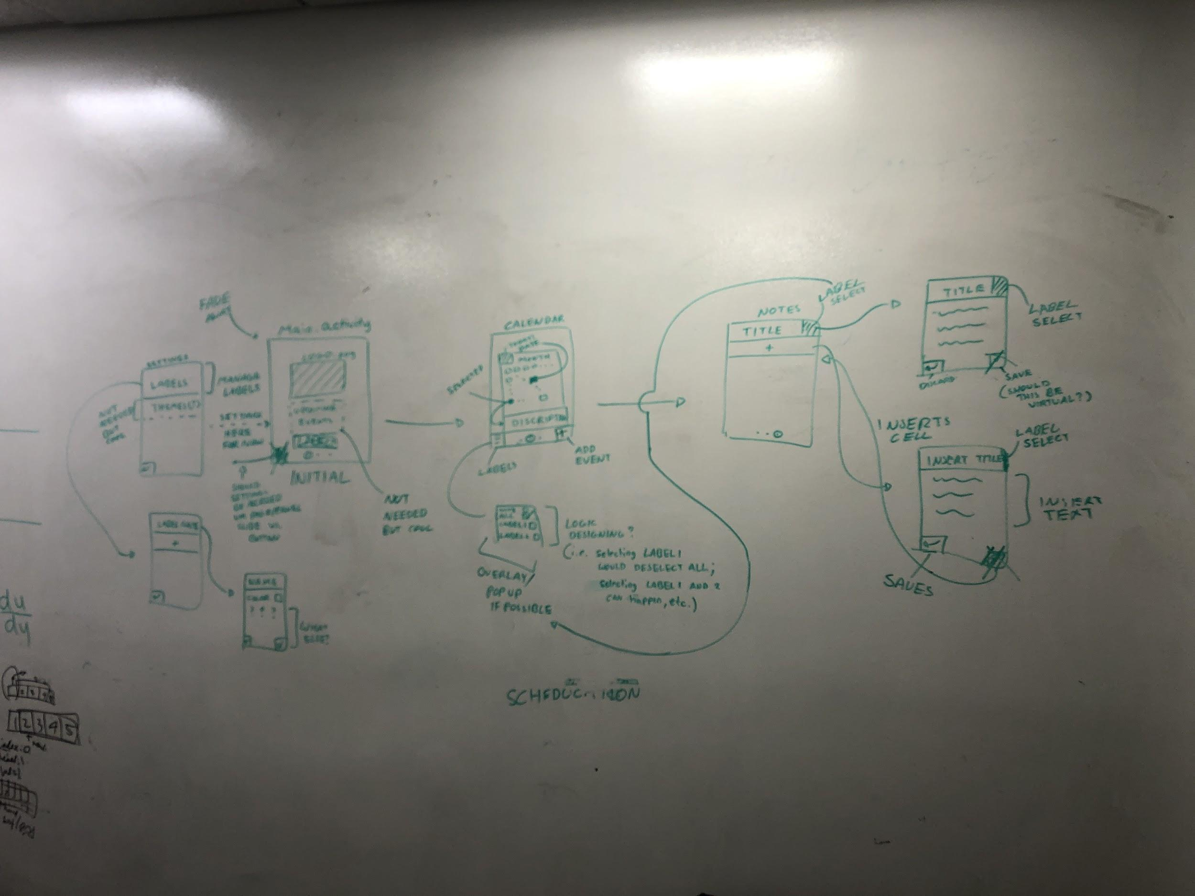
Main Screens

Slide 3


Main Menu
Shows the logo from the app
Gives access to settings for the app
Accessed by swiping left on Calendar screen
No events selected
What’s New!

Slide 4
Settings
Labels
Mainly for managing Labels used for organizing events
Labels can have names and different colors
Labels can be used across the entire app
EC327
EK301
PY212
Chores

Slide 5
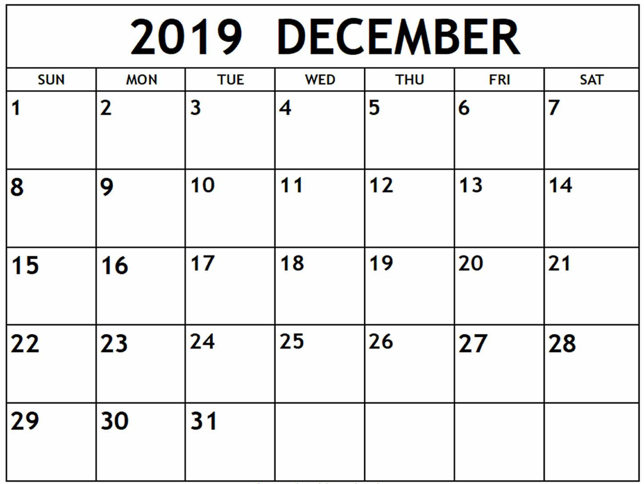
Calendar
Shows the current date at the top left
Shows a description for the current selected event under the calendar
Accessed by swiping right on Main Menu screen or swiping left on Notes screen
No Event Selected

Slide 6
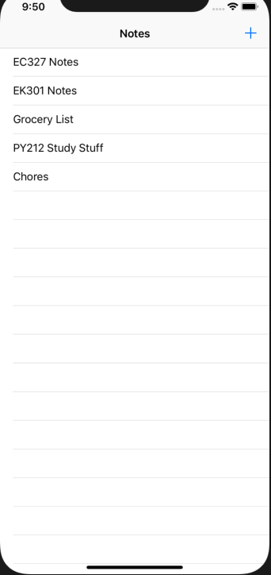
Notes
Can make multiple notes with designated titles
Press the arrow to create new notes
Menu accessed by swiping right from the Calendar screen

