Slide 1


Poject Presentation
Chen Jia
August , 2021

Slide 2
Requirement of presentation
Presentation
- Slides - 10
- Features of project - 20
- How you have implemented it? - 10
- Any troubleshooting or debug steps if you have performed? - 10
- Closing - 10
- Q/A - 40 (4 or more questions)

Slide 3
Project Requirement
It allows users to open new accounts
Users can make transactions by entering the respective amounts
Deposit Amount
Withdraw Amount
Balance Enquiry
Admin can view a list of users to see how many users there are along with their details
All account holder list with details
Modify Account
Close Account

Slide 4
Business process design

Slide 5
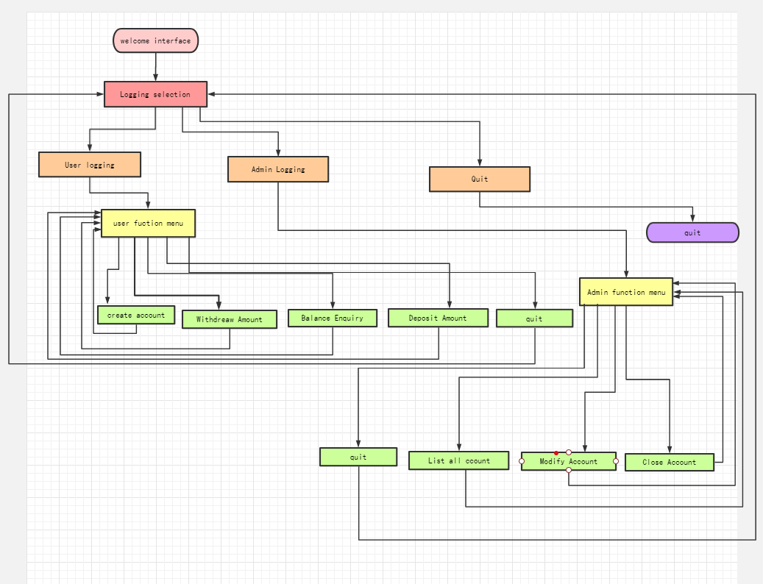

Slide 6
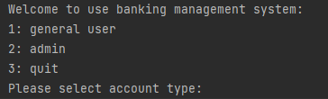
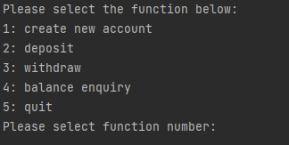
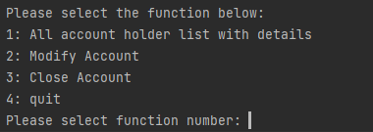
User interface design
1:general user
2:admin

Slide 7
Data structure and storage design
account_info_list
account_info_list
Adopt object-oriented design
Account_info_list =[ account_info object1, accont_info object2, ……….]
Data storage
Save to file – account_info.data

Slide 8
Solution architecture design
Adopt object-oriented design
Role analysis (One role one class)
Class -Account_info
Class --BankingManageSystem_User(Parent class)
Class --BankingManageSystem_Admin (Derived from BankingManageSystem_User)

Slide 9
Create program file
Create folder: BankingManageSystem
Create program file:
Program entry file: main.py
Account information file: account_info.py
Management system for user file: bankingManageSystem_user.py
Management system for Admin file:bankingManageSystem_admin.py

Slide 10
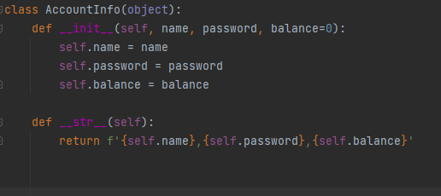
Class account_info

Slide 11
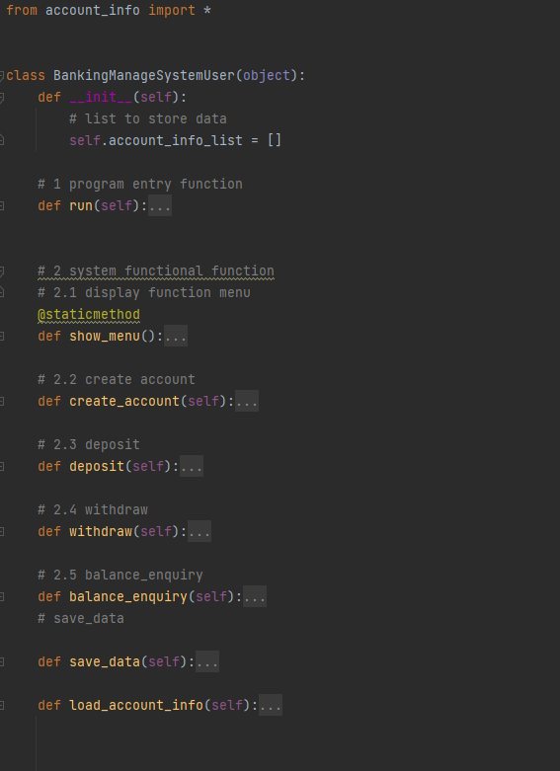
Class bankingMangeSystem_User

Slide 12
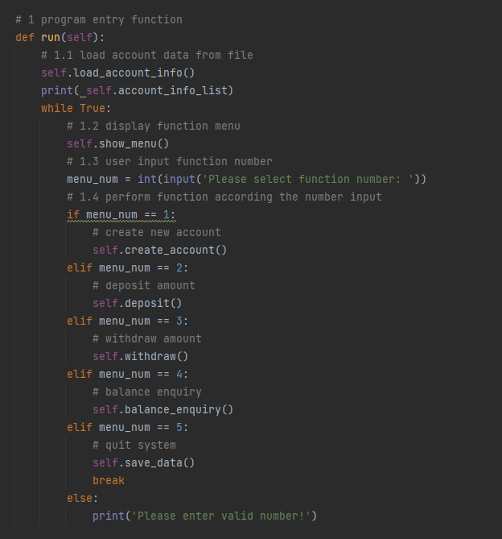
Class bankingMangeSystem_User

Slide 13
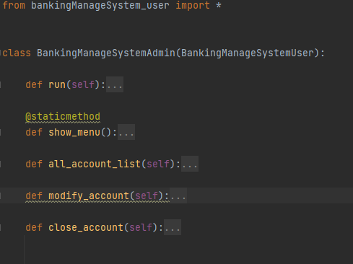
Class bankingMangeSystem_Admin

Slide 14
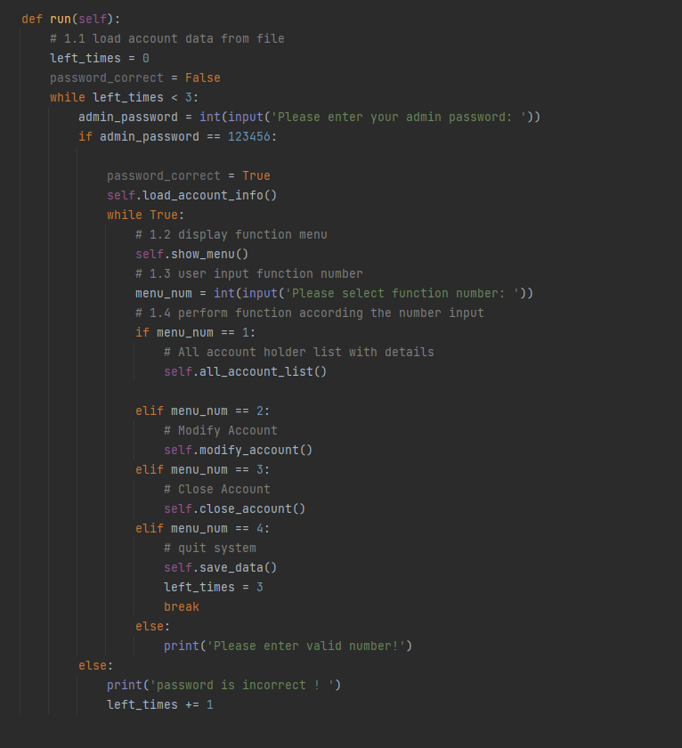
Class bankingMangeSystem_Admin

Slide 15
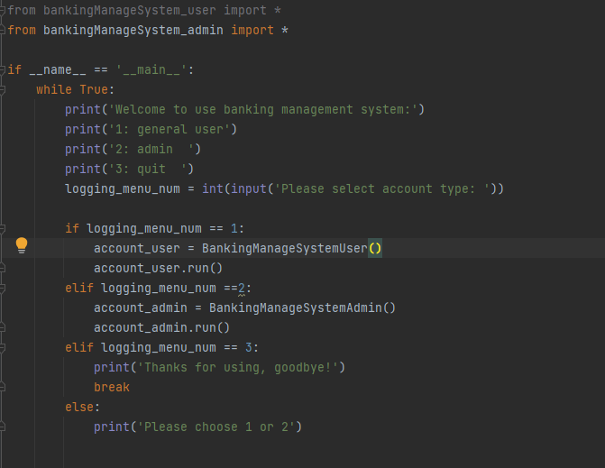
Program entry file- main.py

Slide 16
troubleshooting or debug steps
technologies and difficulties
Save data to file
Load data to file
Debugging methods and techniques

Slide 17
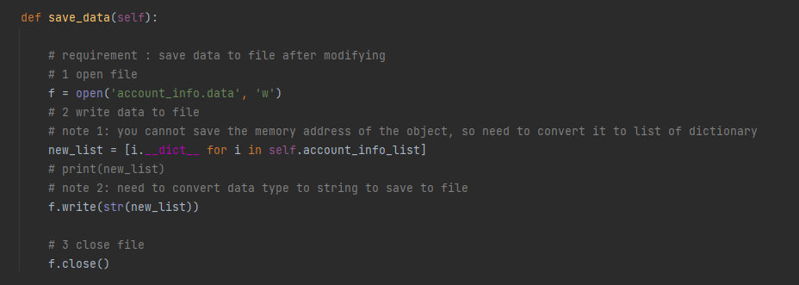
Key technologies and difficulties --Save data to file- __dict__ function
List comprehension

Slide 18
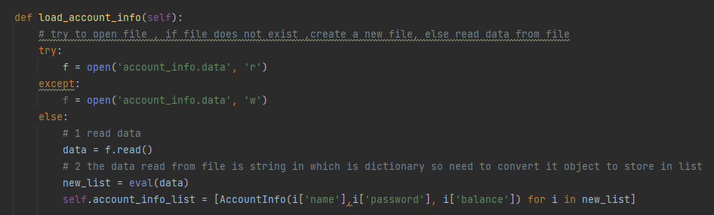
Key technologies and difficulties --Load data from file
List comprehension

Slide 19
troubleshooting or debug steps
Step1
class function architecture create and debugging
Step2
Write and debug each function
Step3
Overall debugging

Slide 20
Future improvements and optimizations
GUI optimization
Using web programming technology –Flask or Gjango
Data storage
Using database
Function improvement
The admin password need to be set through the configuration file
Display historical transaction details

Slide 21

Thank you !
Questions ？

