Slide 1

Introduction to ExecuComp

Slide 2
Learning Objectives
Upon completing this assignment, students will:
Become familiar with Compustat’s ExecuComp dataset
Execute a query and download ExecuComp data to Excel

Slide 3
Executive Compensation
According to the Center on Executive Compensation there are typically six components that make up executive compensation: salary, annual incentives (bonuses), long-term incentives, benefits, perquisites, and severance agreements.
What makes executive compensation unique is the role of both short and long-term incentives for positive performance. In other words, a significant portion of an executive’s compensation can be contingent upon meeting company performance goals.

Slide 4
What Data is in ExecuComp?
Compustat ExecuComp from S&P contains extensive information about executive compensation.
This compensation data includes:
Salary
Bonus
Options
Stock awards
Non-equity incentive plans
Pensions
Other non-salary compensation

Slide 5
What Companies are in ExecuComp?
Almost entirely made up of U.S. companies, ExecuComp contains over 3460 firms, including:
S&P 1500
+
Companies that were once part of the S&P 1500
+
Companies removed from the index, but still trading
+
Additional companies included specifically due to client request

Slide 6
What Companies are in ExecuComp? (cont.)
ExecuComp only began including the full S&P 1500 in 1994. In 1992-1993, the data was primarily comprised of the S&P 500.
S&P 1500
S&P 500
1992
1993
1994

Slide 7
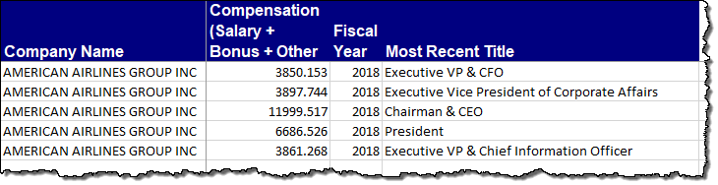
How Many Executives per Company?
Data can be reported for up to nine executives per company each year.
However, as in this example from American Airlines, most companies only report data on five executives.

Slide 8
Who are the Executives in ExecuComp?
Titles can vary widely. In general, the top five executives whose compensation is reported include:
The company’s executive officer (CEO) and principal financial officer (CFO), or anyone acting in those capacities at any time during the fiscal year, regardless of compensation level.
The company’s three highest paid executive officers, other than the CEO and CFO.

Slide 9
Where Does the Data Come From?
Data comes from the SEC.
Specifically, the data comes from the company’s “definitive proxy statement“ known as DEF 14A, which is filed by the company 120 days after the company’s fiscal year ends.
SEC Form DEF 14A
- Items up for shareholder vote are listed, including re-election of directors and approval of executive compensation.
- Includes executives’ and directors’ compensation.

Slide 10
Defining Fiscal Year in ExecuComp
When a firm has a fiscal year ending in the months of January through May, ExecuComp assigns the fiscal year as one year less than the year in which the company’s fiscal year ends.
For example, for a fiscal year ending May 31st 2019, the fiscal year assigned would be 2018.
Therefore, in ExecuComp, FY2019 data would include only the companies whose fiscal year ended anytime from June 1, 2019 through May 31, 2020.

Slide 11
How is the Data Organized?
Since 2006, ExecuComp data has been organized into six main categories:
Annual Compensation
Outstanding Equity Awards
Pension Benefits
Deferred Compensation
Plan Based Awards
Director Compensation

Slide 12
How is the Data Organized? (cont.)
In 2006, SEC guidelines changed, affecting the definitions of executive pay in proxy statements.
From 2006 onward, the cost of all employee stock options, as well as other equity-based compensation arrangements, had to be reported in the company’s financial statements based on an estimated fair value of the awards.
These 2006 changes can make it difficult to compare post-2006 ExecuComp data to data collected in previous years; however, the main compensation data points have continuity.

Slide 13
How is the Data Organized? (cont.)
In addition to the six main categories of data since 2006, ExecuComp also provides compensation data under the old reporting rules for those who are researching historical compensation trends.
The following three sections of ExecuComp contain data using the 1992 format, prior to the adoption of the new FASB 158 standard:
Company Financial and Director Compensation for 2005 and Prior
Long Term Incentive Awards – 1992 Format
Stock Options Grants – 1992 Format

Slide 14
Main Types of Data
Annual Compensation: yearly data summarizing executive financial compensation. This summary is typically the most commonly used data in ExecuComp.
One frequently used variable is “Total Compensation Including Option Grants” (TDC1) comprised of salary, bonus, total value of restricted stock granted, total value of stock options granted (using Black-Scholes¹ method for valuation), and long term incentive payouts.
¹A detailed description of the modified Black-Scholes methodology is in the WRDS ExecuComp documentation.

Slide 15
Main Types of Data (cont.)
Pension Benefits: data about executive pensions, including total pension payments that have been made in a specific year, the discounted value of the pension assets and the number of years that a specific executive has contributed to a pension plan.
Plan Based Awards: similar to Pension Benefits, but providing more detailed information on rewards other than pensions, such as options and stock grants awarded during the fiscal year.

Slide 16
Main Types of Data (cont.)
Outstanding Equity Awards: detailed information about outstanding option and restricted stock awards.
Deferred Compensation: compensation that is deferred until a later date, primarily for tax purposes. Information about deferred compensation plans includes contribution information and individual plan balances.

Slide 17
Main Types of Data (cont.)
Director Compensation: similar to Annual Compensation, except that this category only provides data on directors (instead of also including other executives).
In general, when compared to Annual Compensation, less data is available in this category. However you can use Director Compensation to find the total compensation as reported in SEC filings for each director, as well as a breakdown of cash fees and other types of compensation.

Slide 18
Assignment Instructions
Find the total compensation (including option grants) for all CEOs in the ExecuComp database for fiscal year 2018.
In addition to total compensation, your results should include the company name and the CEO’s full name.
Download this information to Excel.

Slide 19
Link to Assignment
From the WRDS main menu, go to Get Data > Compustat - Capital IQ > ExecuComp > Annual Compensation.
Or, use the link below to directly access ExecuComp Annual Compensation:
https://wrds-www.wharton.upenn.edu/pages/get-data/compustat-capital-iq-standard-poors/compustat/execucomp/annual-compensation/

Slide 20
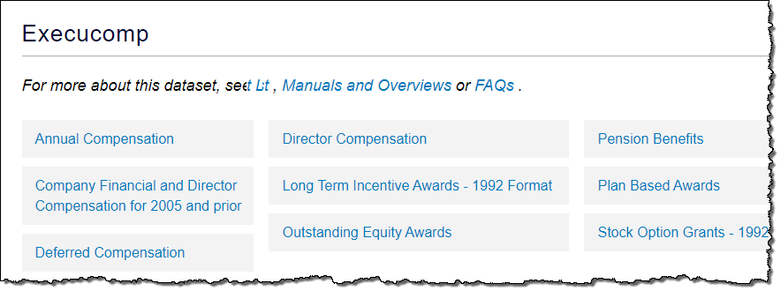
Assignment Instructions
From the ExecuComp screen, click on Annual Compensation.

Slide 21
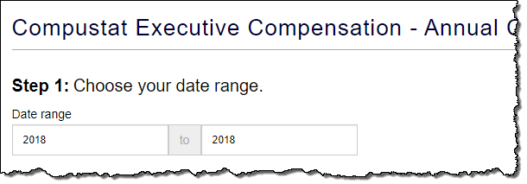
Assignment Instructions (cont.)
Enter 2018 as both the start and end of the Date range.

Slide 22
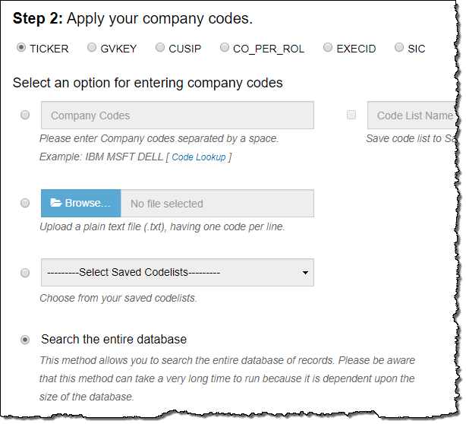
Assignment Instructions (cont.)
Recall, you are searching for all CEOs in the database, rather than a particular company’s CEO. Therefore, leave the Company Codes field blank.
Select Search the entire database.

Slide 23
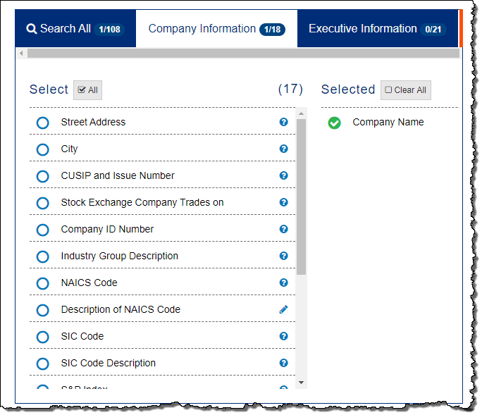
Assignment Instructions (cont.)
In the Query Variables window, click the Company Information tab.
Select the Company Name variable.

Slide 24
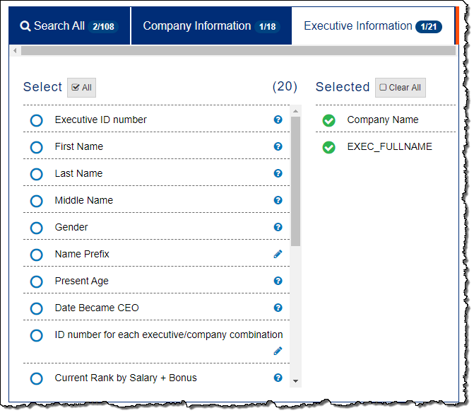
Assignment Instructions (cont.)
Click the Executive Information tab.
Select the EXEC_FULLNAME variable.

Slide 25
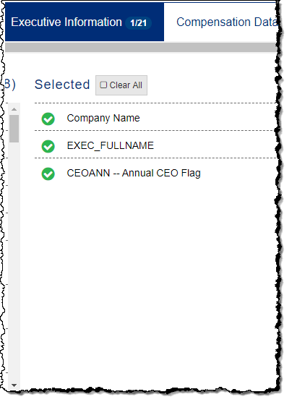
Assignment Instructions (cont.)
Click the Compensation Data tab.
Select the CEOANN – Annual CEO Flag variable.
CEOANN is a flag indicating that this executive served as CEO for all or most of the specified fiscal year.

Slide 26
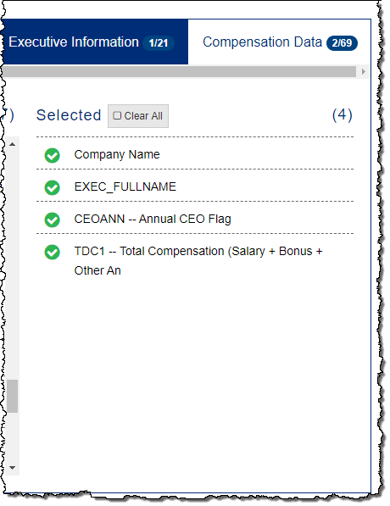
Assignment Instructions (cont.)
Select the TDC1 – Total Compensation (Salary + Bonus + Other) variable.

Slide 27
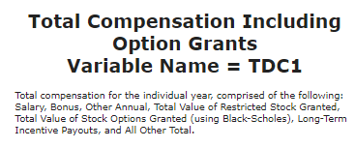
Assignment Instructions (cont.)
Note there are several total compensation variables. TDC1 is defined by ExecuComp as follows:

Slide 28
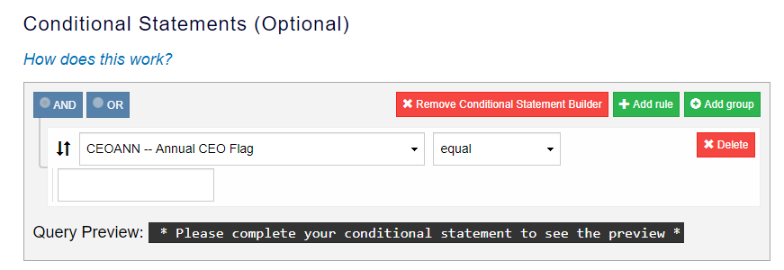
Assignment Instructions (cont.)
Using the drop-down menu in the Conditional Statements builder, select CEOANN – Annual CEO Flag.
This variable must be set to CEO to limit your results to only the executives flagged as annual CEOs.

Slide 29
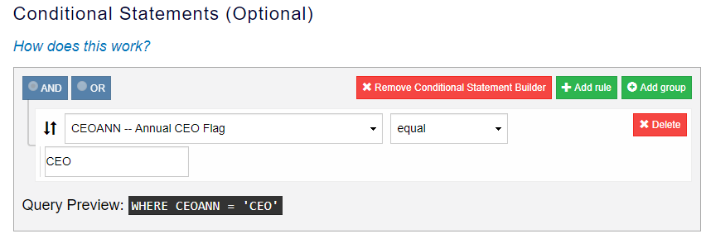
Assignment Instructions (cont.)
Type CEO in the conditional statement builder field. The Query Preview now displays the condition:
WHERE CEOANN = ‘CEO’

Slide 30
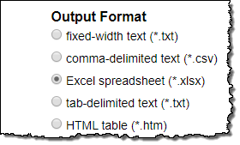

Assignment Instructions (cont.)
Select Excel spreadsheet (*.xlsx) as the output format.
Click the Submit Query button.

Slide 31
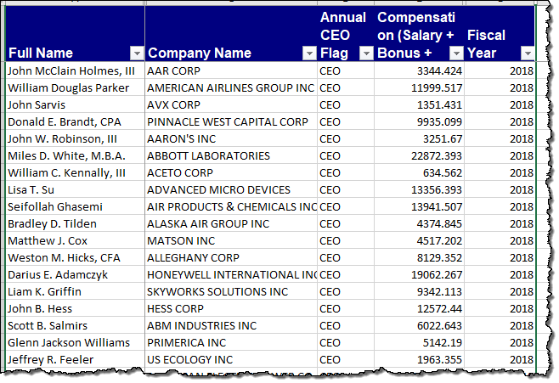
Assignment Instructions (cont.)
Review results. Note that annual compensation data is reported in units of thousands.

Slide 32
Conclusion
Compustat ExecuComp contains executive compensation data for over 3460 firms, including the S&P 1500. Most of these are U.S. firms.
In general, the top five executives whose compensation is reported in ExecuComp include: (1) the CEO, CFO, or anyone acting in those capacities at any time during the fiscal year, regardless of compensation level; (2) the three highest paid executive officers, other than the CEO and CFO.

Slide 33
Conclusion (cont.)
Since 2006, the data has been organized into six main categories: annual compensation, pension benefits, plan based awards, outstanding equity awards, deferred compensation, and director compensation.
Data using the 1992 format, prior to the adoption of the 2006 FASB 158 standard, is also available in ExecuComp.
Additional information is available at WRDS ExecuComp Support.

