Slide 1

Introduction to BoardEx

Slide 2
Learning Objectives
Upon completing this assignment, students will:
Be familiar with the BoardEx dataset
Execute a query and download BoardEx data to Excel

Slide 3
Background Information: What is a Board of Directors?
The board of directors is the governing body of a corporate entity.
All public companies have a board of directors.
In the context of a public company, the board of directors is the group of people elected by—and responsible to—the company’s shareholders.

Slide 4
Role of the Board of Directors
The board meets regularly, providing oversight and setting policies and strategy for the corporate management of the organization.
The board is responsible for appointing the chief executive officer (CEO).
The head of the board of directors is the “chairperson.” In some cases, the CEO is also the chair of the board. This is known as “CEO duality.”

Slide 5
Board of Directors: International Differences
In some European countries a portion of the board is elected by the company’s workers rather than the shareholders.
Several countries outside of the U.S. utilize “dual boards,” meaning their corporations have a two-tiered board structure: (1) one board of directors for management, and (2) a separate board of directors in a supervisory role.

Slide 6
What Data is in BoardEx?
BoardEx contains extensive information about board members of publicly traded and large private companies. Some not-for-profits are also included.
BoardEx also contains information about a company’s top or senior managers, known as “disclosed earners.”

Slide 7
What Data is in BoardEx? (cont.)
The data includes:
Biographical information
Detailed compensation data
Board and committee membership
Connecting networks between individuals and companies/associations

Slide 8
BoardEx Coverage
BoardEx contains information on over 25,000 firms in the United States, United Kingdom, Europe, and other parts of the world.
BoardEx includes data on over a million senior managers and board members.
Data coverage began in 1999. However, individual company records may contain a deeper history.

Slide 9
Where Does the Data Come From?
BoardEx collects its data from a wide variety of public domain sources.
For example in the United States, the major sources for BoardEx include:
The Securities and Exchange Commission (SEC)
Press releases
Corporate websites
U.S. stock exchanges

Slide 10
Note About BoardEx Identifiers
The three primary BoardEx-specific identifiers are BoardID, CompanyID, and DirectorID.
BoardID and CompanyID pertain to company-level data, while DirectorID pertains to individual-level data.
Note: BoardID is the same as CompanyID.
In other words, BoardID and CompanyID can be used interchangeably. BoardEx provides the data in some tables using BoardID and others using CompanyID, but the values are equivalent.

Slide 11
Data Organization: By Region
BoardEx data is first divided into four regions:
North America
Europe
United Kingdom
Rest of World

Slide 12
Data Organization: By Region (cont.)
Company regions are based on the country of the company’s headquarters, or the company’s inclusion in certain indices. Details can be found in the WRDS documentation on regional division.
Note that both companies and individuals can exist in more than one region.

Slide 13
Data Organization: By Region (cont.)
Director profiles are divided into regions based on the director's employment records. If a director is currently employed, they are included in the same region(s) as the company(ies) where they are employed.
If the director is not currently employed, the most recent employment records are used.

Slide 14
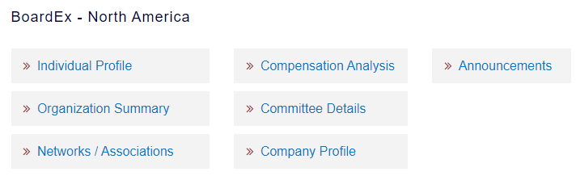
Data Organization: By Section
Each region’s data is categorized into seven sections.

Slide 15
Individual Profile
Individual Profile includes biographical details, such as age, gender, and nationality; this section also contains information about the individual’s employment, education, achievements, and other “non-business” activities.

Slide 16
Organization Summary
Organization Summary provides information about the board of directors. It includes the organization’s name, and its constituents’ names and roles.
This section also contains board-level summary statistics, such as the number of board members, its nationality mix, gender ratio, and attrition rate.

Slide 17
Networks/Associations
Networks/Associations contains: (1) “organizational network data,” which show linked organizations and the name and role of the individual that connects them; and (2) “individual networks,” with names of linked individuals, as well as the organization linking them.

Slide 18
Compensation Analysis
Compensation Analysis includes a detailed breakdown of the individual’s annual remuneration. Total annual remuneration is the total financial compensation paid to an employee for that period. For executive employees, remuneration typically includes salary, options, bonuses, deferred compensation, and any other financial compensation. The data also includes the appropriate currency.

Slide 19
Committee Details, Company Profile & Announcements
Committee Details names the committee(s) upon which the individual sits.
Company Profile includes contact information for the organization, as well as standardized company IDs, such as ISIN code.
Announcements are changes to individuals’ positions as described by the organization.

Slide 20
Assignment Overview
Access BoardEx’s organizational summary for Tesla, Inc. Use the ticker TSLA.
Download the board members, as well as the board’s gender ratio (male to female), for the fiscal year ending 12/2019.
Your results should include each individual’s name and role on Tesla’s board.

Slide 21
Link to Assignment
From the WRDS main menu, go to Get Data > BoardEx.
Or, use the link below to access BoardEx directly: https://wrds-www.wharton.upenn.edu/pages/get-data/boardex/

Slide 22
Assignment Instructions
From the BoardEx screen, locate North America and click on Organization Summary.

Slide 23
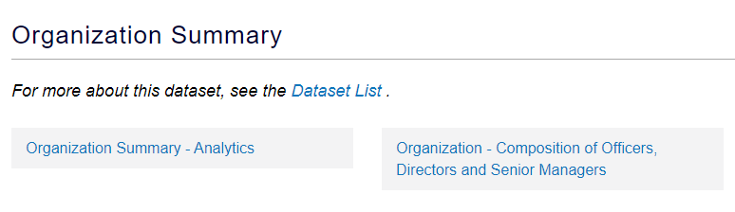
Assignment Instructions (cont.)
Click on Organization Summary – Analytics.

Slide 24
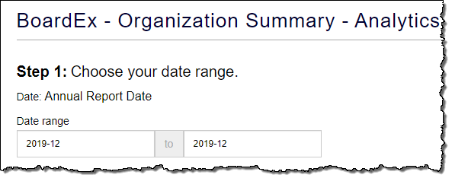
Assignment Instructions (cont.)
Enter 2019-12 to 2019-12 as the date of the annual report.

Slide 25
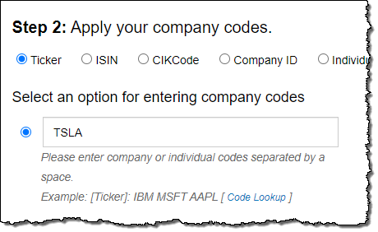
Assignment Instructions (cont.)
Select the Ticker option for entering the company code.
Enter Tesla, Inc.’s ticker, TSLA.

Slide 26
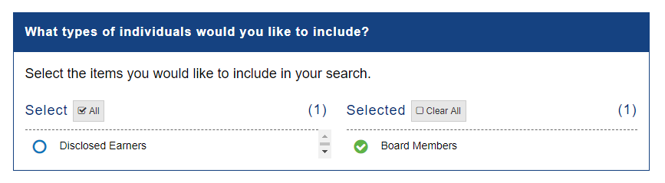
Assignment Instructions (cont.)
For this query, we are only interested in the board members—not the other “Disclosed Earners” the company reports. Narrow the search by selecting Board Members in the query window. Deselect Disclosed Earners.

Slide 27
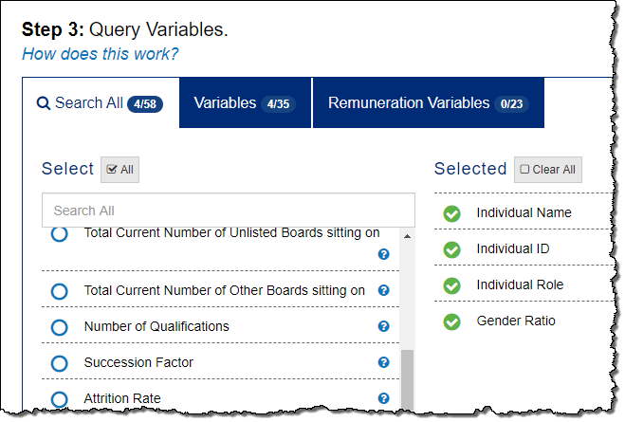
Assignment Instructions (cont.)
Select the following query variables:
Individual Name
Individual ID
Individual Role
Gender Ratio*
*BoardEx calculates the gender ratio as male/total.

Slide 28
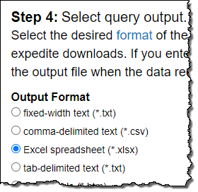

Assignment Instructions (cont.)
Select Excel spreadsheet (*.xlsx) as the query output.
Click the Submit Query button.

Slide 29
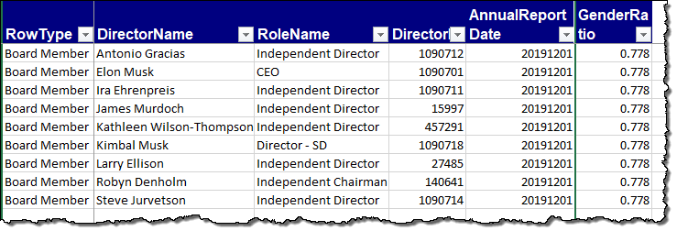
Assignment Instructions (cont.)
Review your results.

Slide 30
Conclusion
BoardEx contains extensive information about board members and senior managers of publicly traded and large private companies.
This information includes biographical details, compensation data, board and committee membership, and connecting networks between individuals and companies and organizations.
Coverage includes over 25,000 firms in the United States, United Kingdom, Europe, and other parts of the world. Data coverage began in 1999.

