Slide 1
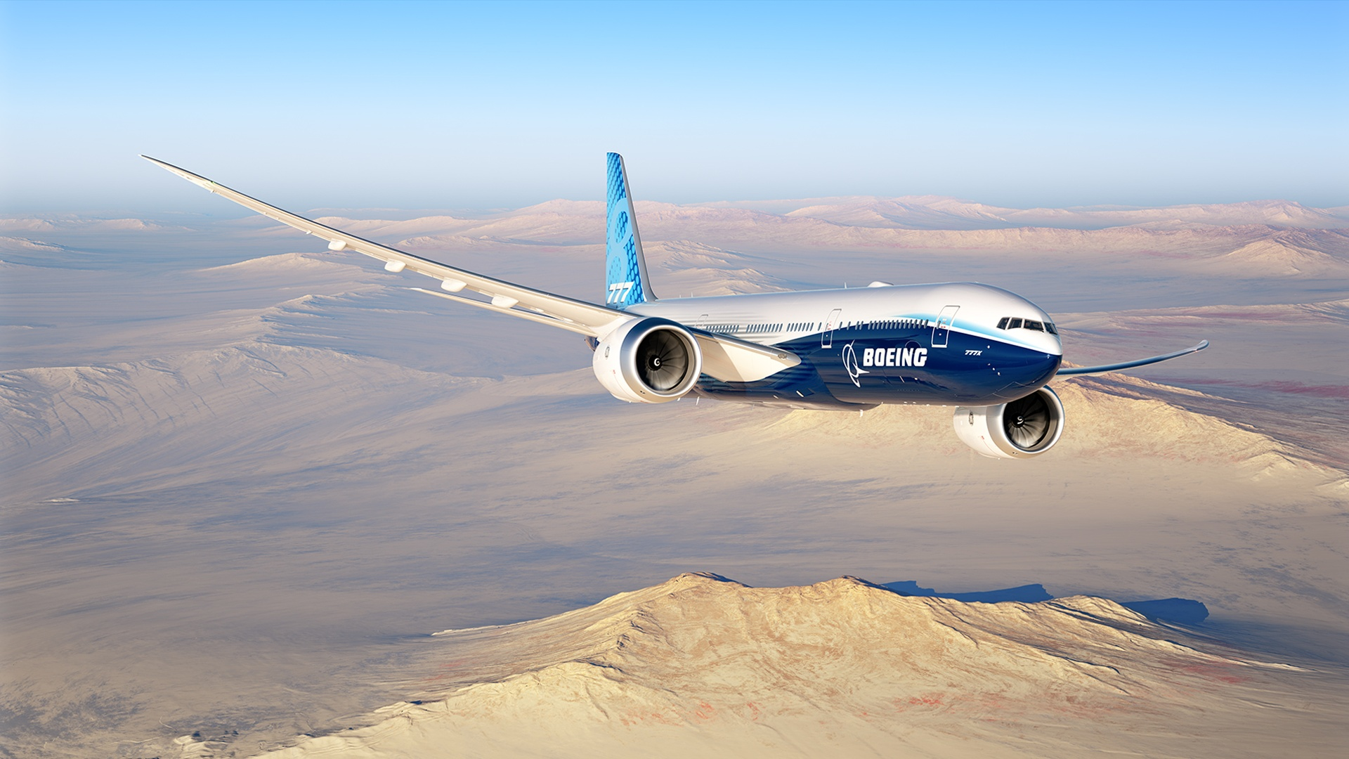
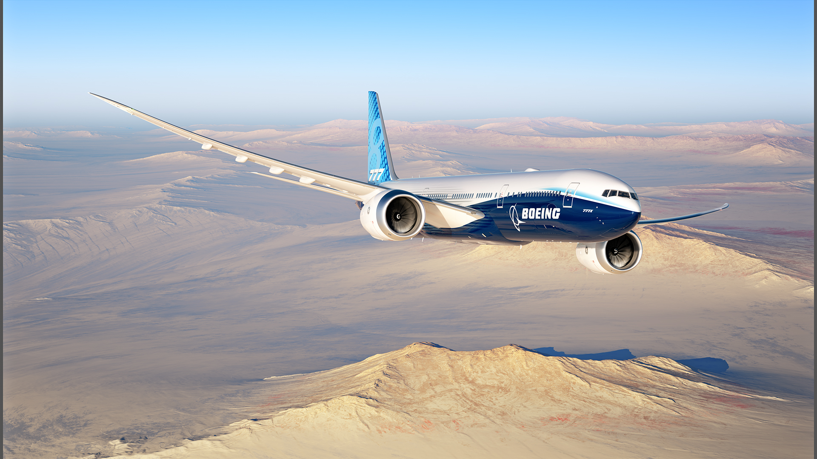
Proprietary: The information contained herein is proprietary to The Boeing Company and shall not be reproduced or disclosed in whole or in part except when such user possesses direct written authorization from The Boeing Company.
The statements contained herein are based on good faith assumptions are to be used for general information purposes only. These statements do not constitute an offer, promise, warranty or guarantee of performance.
Presentation Title
Presenter Name
Date
Copyright © 2020 Boeing. All rights reserved. | BOEING PROPRIETARY |
CSM-PM&A |
24JAN20

