Slide 1
EON Blanket Training
The intent of this training is to familiarize new Everett Operation North (EON) ME members with the systems that we uses on frequent basis. They will become familiar with navigating REDARS and CAPP to release follow-on blanket work order while they are waiting for classes and access. This will complement the hands-on training.

Slide 2
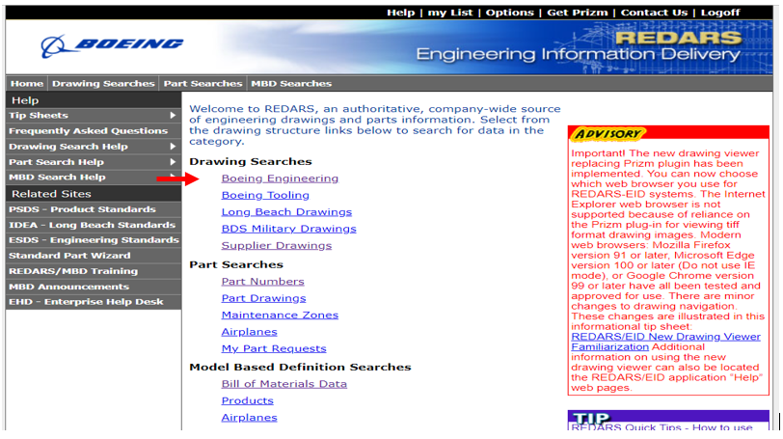
Open drawings related to blanket in REDARS. Only the PL (Parts List) and the component assembly PL will need to be printed and added to the work package. We will use 411T0140-442 for this exercise. Select Boeing Engineering

Slide 3
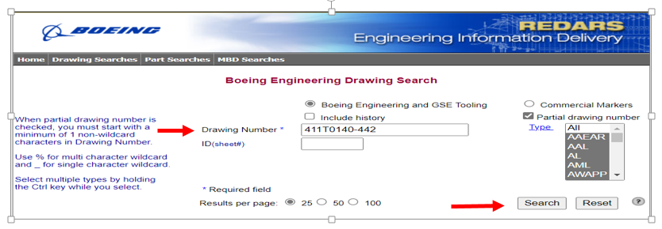
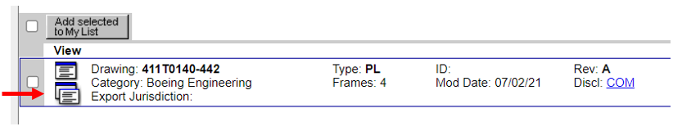
Search for Drawings Add Drawing Number, click Search When result pops up, click bottom icon to View the PL (Parts List) in separate window

Slide 4
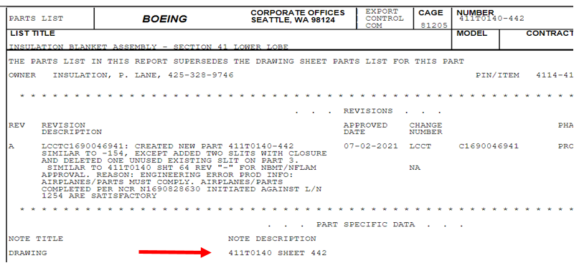
View the PL and make note of Drawing Sheet number

Slide 5
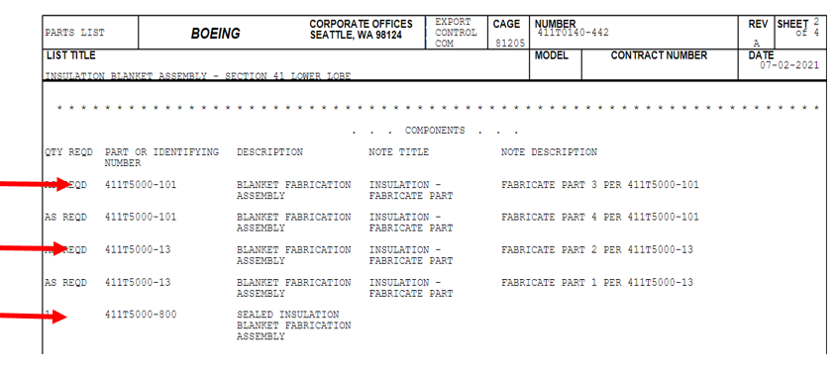
Note the Assembly Component 411T5000-101 and 411T5000-13 Note the Collector drawing 411T5000-800

Slide 6
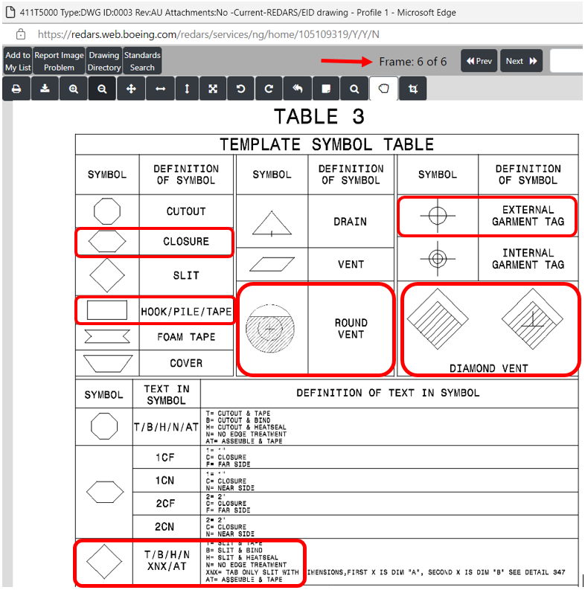
The symbols in red boxes are the most common items that we would look for in the drawing sheet. Those are items that are included in the Capp plan. Watch for note about SEW or BIND Ref: 411T5000 sheet 3 Frame 6 of 6 Note: Click Prev or Next to move between Frames

Slide 7
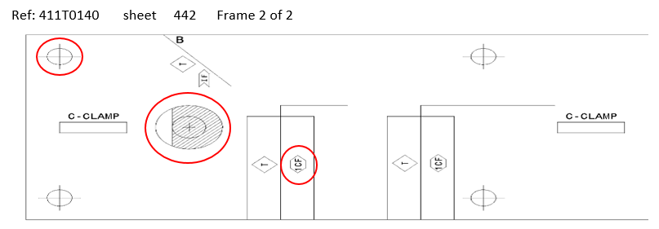
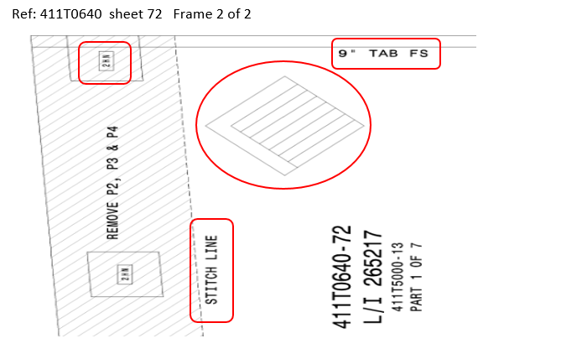
Examples of the symbols in drawing sheet

Slide 8
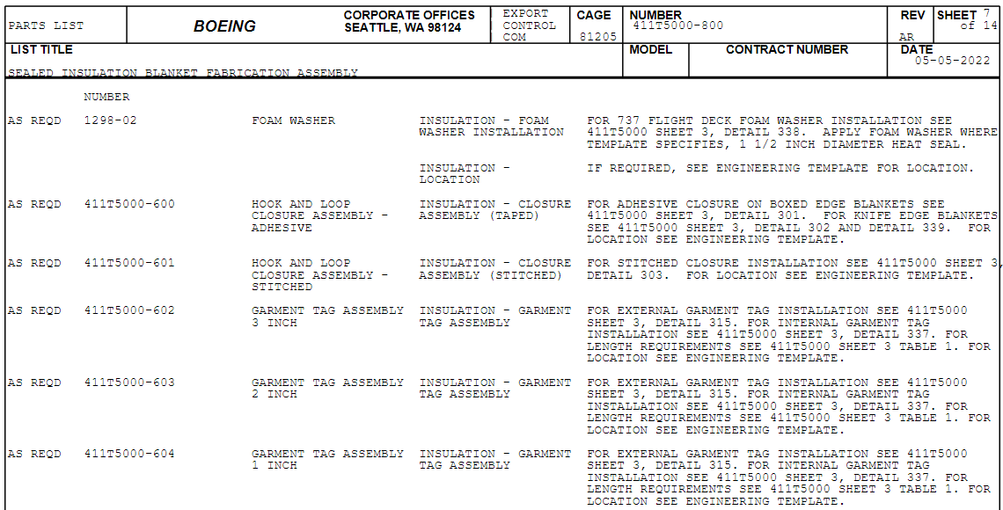
The collector drawing 411T5000-800 contains good information. It list the following item that are added to the Capp plan 411T5000 SHEET 1, 411T5000 SHEET 3, and 411T5000 SHEET 6 PART MARK PER BAC 5307, CODE M. You will also find the part number of the components

Slide 9
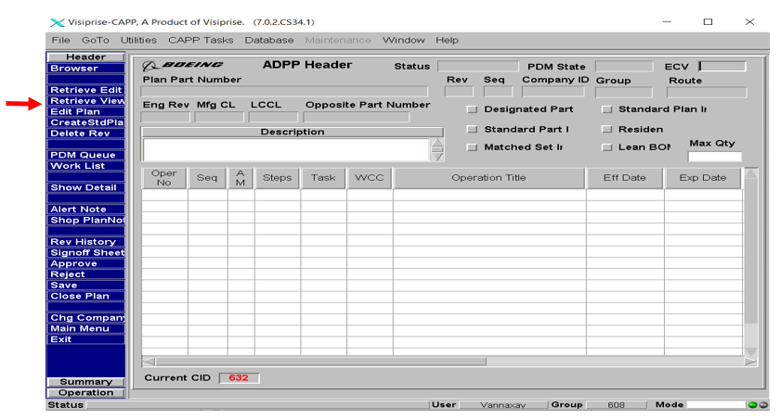
Search in CAPP for 411T0140-442 Click Retrieve View

Slide 10
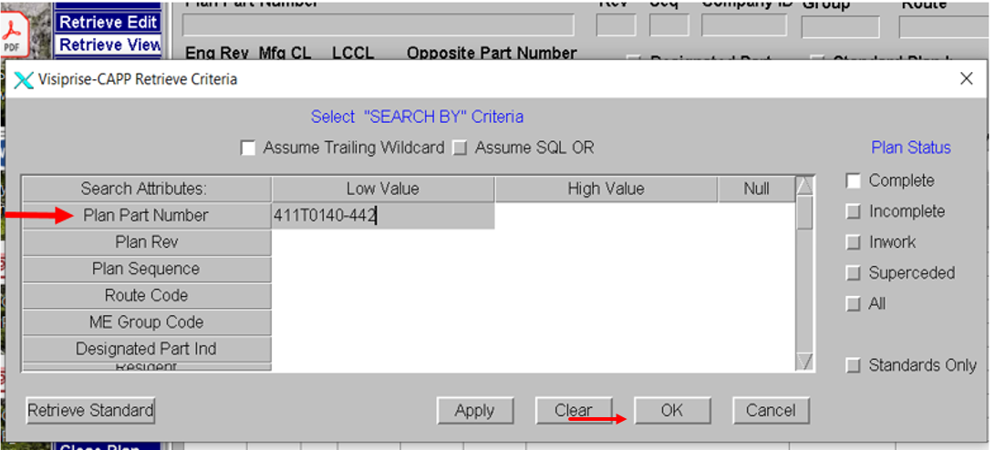
Input Plan Part Number and click OK

Slide 11
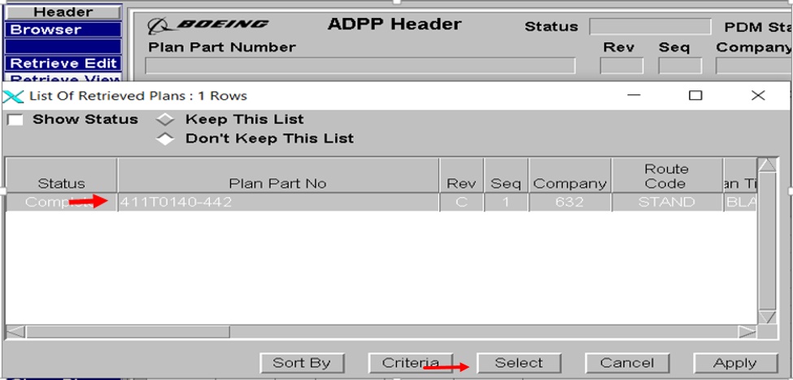
Highlight the Plan Part number and click Select

Slide 12
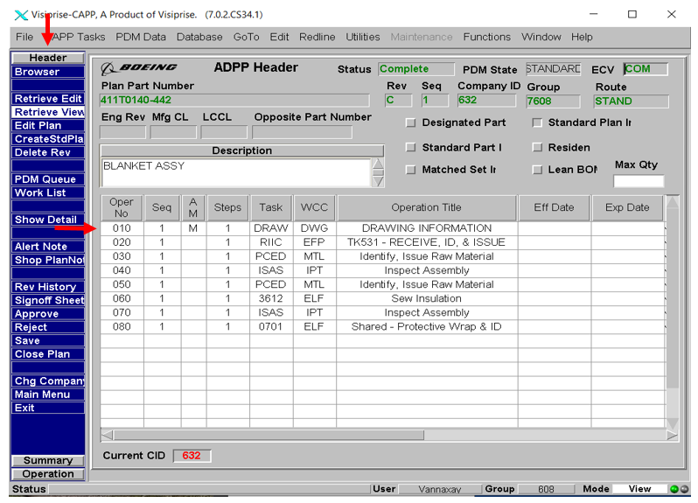
Notice the menu options in the Header column. Click on Oper010

Slide 13
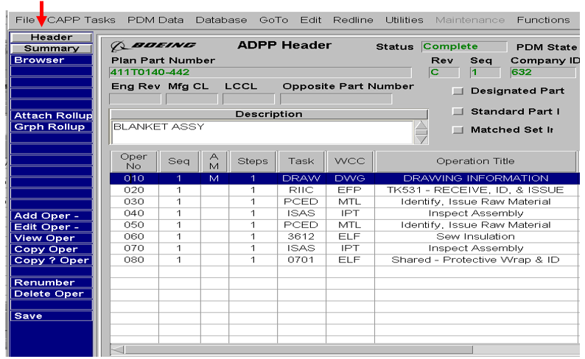
Notice the menu on right side changed. At this level you can double click on any operation that you want to view. Double click on Oper010 to view the text

Slide 14
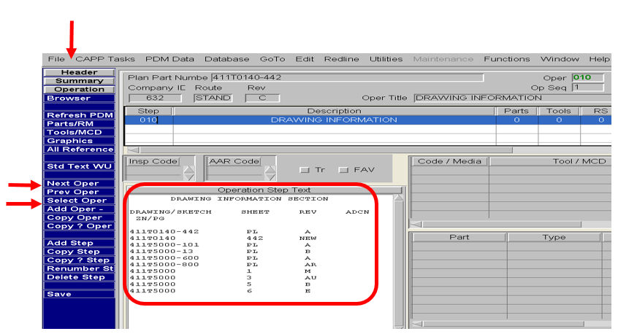
Notice the menu on the left side changed again. Now you can see the text on operation level. Verify that the drawing revision level in Oper 010 are current. Click Next Oper to go to Op 020. NOTE: You can also use Select Oper to see nonconsecutive operation of your choice.

Slide 15
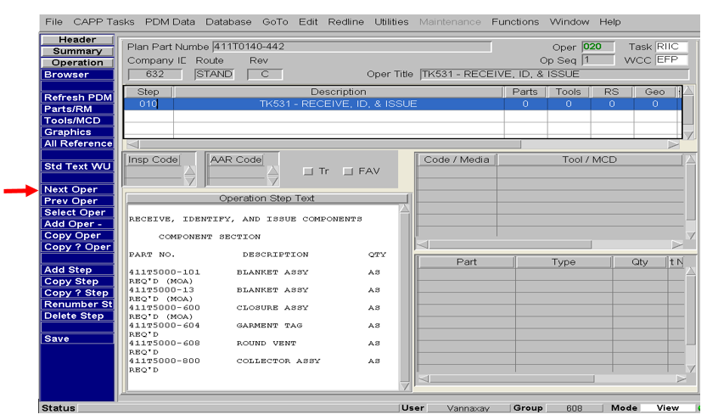
Oper020 contains the blanket components part number as listed in the PL and the Drawing sheet. Click Next Oper

Slide 16
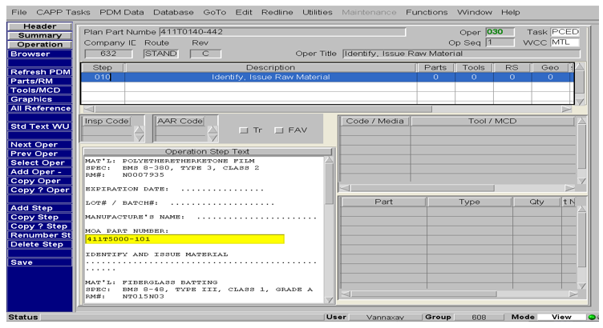
Oper30 contain the Raw Material (RM#) of the MOA -101 and -13

Slide 17
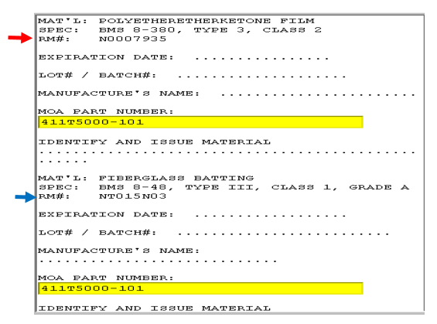
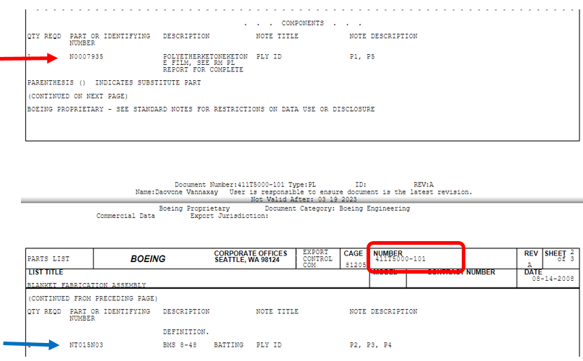
Notice in Oper 030 that RM# correlates to the PL sheet of the 411T5000-101

Slide 18
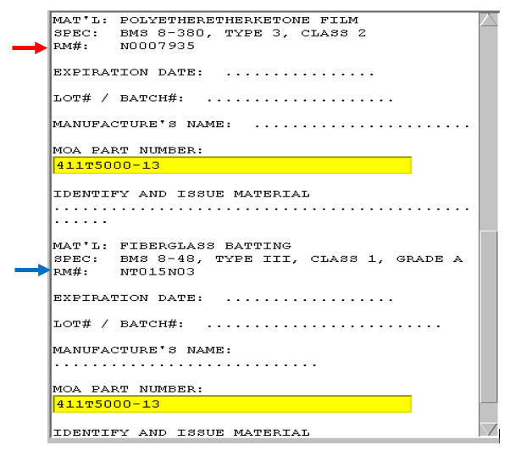
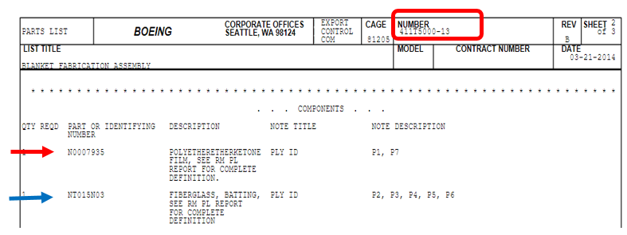
Notice in Oper 030 that RM# correlates to the PL sheet of the 411T5000-13

Slide 19
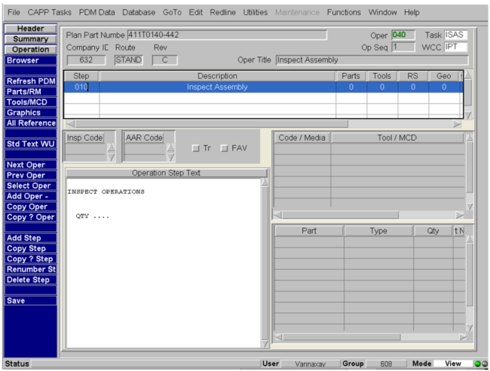
Oper040 is the Inspection Operation, standard operation

Slide 20
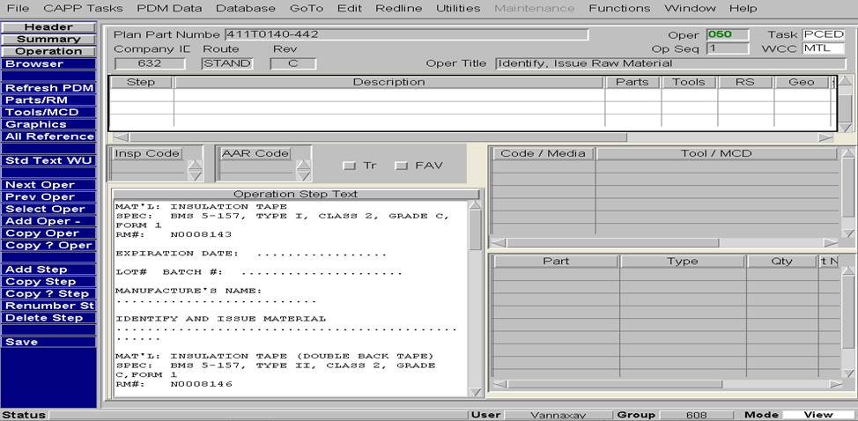
Oper050 Identify, Issue Raw Material. Most -800 collector drawing have raw material operation with Insulation Tape, Double Edge Tape, and Double Back Tape. The RM# is different depending on the collector drawing. The -700 have Thread, Binding (if/required), and Insulation Tape (as courtesy in case of tears)

Slide 21
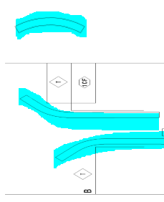
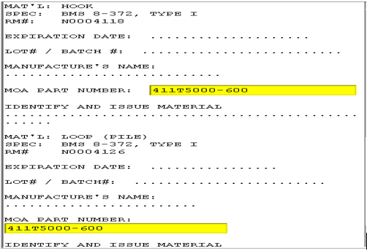
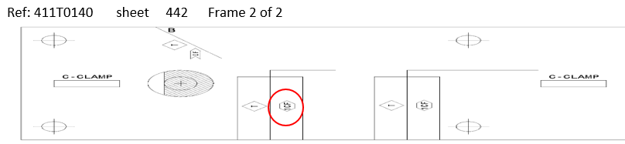
Oper050, Identify, Issue Raw Material. Check for Hook and Loop (Pile), (if/as required). There are 3 types: adhesive (-600 type I) or sewn (-601 type II) or 777X (type III) Check if/as required for TAB TAPE, Stitch/Quilt: ARAMID THREAD, Bind (if as required), Sound damping tape RM#: NL642V3 (pic right) This blanket has Hook and Loop (Pile), with Closure Assembly as MOA as shown on the drawing sheet 442

Slide 22
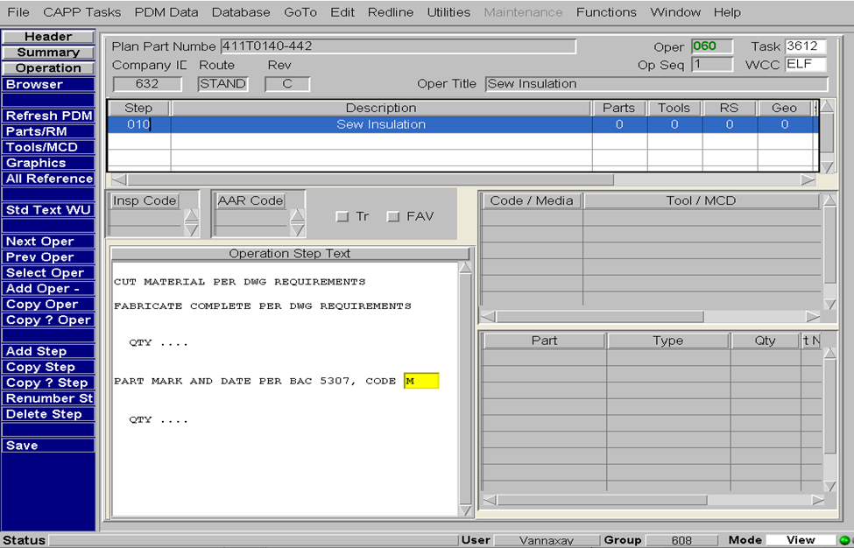
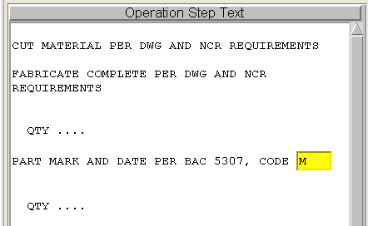
Oper060, Fabricate and part mark Note: Blankets fab per NCR have added verbiage

Slide 23
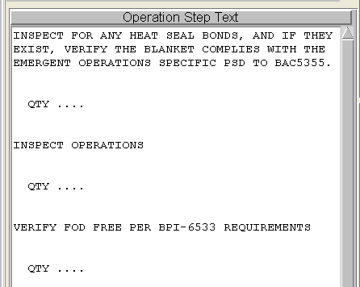
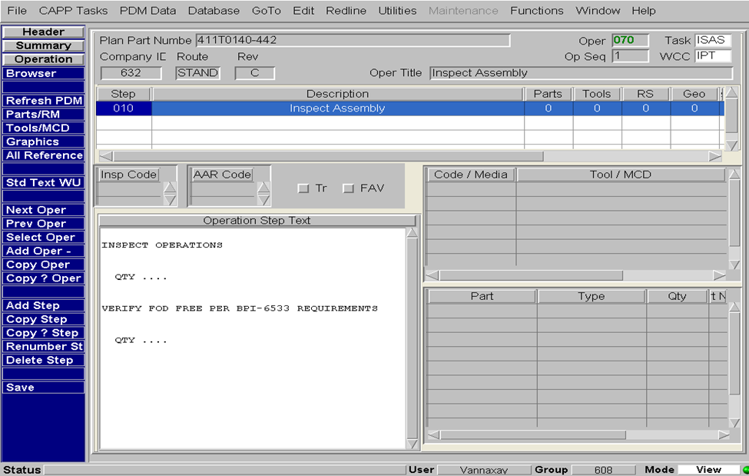
Oper70, Inspect operation. Verify valid FOD callout BPI-6533. Watch for missing FOD verbiage or incorrect BPI callout in older plans. Recommended to use standard text instead of just typing in verbiage as much as possible. If the standard text get revised, it will be incorporate on next release of the plan. 777X: Add standard text as first text in oper070 ‘HEAT SEAL MATERIAL INSPECTION’ , (found in CAPP folder 632INSPECT)

Slide 24
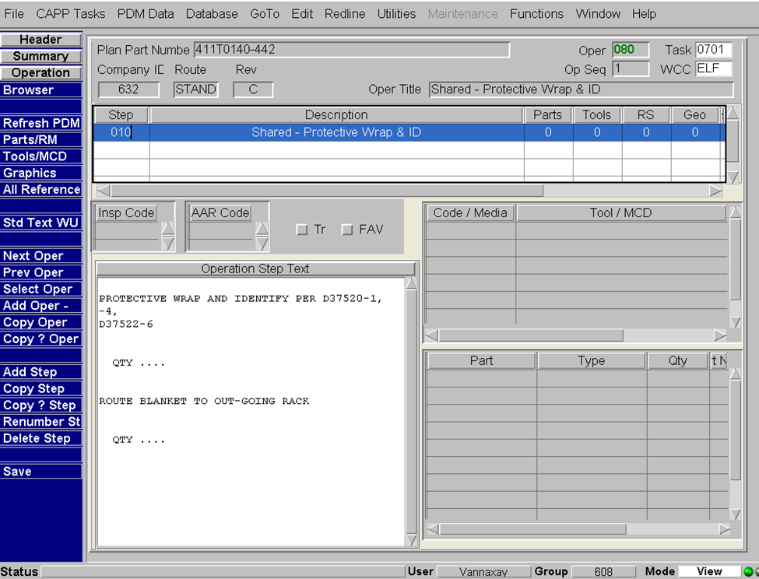
Oper080, Final operation

Slide 25
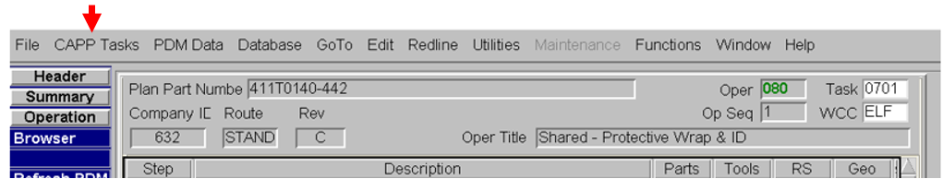
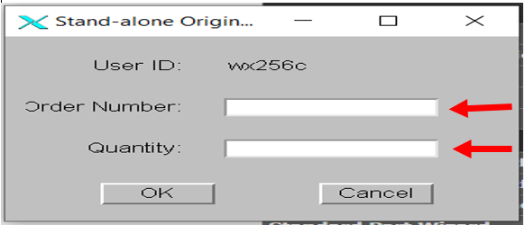
TO PRINT You have option of printing with Order ID or without Order ID Right Click CAPP Tasks >Shop Print OR Right Click CAPP Tasks > Stand-alone Original Print Input Order Number and Quantity in pop –up window

Slide 26
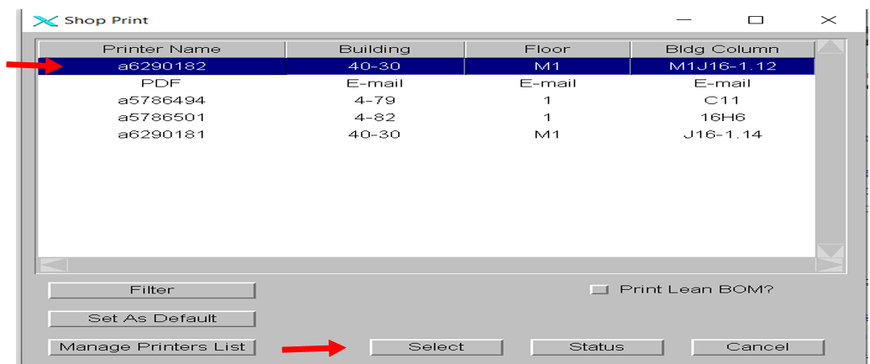
Highlight the printer you want then click Select. Note: Using PDF sends it to your email instead of the printer. Good for when you want to only view the plan on your screen.

