Slide 1
CS100 Final: Grand Slam, Predicting MLB Success
Jason Katz Brandon Dale

Slide 2
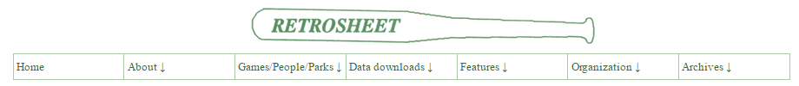
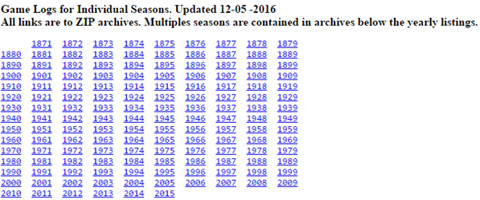
Data Set
All MLB Games from 1871 to 2015
Public Access Data
161 Features
http://www.retrosheet.org/gamelogs/index.html
Notes:
Jason

Slide 3
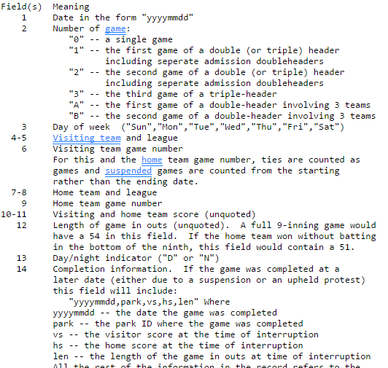
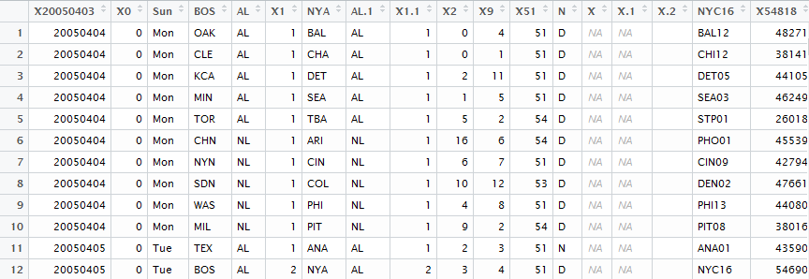
Data Set
Original dataset encoded
Messy
Several non-numeric features
Cleaning needed
Individual sets per each year
Notes:
Jason

Slide 4
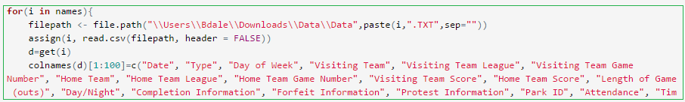

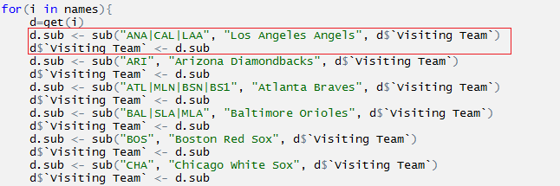
Data Set
Fix Feature Names -for loops, hardcoding the encoded term
Combining of Data -GL pattern recognition
Standardize Team Names -for loops, replacing abbreviated names
Notes:
Jason
-Had to create uniform data column names to merge
-Lapply used to create a list with all of the data frame beginning with GL (in our case, all frames). Following this, the lapply is stored in dlist which is then used with the do.call function to perform r.bind, a merge function, on the entire list of data frames that’s stored in now data total.

Slide 5
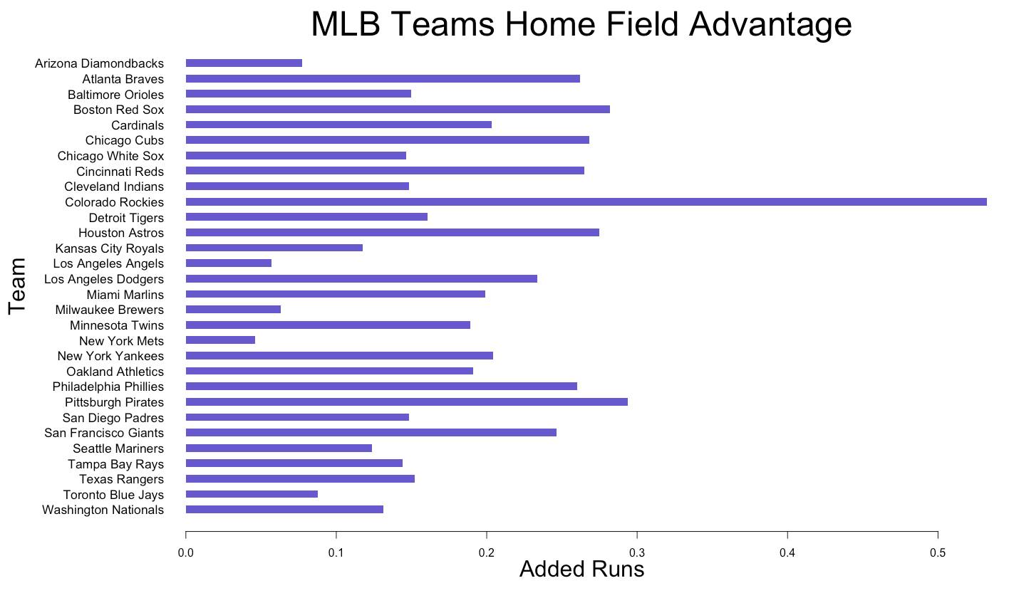
Visualizations
Notes:
Jason
This graph explores the trend of home field Advantage that is often discussed in the MLB. This data comes from every game played by each team in MLB history. The team names are listed horizontally on the y-axis and their corresponding “added run,” value can be seen extending across the x-axis. In this case, each team’s added run value corresponds to the average number runs that a team will add to their score when playing at home versus when they play at an unidentified location. For example, let’s suppose that the Cardinals played in a game and won by 4 runs. If they re-played this game at their own home field, on average, they would have won +0.2 more runs. The largest home field advantage discovered was that of the Colorado Rockies, with an average of+0.5 added runs each time they play at home, almost double the average for the MLB (0.254). Considering this representation is based off of past data and is not a predictive model, we are only able to see post-game influence that home field advantage has on teams runs. How: By creating two data sets for each team that allowed for tallying of the average runs scored when at home versus when away and finding the mean difference between these values, this visualization was able to be created.
Home_Field_Advantage_MLB <- mean(data.total$`Home Team Score` - data.total$`Visiting Team Score`)
Talking Points – Why Home Field Advantage is Real
-Rockies (altitude add – 5280 – 1 mile!)
-Fenway (Green Monster) - Wrigly (Ivy On Walls) -Astros (Tal’s Hill – center field)

Slide 6
Average MLB Home Field Advantage & Confidence Interval
MLB Average Home Field Advantage: 0.254
99% Con. Interval: 0.229-0.279
Notes:
Jason The MLB average home field advantage is 0.254, and this falls within our 99% confidence intervals of 0.229 to 0.279.

Slide 7
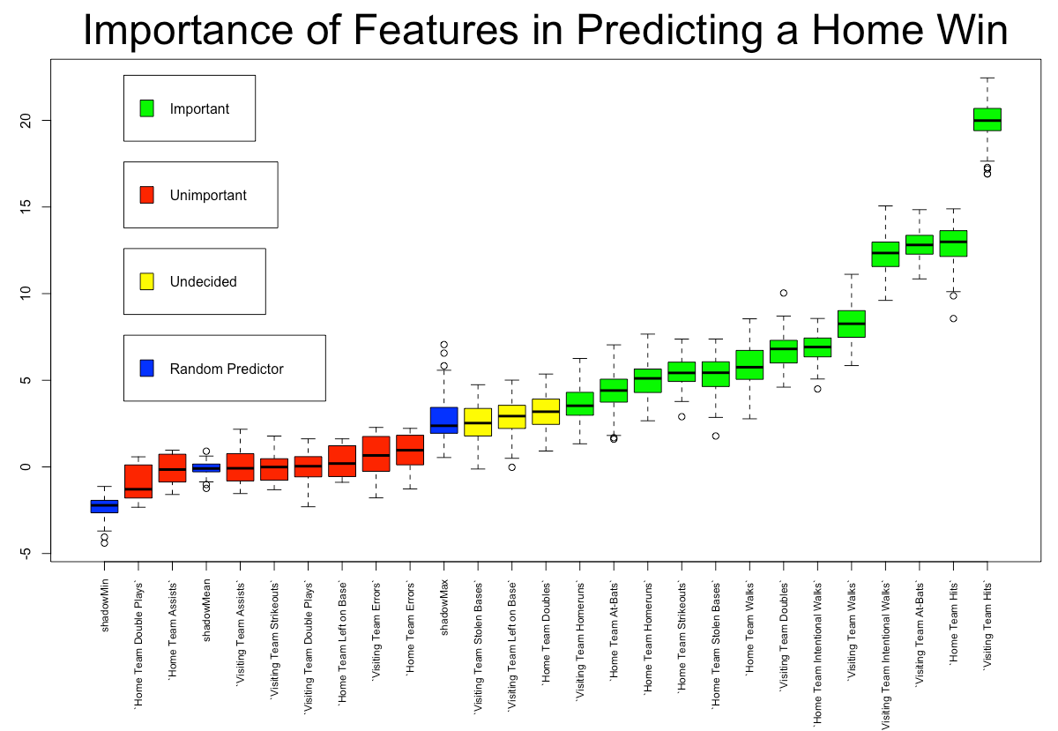
Visualizations
Notes:
Boruta This visualization was created using the boruta package, and it is a graphical depiction of the important features needed to predict a home-team win. We choose this schematic to use as it gives us a very clear idea of what features we should incorporate in our NaiveBayes prediction models. The blue are randomly generated points used as a basis of comparison, while the red whisker plots signify not useful features and useful features are represented in green. Yellow whisker plots represent the data points that boruta deemed to be undecided as to whether or not they are useful in building a model to predict a home-team win. How does boruta work? Loosely, it’s based on the idea that by adding randomness to a system and then collecting results from that system, one can reduce the misleading impact of randomness in the original sample by already taking it into account with your feature selection. Using a random forest classification algorithm (buzz word – decision trees), this provides an intrinsic measure of the importance of each feature that we can then compare to random permutations of (a selection of) the variables to test if it is higher than the scores from random variables (seen here in blue).
Random
https://www.r-bloggers.com/feature-selection-all-relevant-selection-with-the-boruta-package/

Slide 8

Predictive Models – Home Team Win?
NaiveBayes – Win
Not “cheating” (Team Score, RBI, Earned Runs and Visiting Team Putouts)
13 Features - Home Team Hits, Visiting Team Hits, Home Team Homeruns, Visiting Team Homeruns, Home Team Intentional Walks, Visiting Team Walks, Home Team Strikeouts, Home Team At-Bats, Visiting Team Errors, Visiting Team Double Plays, Visiting Team Assists, Visiting Team Strikeouts
Models between 83.2-83.8% accuracy (5 folds)
Notes:
Brandon

Slide 9

Predictive Models – Home Team Score?
NaiveBayes – Win
Not “cheating” (Team Score, RBI, Earned Runs and Visiting Team Putouts)
Features Used – see code block
Buckets used
65.8-67.2% accuracy (5 folds)
Notes:
Brandon -Mention Attempt for Exact Score (~23% highest with several features)
-Buckets more useful/pretty accurate

Slide 10

Correlation Features To Predict Score
Batting Average – (# of Hits / # of At Bats)
Slugging Percentage – ((# of Singles) + (2*# of Doubles) + (3*# of Triples) + (4*# of Homeruns)) / (# of At Bats))
On Base - (# of Walks + Hit-By-Pitch + Hits) / (#of At Bats + Walks + Hit-By-Pitch + Sacrifice Flies)
OPS – (On Base + Slugging)
What Does This Mean?
Notes:
Brandon

Slide 11
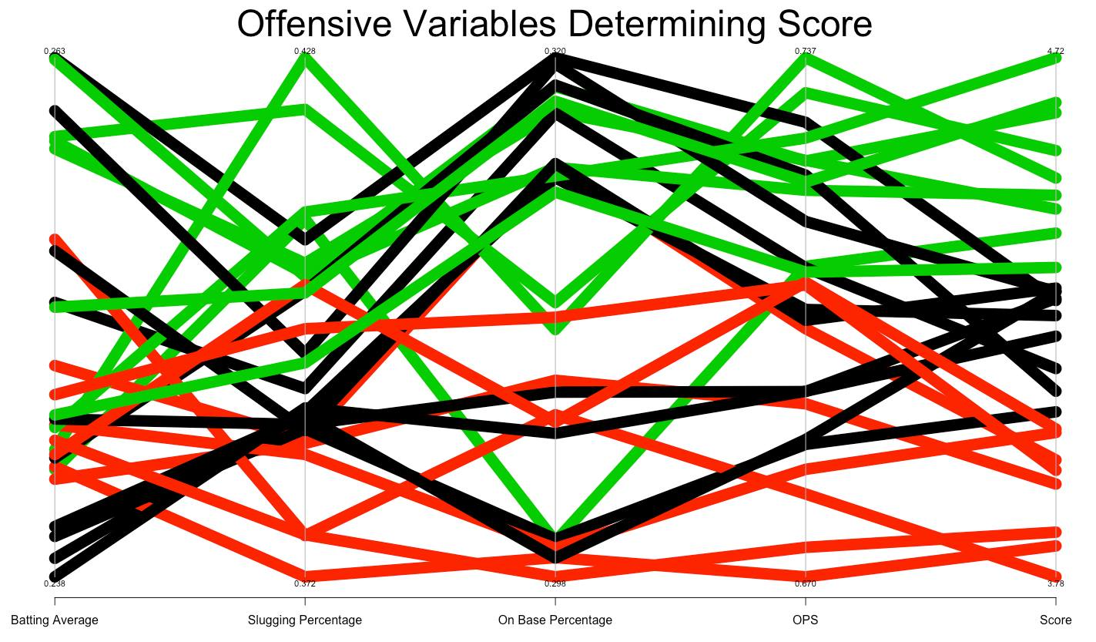
Visualizations
Notes:
Brandon This visualization is a parallel coordinate plot which shows the offensive data from the year 2015. Our intentions with the visualization was to find any potential trends that existed between some common offensive baseball data points and a team’s ranking as high, low or average scoring. Moving from left to right, we see along the x-axis a series of data point labels that we thought were important to include in our analysis (batting average, slugging percentage, on base percentage and OPS). Each bar is representative of a team in 2015, and the colors are broken into three bins that separate teams into three scoring levels: low scoring (red), average scoring (black) and high scoring (green). Examining the graph from left to right with a focus on the green band, we see that in order to be considered a high scoring team it is important to have a high batting average, slugging percentage, on base percentage and OPS (on base percentage and slugging combined) rate to be categorized as high scoring. Conversely, teams that are frequently in the lower percentile of these features (red) display a lower scoring average. This visualization is useful in being able to determine what aspects of improvement should be made (offensively) in a team to raise their scoring frequency.

Slide 12
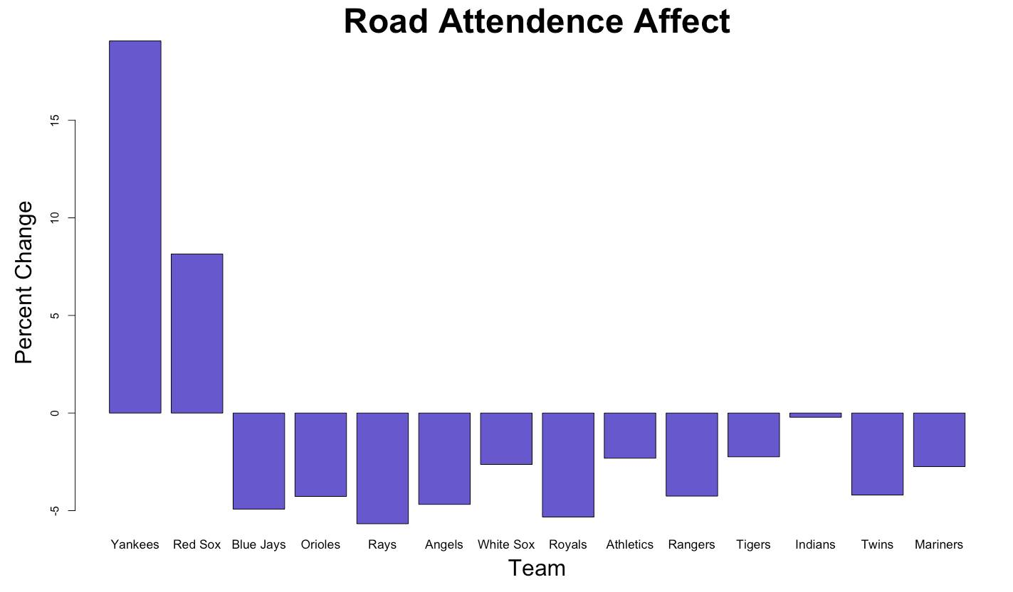
Visualizations
Notes:
Jason This visualization shows the average change in attendance that each team produces when they play on the road. Across the y-axis, we have the percent change, which was gathered from data on fan attendance at specified team’s past games. This was found for each team and compared across teams to show that there are teams that you may play that will positively and negatively affect your attendances stats. For example, playing the Boston Red Sox on average increases a teams’ home attendance by 8%, while playing the Tampa Bay Rays decreases the other teams home attendance statistic by 5%.
Real Useful: $$ For Yankees + Other Generating Teams (they don’t do this pay… however – they should!)
NY Yankees Example - @ Oakland + 36.5% increase Tampa Rays Examples - @ Orioles – 25.7% decrease
**Name explanations for league differences – American v. National

Slide 13
The End
Questions?

