Slide 1
Department of Computer Science and Engineering
Project:- Analysis of Students Marks
Section:- A
NAME | USN
JASON KENNETH N | KUB23CSE045
BHARATH KUMAR J M | KUB23CSE025
C ANIRUDH | KUB23CSE028
NITHYA PRAJWAL P | KUB23CSE096
Faculty Coordinator
Mujeeb Ansari
Chairperson
Dr. Rajashree V Biradar

Slide 2
Storing student details in a database is crucial for educational institutions.
It allows for efficient data management and retrieval of student information.
Understanding the structure and design of student databases is essential for effective use.
Introduction to Student Databases
Notes:
Image source: https://static.daniweb.com

Slide 3
Importance of Student Data Management
Proper management of student data enhances academic planning and reporting.
It promotes better communication between students, faculty, and administrators.
Data-driven decisions can improve student retention and success rates.
Notes:
Image source: https://degree37.io

Slide 4
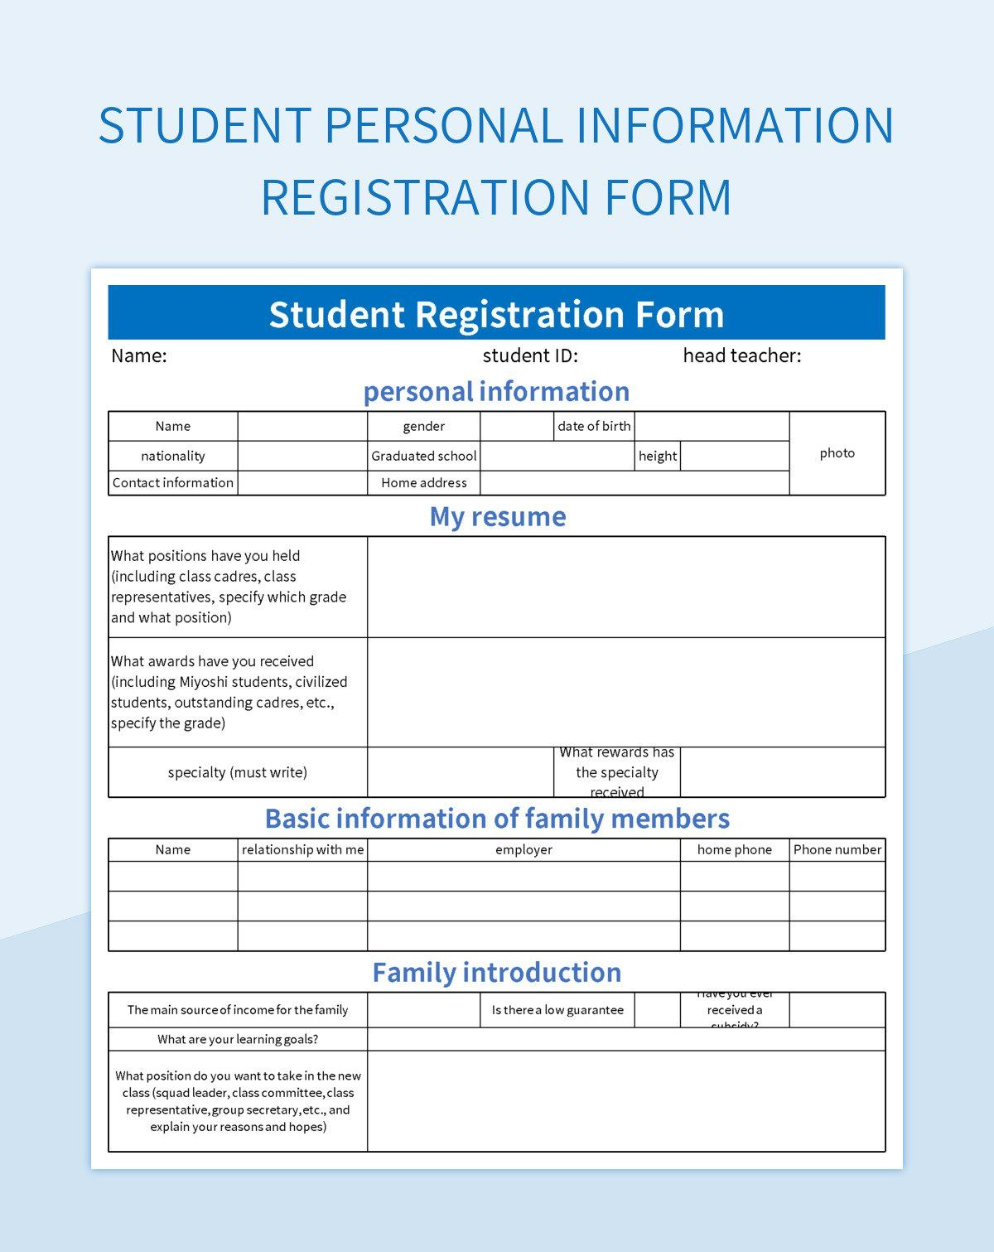
Key Elements of Student Details
Student details typically include personal information, academic records, and enrollment status.
Additional elements may consist of contact information and emergency contacts.
Maintaining comprehensive records ensures compliance with educational regulations.
Notes:
Image source: https://image.slidesdocs.com

Slide 5

Database Structure and Design
A well-designed database utilizes tables to organize student data efficiently.
Relationships between tables can be established to link students with courses and grades.
Normalization techniques should be applied to reduce data redundancy.
Notes:
Image source: https://thumbs.dreamstime.com

Slide 6

Choosing the Right Database Management System (DBMS)
Various DBMS options exist, including relational databases like MySQL and PostgreSQL, SQL lite.
Selecting a DBMS depends on the size of the institution and the complexity of data needs.
An appropriate DBMS enhances performance and scalability for future growth.
Notes:
Image source: https://www.slidemake.com

Slide 7

Data Security and Privacy
Protecting student data is a legal requirement under regulations like FERPA.
Implementing encryption and access controls can safeguard sensitive information.
Regular audits and updates are necessary to maintain data integrity and security.
Notes:
Image source: https://www.clarip.com

Slide 8

Data Entry and Maintenance
Accurate data entry is vital for the reliability of student databases.
Automated systems can streamline data entry processes and reduce human error.
Regular maintenance tasks, such as backups and updates, are essential for data longevity.
Notes:
Image source: https://www.seoclerk.com

Slide 9

Utilizing Student Data for Analytics
Analyzing student data can reveal trends in academic performance and enrollment.
Insights gained can inform curriculum development and resource allocation.
Data analytics fosters a proactive approach to addressing student needs.
Notes:
Image source: https://exempt.trilliummontessori.org

Slide 10

Future Trends in Student Data Management
The adoption of cloud-based databases is increasing for flexibility and accessibility.
Artificial intelligence and machine learning are being used to personalize student experiences.
Integrating mobile applications can enhance communication and data access for students.
Notes:
Image source: https://www.blackbelthelp.com

Slide 11
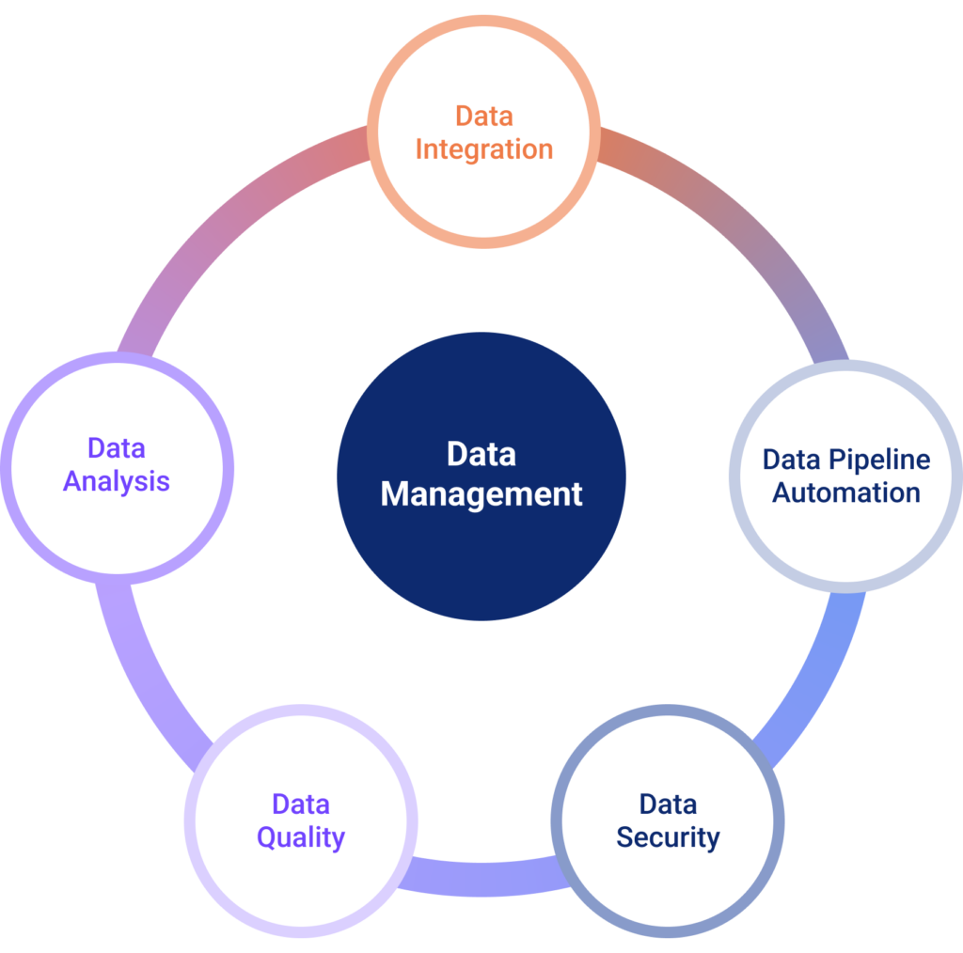
Conclusion and Best Practices
Efficiently storing student data is essential for the success of educational institutions.
Adhering to best practices in database management promotes data integrity and security.
Continuous evaluation and adaptation of data management strategies will ensure ongoing effectiveness.
Notes:
Image source: https://nexla.com

Slide 12
Smith, J. (2022).
Database Management in Education: Best Practices
. Academic Publishing.
References

Slide 13
THANK YOU

