Slide 1
Presentation on “Payroll management system”
Submitted by: Submitted to:
Bishal Lamichhane NCCS College
Jason Khadka
Suyog Shrestha
Suranjan Adhikari

Slide 2
In this presentation…
Introduction
Objective
Problem statement
Scope
Limitation
Main feature
Flow diagram of module

Slide 3
Introduction
It is a system used to help manage the computation and disbursement of the employees salaries
It is an administration module i.e. only used by administration
In this module, user can perform operations like add new record, modify it, delete it, or display the records
Facilitate user to print the salary slip

Slide 4
Objective
To create an application that provides an efficient interface to handle employee salary
To help manage the computation and distribution of employees salary efficient
To reduce frauds by designing an efficient and appropriate system for employees

Slide 5
Problem Statement
Management of payroll in paper is difficult, so choose this project to digitalize efficient method to handle payroll of employees’
choose to solve problem using resources that are most appropriate for us thereby sharpening our coding skill
To create simple module appropriate for small organization

Slide 6
Scope
Can be used in small organization where employees info is not too difficult to handle
Organization which do not have huge structure or huge economy can use it
Large scope when it comes to regulating employees records and their salary
Keeps accout of loan payments and tax regulation

Slide 7
Limitation
Based for single computer and cannot be used online
Not so efficient for huge organization as it is of limited features
Limitation of security of the data
No reliable data backup

Slide 8
Main Features
Add employee record ( based on type of work/ branches)
Modify employee records (Depending on employee ID)
Delete employee record
Display record (one / all)
Print pay slip
Additional

Slide 9
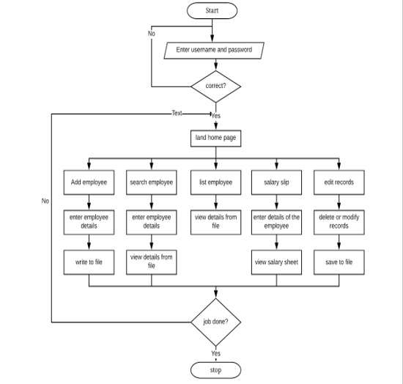
Flow chart

Slide 10
Thank you!!

