Slide 1
LAB ENVIRONMENT

Slide 2
1.Hardware Model of the MIPS-Based System
What is MIPS?
For experiments on the DE2 board, a simple model of a computer system was devised as shown in Fig. 1.

Slide 3
The model, composed of five components:
Single-cycle MIPS CPU
Memory
Address Decoder
Timer
General Purpose Input/Output (GPIO)

Slide 4
Using the system model, user can turn on and off seven-segment displays
LEDs and take input from switches and push-buttons on the DE2 board by writing simple MIPS assembly and/or C code.
Why was 32-bit MIPS was chosen as a target CPU?
From where the single-cycle MIPS design came?
It only implements a subset of the MIPS instructions, as listed in Table I.
Because of that it is hardly able to execute even a simple C program
The critical path is much longer than the pipelined CPU, limiting the operating clock frequency
The main goal of this project is to add new instructions and convert the single-cycle CPU to the pipelined version.

Slide 5
The system model should be downloaded to an FPGA on the DE2 board
Because of that memory is created with Megafunction in Quartus-II instead of using a generic Verilog model
The Megafunction creates the user-configured memory with memory elements inside the FPGA
. There is a dual-port memory, one port for accessing instructions and the other for accessing data
It was created to allow for two simultaneous accesses from the CPU, avoiding the structural hazard
The memory is preloaded with the compiled MIPS binary and merged into a bitstream, downloadable to the FPGA
The components were designed from scratch using Verilog-HDL except the single-cycle MIPS and memory

Slide 6
What is Timer and what it does?
The timer is an essential component in virtually any digital system
Its major role is to periodically notify the system of an event, so that the system can properly manage resources and tasks
The timer in Fig. 1 has a internal counter and can generate an interrupt periodically according to the counter value set by a user.

Slide 7
What is GPIO module and what is it used for?
GPIO is a module for interacting with the external world
By programming the GPIO module, students can take input from switches and push-buttons on the DE2 board
By using the taken input we can display numbers on seven-segment displays, and turn on/off LEDs

Slide 8
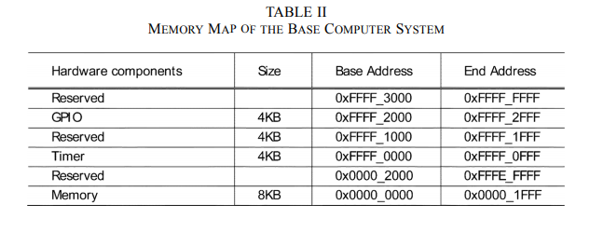

Slide 9
Table II shows the memory map of the system model, which has a 4-GB memory space since the implemented MIPS has a 32-bit address bus
Each peripheral device occupies a 4-kB space
But the whole 4 kB is not completely consumed by its internal registers
The address decoder in Fig. 1 assigns a memory space to each peripheral device in the system. Since the source code is based on Verilog-HDL
students can easily change the memory map and perform experiments with assembly and/or C-programming if desired

Slide 10
2.Software Environment
The Eclipse Integrated Development Environment (IDE) is used for the software development
The Eclipse provides a convenient environment for programming, so it is widely used in both academia and industry. Once software is written using assembly and/or C-language
The MIPS cross-compiler generates a binary file in the Executable and Linkable Format (ELF)
Since the Megafunction-generated memory requires a special file format—Memory Initialization File (MIF)—for initialization, a Perl script was written to convert the ELF binary file to the MIF format
As the name implies, the MIF is used to initialize the memory in Altera FPGA, preloading a software program into the memory in Fig. 1.
To automate the compilation to the MIF conversion process, the make utility is used with Cygwin under Eclipse.

Slide 11
3.Experiment Environment

Slide 12
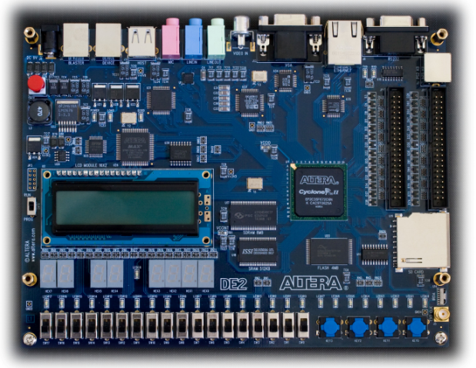
Fig. 2. Altera DE2 board

Slide 13
The main component in this board is a Cyclone-II FPGA, to which a software program downloads the hardware system model.
The board features various input and output components such as switches, push-buttons, seven-segment displays, a serial port, LEDs, and USB connector
Altera provides a CAD tool, Quartus-II, which is used to synthesize, place and route, and download the logic design to the Altera FPGAs
The MIF is merged with the hardware design, and the generated bitstream is downloaded to the Cyclone-II from a PC via the USB connection.

