Slide 1

Coder Academy
Jason Kim

Slide 2
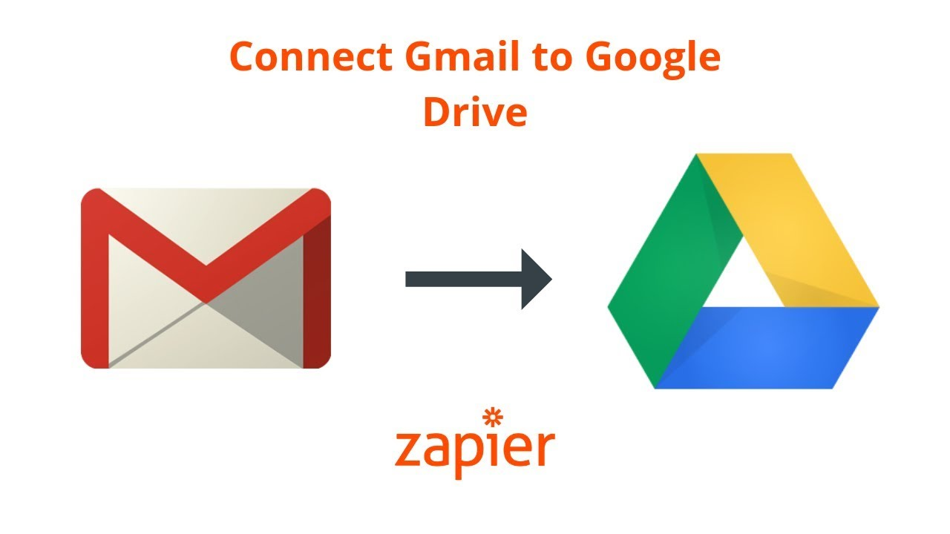
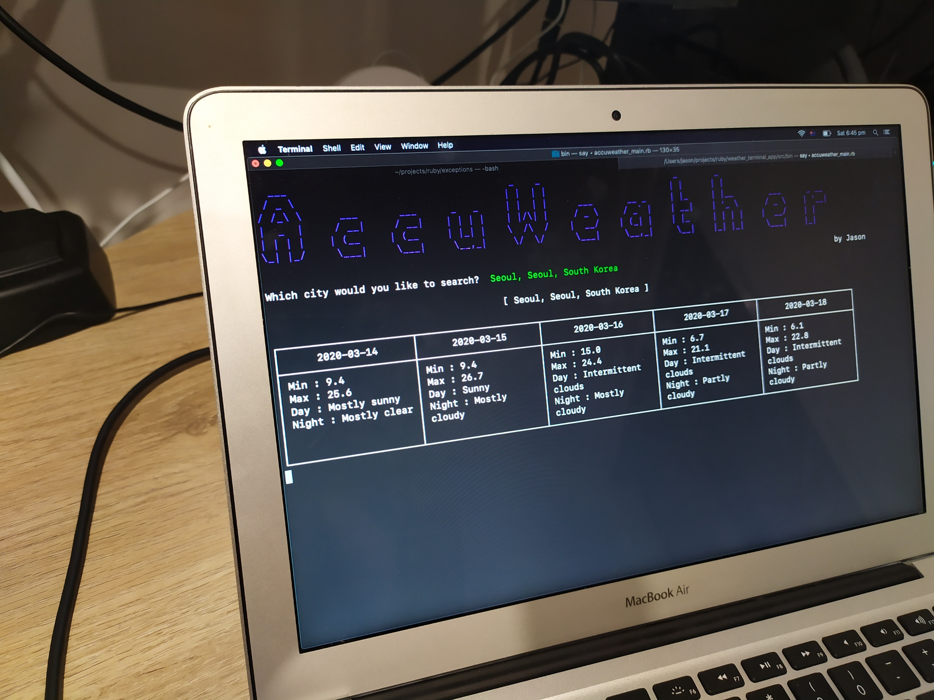
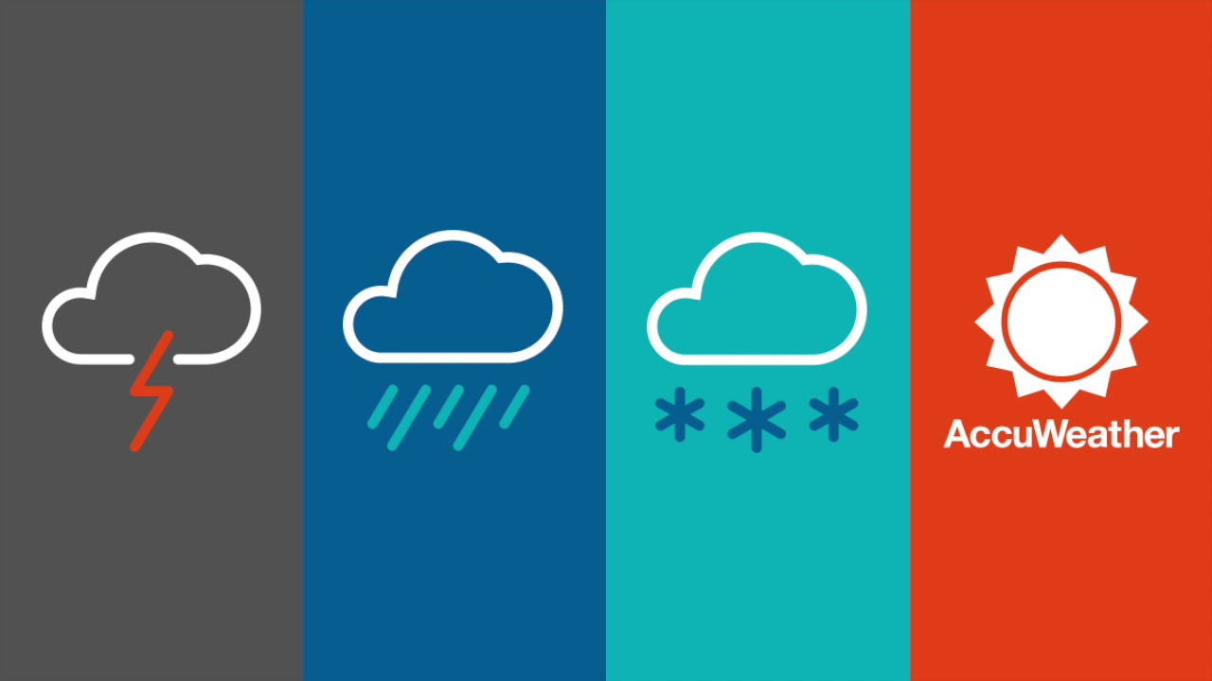
Check the weather on Terminal !

Slide 3
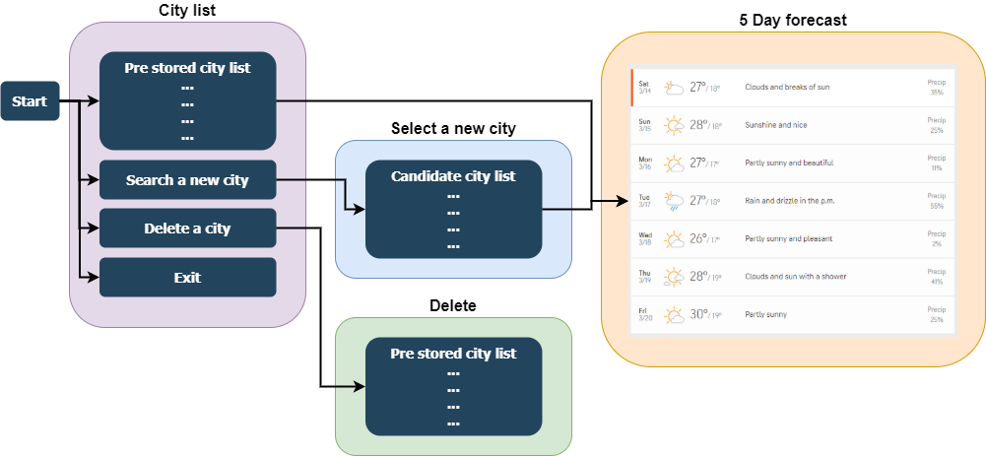
What you can do in AccuWeather application

Slide 4
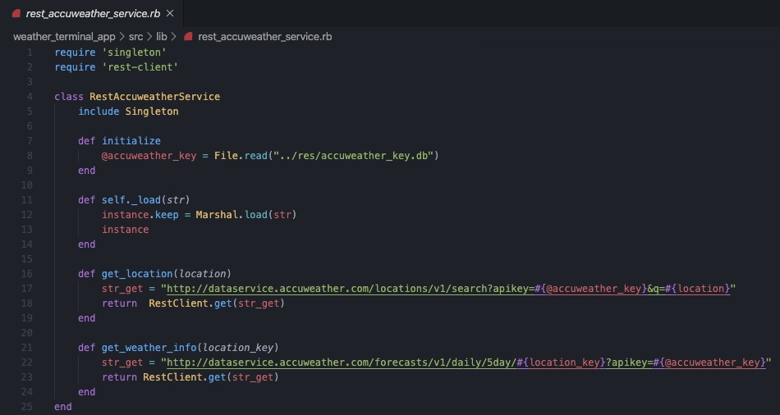
- RestAccuweatherServie class runs as a Singleton and call the REST API to get the information of location and the weather information.

