Slide 1
Phonopy http://phonopy.sourceforge.net/
A python based open source package for phonon calculations based on the supercell approach.

Slide 2
Key Features
Phonon dispersion relation (band structure)
Phonon DOS and partial-DOS
Phonon thermal properties, free energy, heat capacity, and entropy
Thermal expansion and heat capacity at constant pressure within quasi-harmonic approximation (phonopy-qha)
Crystal symmetry tools
Python module (Phonopy can be used in python script.)
Graphical plots

Slide 3
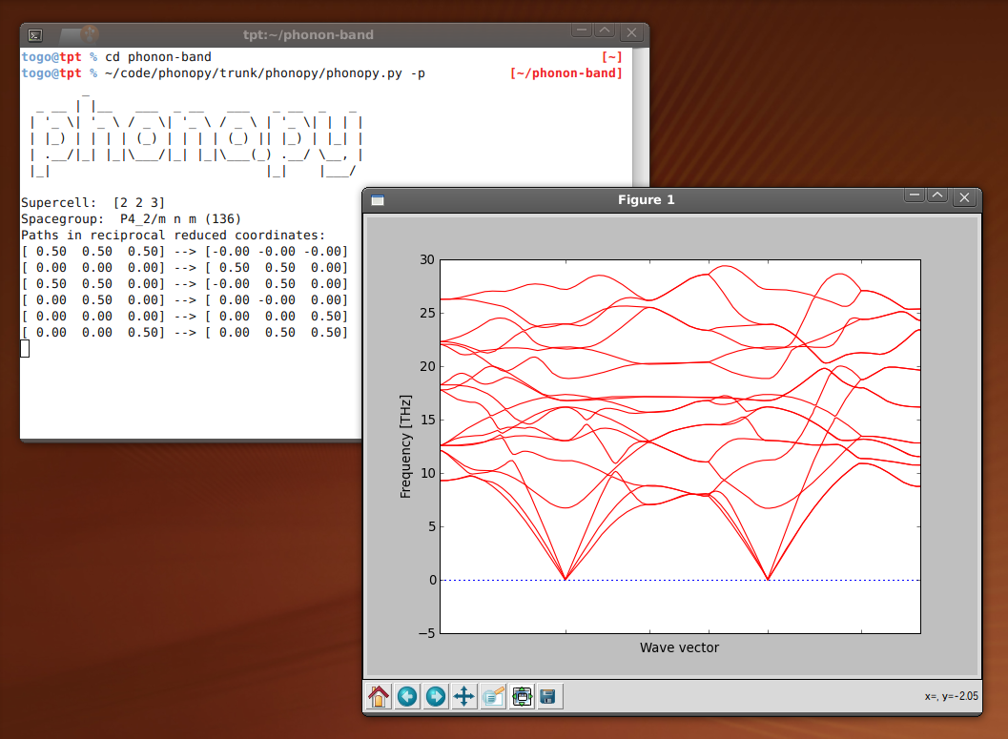

Slide 4
Workflow
Pre-process
Create input file, POSCAR, specifying the atomic positions in the primitive unit cell
Run Phonopy to generate atomic positions with appropriate small displacement in a supercell
Calculation of sets of forces
Run VASP or QuantumEspresso to determine the forces for the supercell produced in pre-process
Post-process
Force constants are calculated from the sets of forces
A part of dynamical matrix is built from the force constants
Phonon frequencies and eigenvetors are calculated from the dynamical matrices with the specified q-points.

Slide 5
