Slide 1




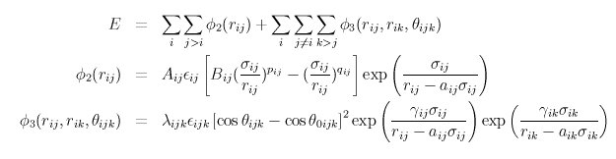
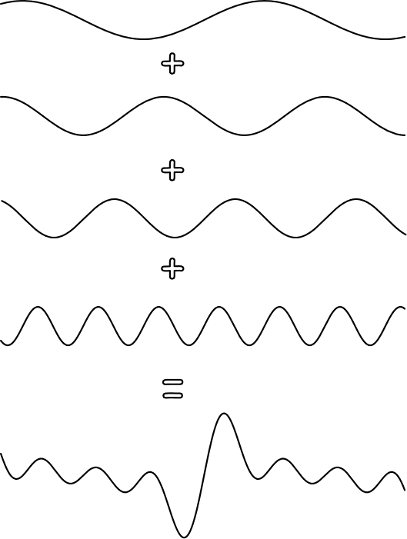
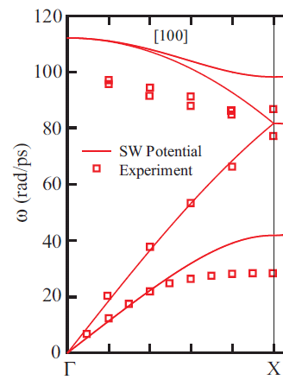
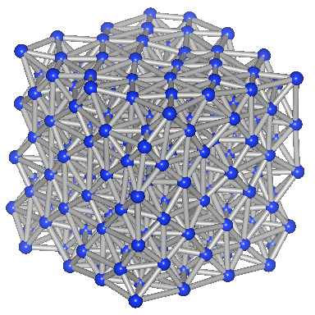
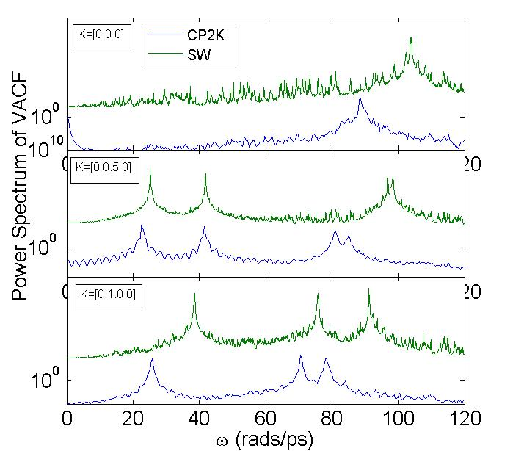
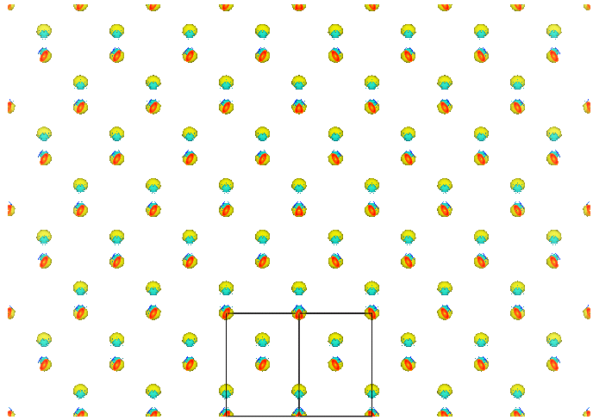
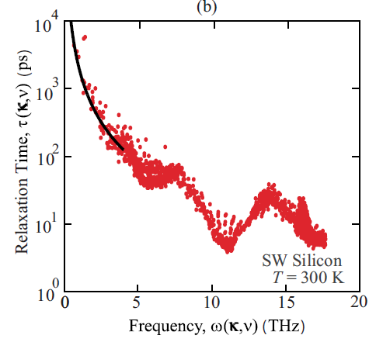
PREDICTING PHONON PROPERTIES FROM AB-INITIO MOLECULAR DYNAMICS AND NORMAL MODE DECOMPOSITION
[Add title, if necessary.]
[Add key point.]
[Sub-bullet]
[Sub-bullet]
[Add key point.]
[Sub-bullet]
[Sub-bullet]
[Add title, if necessary.]
[Add key point.]
[Sub-bullet]
[Sub-bullet]
[Add key point.]
[Sub-bullet]
[Sub-bullet]
￼
Jason Larkin¹, Alex Massicotte¹, Alan J.H. McGaughey¹ , Wissam A. Al-Saidi² ¹Department of Mechanical Engineering, Carnegie Mellon University, ²Department of Chemistry, University of Pittsburgh
Supported by AFSOR FA95501010098 (2010 YIP)
Background
Normal Mode Decomposition
Ab-Initio Molecular Dynamics
Simulation Expense
- Thermal conductivity of Si (dielectric) is determined by phonons:
- Atomic motion is a superposition of normal modes:
Density Functional Theory:
CP2K
3 steps/min/128cpu =
0.023 steps/min/cpu
Stillinger-Weber
6E4 steps/min/4 cpu =
15000 steps/min/cpu
NEED:
Equilibrium positions
Eigenvectors from Lattice Dynamics
Velocities from Molecular Dynamics
- Classical molecular dynamics simulation over-predicts experiment at 300K:
Molecular Dynamics:
¹
Power Spectrum
=
=
CP2K²:
Used 128 CPU on Diamond and Garnet
Mixed Gaussian and Plane Wave code:
- Ab-Initio molecular dynamics can model Silicon accurately to measure phonon properties:
- Map atomic motion onto normal modes:
OBJECTIVE
[Repeat objective from above.]
-Phonon lifetime/mean free path:
- Power spectrum of normal modes:
Power Spectrum
ω (rads/ps)
Si electronic kinetic energy density calculated using Density Functional Theory
Normal Mode Spectral Energy is Lorentzian with peak at phonon frequency.
Vibrational power spectrum for Si from CP2K and Stillinger-Weber with matching dispersion curve.
²http://cp2k.berlios.de/
¹E. S. Landry, Ph.D. Thesis, Carnegie Mellon University 2009

