Slide 1
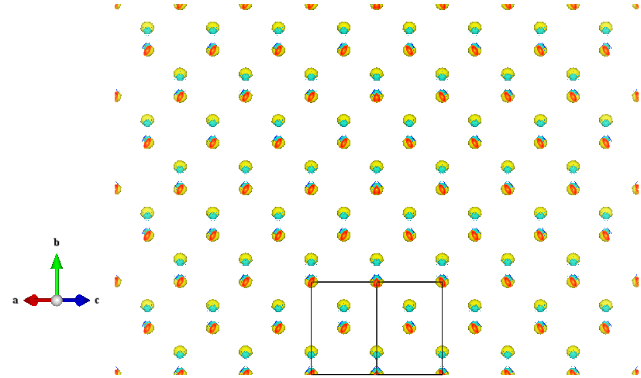
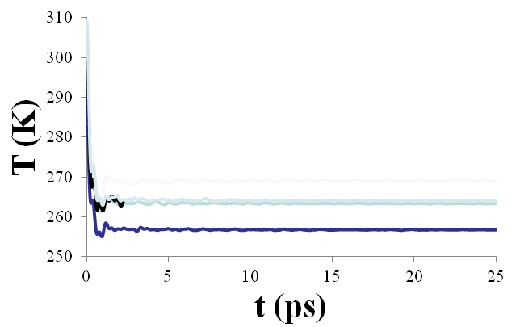
Silicon at ~ 300 K from DFT
Diamond and Garnett
CP2K: mixed Gaussian/Plane Wave code.
Picture of structure
Timing
Some sort of plot (T vs t), spectral? Vac for DOS

