Slide 1
1
Predicting Phonon Properties of Defected Systems using the Spectral Energy Density
Comparison and Evaluation of Spectral Energy Methods for Predicting Phonon Properties
Jason Larkin
Alan McGaughey
Nanoscale Transport Phenomena Laboratory
Carnegie Mellon Department of Mechanical Engineering
http://ntpl.me.cmu.edu/
11/28/2011

Slide 2
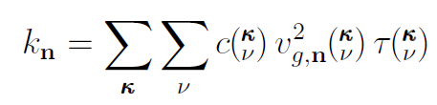
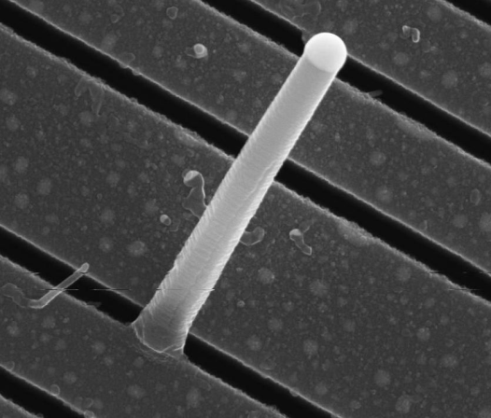
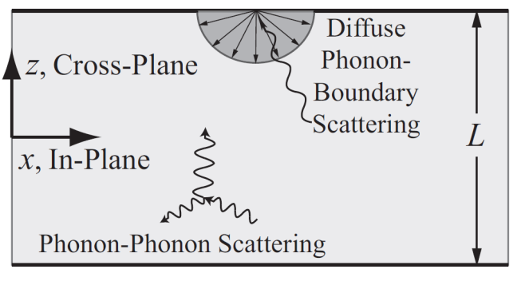
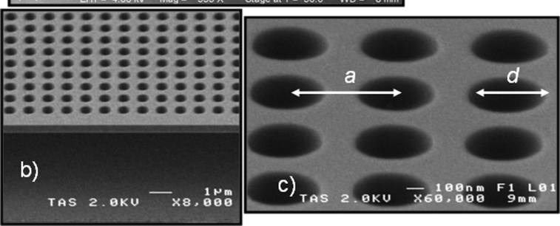
Phonon Properties
2
Thermal Conductivity:
Matthiesen Rule1,2:
Nano Letters 11, 107-112 (2011).
Nano Letters 9 2009 864-869
Accurate phonon lifetimes are important!
1A. J. H. McGaughey et al., Applied Physics Letters 99, 131904 (2011).
2D. P. Sellan, et al., Journal of Applied Physics 108, 113524 (2010).

Slide 3
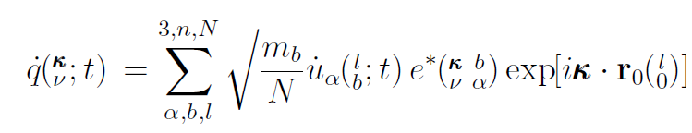
Phonon Normal Mode Coordinate1,2
3
Phonon occupation:
Need:
Allowed wavevectors (from crystal):
Atomic velocities (from molecular dynamics):
Eigenvector (from lattice dynamics):
Phonon occupation:
Lattice dynamics requires periodic system.
1M. T. Dove, Introduction to Lattice Dynamics.
2D. C. Wallace, Thermodynamics of Crystals.

Slide 4
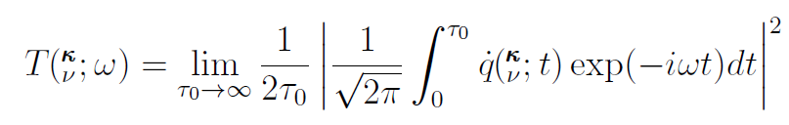

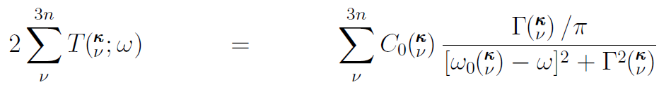
Phonon Lifetime from Spectral Energy
4
Broad peak = short lifetime
SED(ν)
ω

Slide 5
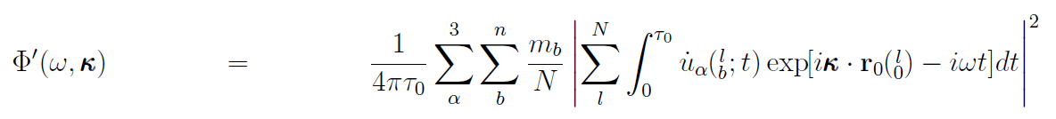
Proposed Phonon Spectral Energy1,2
5
Need:
Allowed wavevectors:
Atomic velocities:
Eigenvector from lattice dynamics:
Measure lifetimes in defected/disordered systems!
Does NOT represent phonon spectral energy!
1S. Maruyama, Microscale Thermophysical Engineering 7, 41 (2003).
2J. A. Thomas, et al., Physical Review B 81, 081411(R) (2010).

Slide 6
Proposed Phonon Spectral Energy
6
- Originally proposed to measure dispersion in CNT.
1S. Maruyama, Microscale Thermophysical Engineering 7, 41 (2003).
- Measured lifetime reduction in water-filled CNT and on SiO2.
2J. A. Thomas, et al., Physical Review B 81, 081411(R) (2010).
3Z.-Y. Ong, et al., Physical Review B 84, 104302 (2011).
- Lifetimes in bulk PbTe agree with experiment
4B. Qiu, et al., Computational Materials Science 53, 278285 (2011).
- Lifetimes in MgO and Half-Heusler alloys from ab-initio
5N. de Koker, Physical Review Letters 103, 125902 (2009).
6J. Shiomi, et al., Physical Review B 84, 104302 (2011).

Slide 7
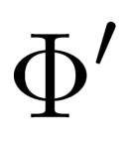

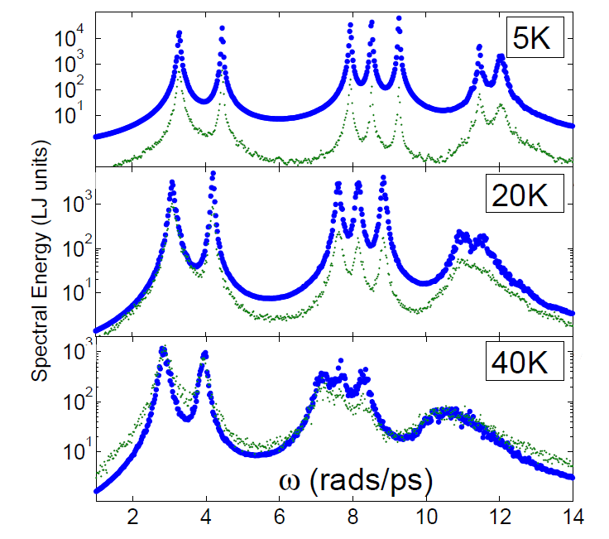
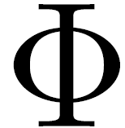
Phonon Spectral Energy Comparison
7
LJ Ar K = [π/2a 00]
Peak locations (freq) agree well.
Clear linewidth variations:
Area under curve is total phonon kinetic energy only for

Slide 8
3 Case Studies
8
Lennard-Jones Ar: well-studied, computationally cheap
Stillinger-Weber Silicon1: “stiff” system (high frequencies, large group velocities, long lifetimes).
Carbon nanotube using REBO2,3: test/validate previous work.
1F. H. Stillinger and T. A. Weber, Physical Review B 31, 5262 (1985).
2D. W. Brenner, et al., Journal of Physics: Condensed Matter 14, 783 (2002).
3J. A. Thomas, et al., Physical Review B 81, 081411(R) (2010).

Slide 9
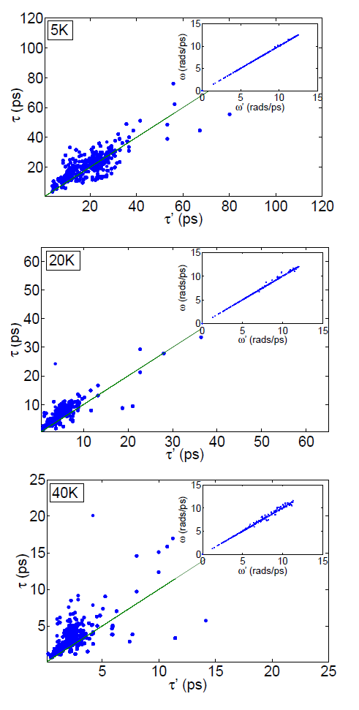
Case Study: LJ Lifetimes
9
Frequencies agree well, increasing scatter with T(K)
Lifetimes large scatter independent of T(K)

Slide 10
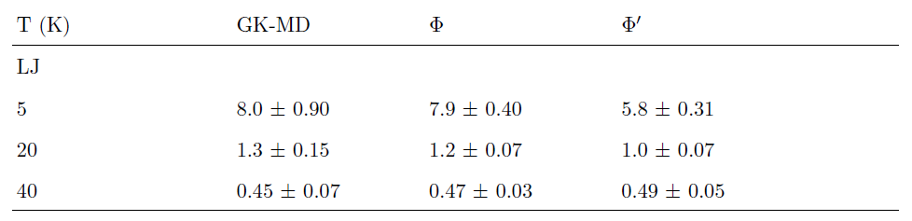


Thermal Conductivity Predictions: LJ
10
LJ results for and other methods agree1, does not.
Results from exact same molecular dynamics data.
1J. E. Turney, et al., Physical Review B 79, 064301 (2009).
2J. A. Thomas, et al., Physical Review B 81, 081411(R) (2010).

Slide 11
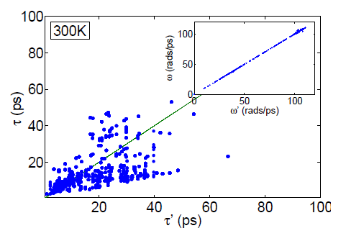
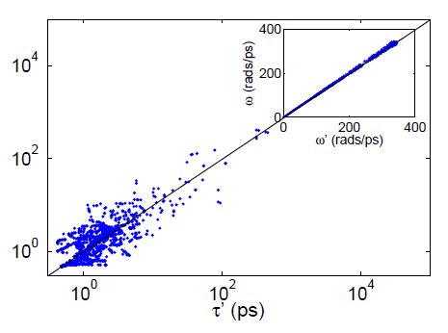
Case Study: SW Si and CNT Lifetimes
11
Frequencies agree well
Lifetimes large scatter
Si
Frequencies agree well
Lifetimes large scatter
CNT

Slide 12
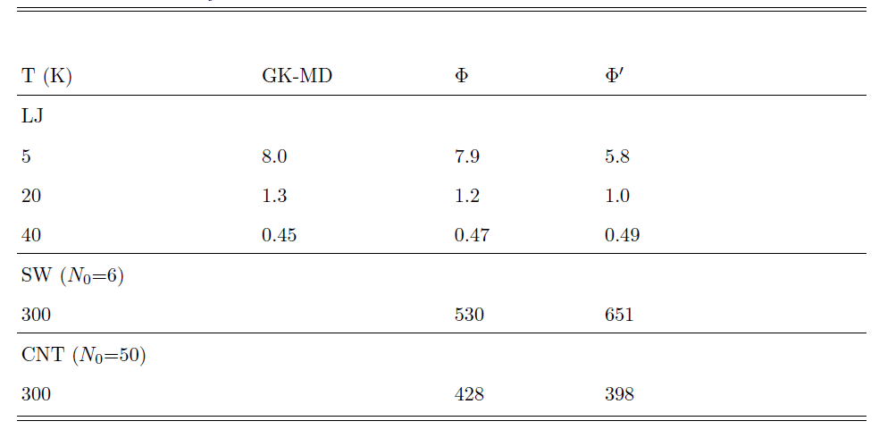
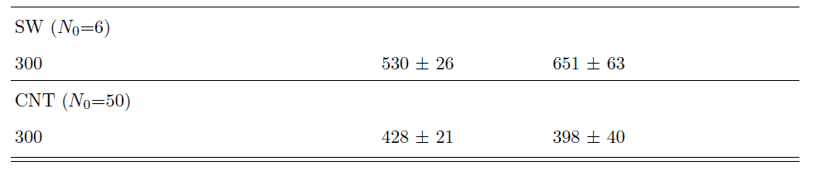
Thermal Conductivity Predictions: SW Si and CNT
12
- SW Si and CNT2 results indicate no systematic behavior for .
1J. E. Turney, et al., Physical Review B 79, 064301 (2009).
2J. A. Thomas, et al., Physical Review B 81, 081411(R) (2010).

Slide 13
Proposed Phonon Spectral Energy Density
13
Should NOT be used to predict lifetimes or thermal conductivity!
Can accurately measure frequencies, even in disordered systems.

Slide 14
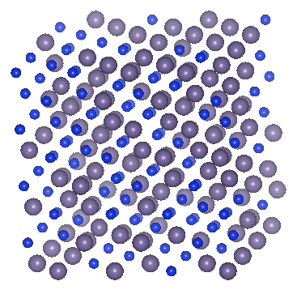
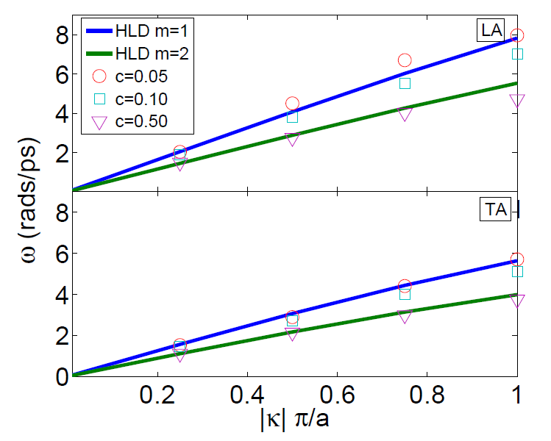

Dispersion in Disordered Systems
14
c=0.5
me=2
K = [100]
LJ alloys with:
ma = 1
mb = 3
- Dispersion well approx. by lattice dynamics w/me
- Original purpose for 1!
1 S. Maruyama, Microscale Thermophysical Engineering 7, 41 (2003).

Slide 15
Questions
15
Acknowledgments:
This work is supported by AFOSR award FA95501010098.

Slide 16
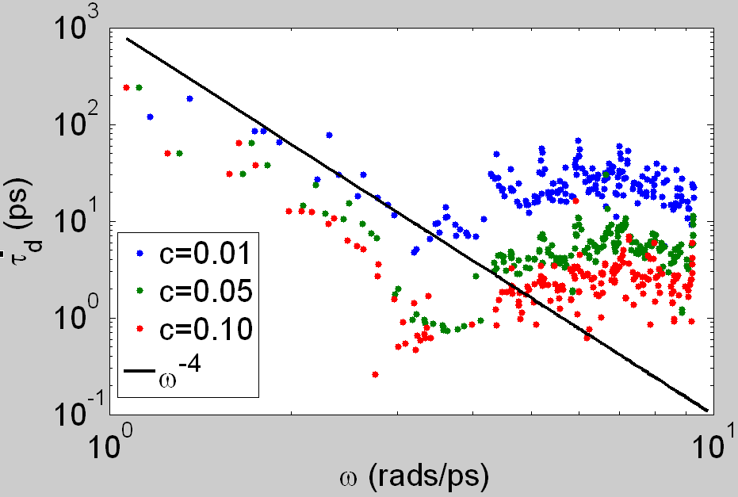
Defect Scattering
16
Matthiesen Rule:
Rayleigh scattering:

Slide 17
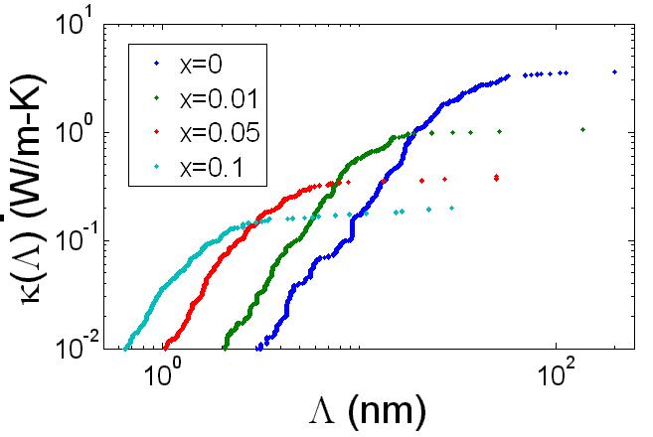
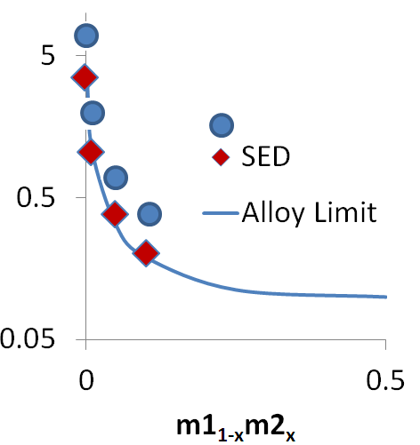
Thermal Conductivity of Thin Films
17
GK

