Slide 1
Ordered and Disordered Contributions to Lattice Thermal Conductivity
1
Jason Larkin and Alan McGaughey
Nanoscale Transport Phenomena Laboratory
Carnegie Mellon Department of Mechanical Engineering
http://ntpl.me.cmu.edu/
07/12/2012

Slide 2
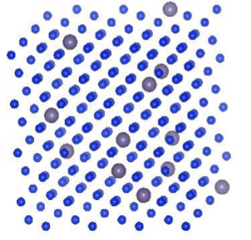
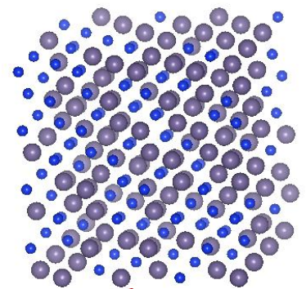
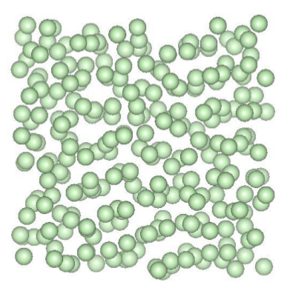

Thermal Transport in Disordered Materials
2
Phonon picture valid with perturbations. Perfect systems and dilute alloys
- Phonon picture only valid for very long wavelengths. Alloy and amorphous
- Localized vibrations (diffusons) become important.
(disorder)
(order)

Slide 3
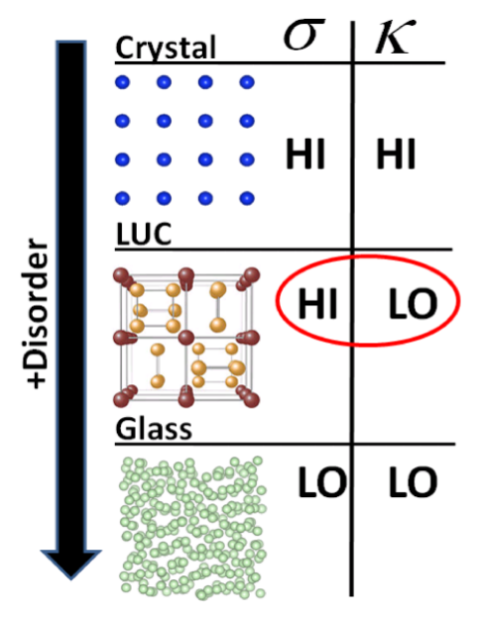
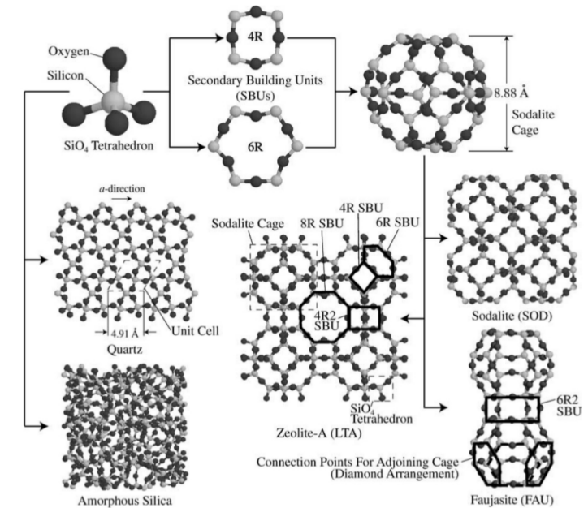
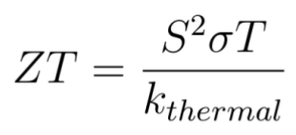
Thermal Transport in Disordered Materials: Applications
3
- Crystal → Large Unit Cell → amorphous

Slide 4
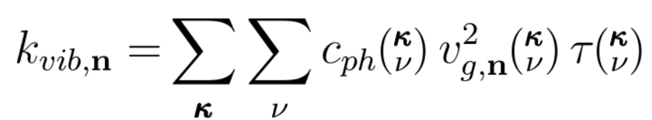


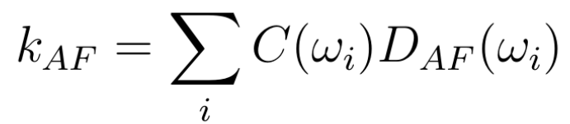
Theoretical Models
4
Phonons (ordered): Interacting Phonon Gas
phonon-phonon (anharmonicity), defects (dilute), boundaries, (phonon-diffuson?)
Diffusons (disordered): Allen-Feldman Theory
?
diffuson-diffuson, (boundaries, diffuson-phonon?)
/ V
/ V
LD : Lattice Dynamics => frequencies, group velocities, eigenvectors for phonon mapping, harmonic disordered thermal conductivity
MD: Molecular Dynamics => Green-Kubo, trajectories for phonon mapping, phonon/diffuson lifetimes
Classical Only: for solids, Force Constant MD can

Slide 5
Modeling Tools
5
 | Predicted quantities | Computational cost | Code availability
Green-Kubo (GK) w/ Molecular Dynamics (MD) | Thermal conductivity | Classical | Several
Harmonic Lattice Dynamics (HLD) | Vibrational frequencies, eigenvectors, group velocities, diffuson properties (Allen-Feldman (AF)) | Classical/Ab-Initio | Several
Normal Mode Decomposition (NMD) w/ HLD and MD | Thermal conductivity, Vibrational frequencies, lifetimes | Classical | None
LD : Lattice Dynamics => frequencies, group velocities, eigenvectors for phonon mapping, harmonic disordered thermal conductivity
MD: Molecular Dynamics => Green-Kubo, trajectories for phonon mapping, phonon/diffuson lifetimes
Classical Only: for solids, Force Constant MD can

Slide 6
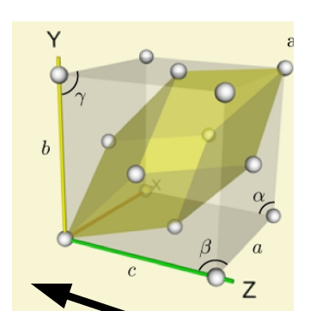
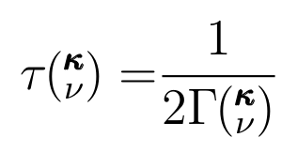




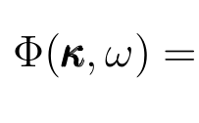
Systems Modeled: LJ Alloys and Amorphous
5
Unit cell
Virtual Crystal (VC) approximation
T=10K
c=0.5, mavg = 2.0
System sizes: up to 4000 atoms, 6 nm
= 0
Unit cell
LD : Lattice Dynamics => frequencies, group velocities, eigenvectors for phonon mapping, harmonic disordered thermal conductivity
MD: Molecular Dynamics => Green-Kubo, trajectories for phonon mapping, phonon/diffuson lifetimes
Classical Only: for solids, Force Constant MD can

Slide 7
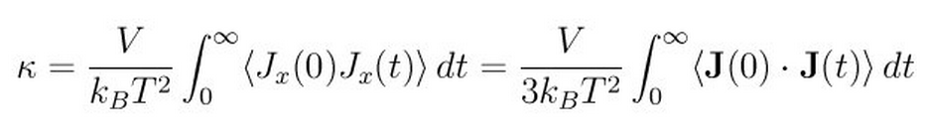
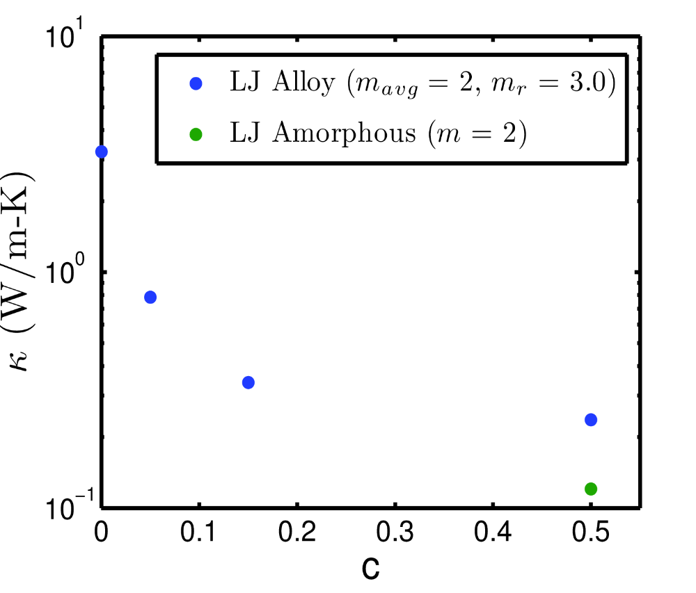
Thermal Conductivity: System-Level
6
Green-Kubo
Heat current J has all effects of MD (anharmonicity, defects, etc.)
Heat current J has KE and PE parts.
J is difficult to define using ab-initio calculations.
T=10K

Slide 8
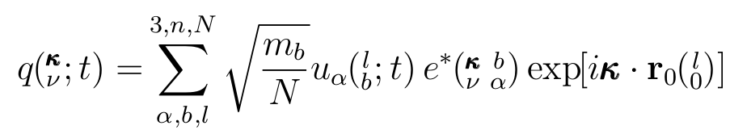
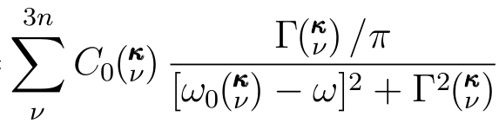
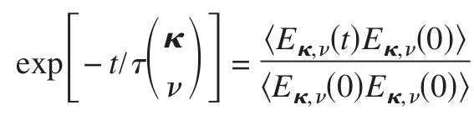
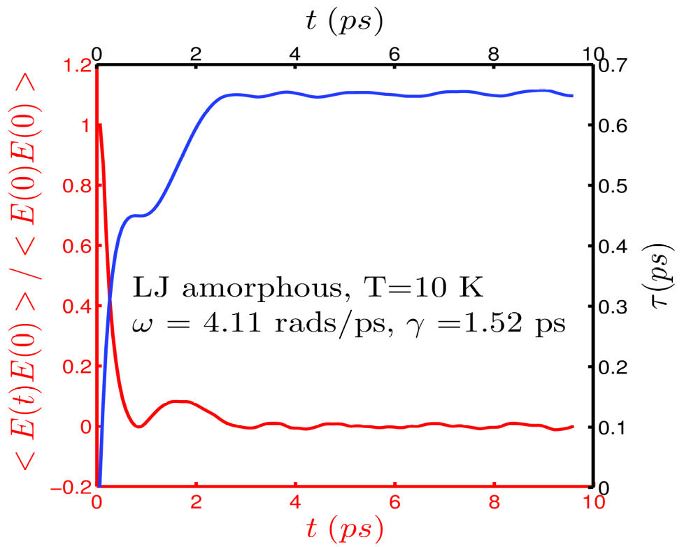
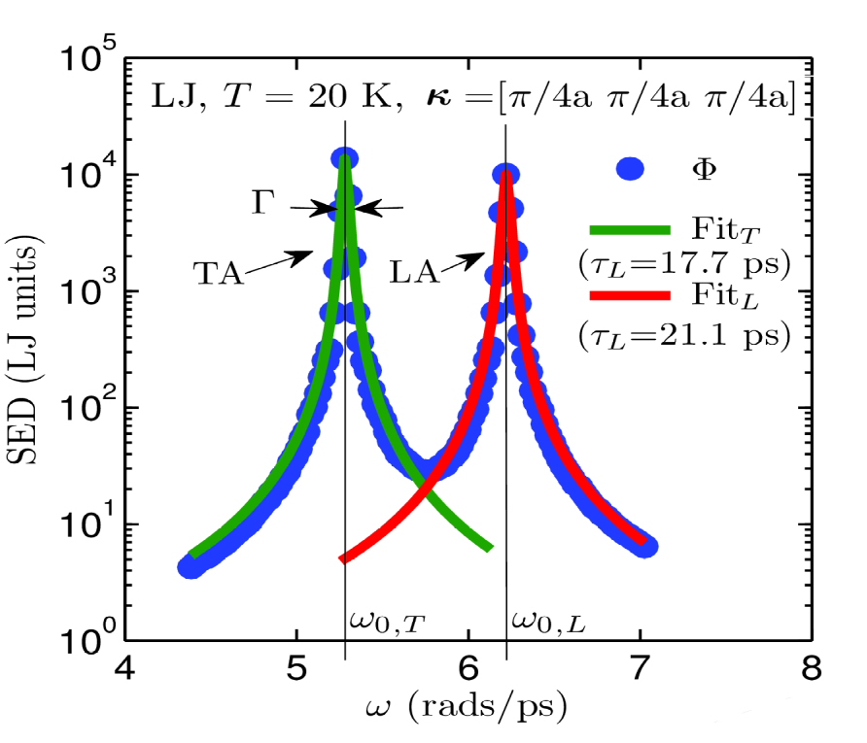
Normal Mode Decomposition (NMD)
7
NMD: Frequency-Domain
NMD: Time-Domain
Kinetic Energy

Slide 9
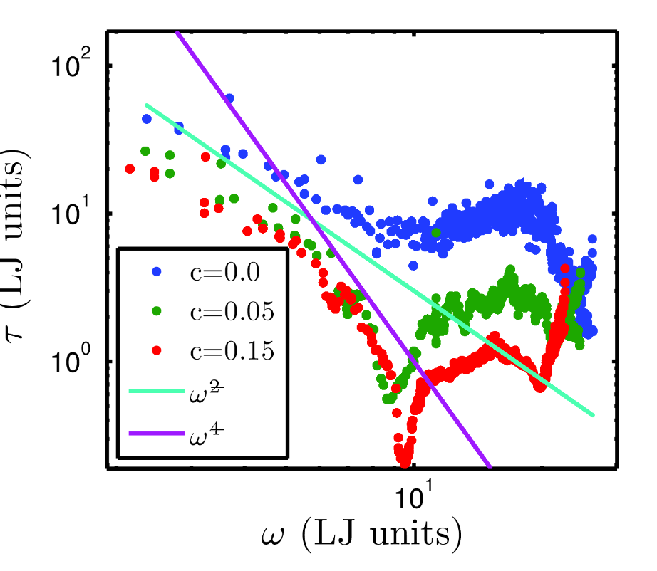
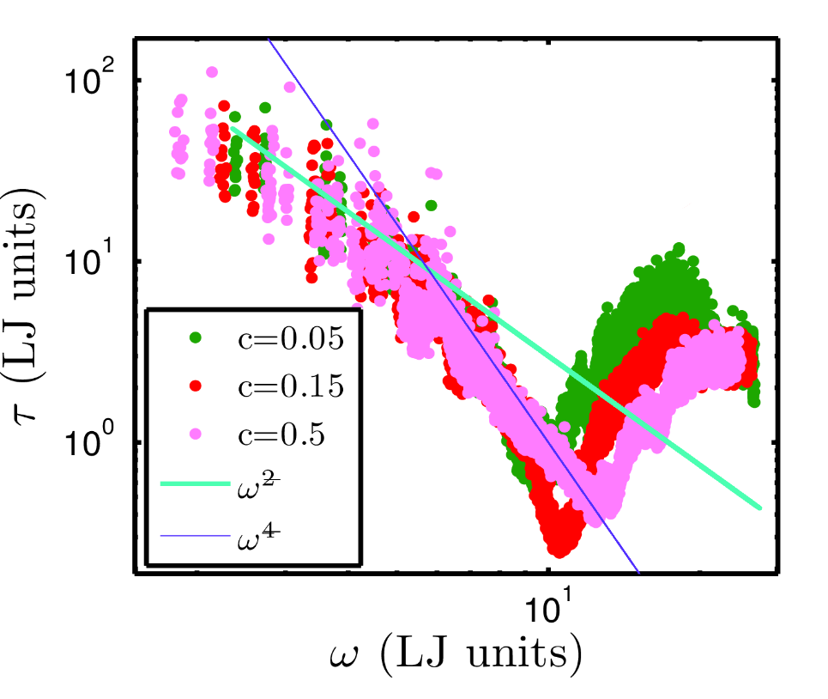
Normal Mode Decomposition (NMD)
8
Virtual Crystal
Gamma point
= 0

Slide 10
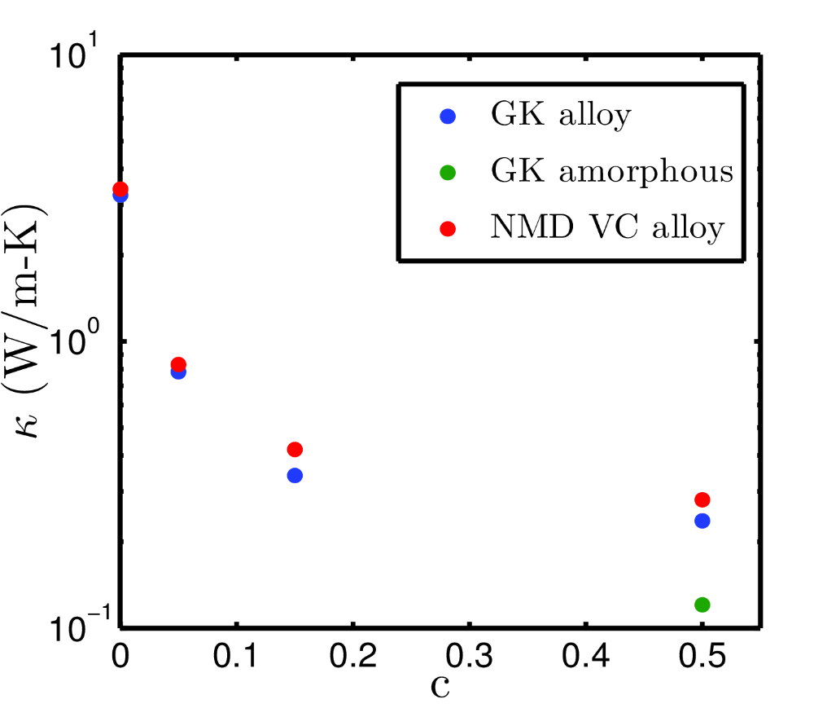
Thermal Conductivity: System- and Carrier-Level
9
Virtual Crystal approximation and phonon scaling relations work well!
Anharmonic Lattice Dynamics + Defect scaling =
PHYSICAL REVIEW B 85, 184303 (2012)
PRL 106, 045901 (2011)

Slide 11
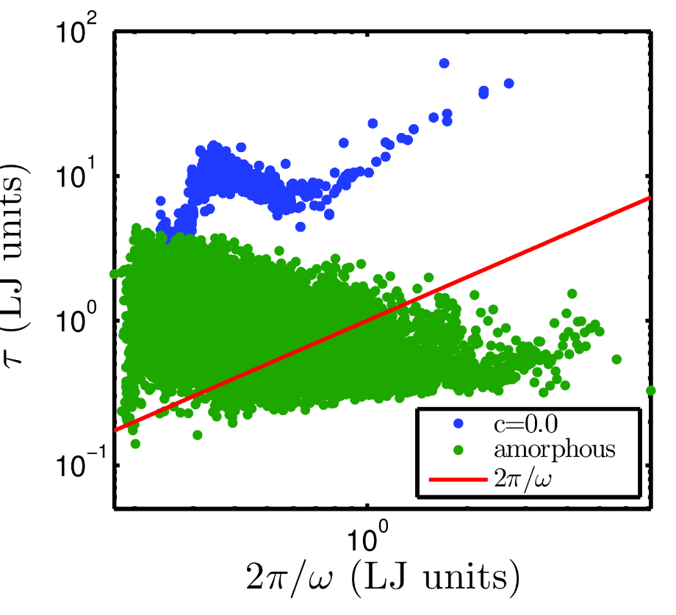
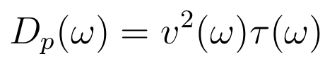
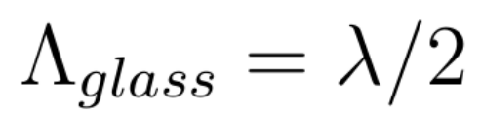

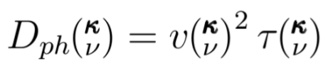
Ordered and Disordered Vibrations
10
Ioffe-Regel Limit:
/
Cahill-Pohl Model:
/
s
Solid State Communications 70 (1989) 927-930.

Slide 12
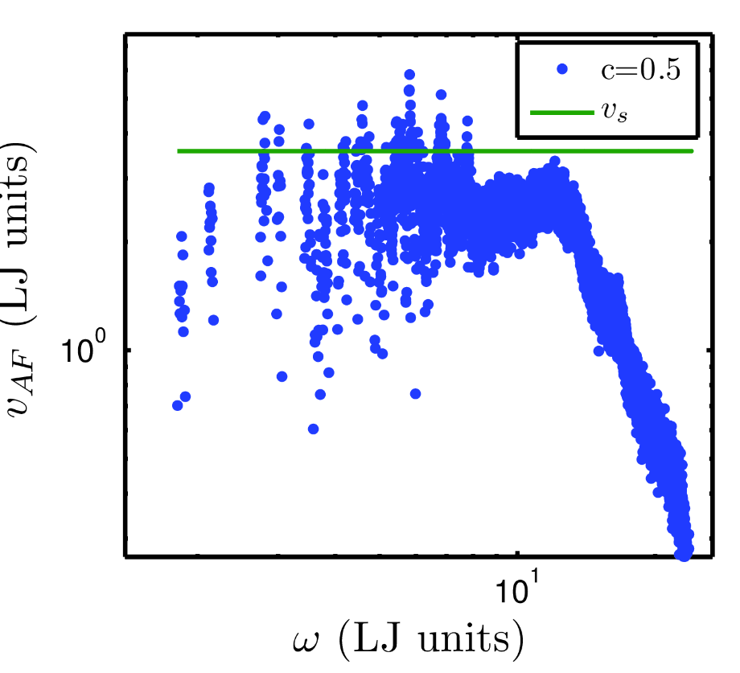

Ordered and Disordered Vibrations
11
Dynamic Structure Factor:
Low-frequency modes can identify a wavelength, not possible in general:
PHIL. MAG. B 79, 1715-1731 (1999)
PHIL. MAG. B 79, 1747-1754 (1999)
?
Phonons
Diffuson
/
>
s
= sound speed
s
<
Phonon:
s
s
Diffuson:
1/2
(
)

Slide 13
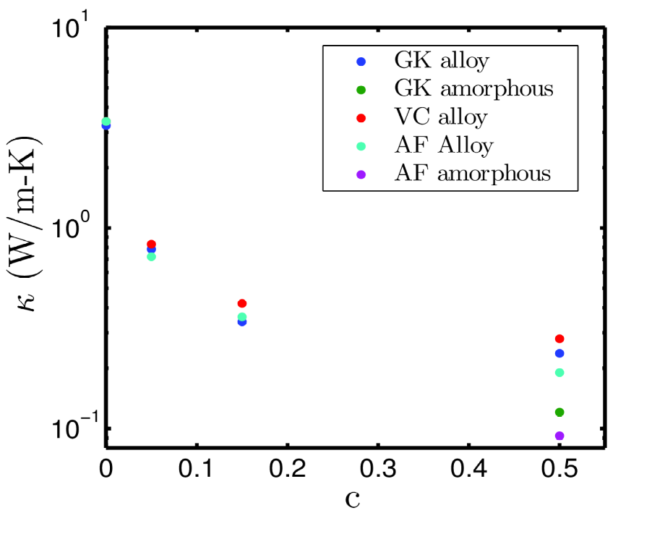
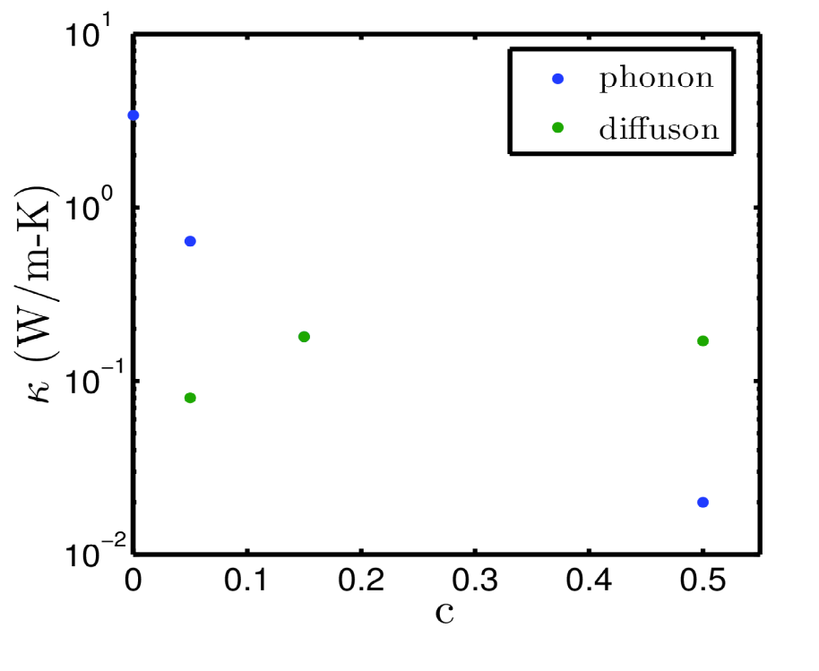
Predicted Thermal Conductivity
12

Slide 14
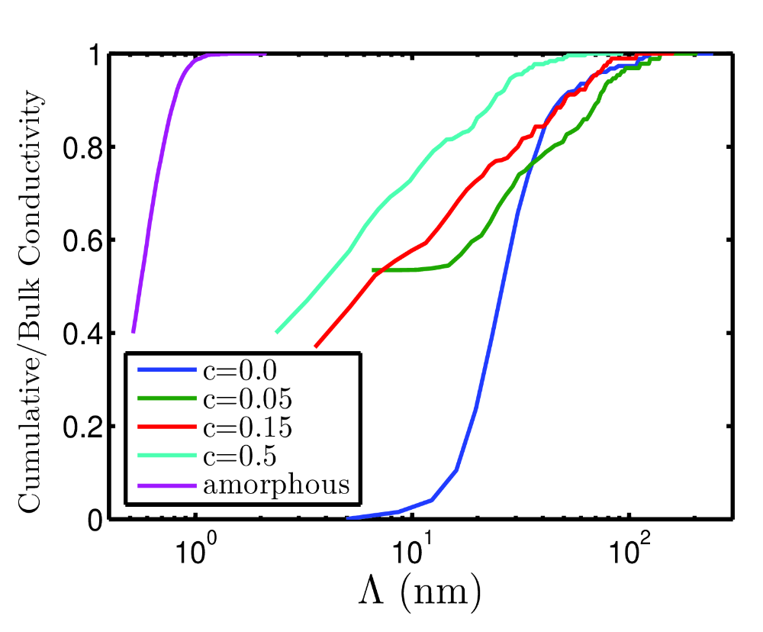
Cumulative Thermal Conductivity
13
- Boundary Scattering:
Cumulative Thermal Conductivity
- Large c alloys and amorphous vibrations have decreased MFP
- Boundary scattering less effective for length scales >10 nm

Slide 15
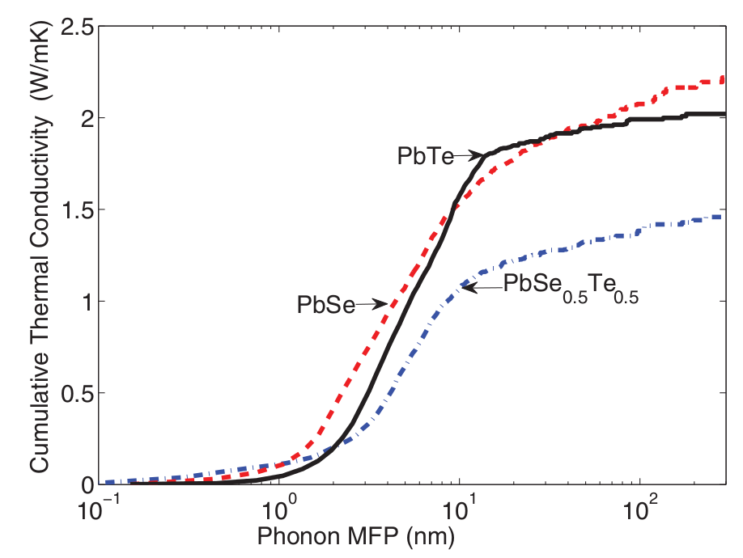
Bulk Thermoelectrics
14
- Bulk thermoelectric systems are “soft” (small group velocities, small lifetimes)
- MFPs are typically < 100 nm, boundary scattering not effective
- Alloying can still be effective
PHYSICAL REVIEW B 85, 184303 (2012)

Slide 16
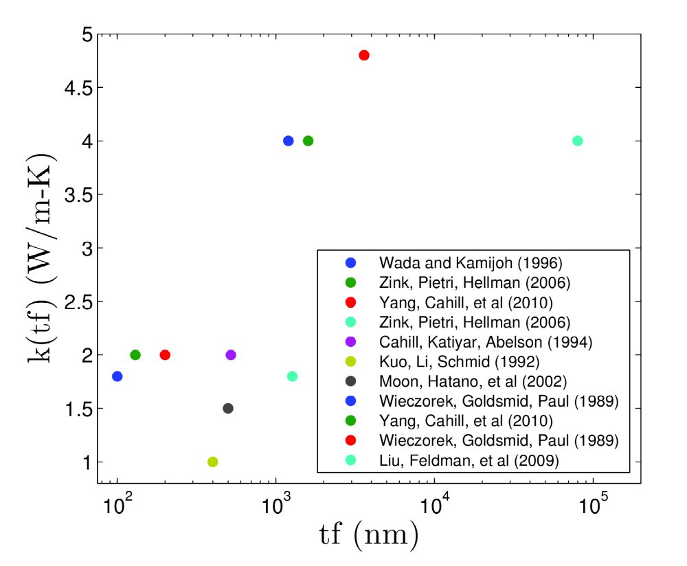
Amorphous Silicon
15
- a-Si thermal conductivity displays clear film thickness dependance
- Indicates a phonon-like boundary scattering dependance
- Ordered/Disordered analysis could measure the MFP spectrum in a-Si
APPLIED PHYSICS LETTERS 98, 144101 ͑2011͒

Slide 17
Questions
16

Slide 18
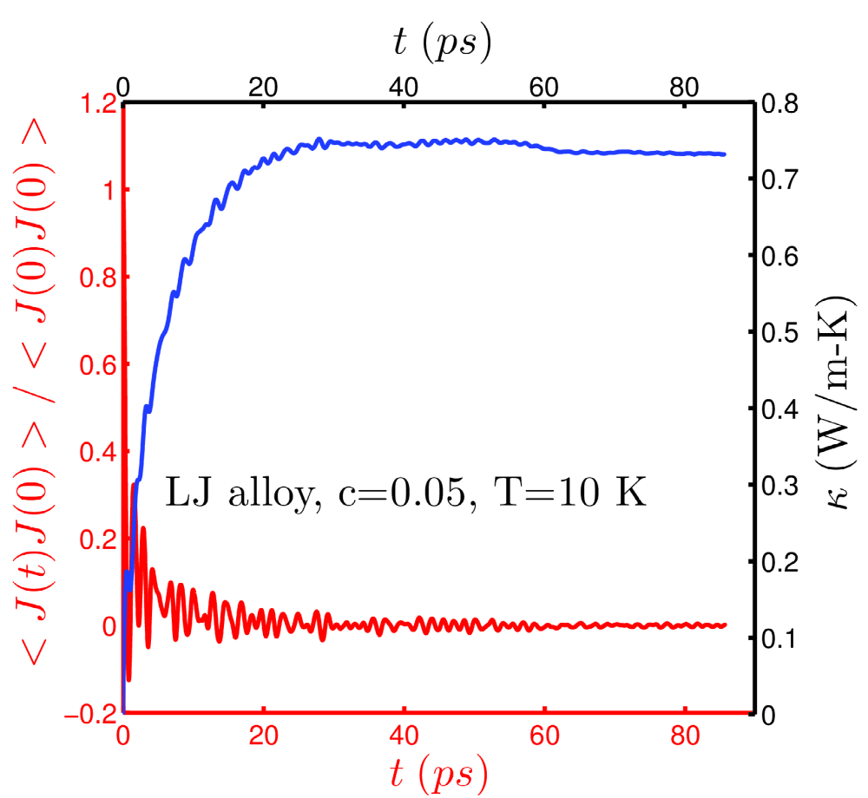
Green-Kubo
2
Heat current J has all effects of MD (anharmonicity, defects, etc.)
Heat current J has KE and PE parts.
J is difficult to define using ab-initio calculations.

Slide 19
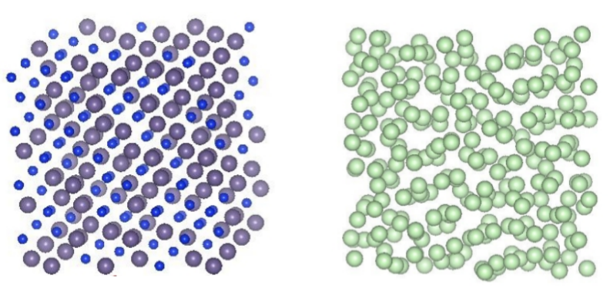
Normal Mode Decomposition (NMD)
34
Perfect system: vibrations are phonons with an allowed wavevector
Perturbed system: vibrations are phonons with an allowed wavevector (dilute alloy).
Virtual Crystal (VC) approximation.
Disordered system: vibrations are phonons/diffusons. Vibrations analyzed at Gamma point.
= 0

