Slide 1
Predicting Phonon Properties of Defected Systems using the Spectral Energy Density Jason Larkin Alan McGaughey http://ntpl.me.cmu.edu/ 5/24/2011

Slide 2
Dielectric Thermal Conductivity
Dielectric crystal = Electrical Insulator
Ex: Si, Ge
Dielectric Thermal Conductivity:
Phonons are lattice vibrations…

Slide 3

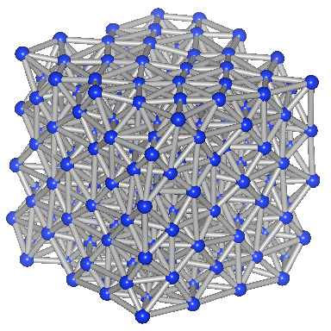
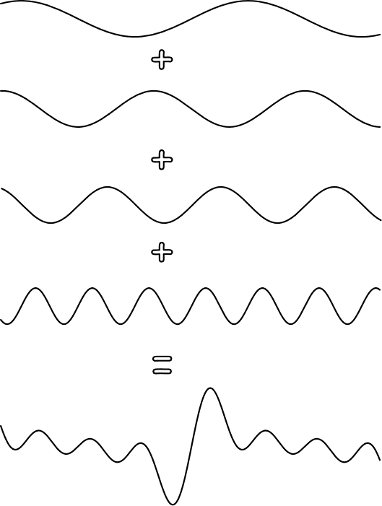
Phonons
m_{atom}
k_{spring}
Lattice vibrations (Phonons) are travelling waves:
Waves that can exist depend on system size.
When system is very large (bulk)…
=
m_{atom}
k_{spring}
Phonons Interact:
Non-linear springs cause phonons to interact.

Slide 4
Thermal Conductivity Phonon Gas
Kinetic Theory Phonon Gas:
T_{H}
T_{c}
If system L >> :
Phonons interact: with each other, defects, boundaries, etc.
Phonons interact

Slide 5
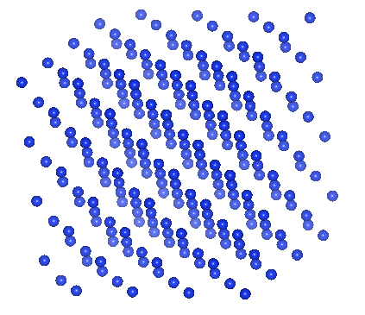
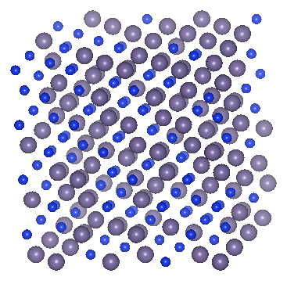
Molecular Dynamics and Spectral Energy Density
Molecular Dynamics
- Lennard-Jones:
Spectral Energy Density
Frequency, group velocity and lifetimes of phonons from Molecular Dynamics.

Slide 6
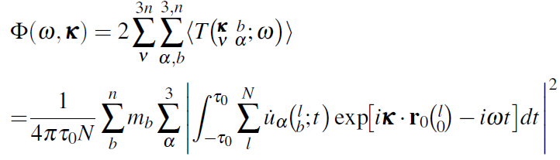
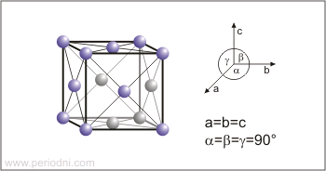
Spectral Energy Density
Spatial and temporal fourier txn.
mass
velocity
allowed wavevectors and equil. positions
- No phonon knowledge required a priori.
Can measure:
PHYSICAL REVIEW B 81, 081411R 2010

Slide 7
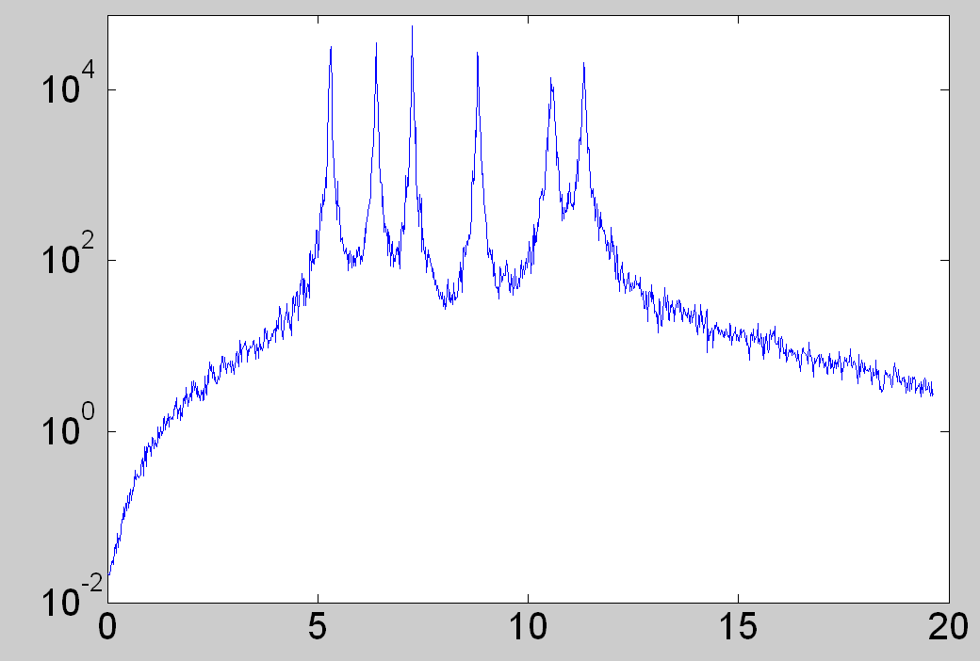
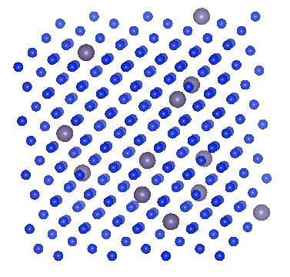
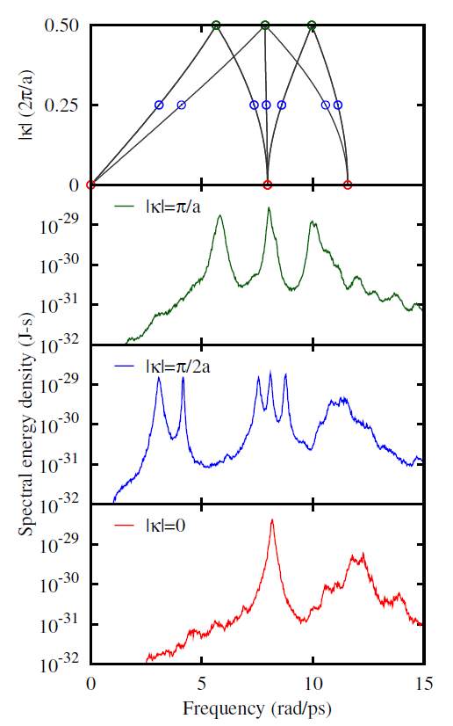
Spectral Energy Density Pure System
SED(ω)
Spectral Energy Density (SED): system energy in frequency and wavevector space.
ω (rads/ps)
Broad peak = short lifetime
PHYSICAL REVIEW B 81, 081411R 2010

Slide 8
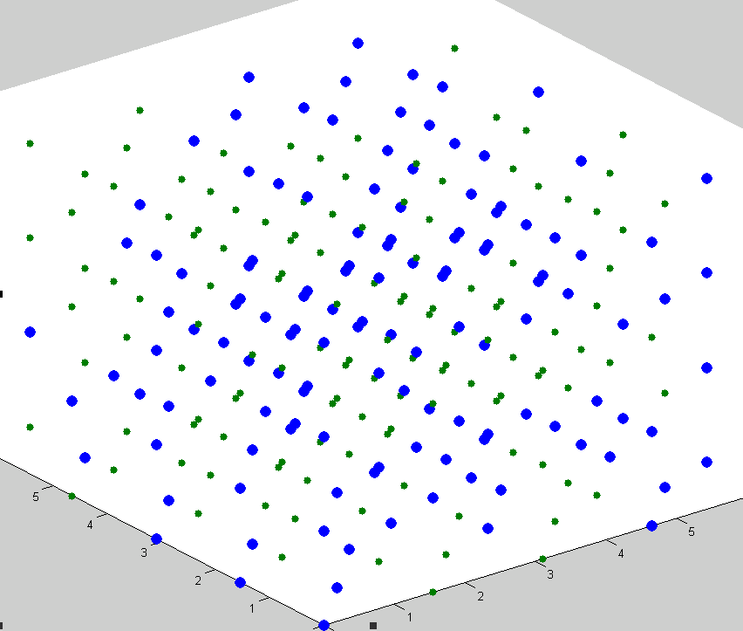
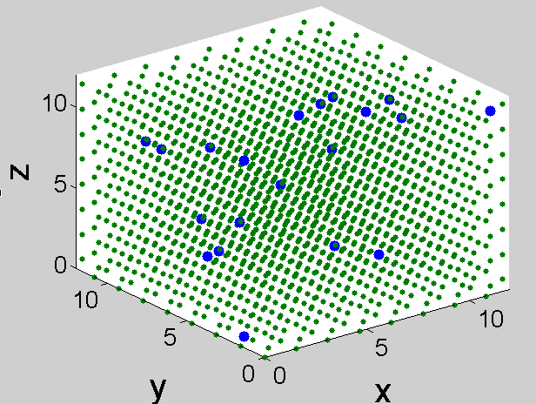
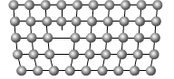
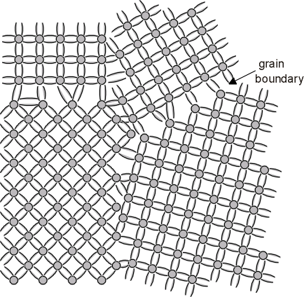
Spectral Energy Density of Defected System
Defect = Disorder = non-periodic
m1=1.0 m2=3.0
Phonon picture still valid?
m1_{1-x}m2_{x}

Slide 9
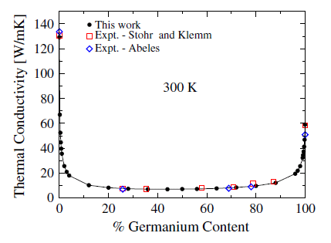
Bulk Thermal Conductivity Prediction
Predict thermal conductivity up to x=0.1 (weakly perturbed)
Typically:
m1/m2 = 3 (m_{Si}/m_{Ge}≈3)
PRL 106, 045901 (2011)

Slide 10
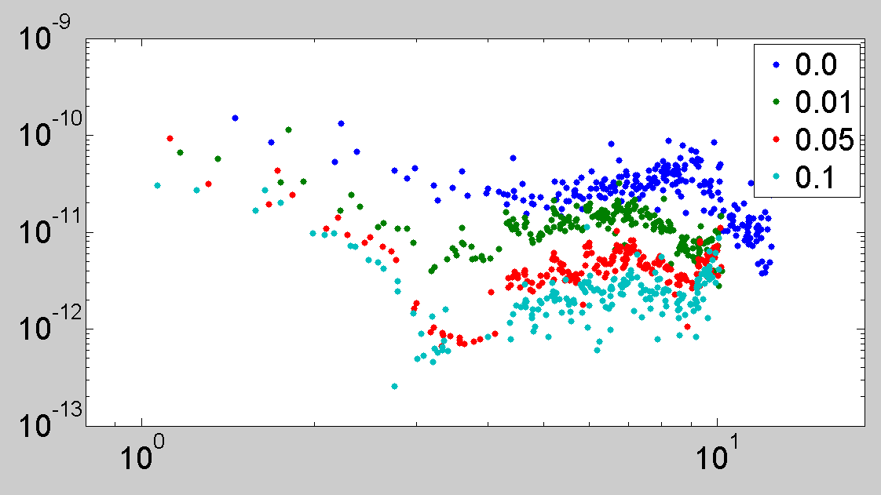
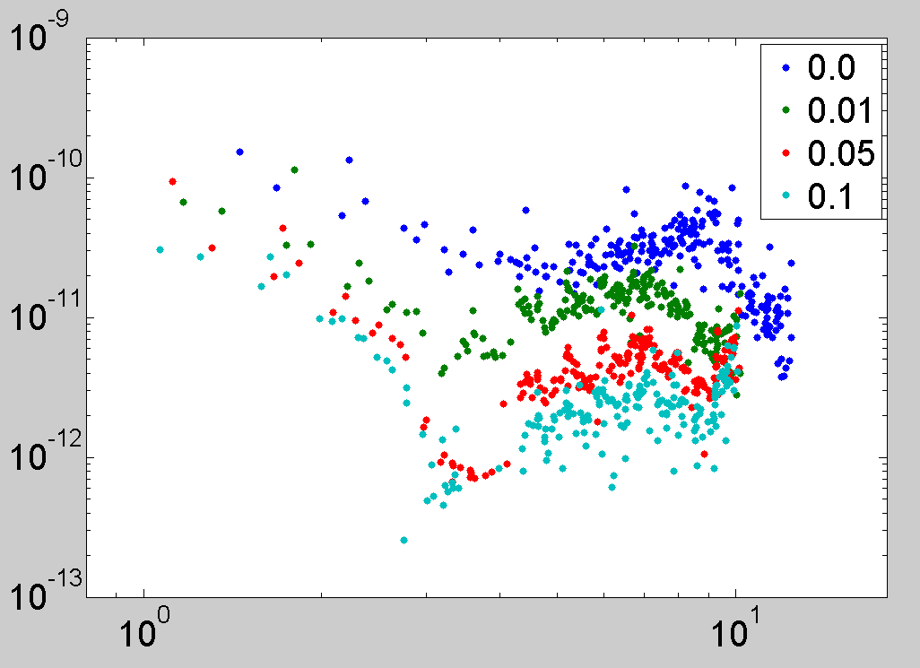
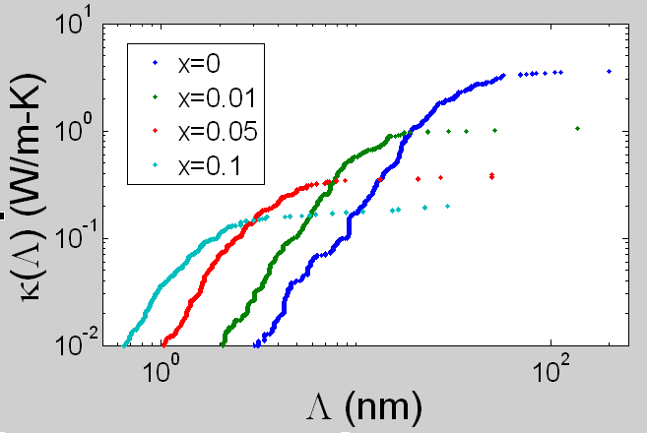
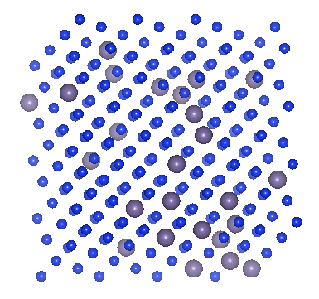
Thermal Conductivity of Thin Films
τ(ω) (ps)
Increasing
Disorder
ω (rads/ps)
Pure
198 – 3 nm
Defected
29 – 0.65 nm

Slide 11

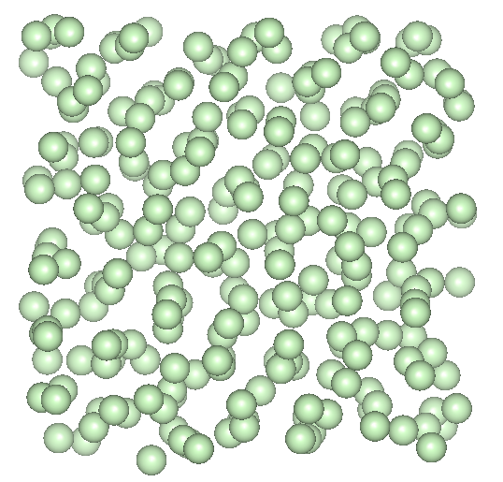
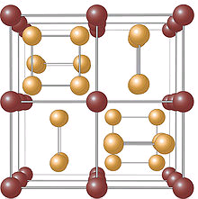
Thermal Conductivity Amorphous (Heavily Disordered) Materials

Slide 12
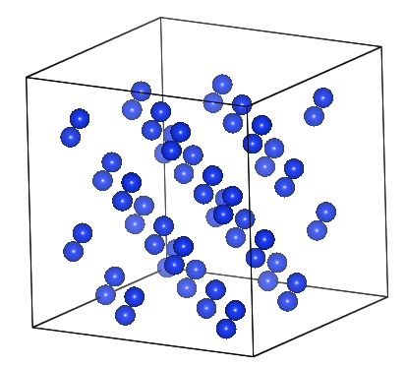
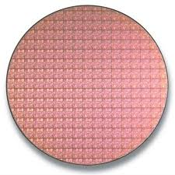
Discussion
Dielectric thermal conductivity can be described by Kinetic Theory (bulk system).
Molecular Dynamics and Spectral Energy Density can measure phonon properties.
Phonon properties can be predicted for “weakly” perturbed systems, analyzed on mode by mode basis.
SED(ω)

Slide 13
Questions

Slide 14
Phonon Gas
Phonon Spectral Distribution
“Acoustic” Modes
Phonons vs. Photons:
Non-linear springs
Phonons interact with each other
Interacting Gas…
m_{atom}

Slide 15
Dispersion of Disordered System
Quasi-Harmonic Lattice Dyanmics:
T=5K
x=0.1
m_{x=0.1}
m_{atom}
a=f(T)
Virtual Crystal Approximation:
m_{x=0.1} = (0.9m1+0.1m2) = 1.2

