Slide 1


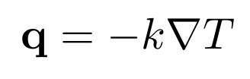
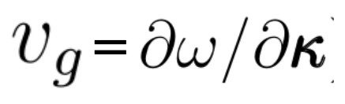
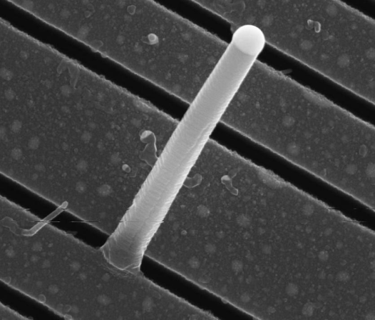

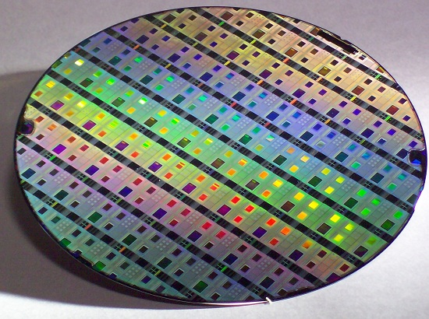
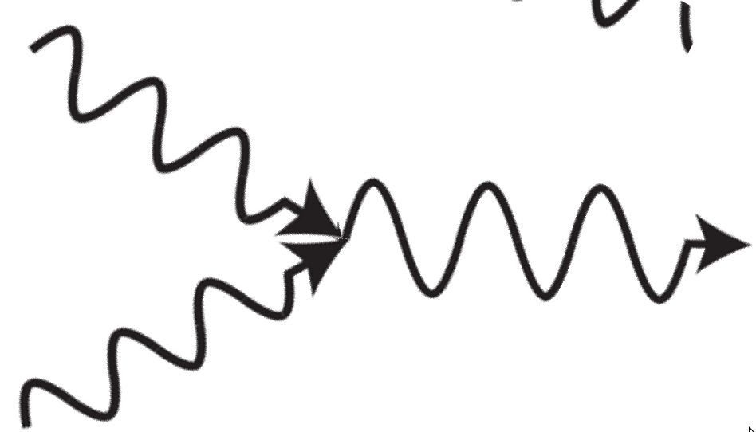
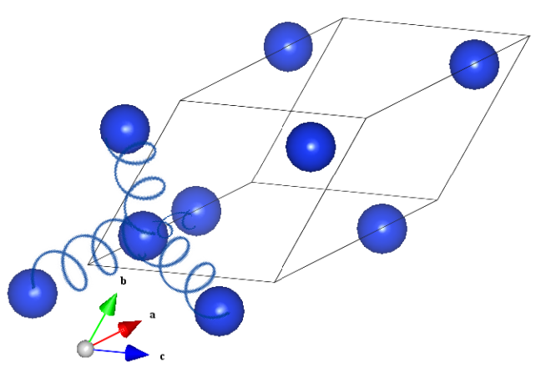
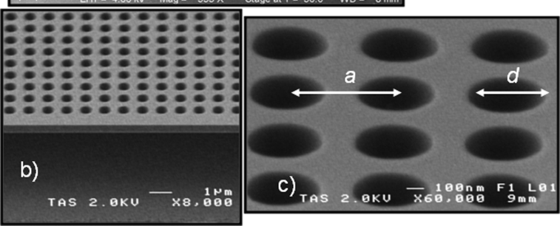
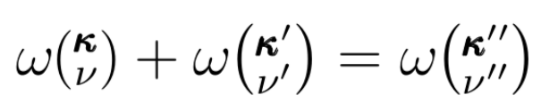

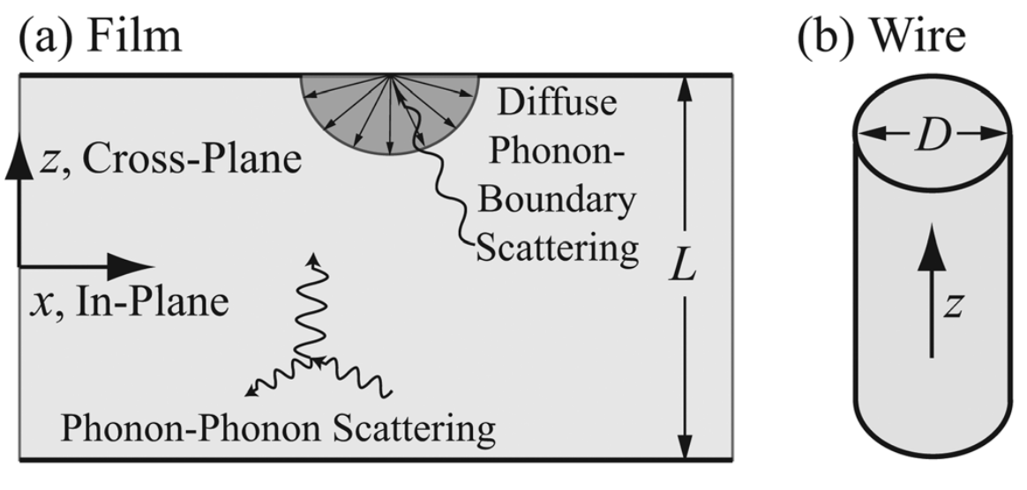
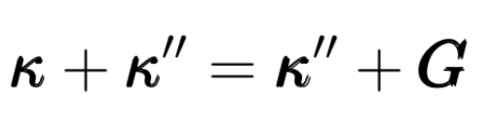
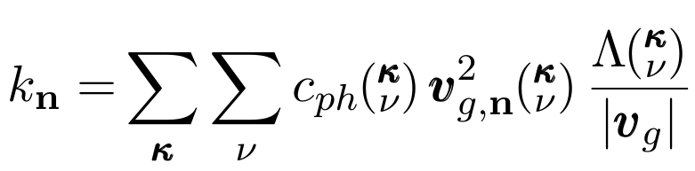
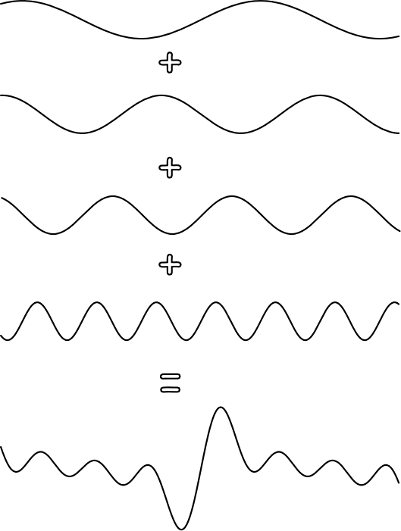
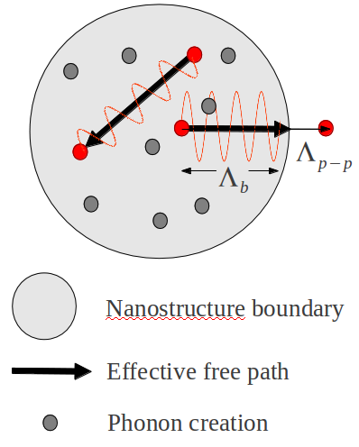
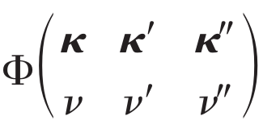
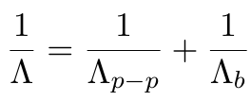

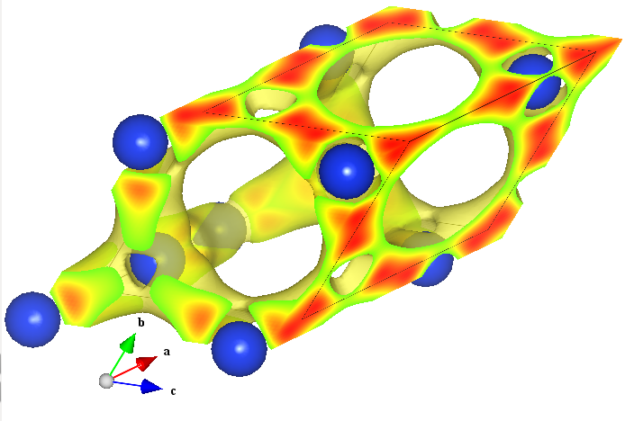
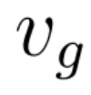

PREDICTING THERMAL TRANSPORT IN NANOSTRUCTURES USING AB-INITIO CALCULATIONS
1
1
Ankit Jain , Jason Larkin , Alan J.H. McGaughey , Wissam A. Al-Saidi
Department of Mechanical Engineering, Carnegie Mellon University,
Department of Chemistry, University of Pittsburgh
￼
1
1
2
2
- Atomic motion is a superposition of normal modes:
Supported by AFSOR FA95501010098 (2010 YIP)
Heat Transport in Silicon
Heat Transport in Nanostructures
Bulk Phonon Properties
Accurate Predictions
- Nanowires/rods
Phonon-Phonon Scattering
Group Velocity
- Thermal conductivity of Si (dielectric) is determined by phonons:
O(10 cm)
1
Nano Letters 9 2009 864-869
3-phonon process
- Porous Silicon
- Conservation of energy:
- Lattice translational invariance:
Effective Mean Free Path:
- Ab-Initio molecular dynamics can model Silicon accurately to measure phonon properties:
O(1 nm)
Nano Letters 11, 107-112 (2011).
Energy Carriers: Phonons
Monte Carlo Sampling
Ab-Initio Calculations
VASP
-Phonon lifetime/mean free path:
- Phonon-Phonon interactions:
- Calculated by Density Functional Theory:
=
Group Velocity:
Bulk Mean Free Path:
= O(1 nm – 10 μm)
A. J. H. McGaughey and A. Jain, "Nanostructure thermal
conductivity prediction by Monte Carlo sampling of phonon
free paths." Applied Physics Letters 100 (2012) 061911.
We thank Keivan Esfarjani (MIT)
for supplying the bulk phonon
properties
http://www.vasp.at/

