Slide 1
Thermal Conductivity Predictions for Nanostructures by Phonon Free Path Sampling
Ankit Jain
Advisor: Alan McGaughey

Slide 2
Motivation
Nanostructures are important part of our life.
They are present in semiconductor laser, solar energy conversion, thermoelectric energy conversion devices, nano-sensors, etc.
Thermal properties of nanostructures are considerably different from bulk materials.
Can be advantageous in some applications like thermoelectric energy conversion while disadvantageous in other applications like solar cells.

Slide 3
Outline
Introduction
Phonon Scattering Mechanisms
Results
Conclusions

Slide 4

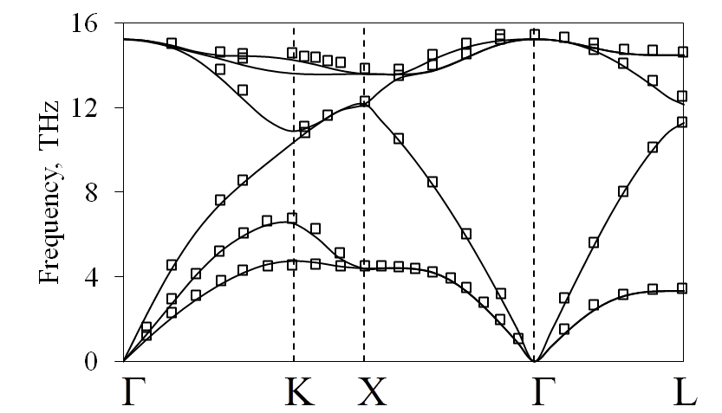
Introduction
Heat Carriers: PHONONS, electrons.
Thermal Conductivity: Boltzmann Transport Equation,
Specific heat per phonon mode
Phonon mode group velocity
Relaxation time
Phonons specific heat:
Group velocity:
Time taken (distance travelled) by phonons before getting scattered.
Need to know different phonon scattering mechanisms in material.
Bose-Einstein Statistics
Group Velocity is the slope of phonon dispersion curve
Turney et al., PRB 79, 064301 (2009)

Slide 5
Phonon Scattering Mechanisms
Phonon-phonon scattering:
All Temperatures.
All length scales.
Anharmonic lattice dynamics calculations.
Phonon-boundary scattering:
All Temperatures.
Length scales compared to phonon-phonon mean free path.
Approaches like Matthiessean rule, Casimir limit, etc.
Other scattering mechanisms:
Electrons, dislocations, isotopes, etc.
Negligible as compared to other two scattering mechanisms at room temperature and for perfect crystals.
Notes:
Important in Zoey’s case

Slide 6
Phonon-Boundary Scattering: Matthiessean Rule
Different Scattering Mechanisms are independent of each other.
Total Scattering Rate
Phonon-phonon scattering rate
Phonon-boundary scattering rate
Other phonon scattering rates
=
+
+
Assumes single length scale for phonon-phonon and phonon-boundary scattering.
Complex Geometries:

Slide 7
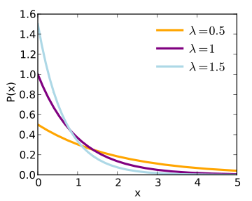
Sampling: An Alternative Approach for Phonon-Boundary Scattering
Sampled from Poisson distribution
Random sampling of phonons initial position inside the material
1000 samples for each phonon mode
McGaughey et al., APL 100, 061911 (2012)

Slide 8
Bulk Thermal Conductivity
Bulk phonon properties from Esfarjani, MIT.
Bulk properties are calculated using ab-initio technique without using any potential.
32000 phonon modes are used for capturing first Brillioun zone.
All thermal conductivity calculation are done at 300K in this work.
Bulk thermal conductivity:
Simulation: 132 W/mK.
Experiments: 143 W/mK.
Esfarjani et al., PRB 84, 085204 (2011)

Slide 9
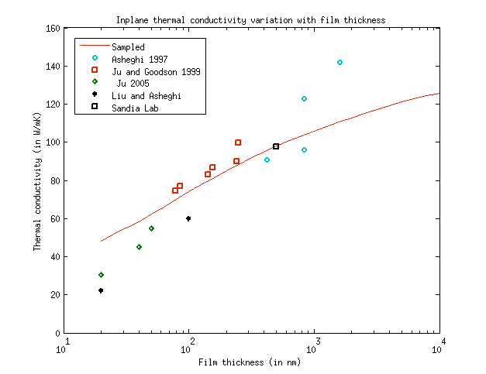
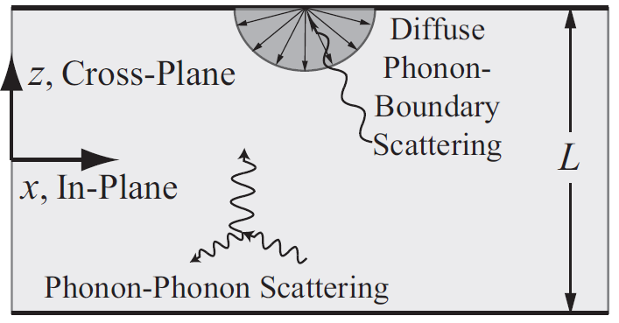
Results: Thin Films

Slide 10
Porous Thin Films
a: Pore separation
t: Film thickness
d: Pore diameter
Thin film with an array of cylindrical thorough holes

Slide 11
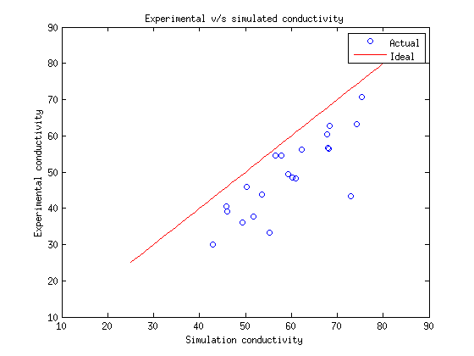
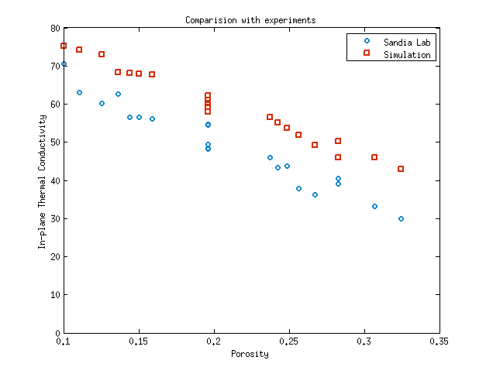
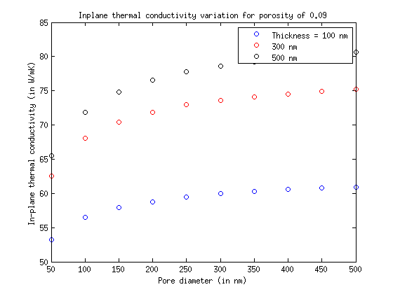
Results: Porous Thin Films
Film thickness = 500 nm

Slide 12
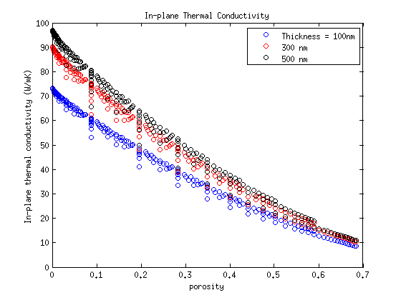
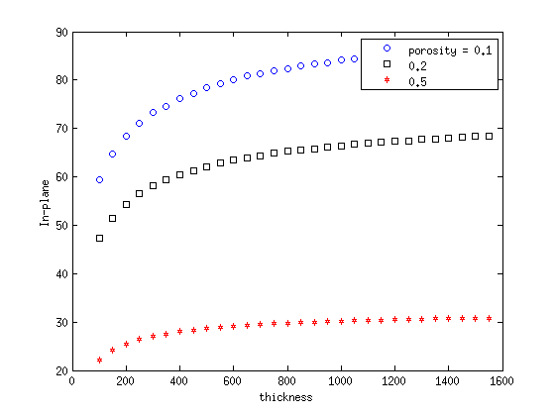
Results: Porous Thin Films (Contd..)
In-plane thermal conductivity variation with film thickness

Slide 13
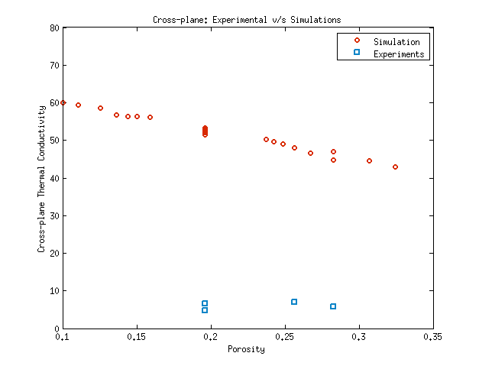
Results: Porous Thin Films (Contd..)
Cross-plane thermal conductivity comparison with experiments
Film thickness = 500 nm
Hopkins et al.,Nano Letters 11(1), pp 107 (2011)

Slide 14
Conclusions and Future Work
Sampling approach can be applied for any geometry.
Poisson distribution is assumed as phonon-phonon free path distribution.
In-plane thermal conductivity predictions matches very well with the available experimental data for thin films and porous media.
Cross-plane thermal conductivity predictions are very different from experiments. Presence of oxide layer or some different physics is expected for this discrepancy.

Slide 15
Thank You

