Slide 1
Statistics of Particle Concentration in Free-Surface Turbulence
Jason Larkin
Department Mechanical Engineering and Materials Science, University of Pittsburgh.
Mahesh M. Bandi
Center for Nonlinear Studies and Condensed Matter & Thermal Physics Division,
Los Alamos National Lab.
Walter Goldburg
Department of Physics & Astronomy, University of Pittsburgh
Alain Pumir
Institut Nonline´aire de Nice, CNRS, France
LA-UR-07-7929

Slide 2
Outline
I. Experiment Description/Overview
II. Coarse-Graining Procedure
III. Scale-Free Behavior
IV. Probability Distribution
V. Review
VI. Questions

Slide 3
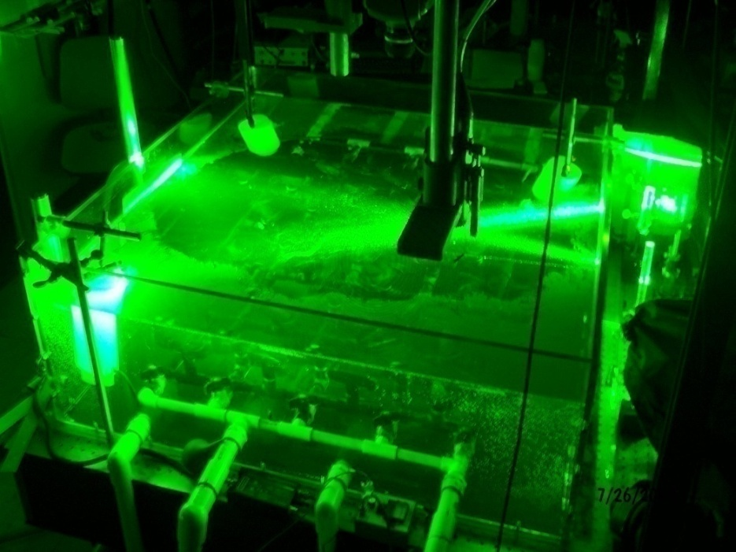



I. Experiment Overview
Tank: 1 m x 1 m x 0.3 m driven by 8 hp pump through “sprinkler” system.
Real particles 50 micron size and highly bouyant (sg 0.25), low Stokes number
Want to study particle coagulation due to surface effect, not inertia.
Instantaneous velocity fields measured by high-speed camera (9 cm field of view) used to evolve virtual particles.
LA-UR-09-00423
Notes:
-

Slide 4
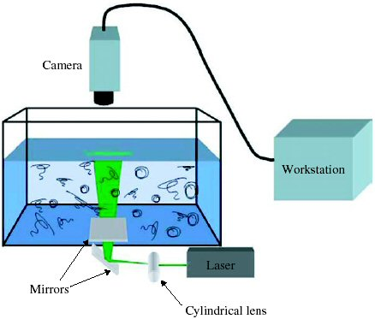

Slide 5
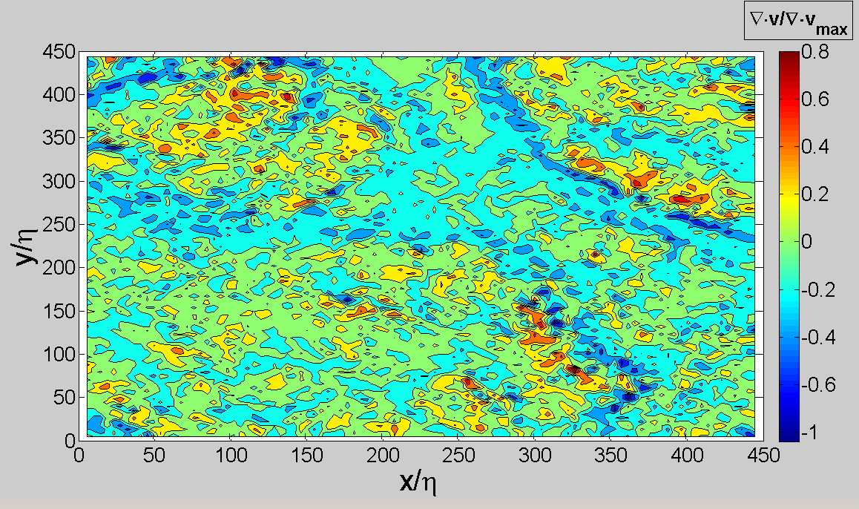
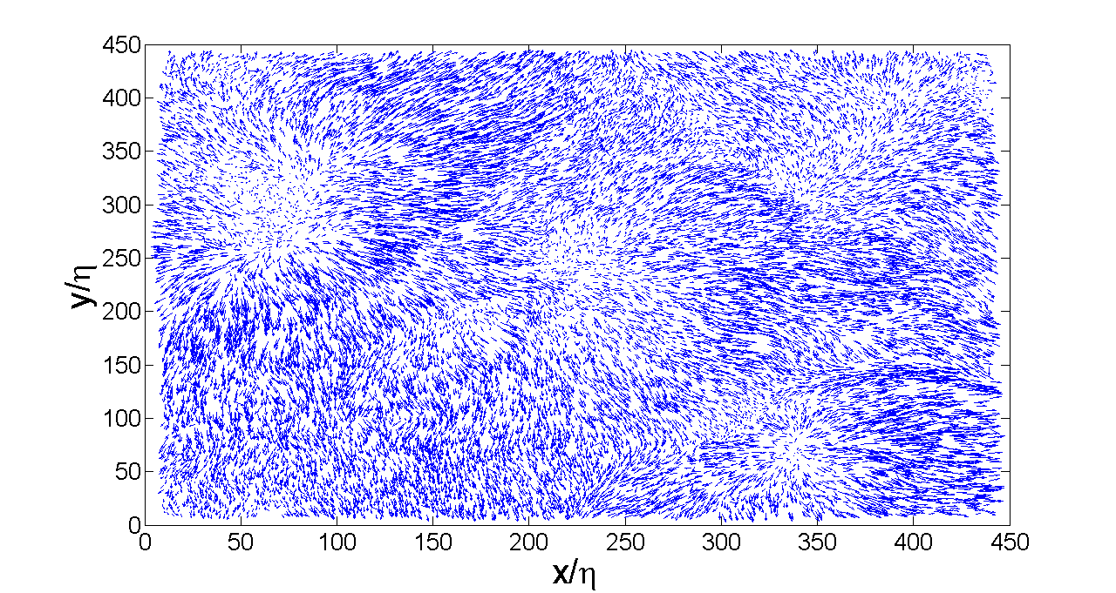

Slide 7
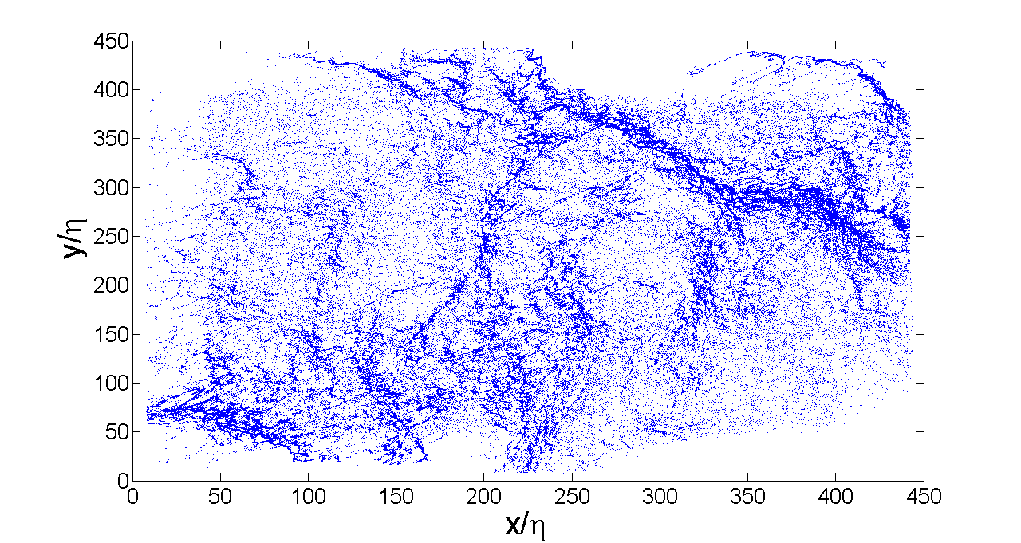
II. Coarse-Graining Procedure
Coarse-Grained Concentration:
All analysis done in steady-state!

Slide 8
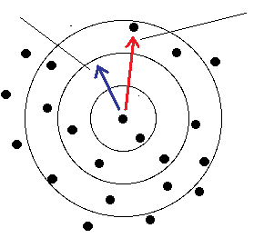

Slide 9
III. Scale-Free Distribution
Point:
Line:
Surface:
-For fractal distributions:

Slide 10
IV. Concentration PDF
-For power-law distributions:
-Cumulative PDF:
Can this be explained by theory of compressible clustering?

Slide 12
V. Review
Floaters coagulate into strings.
Effect not due to surface waves or inertia.
Distribution is scale dependent.

Slide 13
VI. Question?
Funding was provided by the US National Science Foundation grant # DMR-0604477. This work was partially carried out under the auspices of the National Nuclear Security Administration of the U.S. Department of Energy at Los Alamos National Laboratory under Contract No. DE-AC52-06NA25396.

Slide 14
A. Algebraic Concentration Distribution
-System is unlike effectively compressible systems involving 3D flow and intertial particles.
-Compressibility is quite large here, particles are non-inertial.
-Waves were also minimized (<0.1mm) during the experiment.
-Result is a much broader, algebraic distribution for large concentrations.

Slide 15
A. Larger Moments
-For scale-free distributions
-Simple interpretation
= 169

Slide 16
A. Particle Coagulation
Why do particles coagulate?
-Underlying turbulence is 3D incompressible, drives motion at surface.
-2D divergence is non-zero, hence compressibility is non-zero

Slide 18

B. Some Experimental Values
-Taylor-Microscale Reynolds Number:
-Integral Scale:
-Dissipative Scale:

Slide 19
III. Statistical Steady-State
-Variance saturates in approximately 1s.
-Saturation occurs at all scales.
Analysis

