Slide 1
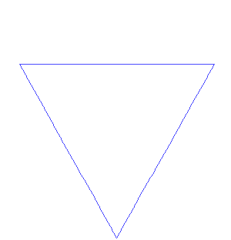
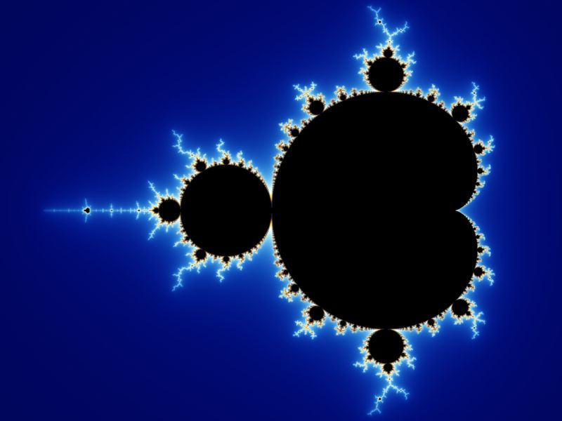
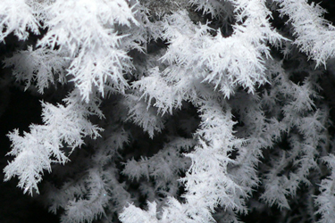
Fractals
A fractal often has the following features:
It has a fractal dimension which is not equal to its topological embedding dimension.
It may be too irregular to be easily described in traditional Euclidean geometric language.
It is self-similar (at least approximately or stochastically) or it is detailed at all scales (mathematically).
It has a “fine” structure at arbitrarily small scales (experimentally).
It has a recursive definition (mathematically).

Slide 2
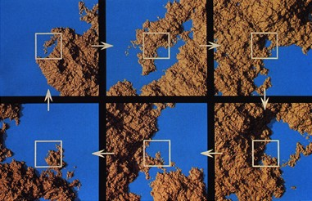
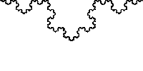
Self Similarity
In mathematics, a self-similar object is exactly or approximately similar to a part of itself,
e.g., the whole has the same shape as one or more of the parts. Many objects in the real
world, such as coastlines, are statistically self-similar: parts of them show the same
statistical properties at many scales.
Scale invariance is a form of self-similarity where at any magnification there is a smaller
piece of the object that is similar to the whole.
Because they appear similar at all levels of magnification, fractals are often considered to
be infinitely complex.
Example of natural objects that approximate fractals: clouds, mountain ranges,
lightning bolts, coastlines, and snow flakes. However, not all self-similar objects are
Fractals (example: real line).

Slide 3
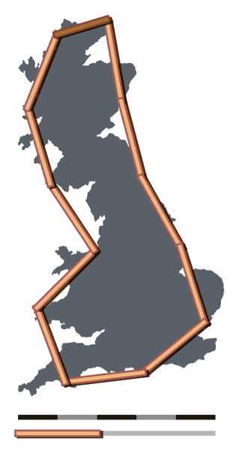
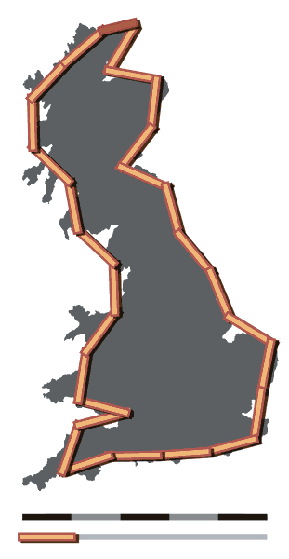
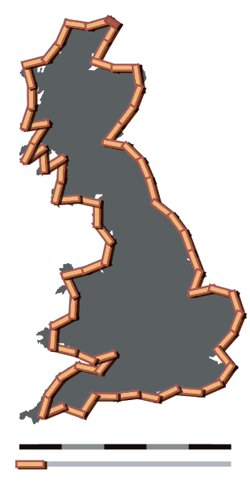
Coastline of England (or Norway…)
The paper examines the surprising property that the measured length of a stretch of coastline depends on the scale of measurement.
If you were to measure a stretch of coastline with a yardstick, you would get a shorter result than if you were to measure the same stretch with a small ruler.
The empirical evidence suggests a rule which, if extrapolated, shows that the measured length increases without limit as the measurement scale decreases towards zero.
Original research was published by Lewis Fry Richardson on how the measured lengths of coastlines and other natural geographic borders are dependent on the scale of measurement.
Note that the paper does not claim that any coastline or geographic border actually is a fractal. It simply states that the measured length of a coastline or border may be observed to behave like a fractal over a range of measurement scales.
Benoît Mandelbrot, 1967, How Long Is the Coast of Britain? Statistical Self-Similarity and Fractional Dimension. Science, New Series, Vol. 156, No.
3775. (May 5, 1967), pp. 636-638. doi:10.1126/science.156.3775.636

Slide 4
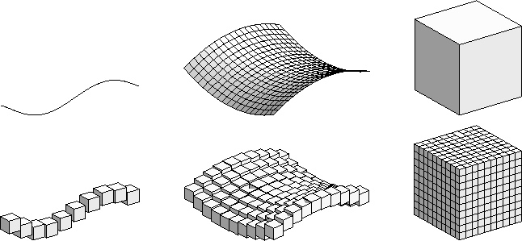
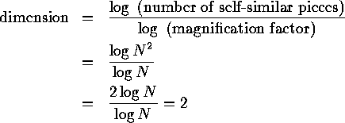
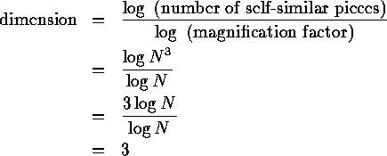

Fractal Dimensions
The fractal dimension is a non-negative real number that gives an indication of how
completely a fractal object appears to ll space, as one zooms down to smaller and smaller
scales. Fractal dimension is a measure of complexity of an object.
Dimension of a surface:
Dimension of a cube:
“Box-Counting” Dimension:
The measurements of the box counting dimension vary from 1.02 for the coastline of South Africa to 1.25 for the west coast of Great Britain.

Slide 5


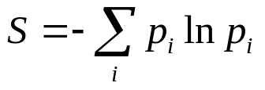



Generalized Fractal Dimensions
D_0 “Box-Counting” Dimension:
D_1 Information Dimension:
Shannon Entropy:
D_2 Correlation Dimension:

Slide 6
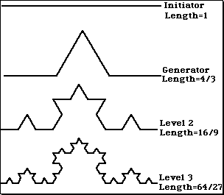

Mathematically Generated Fractals
Koch Snowflake
D_0 = log(4)/log(3) = 1.26 = D_q
Cantor Dust
D_0 = D_q = .63
Experimentally Measuring Fractals
Practical dimension estimates are very sensitive to numerical or experimental noise, and particularly sensitive to limitations on the amount of data. Claims based on fractal dimension estimates should always be taken with a handful of salt — there is an inevitable ceiling, unless very large numbers of data points are used in the calculations.

Slide 7
Multi-Fracticality
An attractor for which the fractal dimensions are not all equal is said to be a multifractal. This is a
signature that different scaling behaviour is occurring in different parts of the attractor. Many (probably
most) real world objects have this property.
A natural question to ask is: how many “regions” have a particular value or range of values of the
fractal dimension? For example, 2 quite different objects can have the same correlation dimension but
differ wildly in appearance. Multi-fractal objects can be viewed as objects with overlapping collections
of several fractal objects. q
Let’s take the attractor again and partition it into a group of cells of size R. We then calculate the probability that piece of the object falls in the i_th cell:

Slide 8
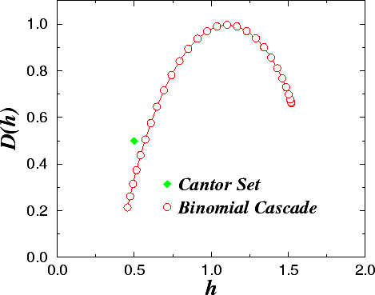
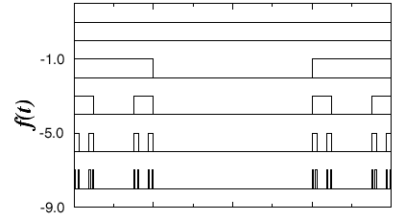
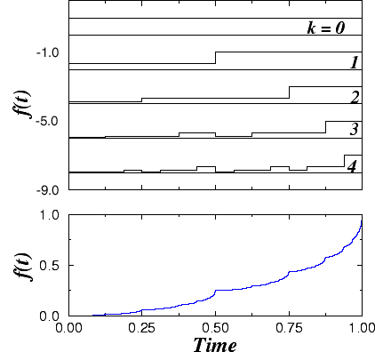
Singularity Spectrm
The singularity spectrum quantifies the degree of nonlinearity in the system. For a linear fractal process the output of a system will have the same fractal properties (i.e., the same type of singularities) regardless of initial conditions or of driving forces. In contrast, nonlinear fractal processes will generate outputs with different fractal properties that depend on the input conditions or the history of the system. That is, the output of the system over extended periods of time will display different types of singularities (Navier-Stokes Equations in Turbulent Regime).
Cantor Set
Binomial Cascade

Slide 9
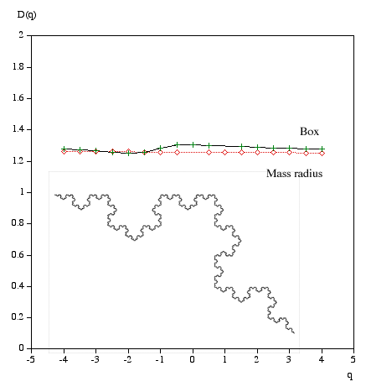
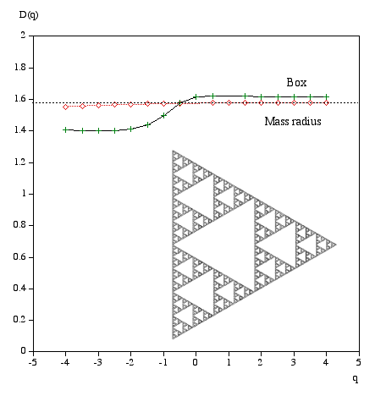
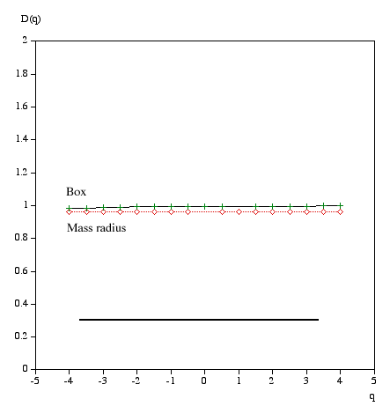
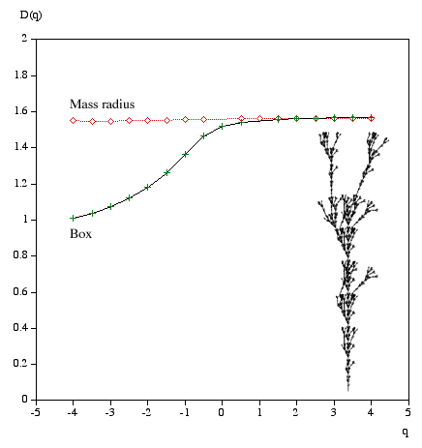
D_q for various objects

Slide 10
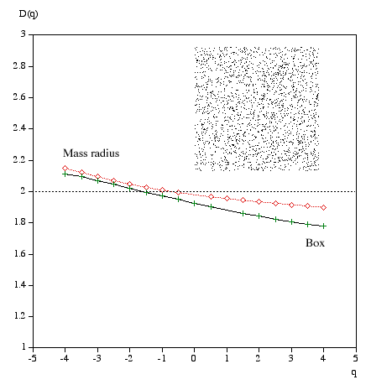
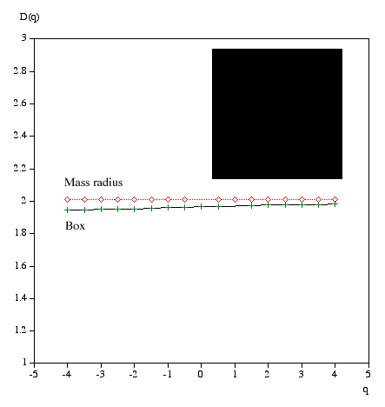
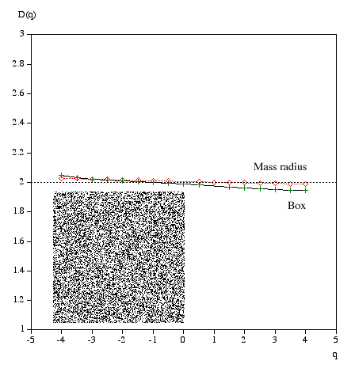
Convergence of Fractal Dimensions
Random 1000x1000 pixels
100000 random points uniformly distributed on both axes.
“Completely” covered 2-D surface
Random 1000x1000 pixels
500000 random points uniformly distributed on both axes.

Slide 11
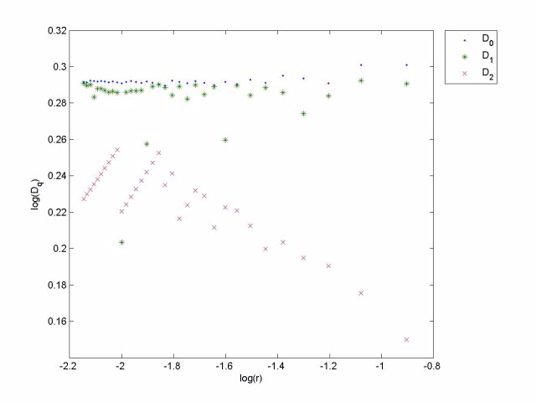
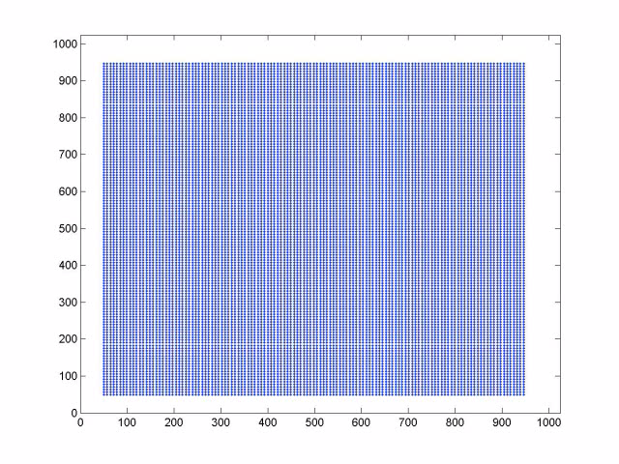
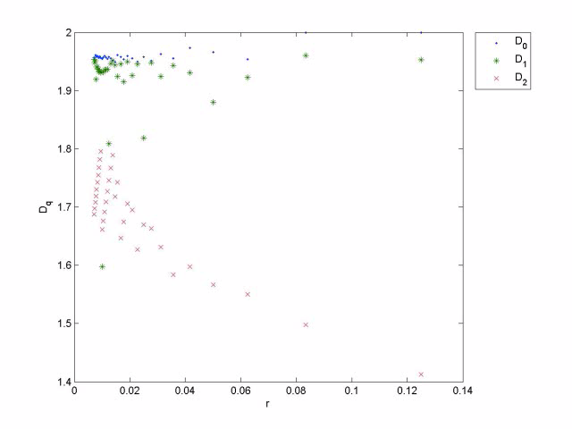
Glass Floaters on Surface of Turbulent Flow in Tank

