Slide 1
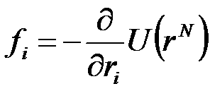
MD Simulation
What are you doing? Solving F=ma simultaneously
Predictions are restricted by computer budget and approximations
Possible to carry out simulations that are difficult or impossible in experimental settings high temperatures or pressures
Inter-atomic potentials are key.
Most potentials use Born-Oppenheimer approximation, electron dynamics fast and move with nucleus, nucleus treated as point particle.

Slide 2
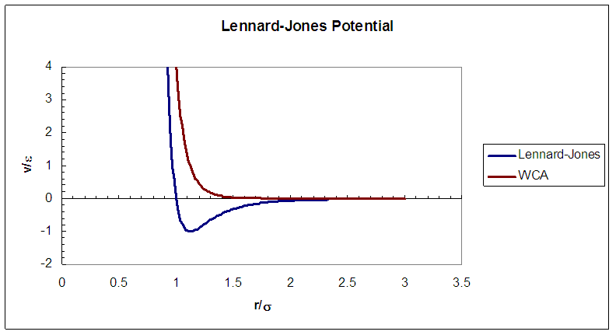
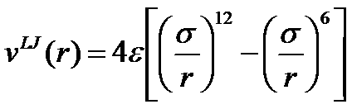
Lennard-Jones Potential
Lennard-Jones is workhorse of MD simulations.
Includes repulsive (Pauli) interaction and attractive (van der Waals) interaction.
6 term can be derived from 2nd order perturbation. Algebraic 12 term should be exponential, but is easier to integrate numerically.

Slide 3

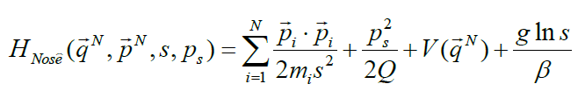
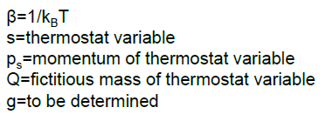
“Thermalizing”
Easiest: velocity rescaling.
Nose-Hoover: reduce external heat bath to additional DOF in Hamiltonian

Slide 4


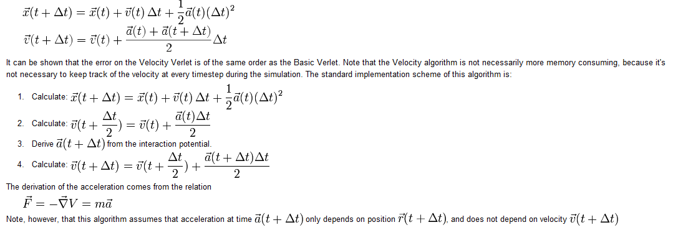
Velocity Verlet Algorithm
Velocity Verlet is the most commonly used algorithm.

Slide 5
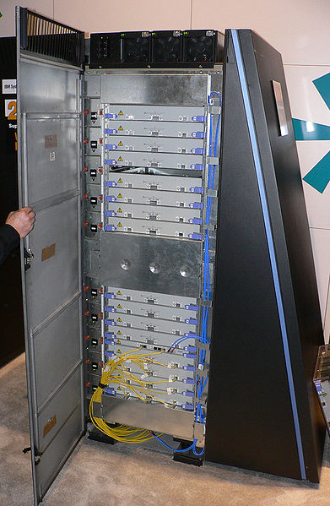
MD and QM
Many-body QM is computationally expensive
MD is no more than O(n^2), and can be reduced to O(n)-O(n^2) by using cut-off radii, periodic updating, etc.
QM typically goes as O(n^3), so only a small part of the system is treated quantum mechanically.
IBM Blue Gene: built to simulate various protein folding, 1 PFLOPs (10^15) speed.

Slide 6
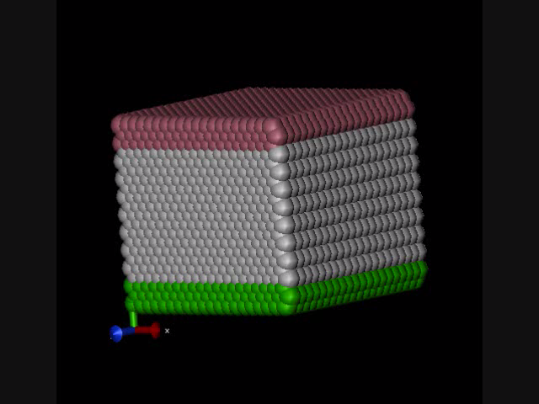
Codes: LAMMPS
MD codes are not difficult to write, many different codes available.
LAMMPS: Large-scale Atomic/Molecular Massively Parallel Simulator.
Written at Sandia National Lab, open source designed to be massively parallel.
LAMMPS has potentials for soft materials (biomolecules, polymers) and solid-state materials (metals, semiconductors) and coarse-grained or mesoscopic systems. It can be used to model atoms or, more generically, as a parallel particle simulator at the atomic, meso, or continuum scale.

Slide 7


Water Transport in Carbon Nano-Tube
“Reassessing Fast Water Transport Through Carbon Nanotubes”
John A. Thomas and Alan J. H. McGaughey, CMU Nano-Letters 2008
“Pressure” driven water flow through carbon nano-tube 1.66-4.99 nm.
Want to measure the flow enhancement
Water is about 1 angstrom

Slide 8
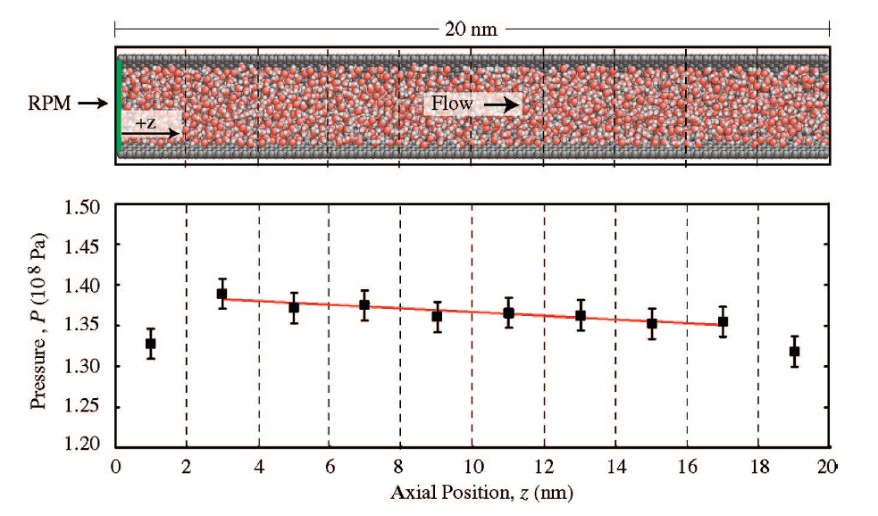
Simulation
Do both equillibirum and non-equillibrium simulations.
Carbon atoms are “fixed”; no heat txn properties predicted.
Use only single wall, less computation even though single wall CNT hard to make.

Slide 9


Flow Enhancement
Tubes of diameter 1.66-4.99 nm.
Measure flow rate vs. Pressure Gradient and radial velocity profile.
Use equillibrium simulation to measure viscosity.
Results show that even 1.66 nm is described by continuum mechanics.
Bulk viscosity
Paper reports enahancements of 47-433. These results can be explained by continuum mechanics. Previous experiments report 560-100k!
Water has very little “wettability” with carbon, so slip must explain
Slip Pouiselle predicts slip length of 1.4 microns to get results of experiment.

Slide 10
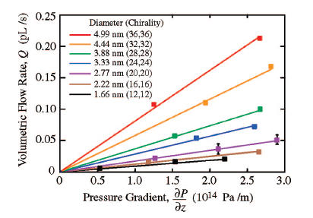
Q vs. dPdx
Each data is at least 5 trials.
Mean flow velocities 3-14 m/s, much lower than thermal velocity.
Time-scale of experiment (few ns) prevented resolving 0.01-1 m/s.
Results show linear dependance

Slide 11
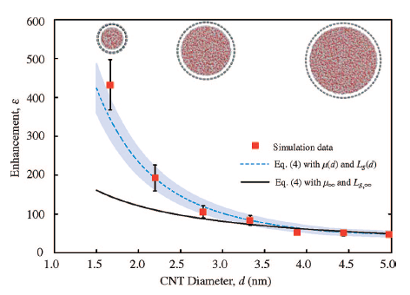
Enhancement
Flow enhancement is decreasing with increasing tube diameter.
Simulation and prediction converging to 30 nm slip length and bulk viscosity at STP (0.89 mPa-s).
Enhancement dependance can’t be explained by single slip length (non-linear).

Slide 12
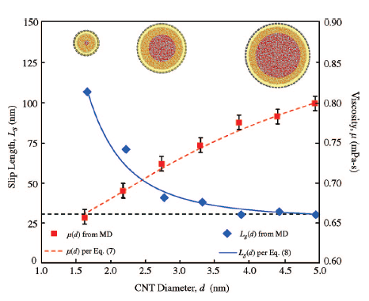






Slip Length and Viscosity
Use Einstein relation for viscosity, Green-Kubo linear response for axial self-diffusion coefficient:
Brackets are summation over all molecules.

Slide 13
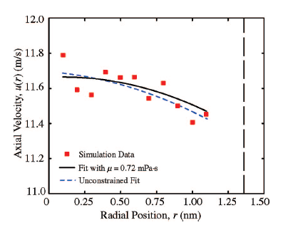
Velocity Profile
Velocity profile for CNT 2.88 nm.
A and B fit to slip profile with constraint of measured viscosity. Slip length is then derived after this fit.

