Slide 1
Power-Law Distributions of Particle Concentration in Free-Surface Turbulence
Jason M. Larkin
University of Pittsburgh, School of Engineering
Master of Science Defense
2009
Thesis committee:
Dr. Walter I.Goldburg
Dr. Sung K. Cho
Dr. Bong J. Lee
LA-UR-07-7929

Slide 2
Collaborators:
Walter Goldburg
Department of Physics & Astronomy, University of Pittsburgh
Mahesh M. Bandi
Center for Nonlinear Studies and Condensed Matter & Thermal Physics Division,
Los Alamos National Lab.
Alain Pumir
Institut Nonline´aire de Nice, CNRS, France
Thanks to thesis committee:
Dr. Walter I.Goldburg
Dr. Sung K. Cho
Dr. Bong J. Lee

Slide 3
Outline
I. Experiment Description/Overview
II. Particle Evolution
III. Coarse-graining Procedure
IV. Concentration Statistics
V. Discussion
VI. Conclusion

Slide 4
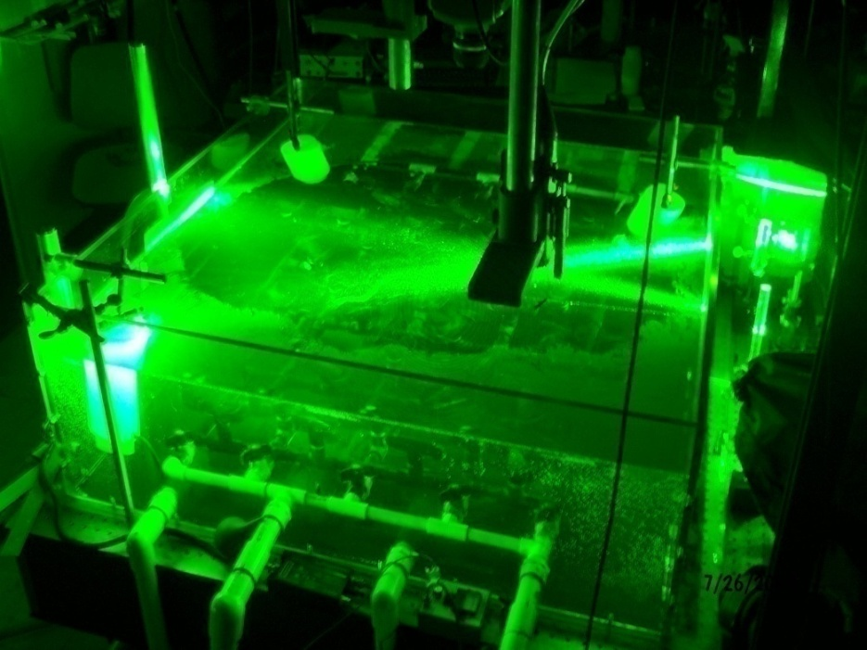
I. Experiment Overview
Experiment: track floating particles on the surface of a turbulent sea.
Models transport of pollutants, chemical species, etc. which are PASSIVE and BOUYANT.
Floaters flee fluid upwellings (sources) and cluster around fluid downwellings (sinks).
Notes:
-

Slide 5
Simple Model
Naïve model of surface flow: Floaters flee fluid upwellings (sources) and cluster around fluid downwellings (sinks).
This would tend to produce line-like concentrations.

Slide 6
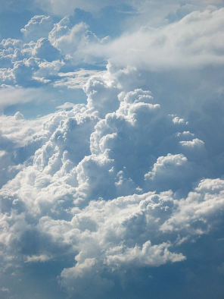


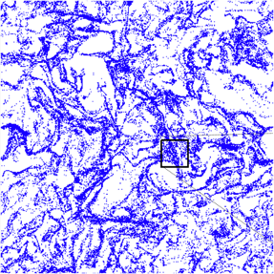
Effectively Compressible Flows
Inertial particles cluster in 3D incompressible turbulence because:
G. Falkovich, Nature 419, 151 (2002).
In same spirit, one may then write velocity of the floaters:
Floaters cluster due to effective compressibility:
C=0 (incompressible)
C=1 (irroational)
C≈0.5 (experiment)
Intertial particles in 3d incompressible flow, J. Bec et al.

Slide 7


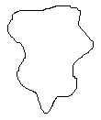




Turbulent Phenomenology
Main idea from Kolmogorov 1941:
Integral Scale:
Dissipative (Kolmogorov) length scale:
Energy Dissipation Rate:
Taylor microscale:
Taylor microscale Reynolds:
RMS Velocity:
Large Eddy Turnover time:
Compressibility:
Results from K41: Energy flows from large to small “eddies”, dissipated by viscosity
For:
“Inertial range”
-Isotropic, homogeneous, 3D incompressible flow.
This is seen at the surface: J.R. Cressman et al., New J. Phys. 6, 53 (2004).
For:
“Dissipative range”
Flow is viscous (laminar).

Slide 8




Theoretical/Numerical Predictions
Free-surface clustering and intertial clustering share many similarities:
In dissipative range:
E. Balkovsky, arXiv.chaodynp. 9912027 (1999).
-Predicts a power-law behavior of the PDF of concentration in dissipative range:
J. Bec, Phys. Rev. Lett. 92, 224501 (2004).
-Predicts a multi-fractal distribution of particles in dissipative range:
In inertial range:
Field is rough, and not amicable to analytical techniques.
A. Pumir, Phys. Rev. E. 77, 066304 (2008).
-DNS of 2D compressible turbulence which shows particles concentrate on multifractal in BOTH dissipative and inertial range. This may or may not apply to this experiment!

Slide 9
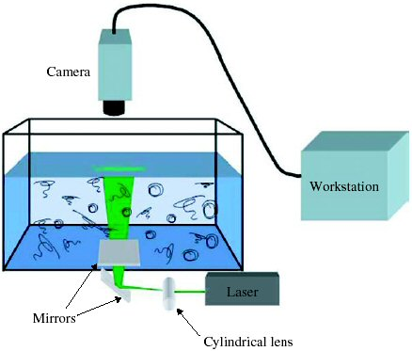

Turbulence generated in tank of water (ν=0.01 cm²/s) 1mx1mx30cm
-Injection source far from surface, waves do not exceed 0.5mm.
J.R. Cressman et al., New J. Phys. 6, 53 (2004)
Studied in: P. Denissenko, Phys. Rev. Lett. 97, 244501 (2006).
Use bouyant (s.g. 0.25) non-inertial (0.05mm) particles:
-Particles are hydrophillic: they do not cluster on a quiescent tank.
Camera speed set at 100Hz, Images processed using special PIV program.
-Typically data taken for 5-10s, producing 500-1000 unique velocity vector fields.

Slide 10
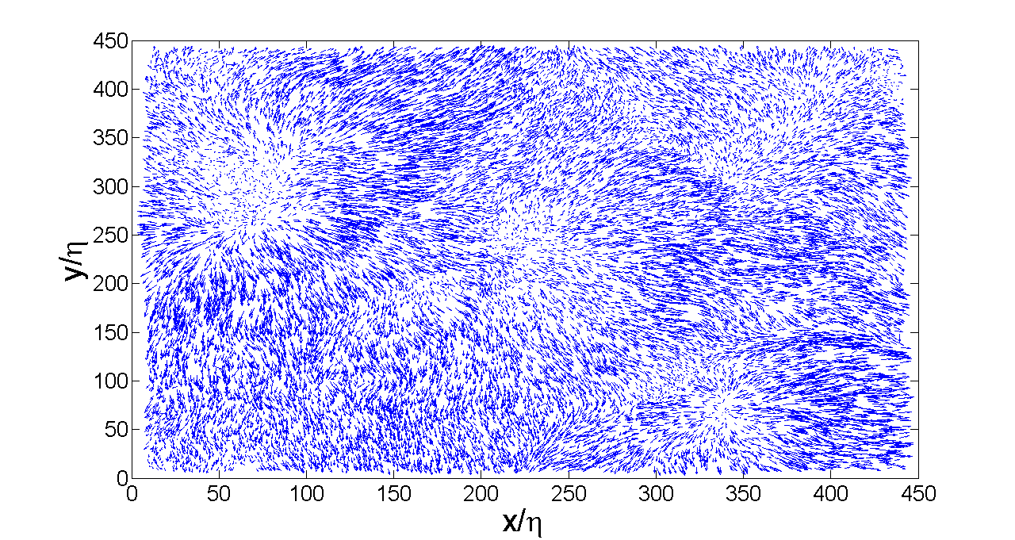
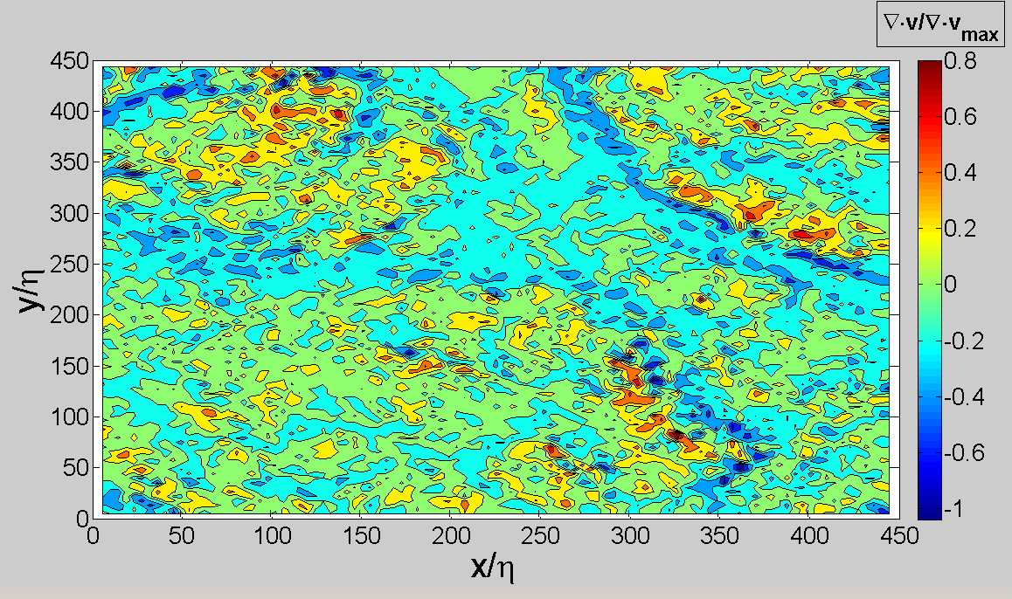
On average 23k vectors/field, yields average vector spacing δx=2.5 η.
This is important for dissipative scale measurements.
Divergence field normalized by absolute value of maximum divergence.
Clearly see line-like flow sinks, regions of flow sources.

Slide 11
Measured Turbulent Parameters
Parameter | Equation | Measured Value
Taylor microscale:
Taylor microscale Reynolds:
Integral Scale:
Large Eddy Turnover time:
Energy Dissipation Rate:
Dissipative (Kolmogorov) length scale:
RMS Velocity:
Compressibility:
Smaller than Camera
field of view: L=9cm
1 pixel~0.01cm

Slide 12
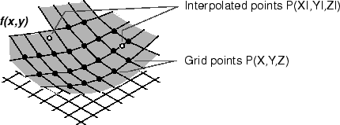
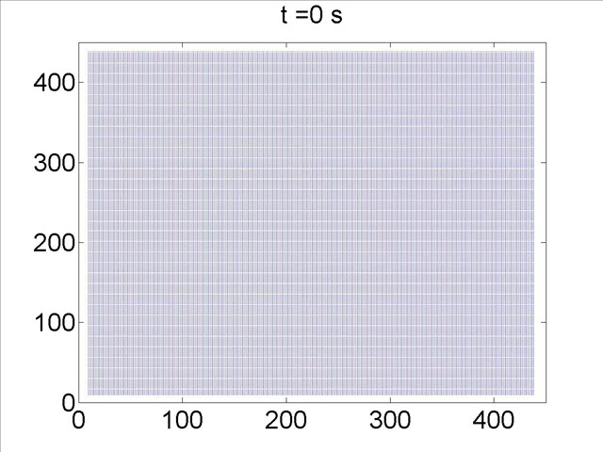
II. Particle Evolution
Lagrangian-Eulerian equation
Particles evolved using cubic interpolation scheme to achieve dissipative length resolution . Criteria: δx<πη
- S. Pope, J. Comp. Phys. 79, 373 (1988).
Our data: δx=2.5η
-results insensitive using δx=4η.
Evolve 4x10⁵ homogeneous distribution at t=0s. Results insensitive using 10⁵ to 4x10⁵.
Steady-state reached in ~1s (2 LETTs).

Slide 13
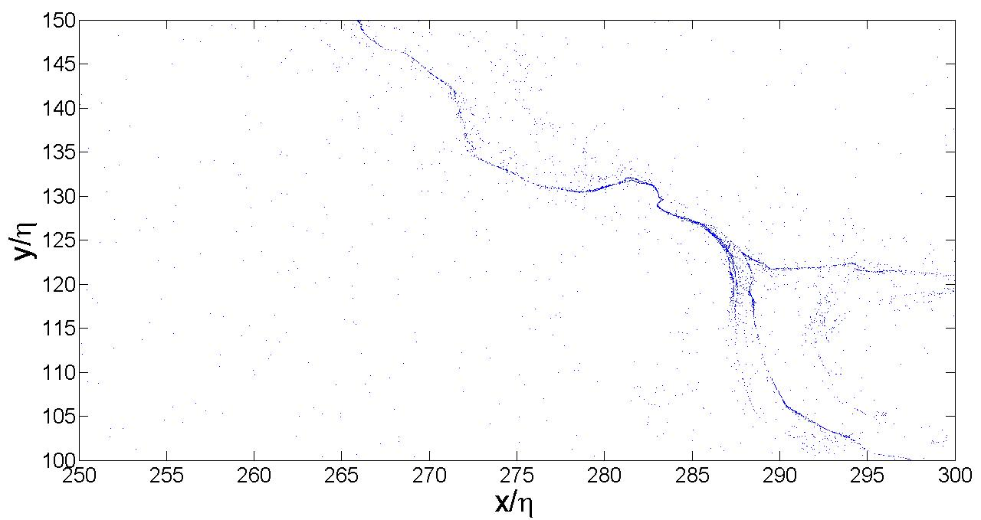
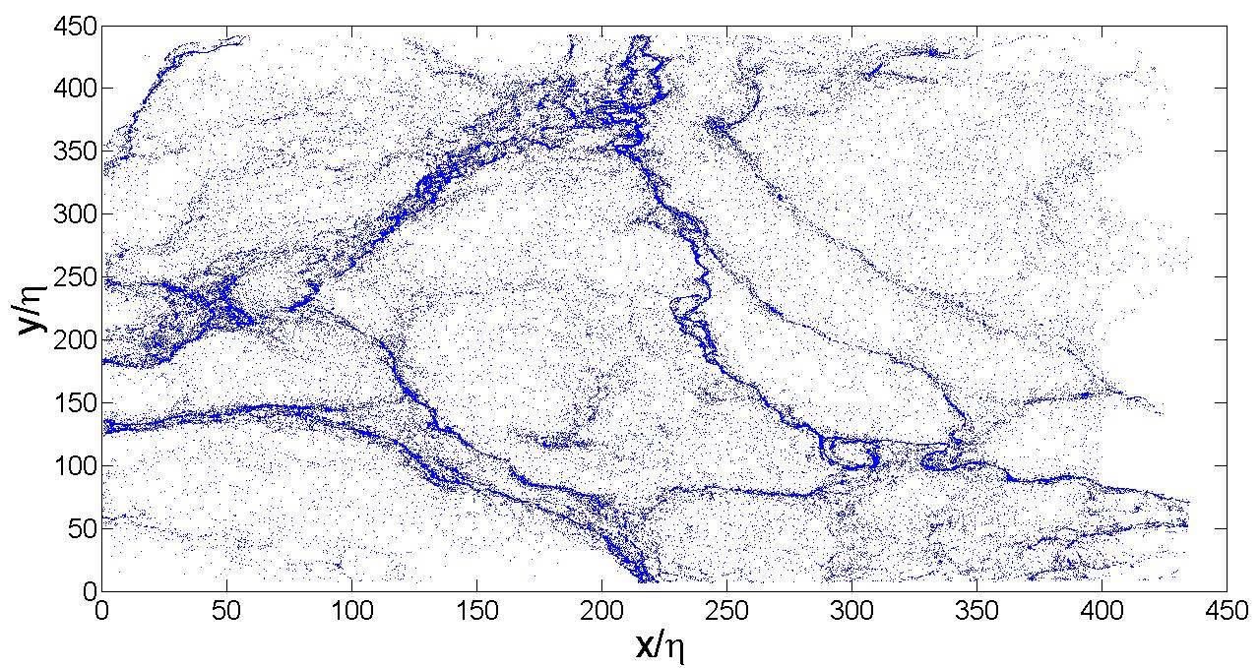
Particles initially uniform on grid spaced ~ η
Recall: integral scale ~70η
Note finite particle concentration.

Slide 14
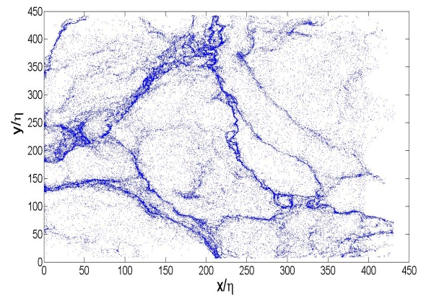
III. Coarse-Graining Procedure
Coarse-Grained (Eulerian) Concentration: # of particles in square of size s

Slide 15
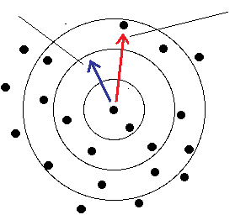
Lagrangian Coarse-Grained Concentration
Coarse-Grained (Lagrangian) Concentration:
The Eulerian and Lagrangian frames are equivalent with a weighting:
-P. Grassberger, Phys. Rev. Lett. 50, 346 (1983).
Easier to obtain accurate results in Lagrangian frame, two frames checked to be equivalent.
The moments evolve to a statistically steady state in approx. 1 s (2 LETTs). All analysis done on steady-state distributions!
Concentration statistics averaged over 15 independent fields.

Slide 16
IV. Concentration Statistics
Point:
=
Line:
Surface:
-For fractal distributions:
α_{m} is a non-interger: “Strange Attractor”
-2 unique scaling regimes in inertial/dissipative ranges consistent with:
A. Pumir, Phys. Rev. E. 77, 066304 (2008).

Slide 17

Dissipative Range Concentration PDF
Main Results:
1) For intermediate concentrations:
-Power-laws seen in many physical contexts, issues of boundedness:
M.E.J. Newman, Contemporary Phys. 46, 323 (2005).
Smallest resolved concentration:
2) At very small concentrations:
E. Balkovsky, arXiv.chaodynp. 9912027 (1999).
3) At large c_{r}, observed fall-off is faster than algebraic:
-Recall, in dissipative Range:
-PDFs

Slide 18
Inertial Range Concentration PDF
Main Results:
1) Again see power-law, exponent varies with scale r:
2) Very small c_{r} wing is observed with:
3) At large c_{r}, observed fall-off is faster than algebraic.
dissipative
range
inertial
range
4) Inertial range results qualitatively consistent with:
A. Pumir, Phys. Rev. E. 77, 066304 (2008).
-PDFs

Slide 19
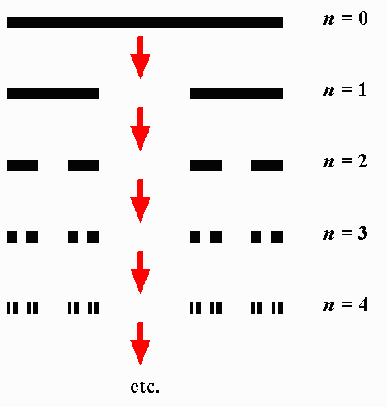

VI. Discussion: Multi-Fractal Distributions
Imagine we have scaling of the concentration moment(s):
A multifractal is defined as:
Consider an Eulerian concentration PDF:
One can then show, if one moment has scaling:
The other moments are related:
Alternatively, if the PDF does depend on r:
And one moment has scaling, then:
Cantor Set: a fractal, but not multifractal!

Slide 20







Caustics
-Caustics are divergences of light intensity produced by focused rays: Patterns at bottom of pool on sunny day
-Simplest caustic divergence:
-Which produces:
-In general:
-Produces:

Slide 21





Caustics in Fluid Dynamics
-In fluid dynamics, solution to Burger’s Equation(simplified Navier-Stokes) can produce shocks. These shocks will produce “caustics” of a passive scalar:
Caustic Aerosols: M. Wilkinson, Europhys. Lett. 71, 186 (2005)
Wave Coagulation: P. Denissenko, Phys. Rev. Lett. 97, 244501 (2006).
-This is likely NOT what is seen in this experiment:
Particles follow fluid flow “exactly”, surface flow governed by 3D Navier-Stokes.
Surface waves are minimized.

Slide 22
VI. Conclusion
Major results of this work:
Particles coagulate into string-like structures.
- Particles concentrate on multifractal in both inertial and dissipative ranges.
Inertial and dissipative range concentrations quantitatively different.
- First moment of the (Lagrangian) coarse-grained concentration exhibits unique scale-free behavior in inertial and dissipative ranges.
PDFs behave algebraically (very broad) over range of concentrations.
- Power-law describes regions of particle expulsion instead of line structures.
-Results in dissipative range in (qualitative) agreement with:
J. Bec, Phys. Rev. Lett. 92, 224501 (2004).
E. Balkovsky, arXiv.chaodynp. 9912027 (1999).
A. Pumir, Phys. Rev. E. 77, 066304 (2008).
-Results in inertial range in (qualitative) agreement with:
A. Pumir, Phys. Rev. E. 77, 066304 (2008).
-Results most likely NOT due to caustics (or waves), as in:
M. Wilkinson, Europhys. Lett. 71, 186 (2005)
P. Denissenko, Phys. Rev. Lett. 97, 244501 (2006).

Slide 23
Questions
Collaborator’s (Dr.’s W.I. Goldburg, M.M. Bandi, and A. Pumir) would like to thank G. Falkovich and K. Gawedzki for very helpful discussions. Funding was provided by the US National Science Foundation grant # DMR-0604477 and by the French ANR (contract DSPET) and by IDRIS. This work was partially carried out under the auspices of the National Nuclear Security Administration of the U.S. Department of Energy at Los Alamos National Laboratory under Contract No. DE-AC52-06NA25396. Dr. A. Pumir thanks the French ANR (contract DSPET), and IDRIS for support.

