Slide 1
Power-Law Distributions of Particle Concentration in Free-Surface Turbulence
Jason M. Larkin
University of Pittsburgh, School of Engineering
Master of Science Defense
2009
Thesis committee:
Dr. Walter I.Goldburg
Dr. Sung K. Cho
Dr. Bong J. Lee
LA-UR-07-7929

Slide 2
Collaborators:
Walter Goldburg
Department of Physics & Astronomy, University of Pittsburgh
Mahesh M. Bandi
Center for Nonlinear Studies and Condensed Matter & Thermal Physics Division,
Los Alamos National Lab.
Alain Pumir
Institut Nonline´aire de Nice, CNRS, France
Thanks to thesis committee:
Dr. Walter I.Goldburg
Dr. Sung K. Cho
Dr. Bong J. Lee

Slide 3
Outline
I. Experiment Description/Overview
II. Particle Evolution
III. Coarse-graining Procedure
IV. Concentration Statistics
V. Discussion
VI. Conclusion

Slide 4
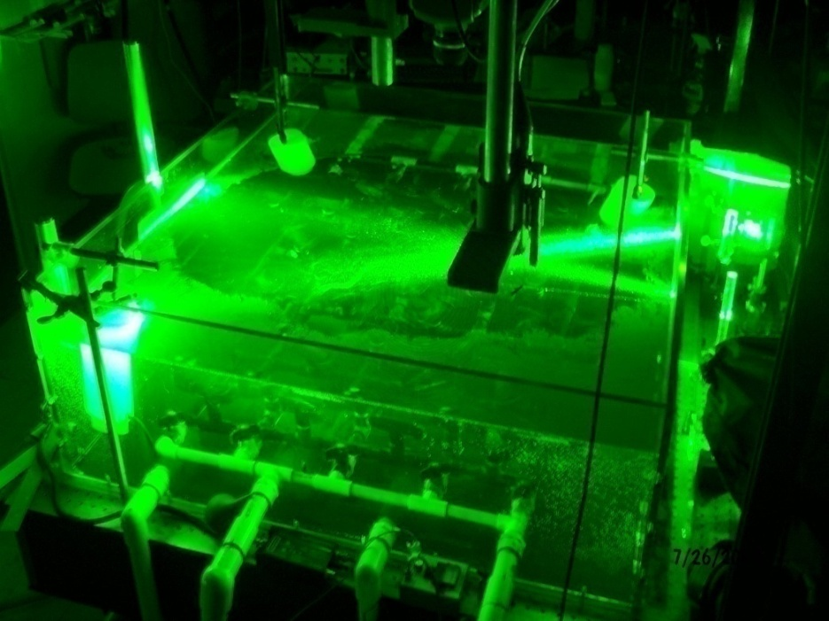
I. Experiment Overview
Experiment: track floating particles on the surface of a turbulent sea.
Models transport of pollutants, chemical species, etc. which are PASSIVE and BOUYANT.
Floaters flee fluid upwellings (sources) and cluster around fluid downwellings (sinks).
Notes:
-

Slide 5
Simple Model
Simple model: Floaters flee upwellings (sources) and cluster around downwellings (sinks).
This would tend to produce line-like concentrations.

Slide 6
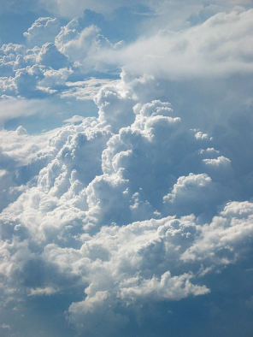


Effectively Compressible Flows
Inertial particles cluster in 3D incompressible turbulence because:
G. Falkovich, Nature 419, 151 (2002).
In same spirit, one may then write velocity of the floaters:
Floaters cluster due to effective compressibility:
C=0 (incompressible)
C=1 (irroational)
C≈0.5 (experiment)

Slide 7


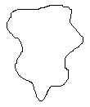




Turbulent Phenomenology
Main idea from Kolmogorov 1941:
Integral Scale:
Dissipative (Kolmogorov) length scale:
Energy Dissipation Rate:
Taylor microscale:
Taylor microscale Reynolds:
RMS Velocity:
Large Eddy Turnover time:
Compressibility:
Energy
Can’t be treated analytically:
For:
“Inertial range”
-This is seen at the surface: J.R. Cressman et al., New J. Phys. 6, 53 (2004).
Can be treated analytically:
For:
“Dissipative range”
Flow is viscous (laminar).

Slide 8
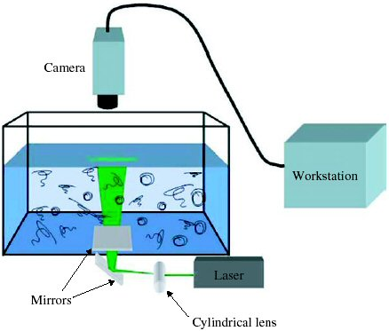

Turbulence generated in tank of water (ν=0.01 cm²/s) 1mx1mx30cm
-Injection source far from surface, waves do not exceed 0.5mm.
J.R. Cressman et al., New J. Phys. 6, 53 (2004)
Studied in: P. Denissenko, Phys. Rev. Lett. 97, 244501 (2006).
Use bouyant (s.g. 0.25) non-inertial (0.05mm) particles:
-Particles are hydrophillic: they do not cluster on a quiescent tank.
Camera speed set at 100Hz, Images processed using special PIV program.
-Typically data taken for 5-10s, producing 500-1000 unique velocity vector fields.

Slide 9
Measured Turbulent Parameters
Parameter | Equation | Measured Value
Taylor microscale:
Taylor microscale Reynolds:
Integral Scale:
Large Eddy Turnover time:
Energy Dissipation Rate:
Dissipative (Kolmogorov) length scale:
RMS Velocity:
Compressibility:
Smaller than Camera
field of view: L=9cm
1 pixel~0.01cm

Slide 10
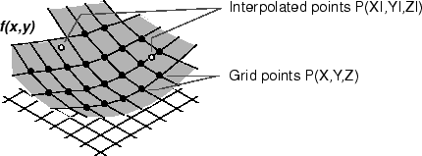
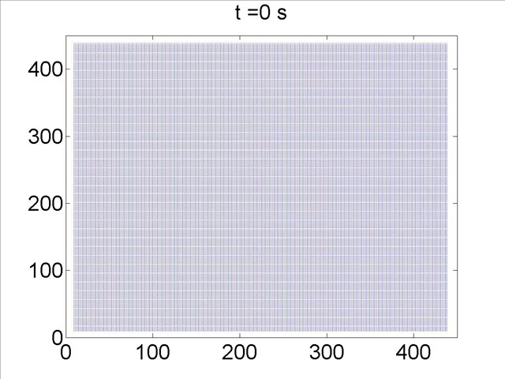
II. Particle Evolution
Advection equation:
Particles evolved using
interpolation scheme.
Criteria: δx<πη
- S. Pope, J. Comp. Phys. 79, 373 (1988).
Our data: δx=2.5η
-results insensitive using δx=4η.
y/η
Evolve 4x10⁵ homogeneous distribution at t=0s. Results insensitive using 10⁵ to 4x10⁵.
Steady-state reached in ~1s (2 LETTs).
x/η

Slide 11
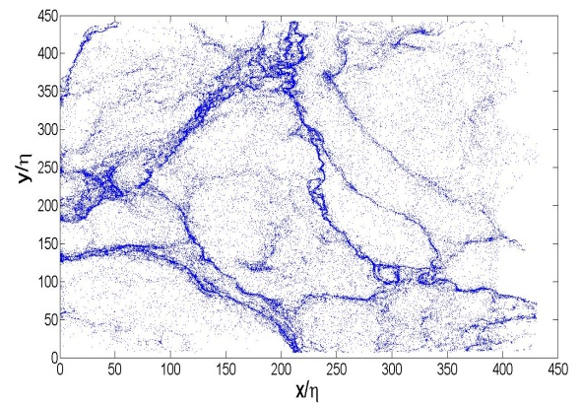
III. Coarse-Graining Procedure
Coarse-Grained (Eulerian) Concentration: # of particles in square of size s

Slide 12
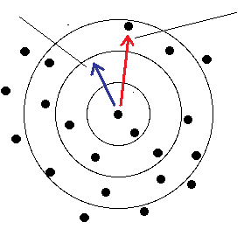
Lagrangian Coarse-Grained Concentration
Coarse-Grained (Lagrangian) Concentration:
The Eulerian and Lagrangian frames are equivalent with a weighting:
-P. Grassberger, Phys. Rev. Lett. 50, 346 (1983).
Easier to obtain accurate results in Lagrangian frame, two frames checked to be equivalent.
The moments evolve to a statistically steady state in approx. 1 s (2 LETTs). All analysis done on steady-state distributions!
Concentration statistics averaged over 15 independent fields.

Slide 13
IV. Concentration Statistics
Point:
=
Line:
Surface:
-For fractal distributions:
α_{m} is a non-interger: “Strange Attractor”
-2 unique scaling regimes in inertial/dissipative ranges consistent with:
-A. Pumir, Phys. Rev. E. 77, 066304 (2008).

Slide 14


Dissipative Range Concentration PDF
Main Results:
1) For intermediate concentrations:
-Power-laws seen in many physical contexts, issues of boundedness:
M.E.J. Newman, Contemporary Phys. 46, 323 (2005).
2) At very small concentrations:
-E. Balkovsky, arXiv.chaodynp. 9912027 (1999).
3) At large c_{r}, observed fall-off is faster than algebraic:
-Recall, in dissipative Range:
-PDFs

Slide 15
Inertial Range Concentration PDF
Main Results:
1) Again see power-law, exponent varies with scale r:
2) Very small c_{r} wing is observed with:
3) At large c_{r}, observed fall-off is faster than algebraic.
dissipative
range
inertial
range
4) Inertial range results qualitatively consistent with:
-A. Pumir, Phys. Rev. E. 77, 066304 (2008).
-PDFs

Slide 16
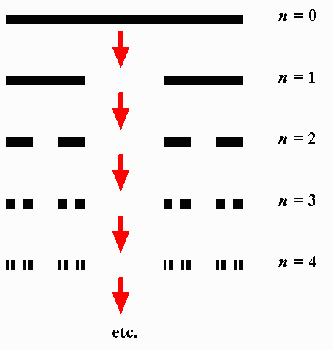
VI. Discussion: Multi-Fractal Distributions
Imagine we have scaling of the concentration moment(s):
A multifractal is defined as:
This is shown implicitly if:
Multifractal distribution in dissipative range consistent with:
-J. Bec, Phys. Rev. Lett. 92, 224501 (2004).
Multifractal in inertial range consistent with:
-A. Pumir, Phys. Rev. E. 77, 066304 (2008).
Cantor Set: a fractal, but not multifractal!

Slide 17








Caustics
-Caustics are divergences of light intensity in optics: Patterns at bottom of pool on sunny day
-Simplest caustic divergence:
-Which produces:
-In fluid dynamics, solution to Burger’s Equation (simplified Navier-Stokes) can produce shocks. These shocks will produce “caustics” of a passive scalar:
Caustic Aerosols: M. Wilkinson, Europhys. Lett. 71, 186 (2005)
Wave Coagulation: P. Denissenko, Phys. Rev. Lett. 97, 244501 (2006).
-This is most likely NOT what produces our distributions:
Particles follow fluid flow “exactly”, surface flow governed by 3D Navier-Stokes.
Surface waves are minimized.

Slide 18
VI. Conclusion
Major results of this work:
Particles coagulate into string-like structures.
- Particles concentrate on multifractal in both inertial and dissipative ranges.
Inertial and dissipative range concentrations quantitatively different.
- First moment of the (Lagrangian) coarse-grained concentration exhibits unique scale-free behavior in inertial and dissipative ranges.
PDFs behave algebraically (very broad) over range of concentrations.
- Power-law describes regions of particle expulsion instead of line structures.
-Results in dissipative range in (qualitative) agreement with:
J. Bec, Phys. Rev. Lett. 92, 224501 (2004).
E. Balkovsky, arXiv.chaodynp. 9912027 (1999).
A. Pumir, Phys. Rev. E. 77, 066304 (2008).
-Results in inertial range in (qualitative) agreement with:
A. Pumir, Phys. Rev. E. 77, 066304 (2008).
-Results most likely NOT due to caustics (or waves), as in:
M. Wilkinson, Europhys. Lett. 71, 186 (2005)
P. Denissenko, Phys. Rev. Lett. 97, 244501 (2006).

Slide 19
Questions
Collaborator’s (Dr.’s W.I. Goldburg, M.M. Bandi, and A. Pumir) would like to thank G. Falkovich and K. Gawedzki for very helpful discussions. Funding was provided by the US National Science Foundation grant # DMR-0604477 and by the French ANR (contract DSPET) and by IDRIS. This work was partially carried out under the auspices of the National Nuclear Security Administration of the U.S. Department of Energy at Los Alamos National Laboratory under Contract No. DE-AC52-06NA25396. Dr. A. Pumir thanks the French ANR (contract DSPET), and IDRIS for support.

