Slide 1
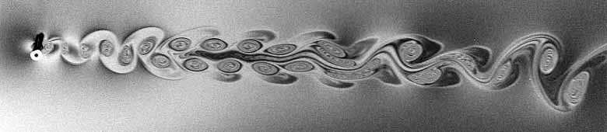
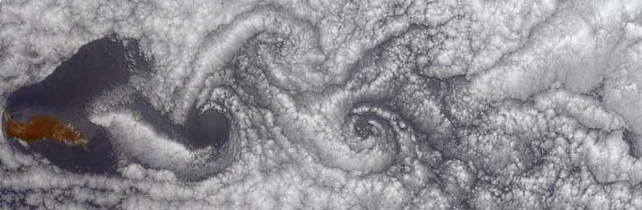

Turbulent Dynamics of a Hydraulic Jump in 2D
M.A. Rutgers
Jason Larkin, Walter Goldburg
University of Pittsburgh
Tuan Tran, Pinaki Chakraborty, Gustavo Goia
University of Illinois, Urbana
Notes:
Guadalupe Island June 2000. 20 miles long

Slide 2
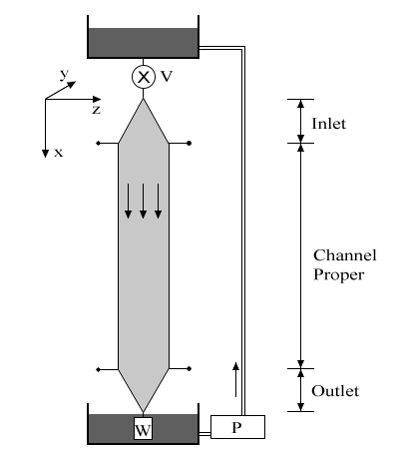



Hydraulic Jump in Flowing Soap Film
• Distilled water and 2.5% soap by volume.
10 cm width, several meter length, 5 m/s max velocity.
Experiment:
(e.g. Rhoton, 1982, not a quantitative study)
Notes:
Motivation: Study of aneurysms
Explain “Circle of Willis” – Ring of arteries that supply blood. If one section restricts flow, blood still reaches areas due to this redundancy, preventing brain damage.
Most aneurysms are found in the Circle of Willis at splits, or “bifurcations” of blood vessels.

Slide 3

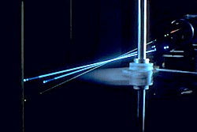






Velocity Measurements: LDV
• Mean particle diameter:
Data duration:
Taylor Frozen Turbulence:
Mean count rates:
Spatial resolution:
Notes:
514.5 nm

Slide 4
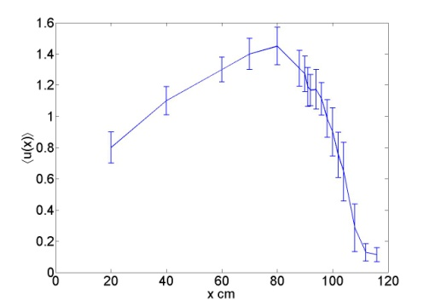


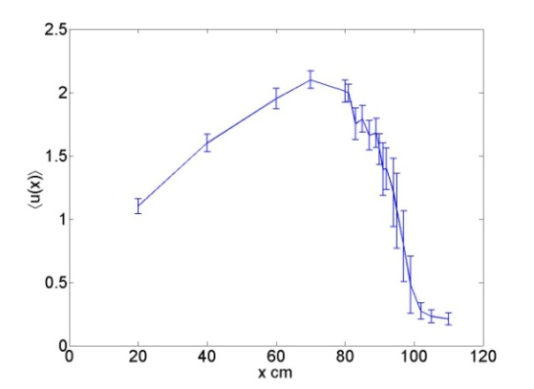

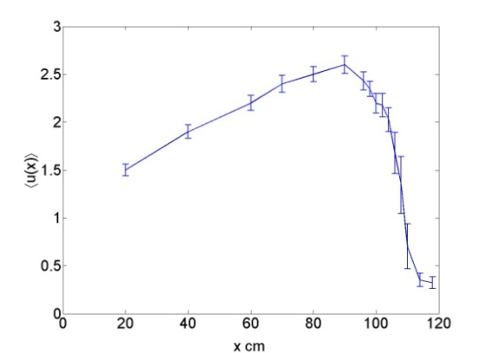
Velocity Profiles
q=0.06 ml/s
• Velocity profile:
• Mean velocities:
• Thickness profile:
q=0.13 ml/s
~constant
Re = 20-60k
q=0.23 ml/s
• General Features:
-Non-monotonic velocity profile.
-Large spatial velocity gradients.
-Localized velocity flucutations.
Notes:
Universal features…

Slide 5
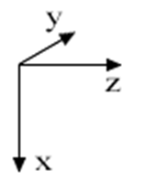
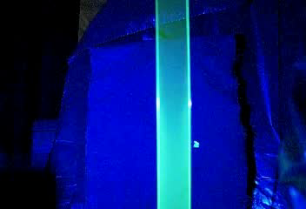
Flow Visualization
A
- Fluorescent dye introduced to visualize film.
- Emission intensity proportional to film thickness.
B
-A
-B

Slide 6



Energy Spectrum in 2D Turbulence
• Total Energy:
Energy injection scale:
Homogeneous, Isotropic Turbulence
Forced, large scales:
Decaying, small scales:
In soap film flows, decaying turbulence:

Slide 7

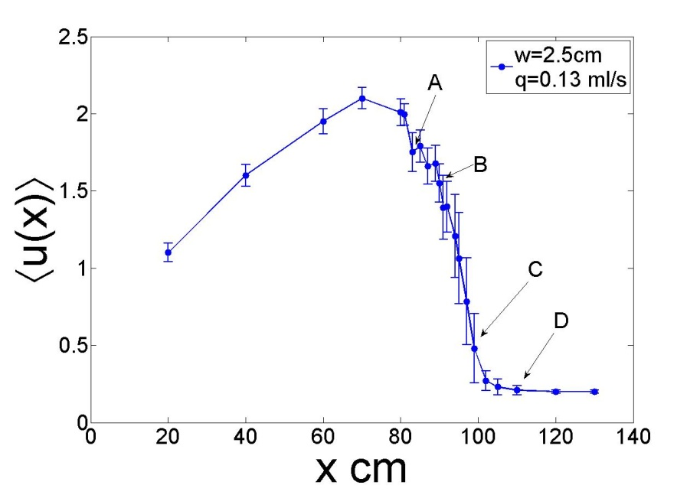
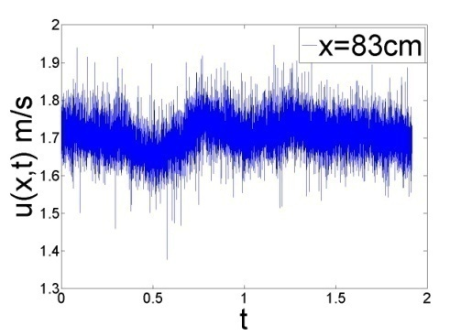
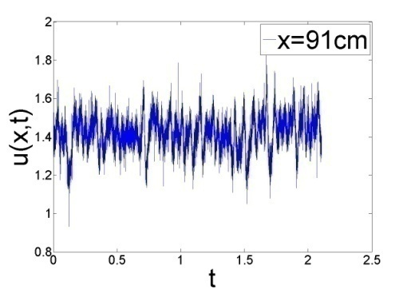
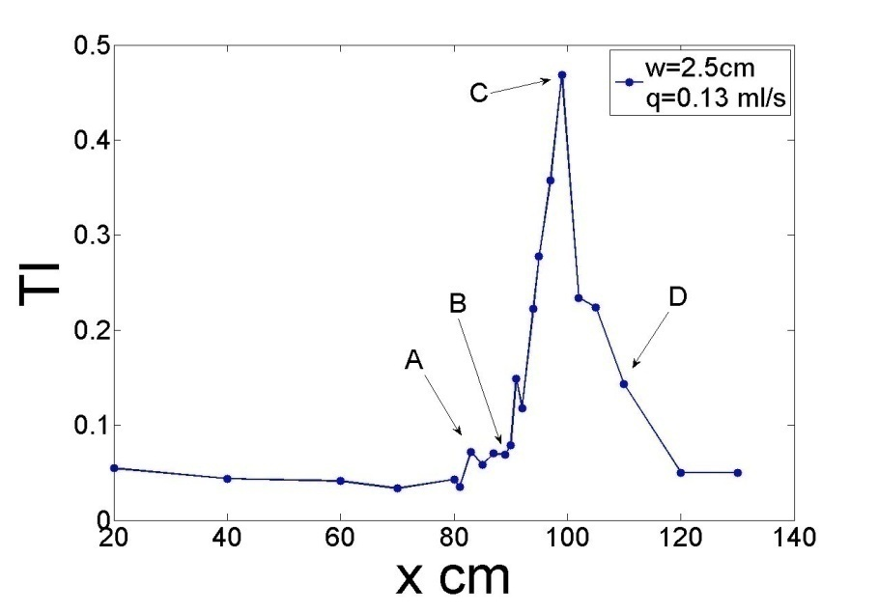
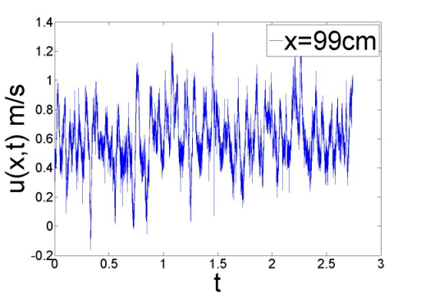
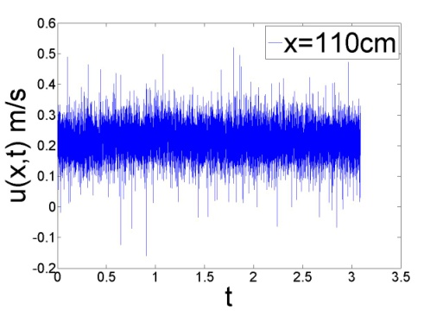
Frozen Turbulence Assumption
- TI as high as ~50%, but highly local.
Majority of measurements made with TI <20%
A
B
C
D

Slide 8
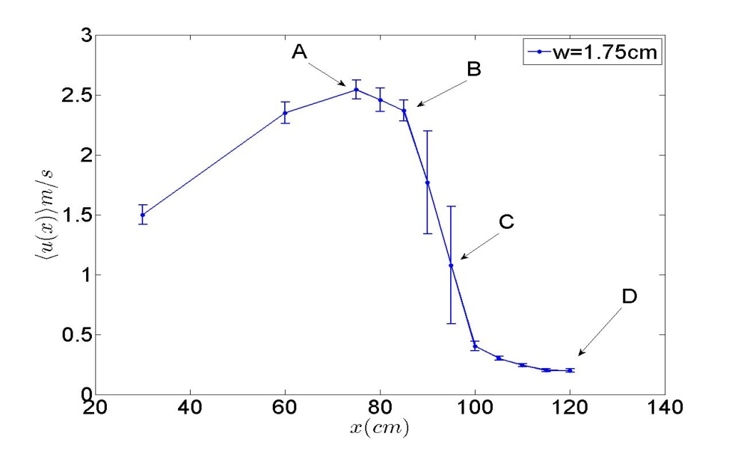
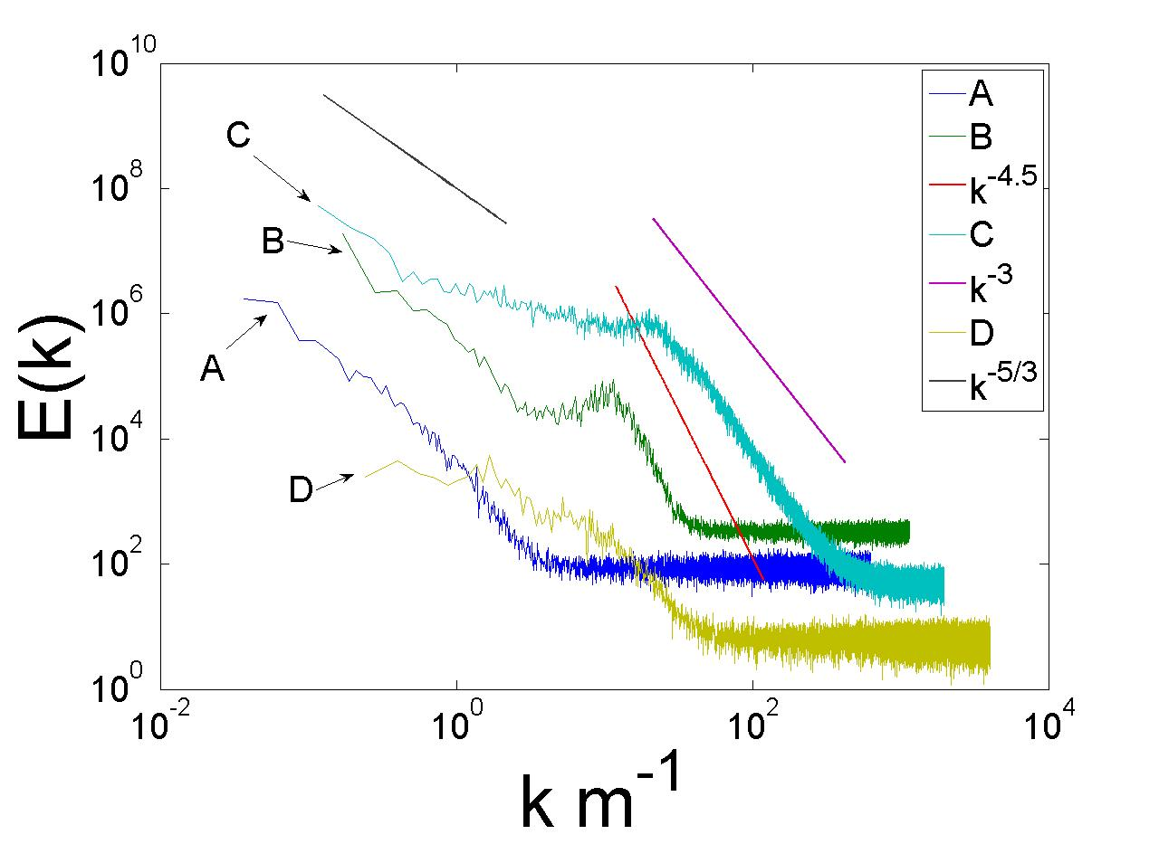
General Features of the Turbulence in Soap Film
-W=1.75 cm, q=0.2 ml/s
-Locations A,B,C,D where E(k) is calculated.
A: no scaling at large k
B: steepened spectrum
C: scaling close to dimensional argument, TI at maximum!
D: no definite scaling

Slide 9
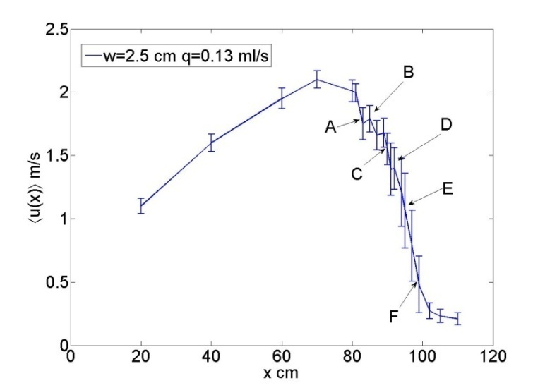
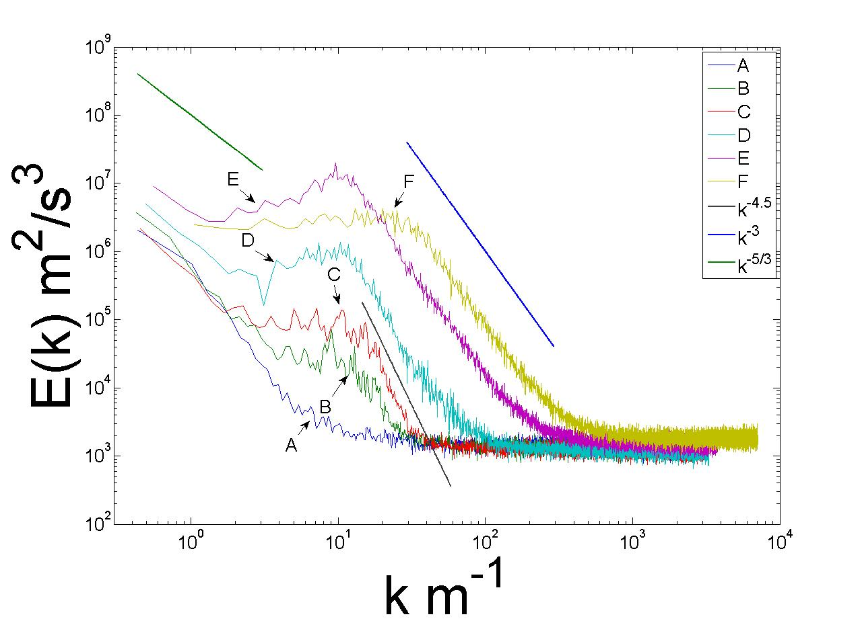
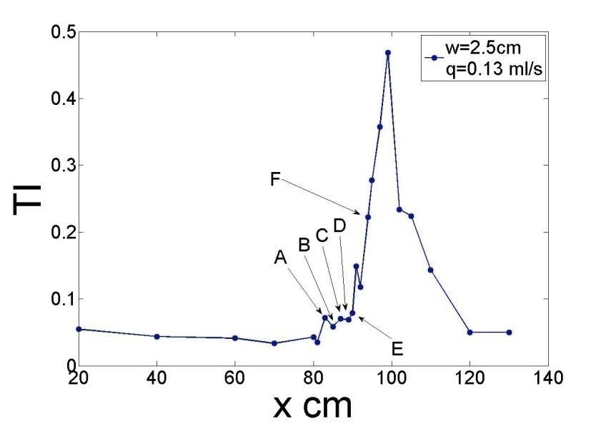
Turbulence in the Transition Region
A: No scaling at large k
B: Some excitation near k~10 1/m
C: Steepened spectrum
D: spectrum steepening progressing to smaller k
E: fully-formed spectrum from k=10..100 1/m

Slide 10





Possible Theory - UIUC
- Energy is injected over range of scales
- Energy spectrum scaling now becomes
- Outside of this range energy injection rate is independent of k

Slide 11
Results and Future Work
Turbulence in Soap Film hydraulic jump confined to a local region of the flow.
Flow here is subject to large Turbulent Intensity and large spatial velocity gradients.
Results in spectral scaling dependent on position within the thickening transition region.
Test Frozen hypothesis in jump region using two probes.
Study flow field in the Lagrangian frame using PIV.

Slide 12
Questions?

Slide 13
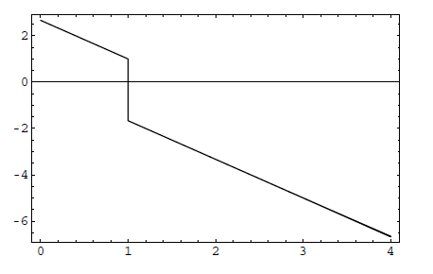






Slide 14




The Classic 3D Hydraulic Jump

Slide 15
General Features of Jump Turbulence
W=1.75 cm
q = 0.2 ml/s

