Slide 1


Turbulent Dynamics of a Hydraulic Jump in 2D
M.A. Rutgers
Jason Larkin, Walter Goldburg
University of Pittsburgh
Tuan Tran, Pinaki Chakraborty, Gustavo Goia
University of Illinois, Urbana
Notes:
Guadalupe Island June 2000. 20 miles long

Slide 2
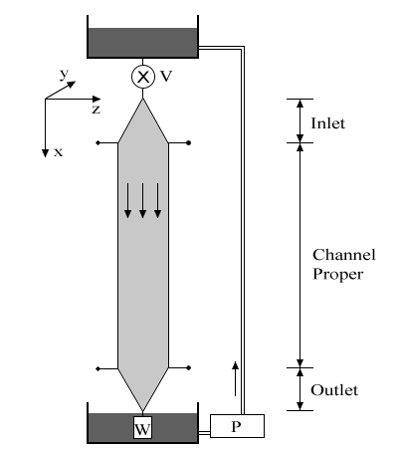




Hydraulic Jump in Flowing Soap Film
• Distilled water and 2.5% soap by volume.
10 cm width, several meter length, 5 m/s max velocity.
For range of flow rate q, length L, and width w, film abruptly thickens at some position x*
Experiment:
w
Notes:
Motivation: Study of aneurysms
Explain “Circle of Willis” – Ring of arteries that supply blood. If one section restricts flow, blood still reaches areas due to this redundancy, preventing brain damage.
Most aneurysms are found in the Circle of Willis at splits, or “bifurcations” of blood vessels.

Slide 3

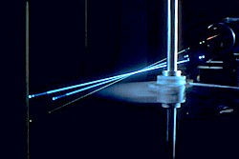






Velocity Measurements: LDV
• Mean particle diameter:
Data duration:
Taylor Frozen Turbulence:
Mean count rates:
Spatial resolution:
Notes:
514.5 nm

Slide 4
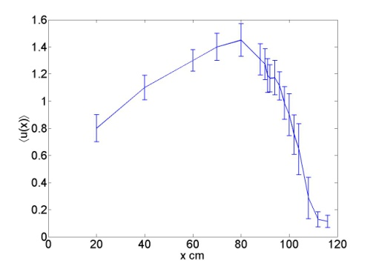

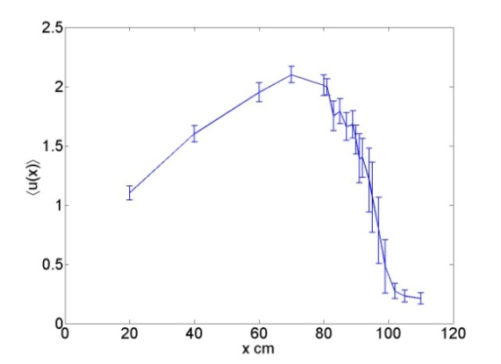

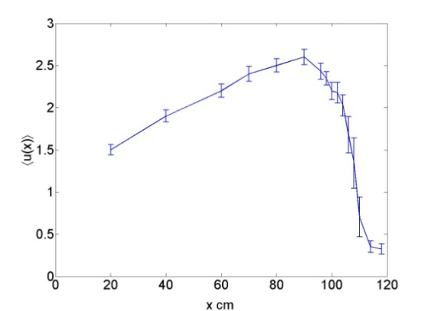
Velocity Profiles
q=0.06 ml/s
• Velocity profile:
W=2.5cm
• Mean velocities:
• Thickness profile:
q=0.13 ml/s
~constant
Re = 20-60k
q=0.23 ml/s
• General Features:
-Non-monotonic velocity profile.
-Large spatial velocity gradients.
-Localized velocity flucutations.
Notes:
Universal features…

Slide 5
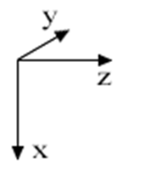
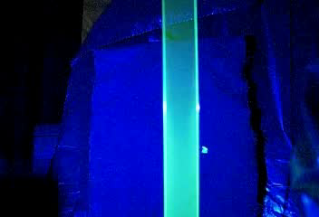
Flow Visualization
A
- Fluorescent dye introduced to visualize film.
- Emission intensity proportional to film thickness.
B
-A
-B

Slide 6

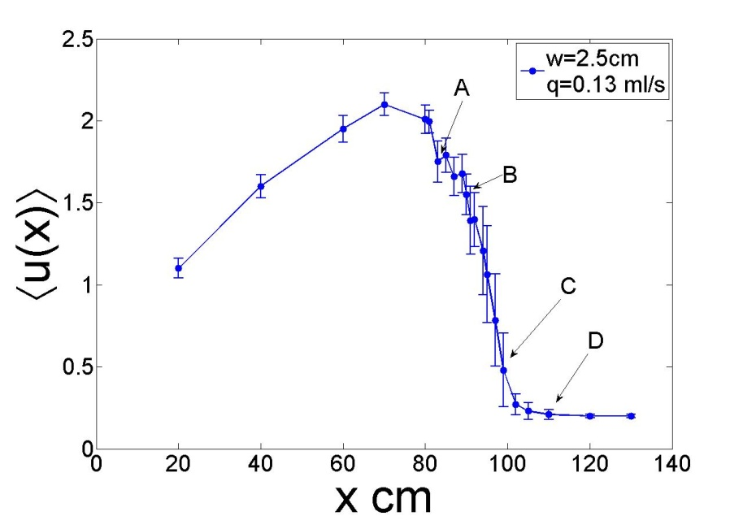
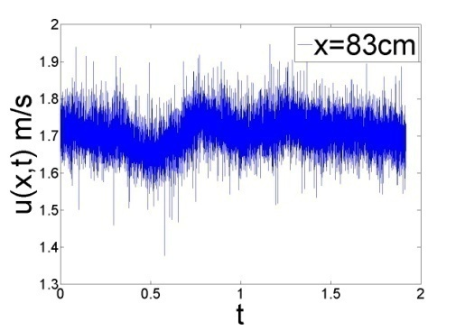
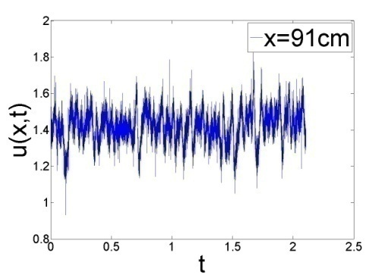
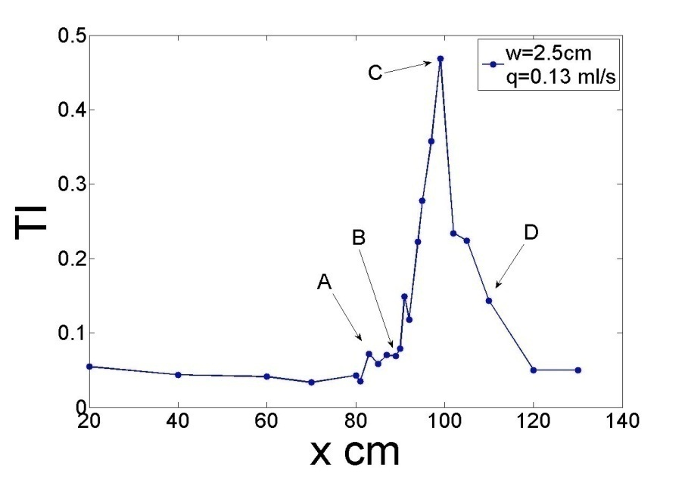
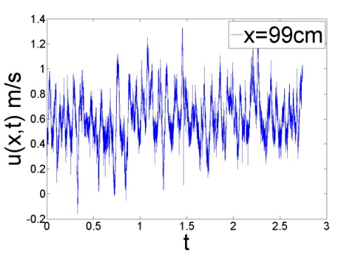
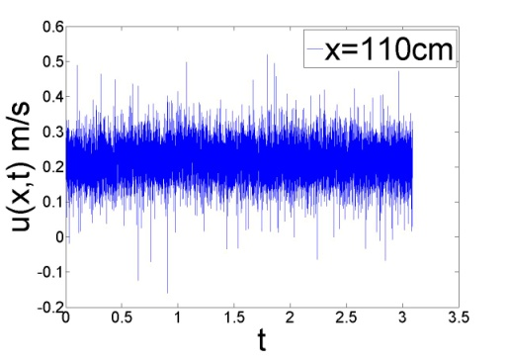
Frozen Turbulence Assumption
- TI as high as ~50%, but highly local.
Majority of measurements made with TI <20%
A
B
C
D

Slide 7





Energy Spectrum in 2D Turbulence
• Total Energy:
Energy injected at scale:
Homogeneous, Isotropic Turbulence
Forced, large scales:
Decaying, small scales:

Slide 8
Soap Film Turbulence
- Grid generated decaying turbulence in soap film flow.
Hydraulic Jump: This turbulence is unlike any seen before.
- Turbulence is produced “spontaneously” by the jump. No grid or channel roughness produces jump.
- What is energy injection scale(s)?

Slide 9
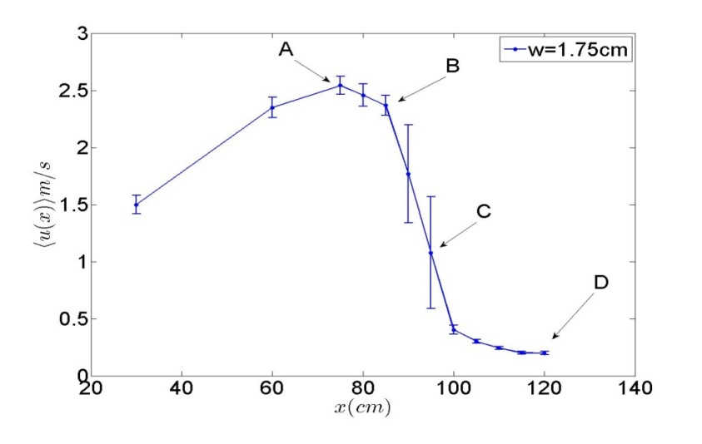
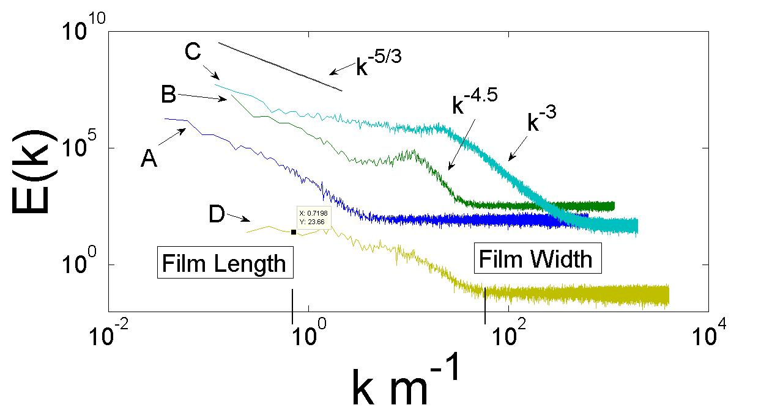
General Features of the Turbulence in Soap Film
-W=1.75 cm, q=0.2 ml/s
-Locations A,B,C,D where E(k) is calculated.
A: no scaling at large k
B: steepened spectrum
C: scaling close to dimensional argument, TI at maximum!
D: no definite scaling

Slide 10
General Results
-For range of film widths and flow rates studied here, spectral scaling varies in the thickening transition region.
- Scaling steeper than dimensional/Kraichnan scaling.
-Turbulence is confined to this region of steep spatial velocity gradients, high Turbulent Intensity. Frozen assumption may be inapplicable.

Slide 11



Possible Theory - UIUC
- Energy is injected over range of scales
- Energy spectrum scaling now becomes
- Outside of this range energy injection rate is independent of k

Slide 12
Results
Turbulence in Soap Film hydraulic jump produced “spontaneously”, confined to a local region of the flow.
Flow here is subject to large Turbulent Intensity and large spatial velocity gradients.
Results in spectral scaling dependent on position within the thickening transition region.
Test Frozen hypothesis in jump region using two probes.
Study flow field in the Lagrangian frame using PIV.

Slide 13
Questions?

