Slide 1
The Karman Constant of 2D Flows
Nicholas Guttenberg, Nigel Goldenfeld, Gustavo Gioia
University of Illinois at Urbana-Champaign
Walter Goldburg
University of Pittsburgh

Slide 2
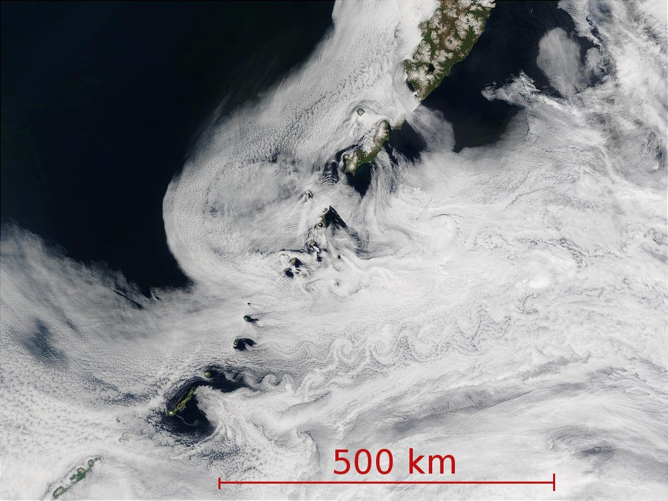
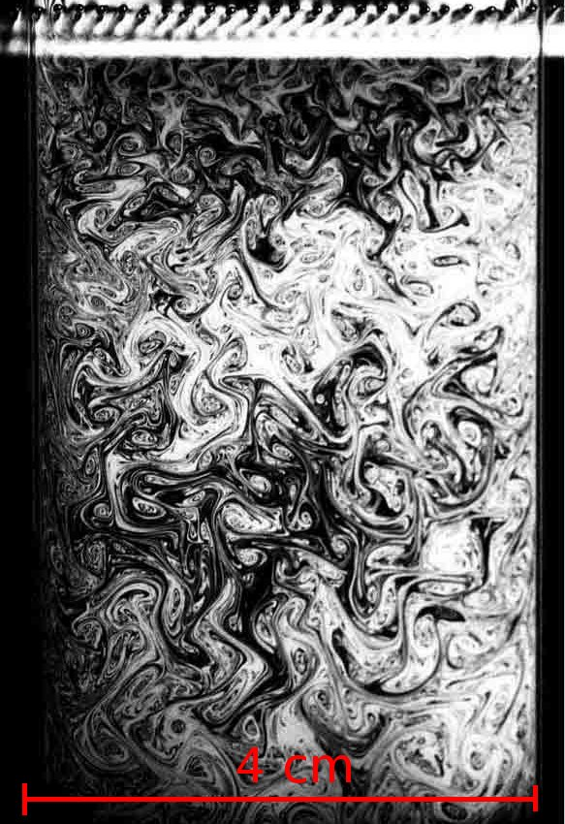
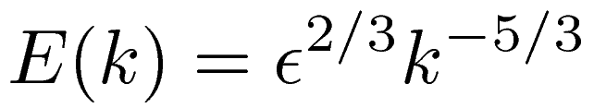
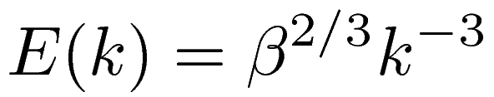
Structure at many scales
Vortex sheet off Kuril Islands¹
Soap film experiment²
Energy cascade (3d) or Enstrophy cascade (2d)?

Slide 3
Consequences of the spectrum
Spectrum differs in 2D, so 2D turbulence can be used to test the dependence of macroscopic flow behaviors on the scale-free structure of turbulence.
What macroscopic quantities are affected by the spectrum?
  Blasius and Strickler regimes of the friction factor in pipe flow
  Shape of the wall velocity profile
    von Kármán constant

Slide 4
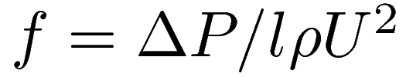
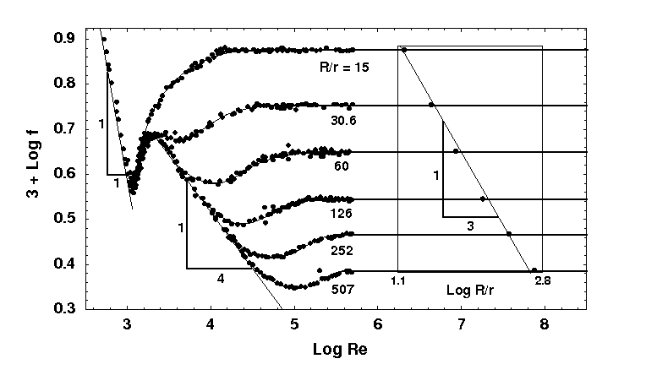
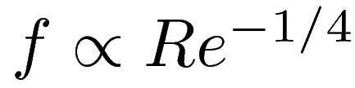
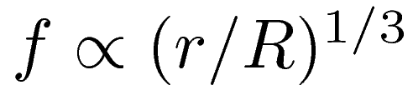
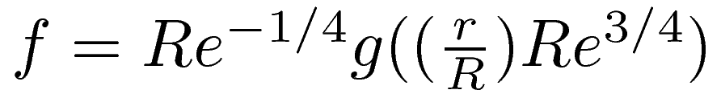
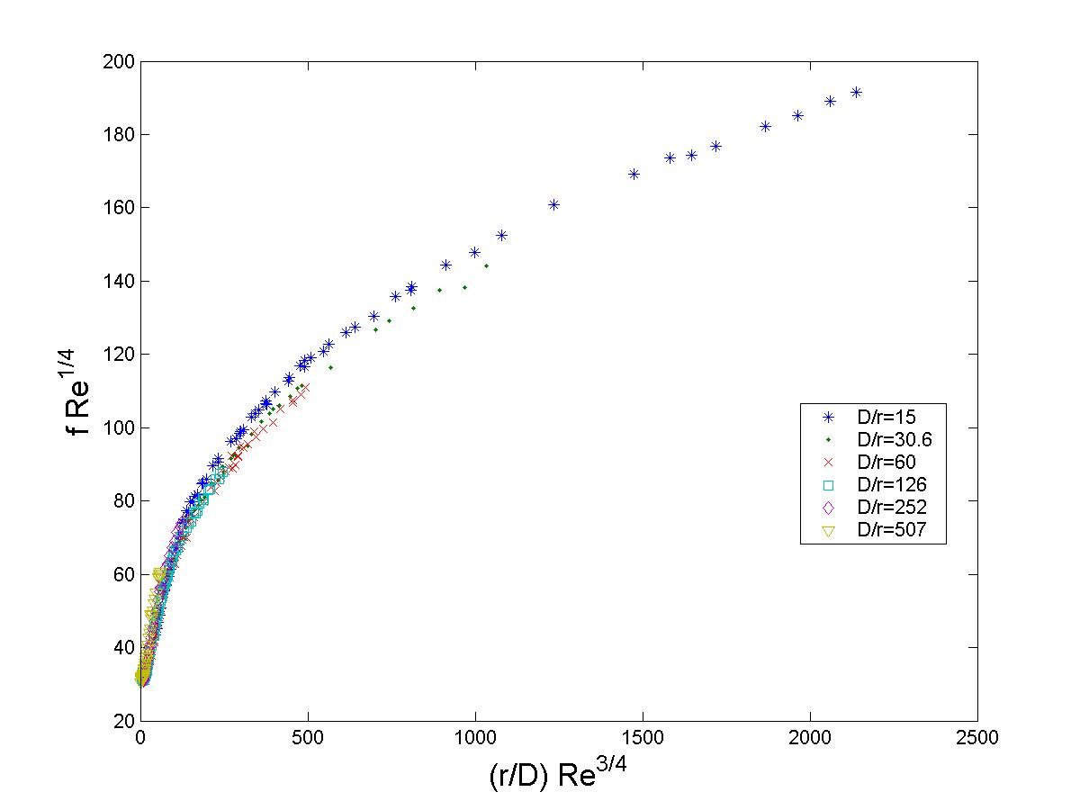
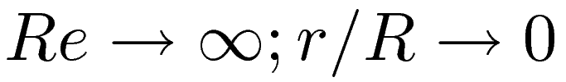
Pipe flow Experiments
Pipe flow experiment by Nikuradze in 1932. Friction factor as a function of Re and roughness scale
Friction factor:
Blasius regime:
Strickler regime:
Data collapse (Goldenfeld 2008)
  Analogy to critical phenomena
  Critical point:
  Intermittency corrections further improve the data collapse (Mehrafarin 2008)
Nikuradze's data. From G. Gioia and
P. Chakraborty, Phys. Rev. Lett. 96 (2006)
Data collapse, from N. Goldenfeld,
Phys. Rev. Lett. 96 (2006)

Slide 5
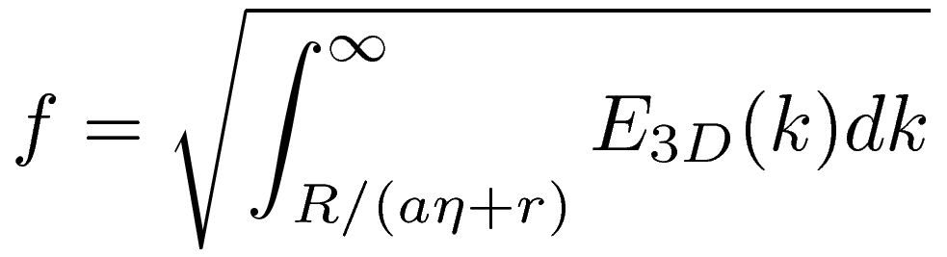
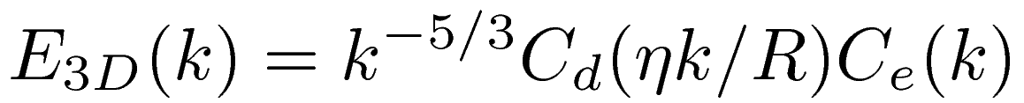
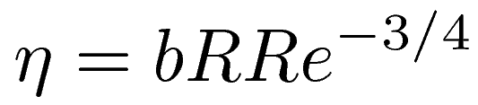
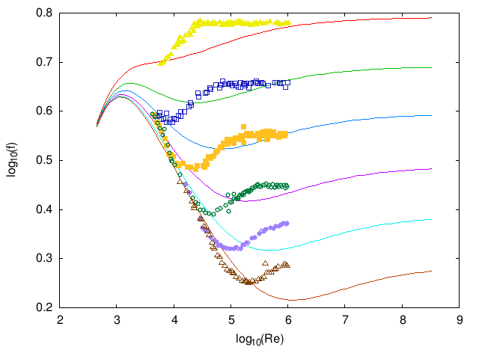
Friction from Spectrum
Argument of Gioia and Chakraborty (2006)
Rough surface has coves, friction produced by momentum transfer across the boundary layer into coves.
Integrate contribution due to all vortices which fit in the cove
Reproduces scalings and belly region of the Nikuradze data but crossover occurs at the wrong Reynolds number.

Slide 6
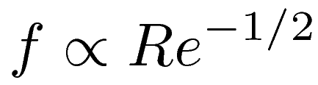
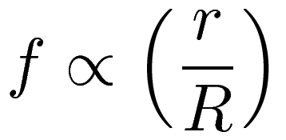
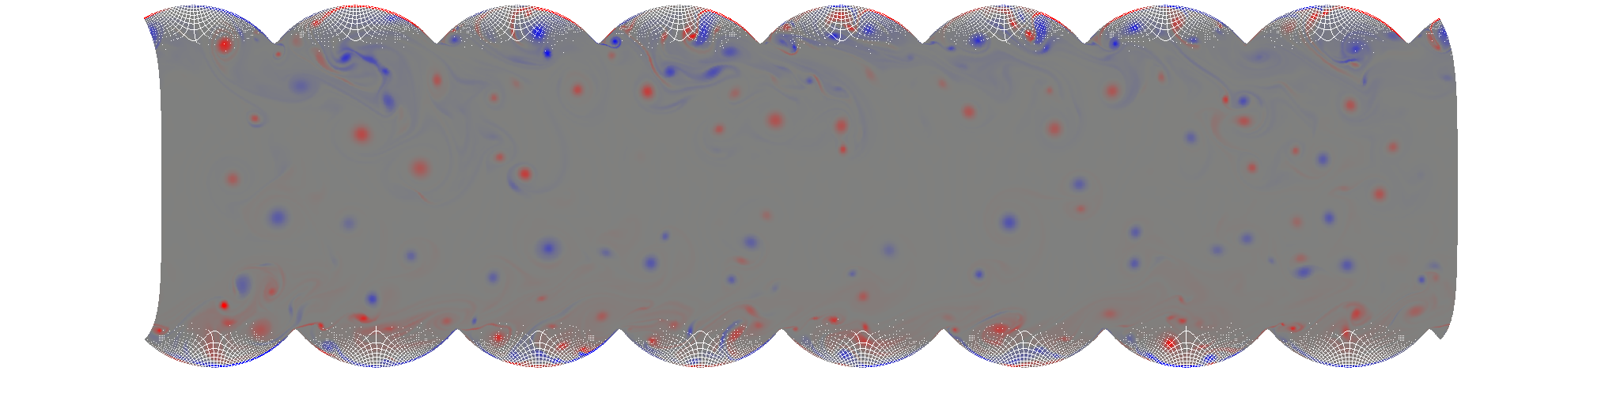
2D Turbulence
Momentum transfer argument in 2D enstrophy cascade:
DNS of two-dimensional turbulence:
  Conformal mapping to capture roughness
  3rd order nonlinear upwinding scheme: SMART (Gaskell & Lau 1988)
  Spectral method to solve pressure equation
Blasius:
Strickler:

Slide 7
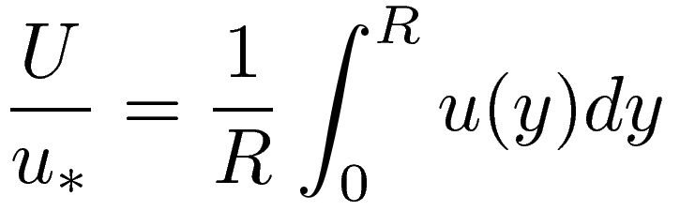
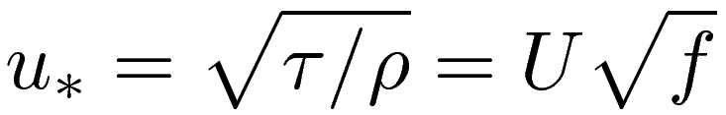
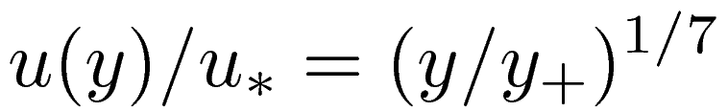
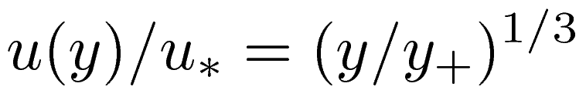

Velocity Profile Predictions
Velocity profile linked to friction factor:
Prandtl friction:
Energy cascade predicts:
Enstrophy cascade predicts:
If one assumes a log law, then this predicts one would measure a different von Kármán constant in 2D!
  Fit to theoretical velocity profile from momentum transfer friction factor:

Slide 8
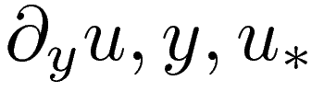
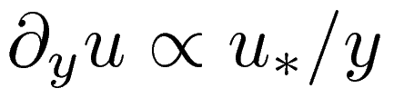
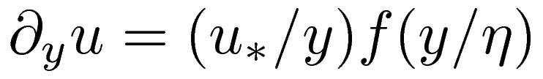
Why not Prandtl?
The usual argument is to consider dimensional analysis in near-wall variables:
This leads to: and from there, the Prandtl friction formula. This assumes no dependence on turbulent lengthscales
More generally (for a smooth pipe):
This can support power-law velocity profiles and friction
factor scalings.
The Prandtl result has no explicit spectral dependence, but in 2D the momentum transfer theory predicts a very specific spectral dependence! We can therefore test this.

Slide 9
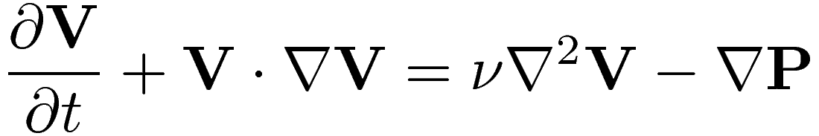
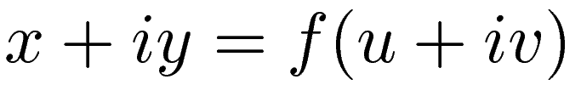
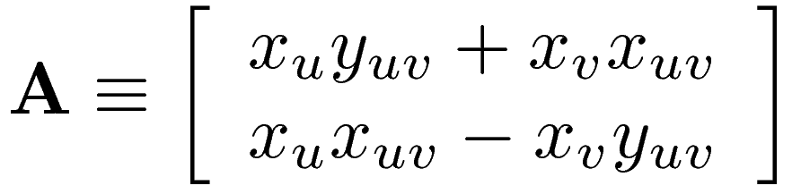
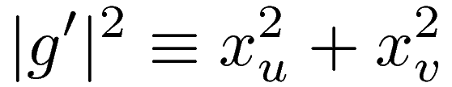
Conformal Mapping
Navier-Stokes equation before mapping:
Map coordinates:
Navier-Stokes equation after mapping:

Slide 10
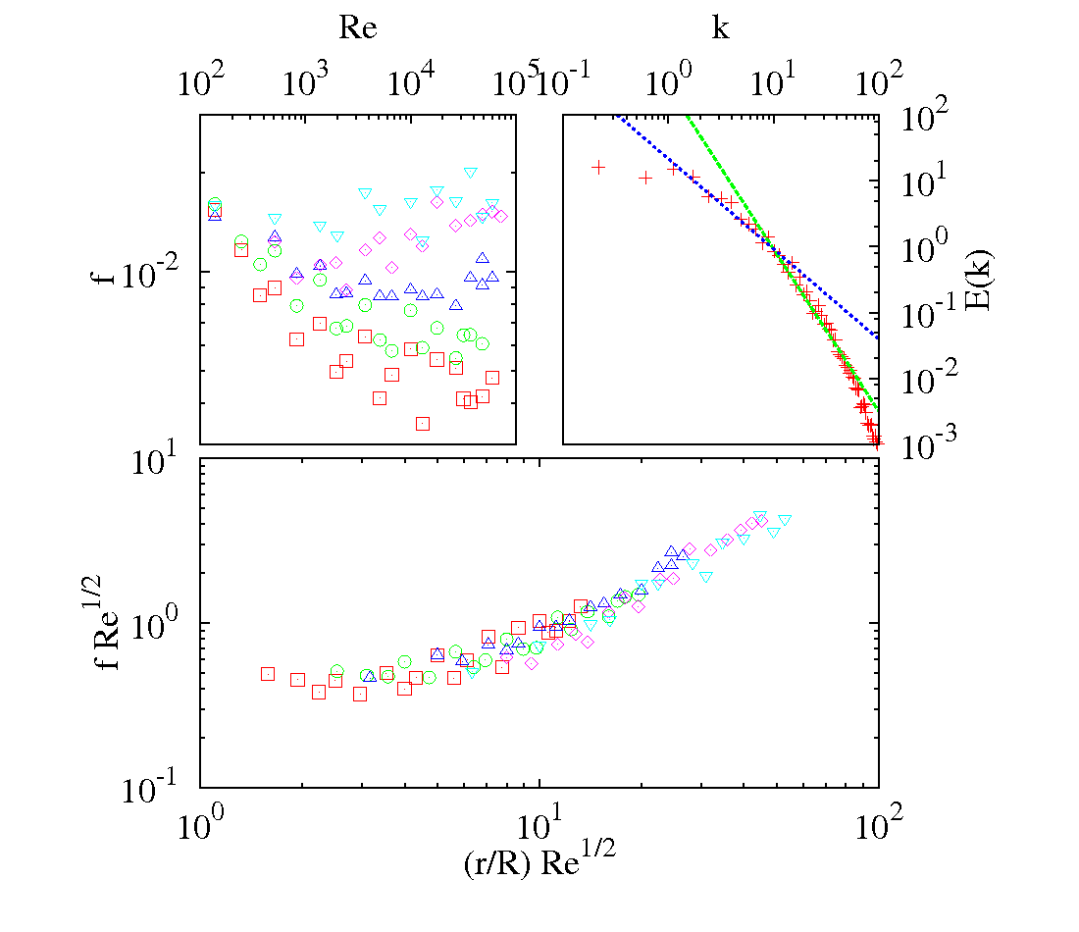
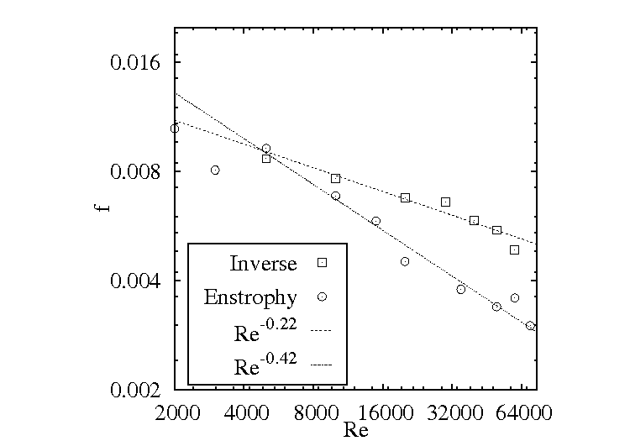
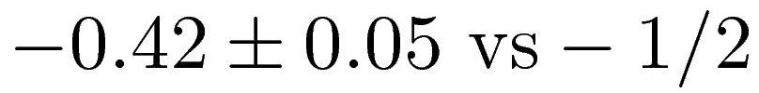
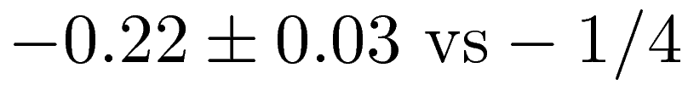
Results of Simulation
Enstrophy cascade Blasius exponent:
Inverse cascade Blasius exponent:
Data collapse in the enstrophy cascade case with the predicted choice of variables - partial verification of Strickler regime

Slide 11
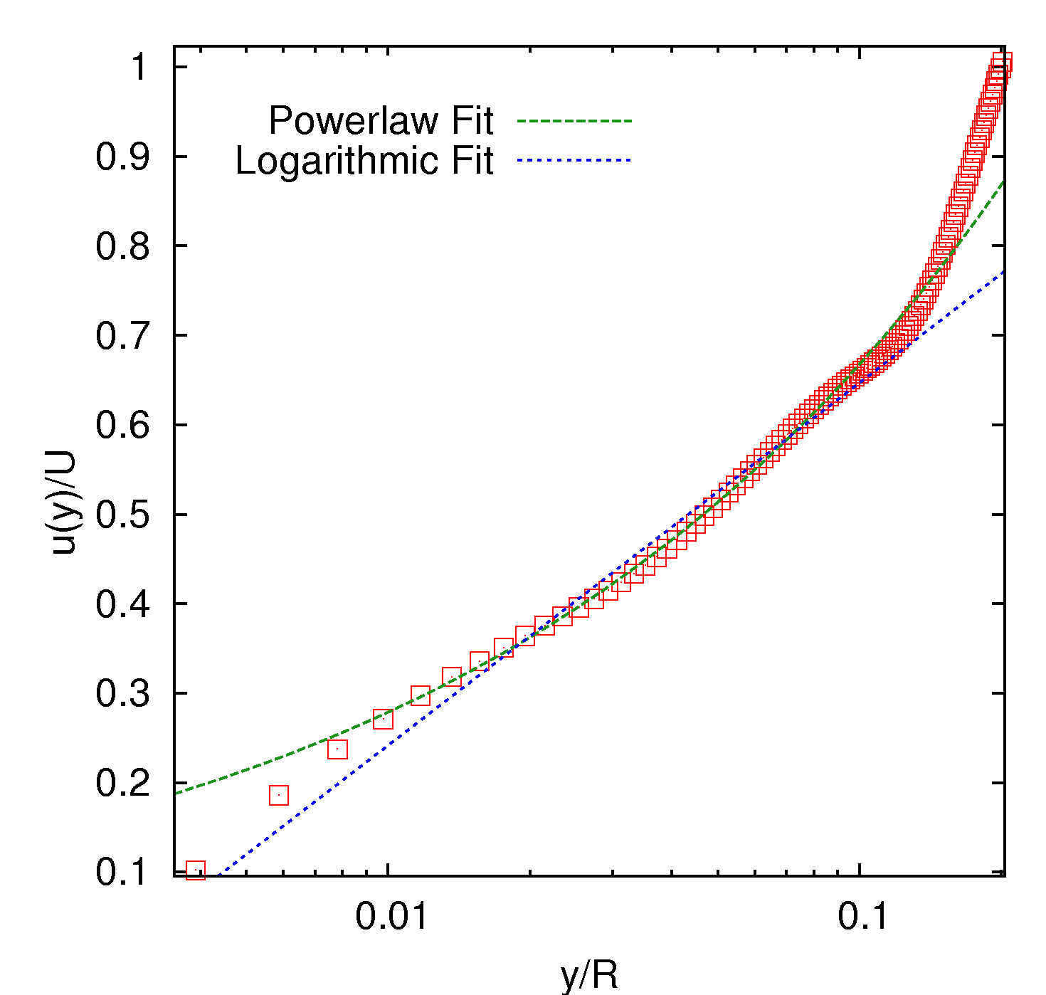
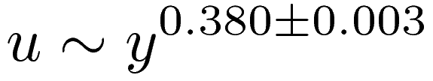


Velocity Profile Results
Power law fit:
Logarithmic fit:
Comparison with experiment:
Must take air resistance into account!
Air resistance steepens the near-wall profile and so decreases the effective von Kármán constant.
Similar simulation with air resistance:
Velocity profile at Re=70000

Slide 12
Conclusions
Spectral structure of turbulence determines macroscopic flow properties
  Not just near-wall dimensional analysis
2D turbulence can be used to probe spectral dependences
Expect steeper friction factor scalings and a smaller von Kármán constant in 2D

