Slide 1
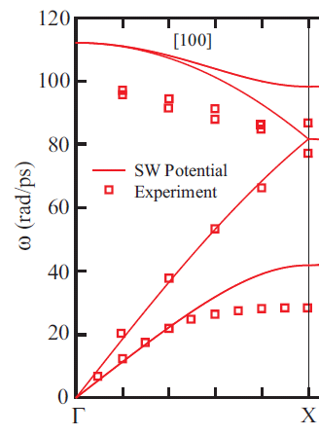
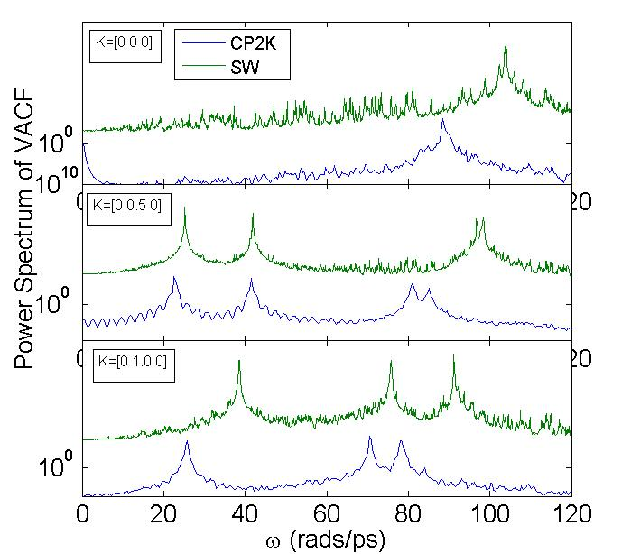
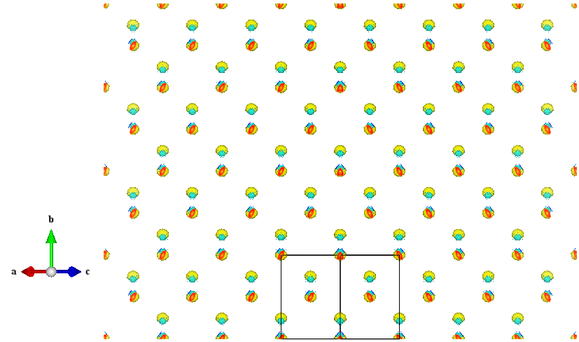
Silicon at ~ 300 K from DFT
512 atoms, 128 cpus on Diamond and Garnett
CP2K: DFT with mixed Gaussian/Plane Wave.
Timing:
- CP2K = 3 steps/min/128cpu ~ 0.02 steps/min/cpu
- SW = 6E4 steps/min/4 cpu ~ 1E4 steps/min/cpu
Electronic KE Density
SW Initial conditions

