Slide 1
NTPL: Nanoscale Transport Phenomena Laboratory Jason Larkin (PhD student) Alan McGaughey http://ntpl.me.cmu.edu/ 4/13/2011

Slide 2
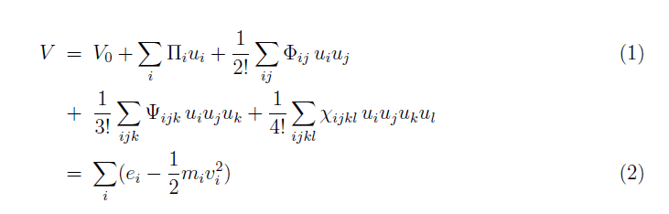

Slide 3
“One, two or three neighboring atoms are moved simultaneously by a
small amount, typically about 0.01°A along the cartesian directions.”

Slide 4
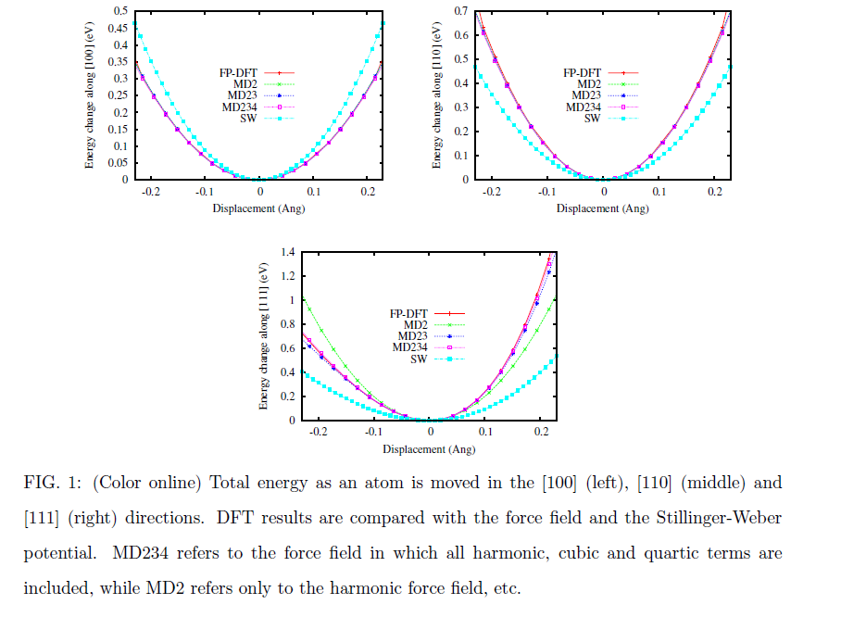
Dove: how far do atoms move? Silicon bond length = 2.35 Ang, so 0.2 ~ 10%

Slide 5
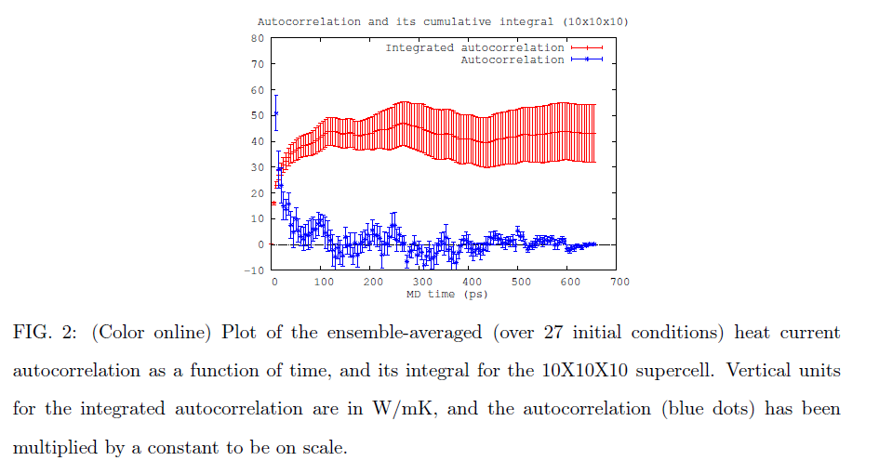

Slide 6
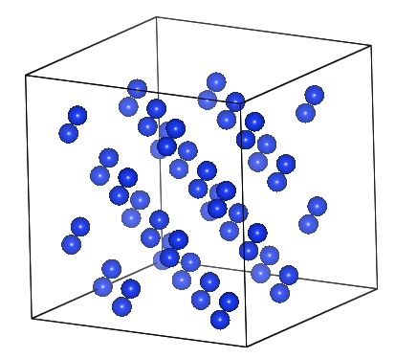
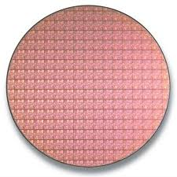
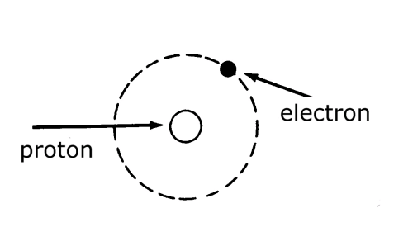
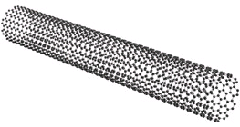
Nanoscale Transport Phenomena
Bulk Properties
Transport Carriers: phonons, electrons, photons, etc.
Statistical Properties: classical vs. quantum
Nanoscale Behavior
Transport: continuum?
Carrier Properties: Bulk?
L=10-100 nm

Slide 7
Predicting Thermal Conductivity of Defected Systems using Spectral Energy Density 4/13/2011

Slide 8
Dielectric Thermal Conductivity
Dielectric crystal = Electrical Insulator
Ex: Si, Ge
Bulk dielectric:
Dielectric Thermal Conductivity:
Phonons are lattice vibrations…

Slide 9

Phonons
1-D model of crystal:
m_{atom}
k_{spring}
Waves that can exist depend on system size.
When system is very large (bulk)…
Lattice vibrations (Phonons) are travelling waves:

Slide 10
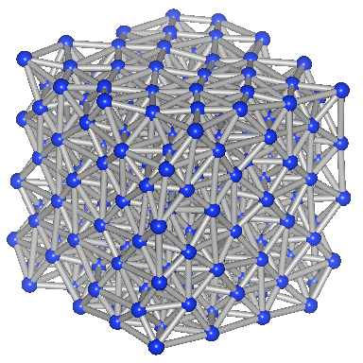
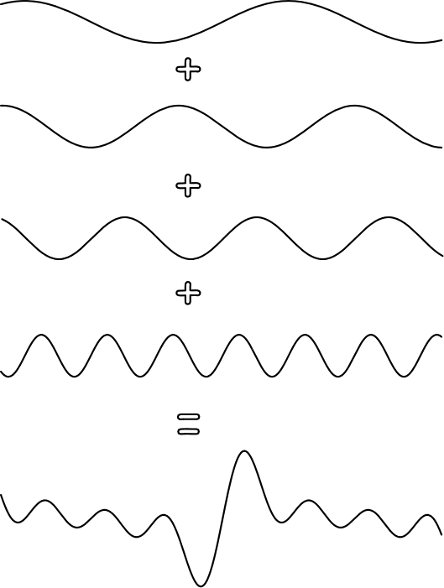
Phonon Gas
=
Phonons Interact:
Non-linear springs make an Interacting Gas…
m_{atom}

Slide 11
Thermal Conductivity Phonon Gas
Kinetic Theory:
T_{H}
T_{c}
Ideal Gas:
Phonon Gas:
If system L >> :
Phonons interact: with each other, impurities, defects, etc.

Slide 12
Thermal Conductivity Phonon Gas
Phonons interact
Phonon Lifetime:
Properties needed for prediction:

Slide 13
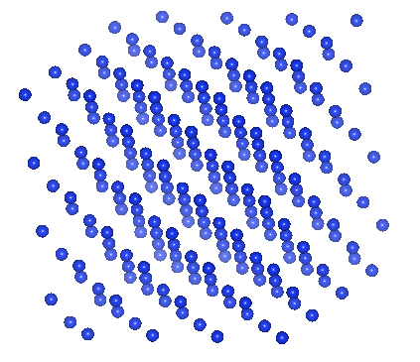
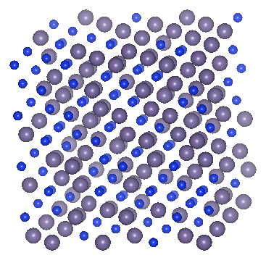
Molecular Dynamics and Spectral Energy Density
Molecular Dynamics
- Equilibrium/non-equlibrium properties:
Spectral Energy Density
Frequency, group velocity and lifetimes of phonons from Molecular Dynamics.

Slide 14
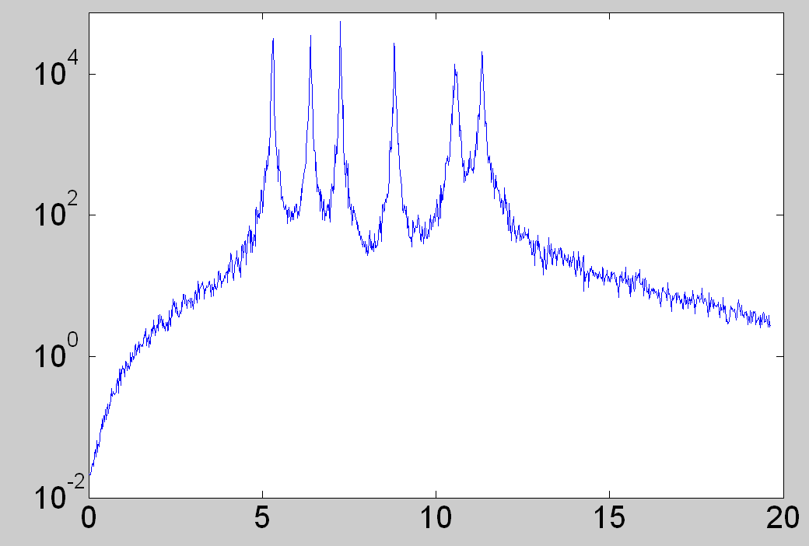
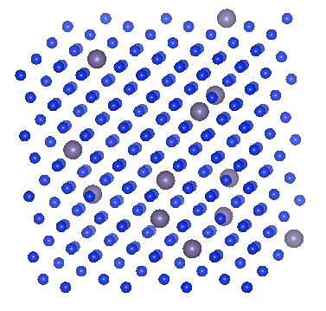
Spectral Energy Density
Spectral Energy Density: (SED) system energy in frequency space.
SED(ω)
ω (rads/ps)
SED(ω)
Broad peak = short lifetime
ω (rads/ps)

Slide 15
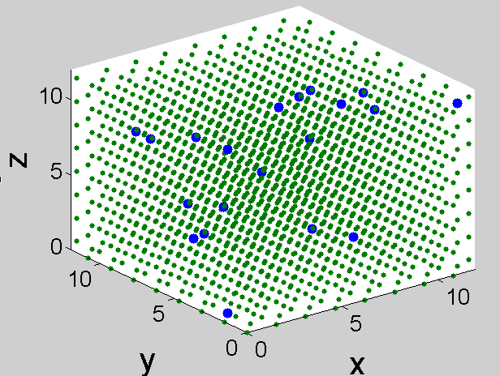
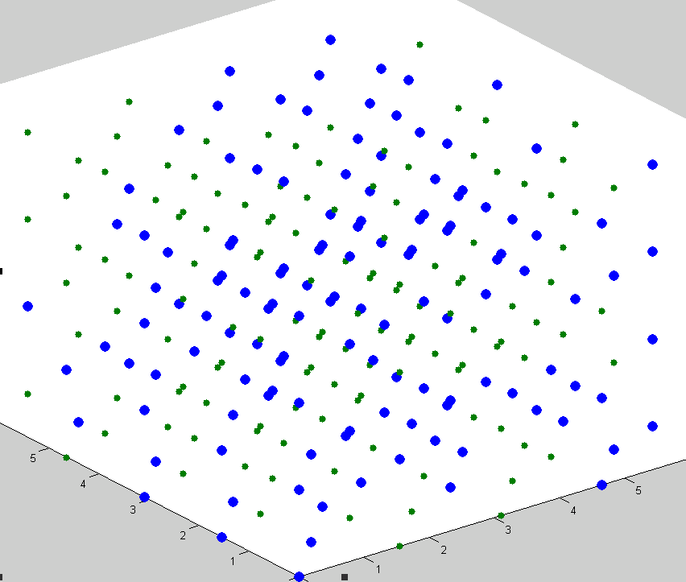
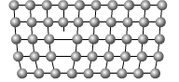
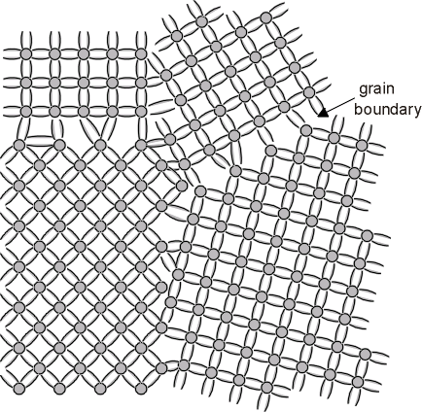
Thermal Conductivity Disordered Materials
Disorder = non-periodic
Blue => mass=1.0
Purple => mass=3.0
Phonon picture still valid?

Slide 16
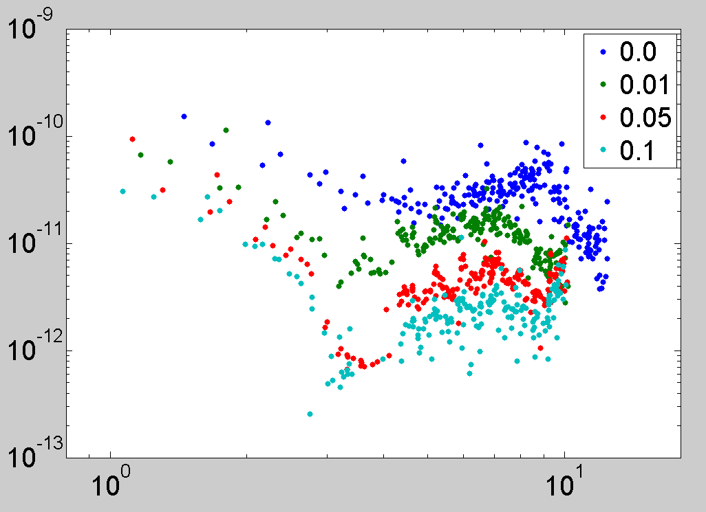
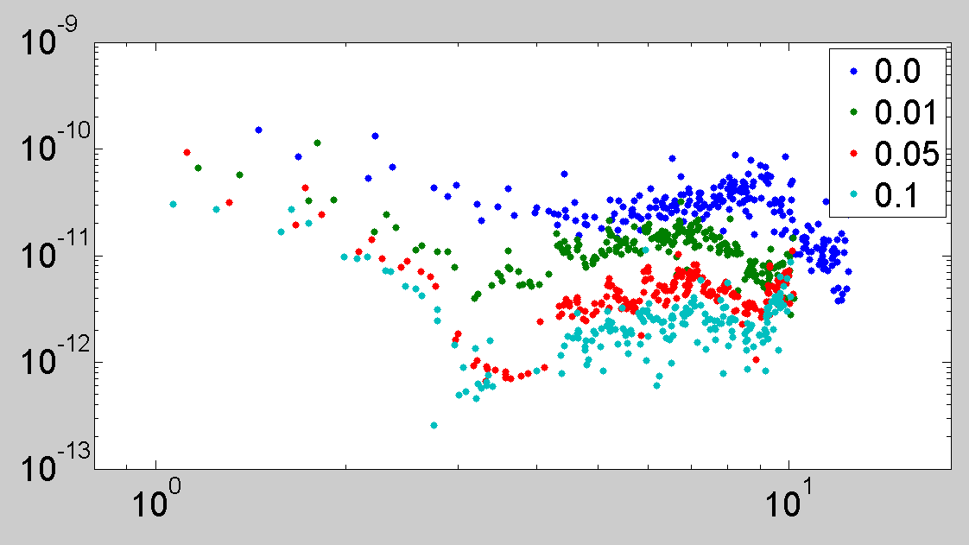
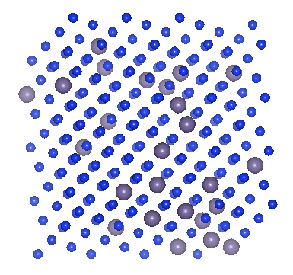
Phonon Lifetimes (Mean Free Path)
τ(ω) (ps)
Increasing
Disorder
ω (rads/ps)
Pure
Defected
74 – 0.5 nm
11 – 0.1 nm

Slide 17
Discussion
Dielectric thermal conductivity can be described by Kinetic Theory (bulk system).
Molecular Dynamics and Spectral Energy Density can measure phonon properties.
Phonon properties can be predicted for “weakly” perturbed systems, analyzed on mode by mode basis.
SED(ω)

Slide 18
Questions

Slide 19
Phonon Gas
Phonon Spectral Distribution
“Acoustic” Modes
Phonons vs. Photons:
Non-linear springs
Phonons interact with each other
Interacting Gas…
m_{atom}

Slide 20
