Slide 1
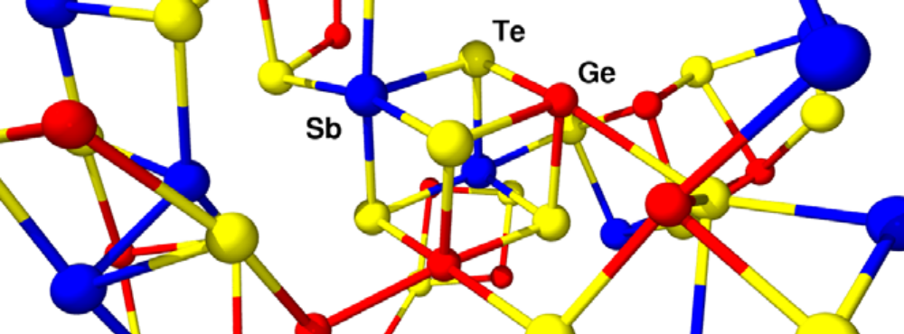
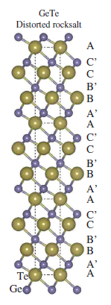
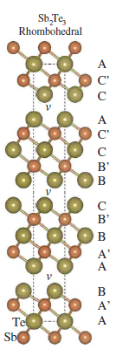
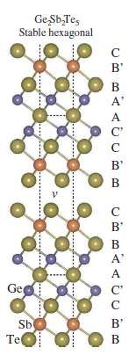
Multi-Scale Modeling of Phase-Change Memory (PCM) Materials
What we are doing with DFT:
Probing energy hypersurface (different structural configurations) of PCM GeTe, Sb₂Te₃, Ge₂Sb₂Te₅.
Fitting classical interatomic potentials to these hypersurfaces.
Using classical potentials to run large-scale MD simulations.
Exploring wavelet DFT as a method to drive MD simulations of PCM materials.
+
=
Notes:
- Predicting Minimum Energy Path & Energy Barriers: Energetics of embedding oxygen atoms into the missing-row reconstructed Cu(100) surface. Embedding paths that involve the missing row (path1 and path3) have lower energy barriers and are more energetically favorable than those that go through the top layer of the copper surface (path2 and path4).

