Slide 1
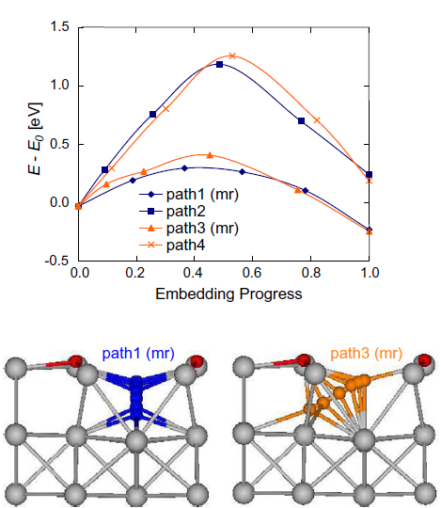
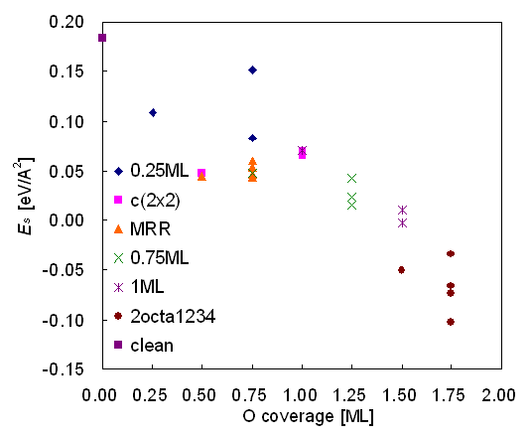
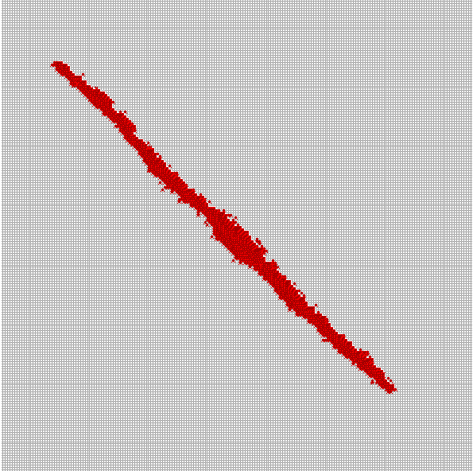
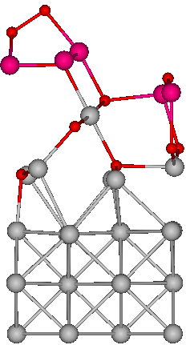
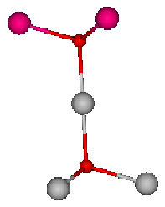


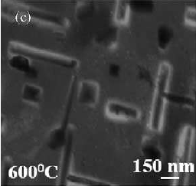
DFT-based modeling of early stages of Cu(100) oxidation
What we are doing by DFT are:
Finding Transition states
Relative stability comparison & Finding energetically more favorable oxidation route
Predicting Minimum Energy Path & Energy Barriers
Producing parameters for bigger scale simulation (kMC simulation)
Cu₂O-like 2octa1234 [1]
Cu₂O [2]
Copper
Oxygen
Average Cu-O length =1.94 Å
Oxygen
180˚
Cu-O length =1.85 Å
179.12˚
Copper in top layer
109.47˚
Copper
118.79˚
- 0.049 eV/A²
Copper in 2nd-4th layers
- 0.147 eV/A²
[1] http://www.engr.pitt.edu/tfox
[1] Lee and McGaughey, appear in Surface Science
[2] Wyckoff, Crystal Structures Vol. I., Wiley-Interscience, New York, 1960
[1] Lee and McGaughey, Surface Science 603, 34043409, 2009
Notes:
- Predicting Minimum Energy Path & Energy Barriers: Energetics of embedding oxygen atoms into the missing-row reconstructed Cu(100) surface. Embedding paths that involve the missing row (path1 and path3) have lower energy barriers and are more energetically favorable than those that go through the top layer of the copper surface (path2 and path4).

