Slide 1
Predicting Mean Free Paths in Disordered Systems
Jason Larkin and Alan J. H. McGaughey
Department of Mechanical Engineering
Carnegie Mellon University
03/29/13

Slide 2
Slides
- Macro-theory: k = \rho C_p \alpha
- Carrier theory (classical harmonic limit):
k_{x} = (kb/V)\sum D_{x} : most general (phonons, diffusons, locons, propagons)
k_{x} = (kb/V)\sum v_{g,x}^2\tau : phonons
k_{x} = (kb/V)\sum v_{g,x} \Lambda : phonons (\Lambda = |v_g|\tau )
- \Lambda in SW alloys, compare to a, compare to k(\Lambda).
- \Lambda in LJ alloys, compare to a, k(\Lambda).
- LJ alloys k(\omega), fast convergence (k(N_0))
- LJ amorphous, all important modes in a sample 4x (2 nm!), no contributions from phonons
- implications for disordered systems, how to beat high scatter limit
-

Slide 3
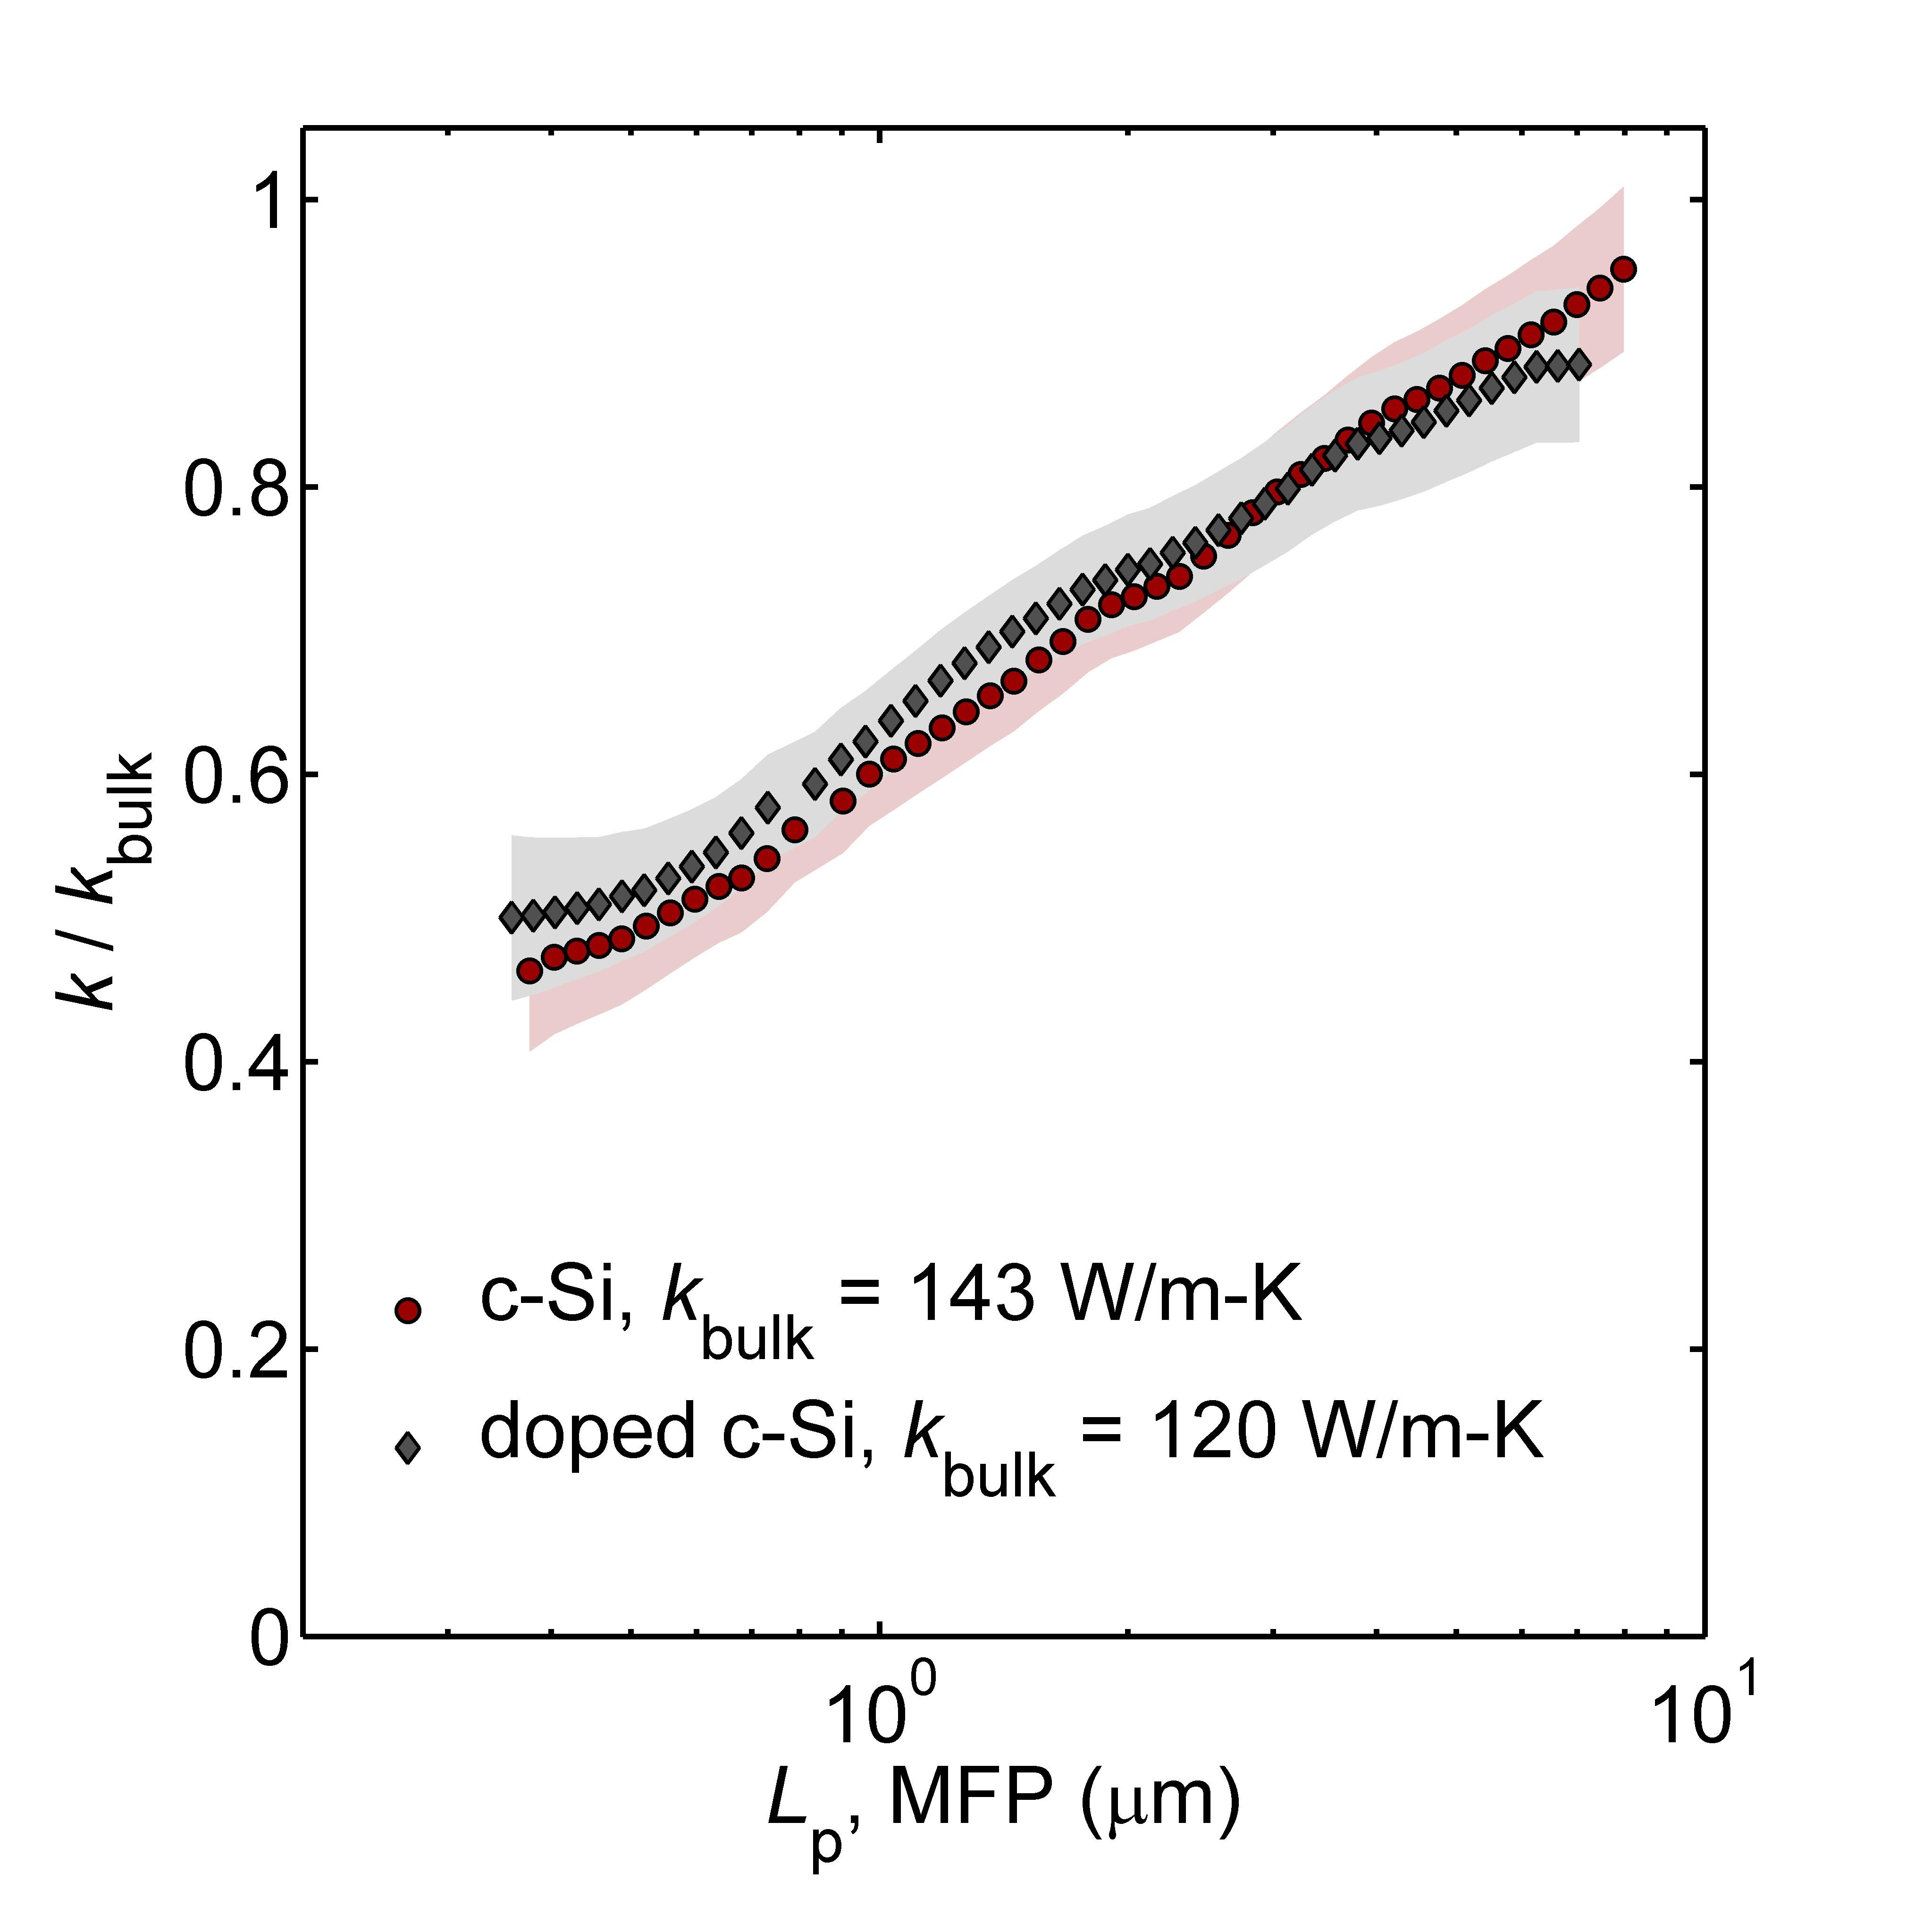
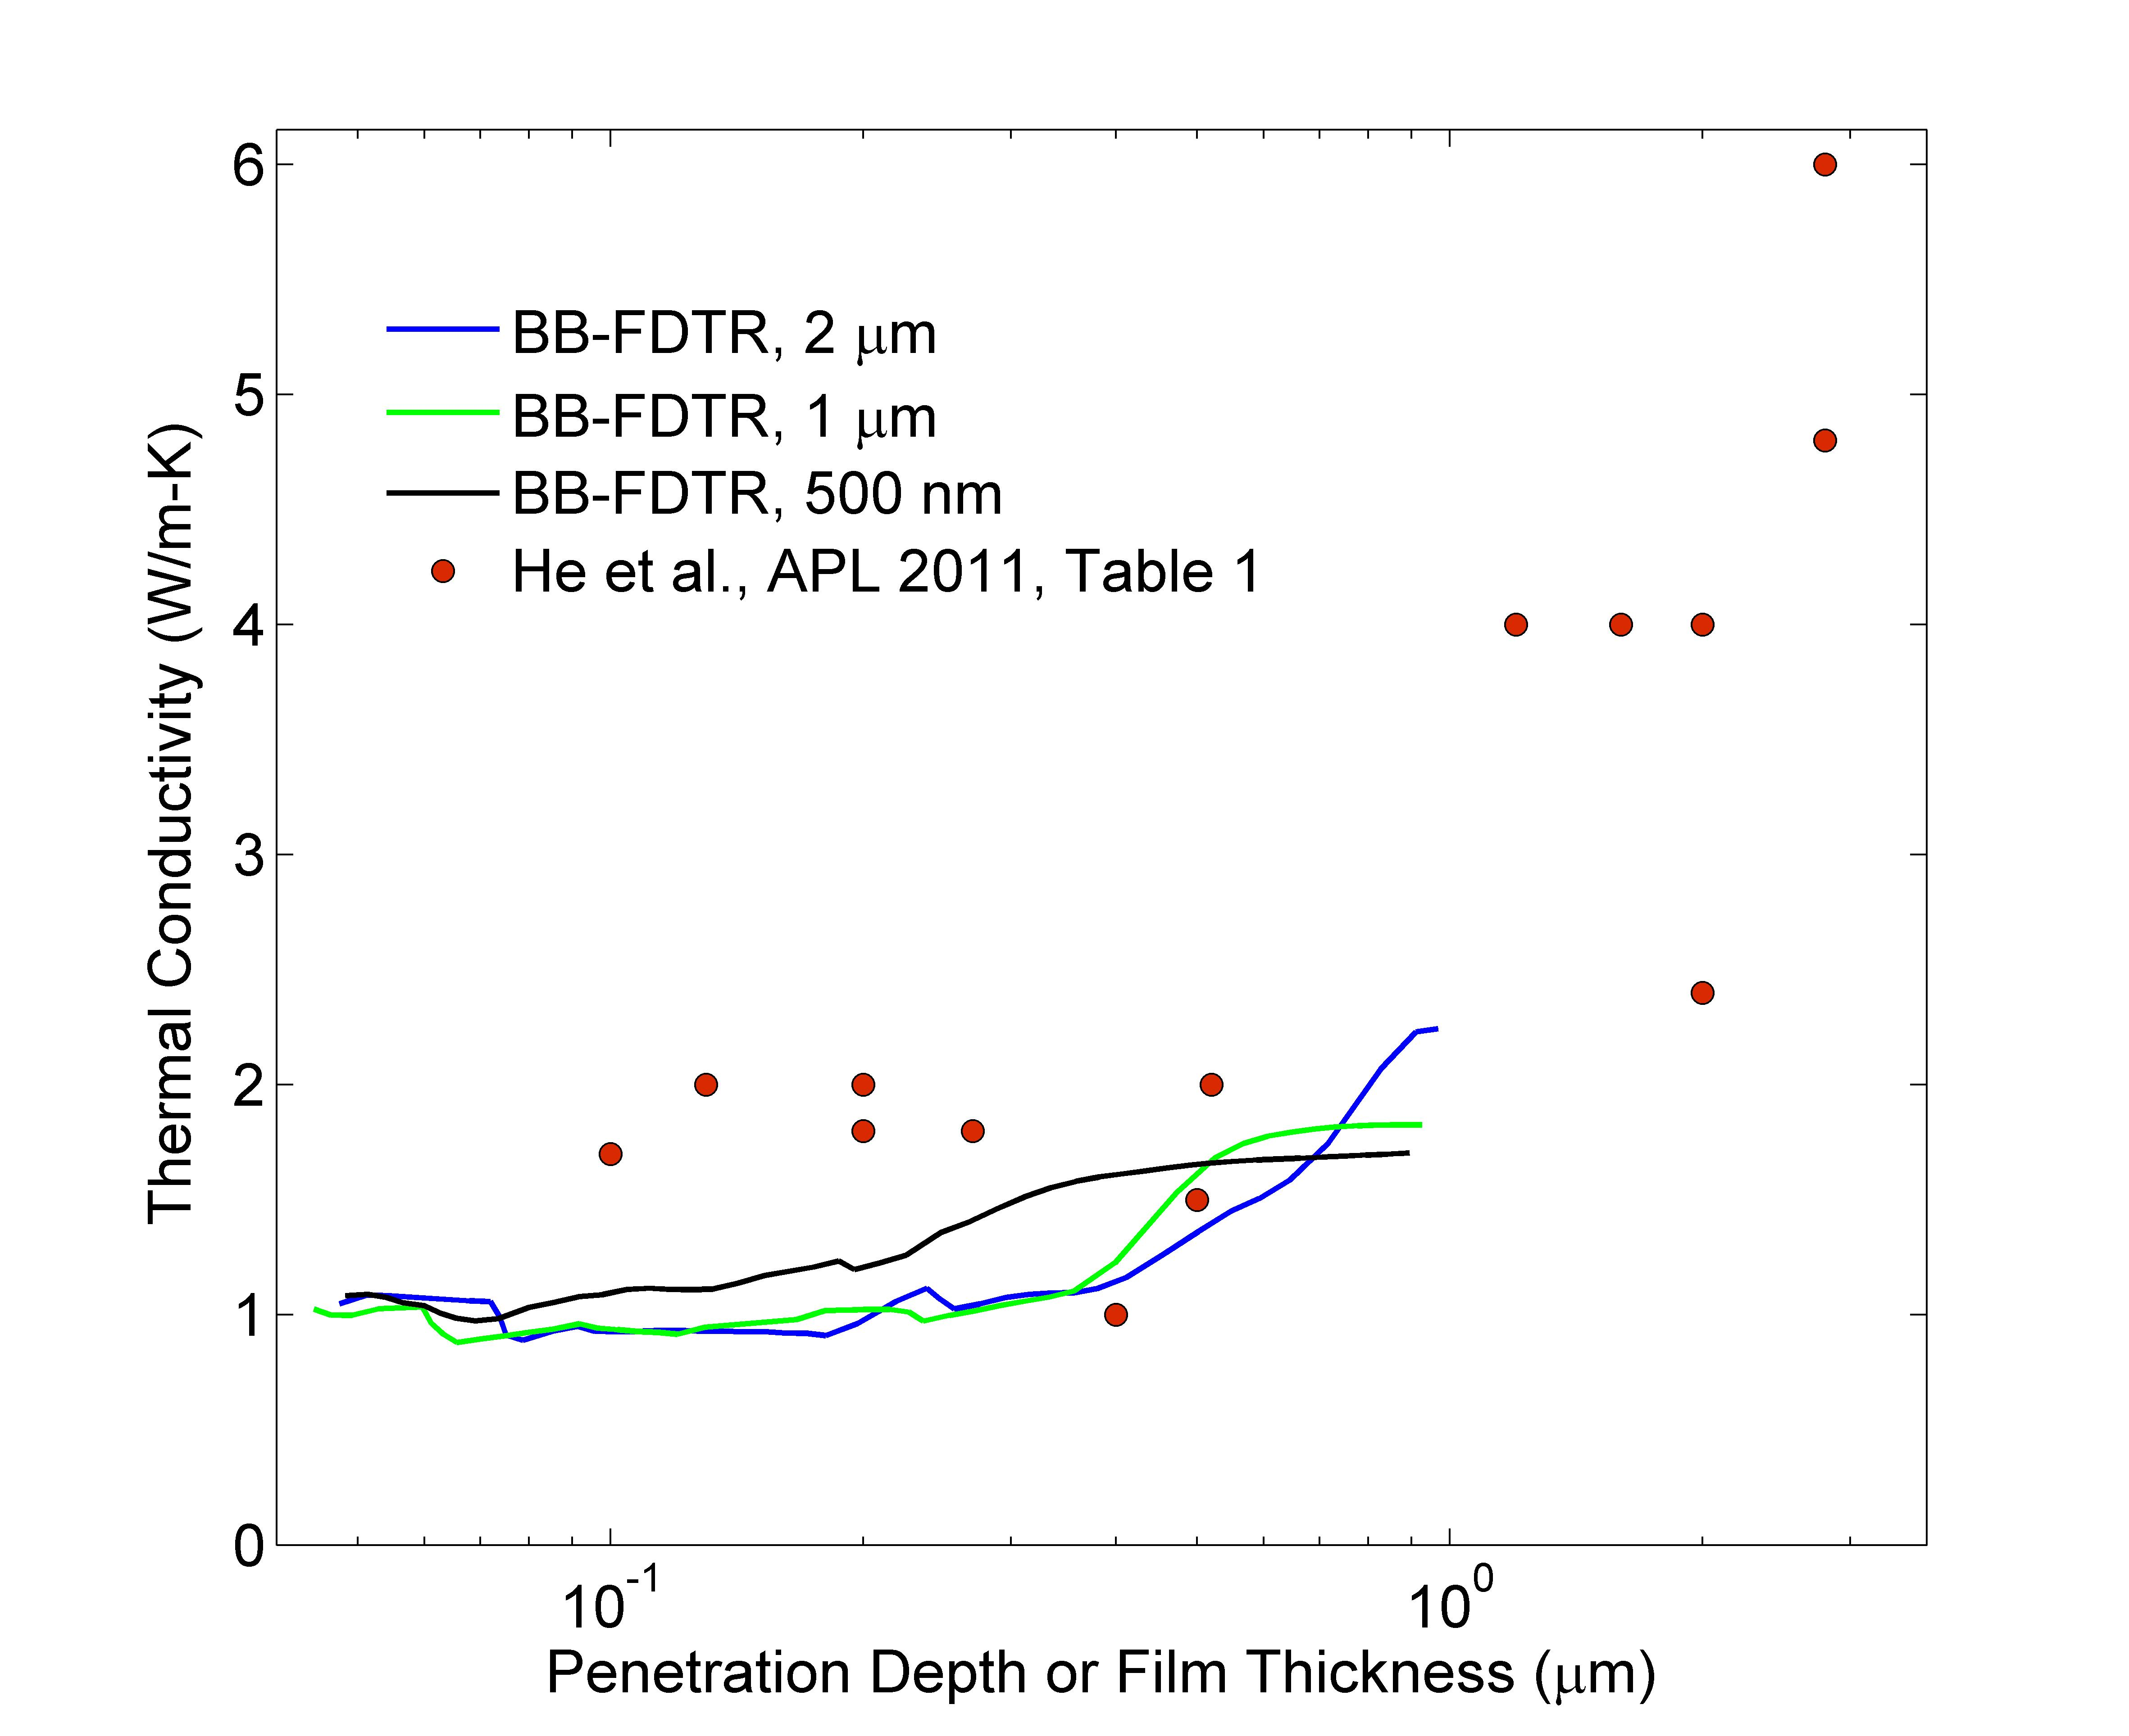
Background & Motivation

Slide 4
Phonon Spectrum: LJ Ar vs SW Si
MD
ALD
MD
MD-based:
1E4 modes
(7 days)*(100 cpu)
ALD:
1E6 modes
(7 days)*(12 cpu)

Slide 5
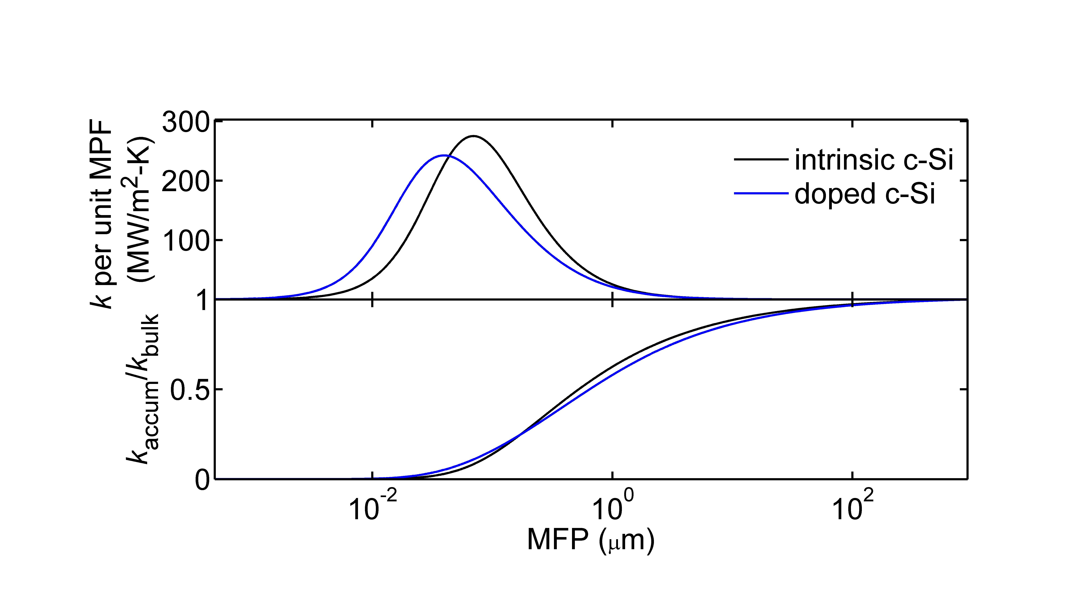
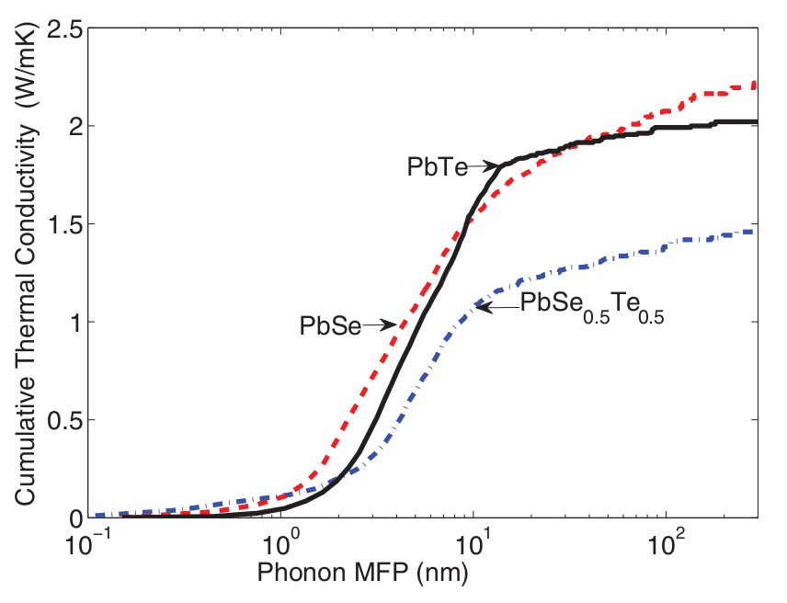
Conductivity Accumulation
SW Si
LJ Ar
PHYSICAL REVIEW B 85, 184303 (2012)

Slide 6
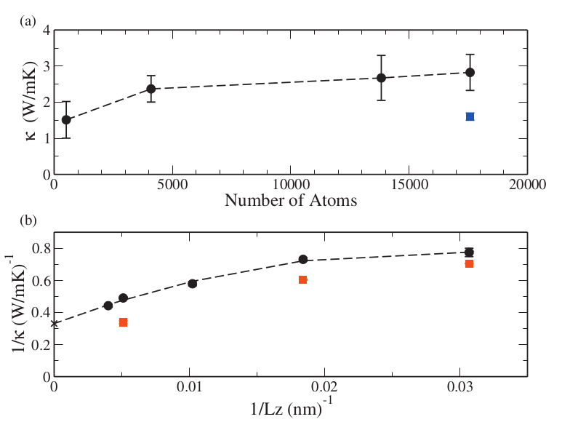
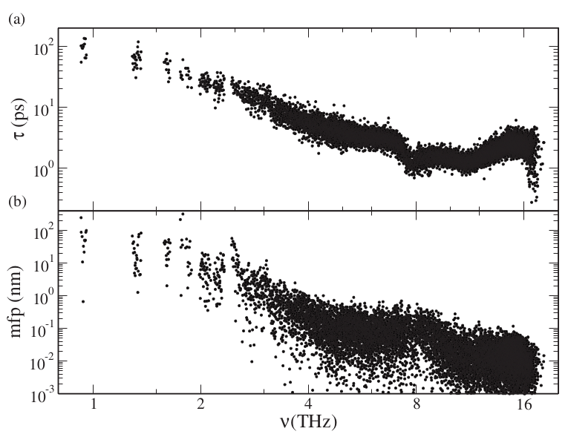
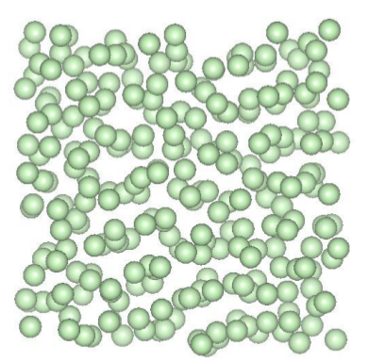
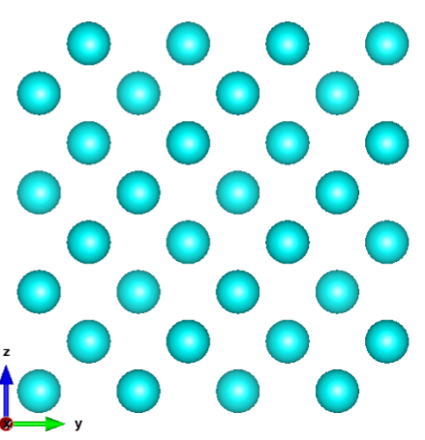
MFP in a-Si: from Tersoff and MD
MD-based: size of simulation cell=4.3 nm
Appl. Phys. Lett. 98, 144101 (2011)
http://apl.aip.org/resource/1/applab/v98/i14/p144101_s1

Slide 7
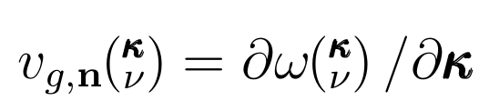
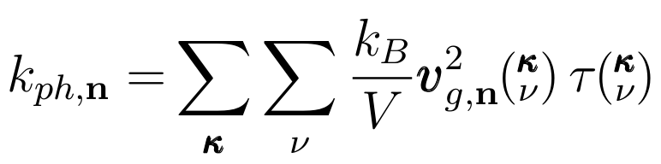
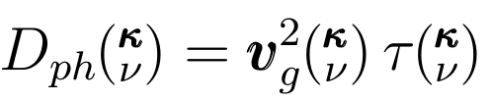
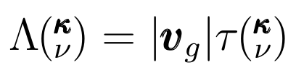

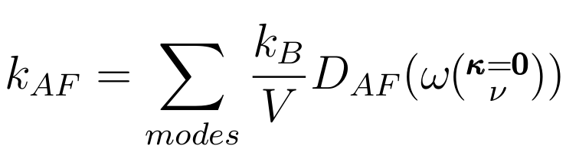
Thermal Transport: Ordered and Disordered
In a disordered material, it is not possible (in general) to specify v_g and \tau independently
Phys. Rev. B 59, 3551–3559 (1999)
http://prb.aps.org/abstract/PRB/v59/i5/p3551_1

Slide 8
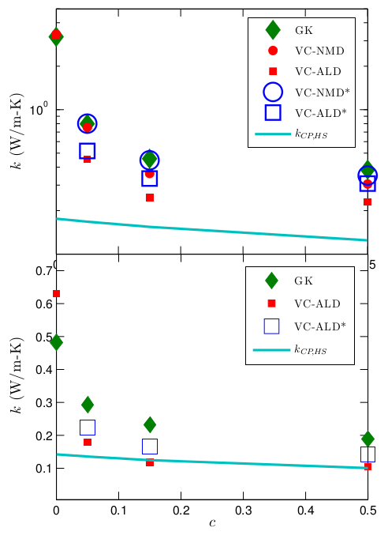
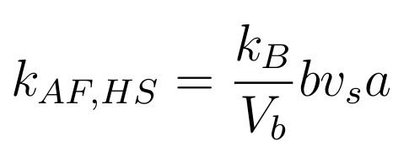
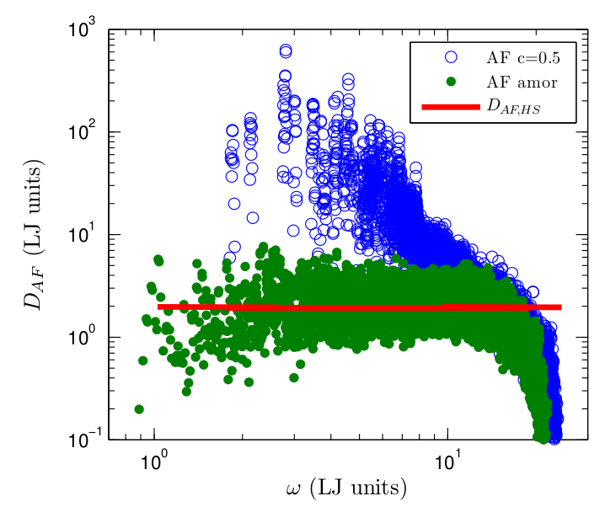
High-Scatter Limit: LJ Ar
T=10K
a-Ar
T=40K

Slide 9
High-Scatter Limit: SW Si
T=300K
a-Si

Slide 10
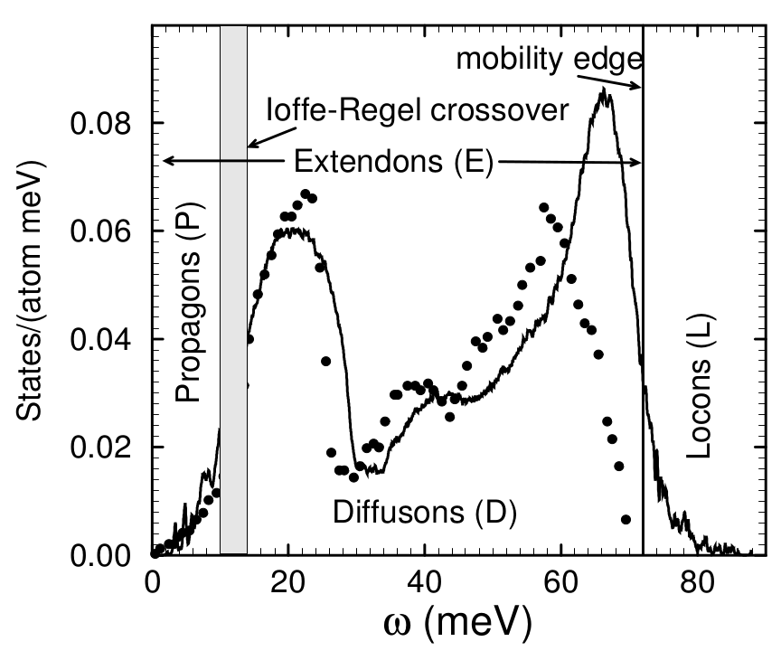
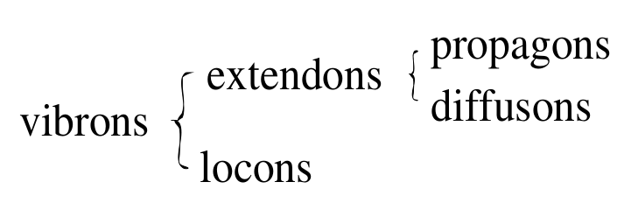
Propagons, Diffusons, Locons
Numerical studies of amorphous silicon show that the low-
est 4% of vibrational modes are plane-wave like (“propagons”)
and the highest 3% of modes are localized (“locons”). The
rest are neither plane-wave like nor localized. We call them
“diffusons.”
\cite{diffusons_allen_1999}

Slide 11
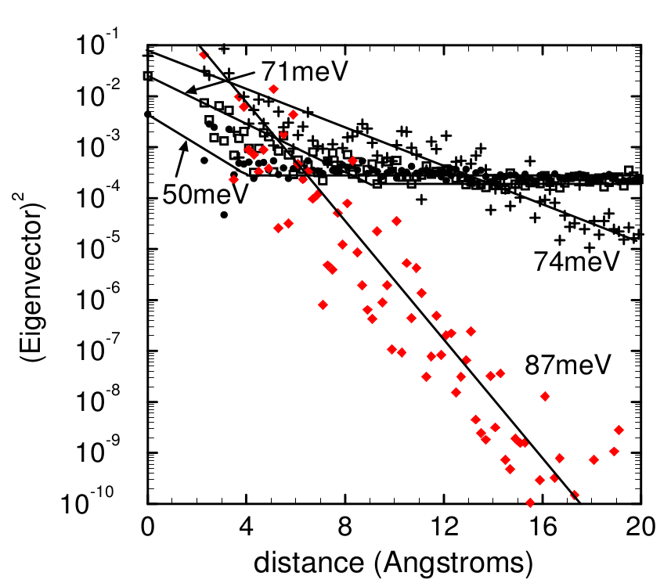
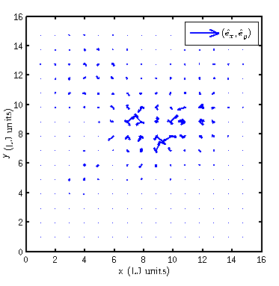
Propagons, Diffusons, Locons

Slide 12
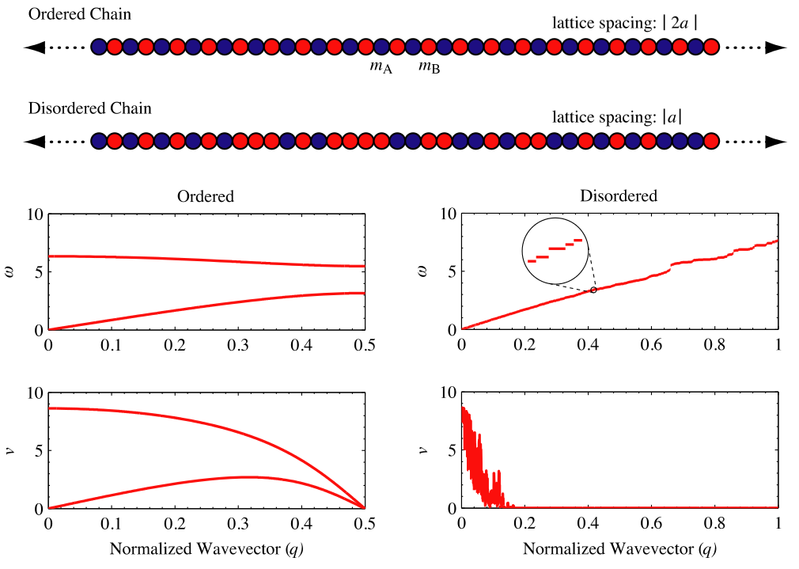
Disordered Mode Group Velocity
v_g from “zone-folding”:
http://iopscience.iop.org/0953-8984/23/20/205401
v_g from near [000]:
http://pubs.acs.org/doi/abs/10.1021/nn2003184
http://pubs.acs.org/doi/abs/10.1021/nl201359q

Slide 13
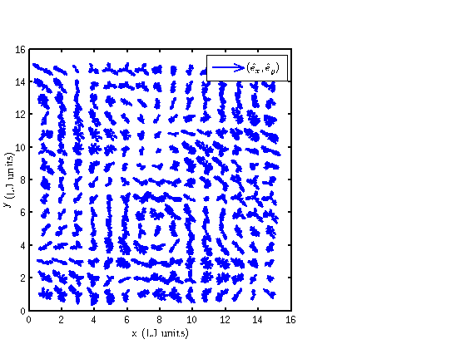
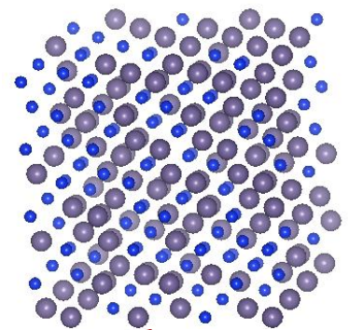
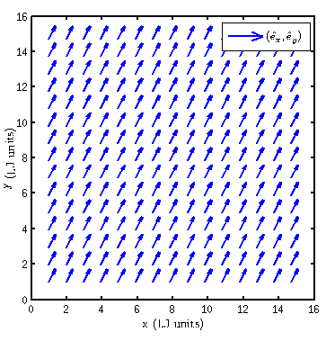
Disordered Mode Group Velocity
DOS
DOS
https://github.com/jasonlarkin/disorder/blob/master/paper/vc/prb_vc_jl_011813.pdf

Slide 14
Extra

Slide 15
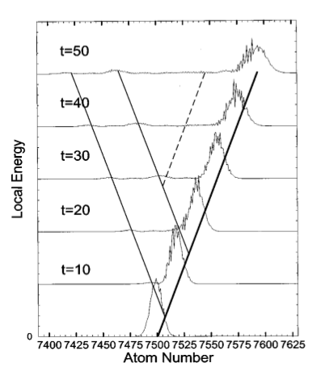
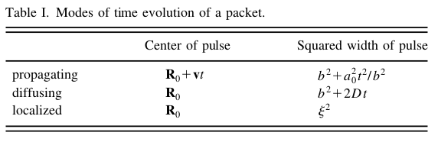
Ballistic vs. Diffusive Transport
R(t)
Am. J. Phys., Vol. 66, No. 6, June 1998

Slide 16
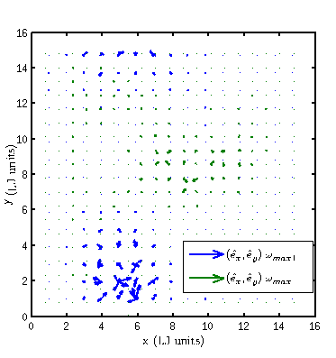
Localized Modes

Slide 17
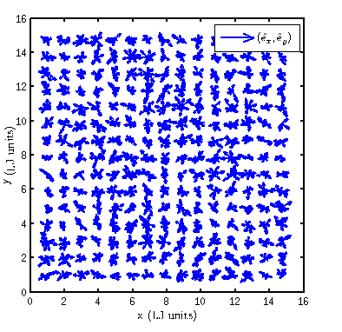
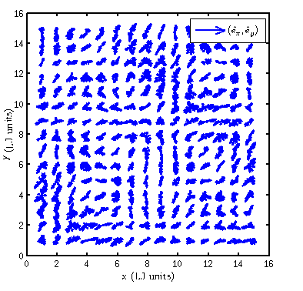
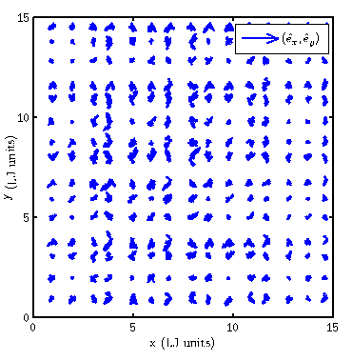
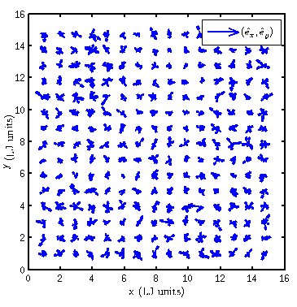
Mode Localization

Slide 18
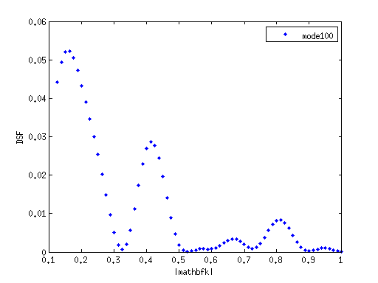
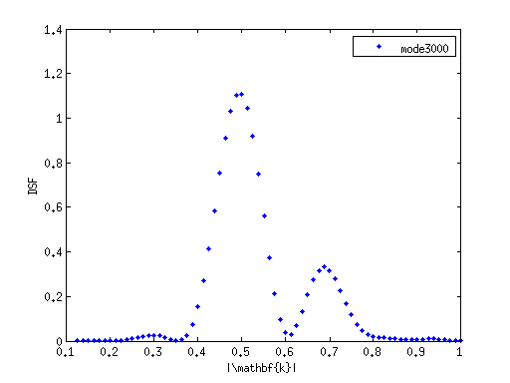
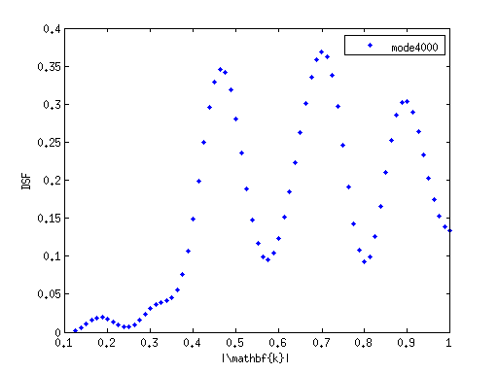
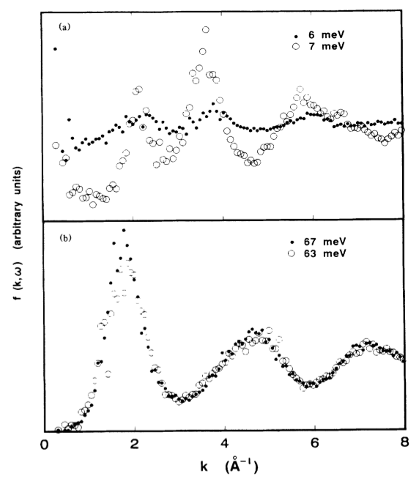
Disordered Mode Plane-Wave Character

Slide 19
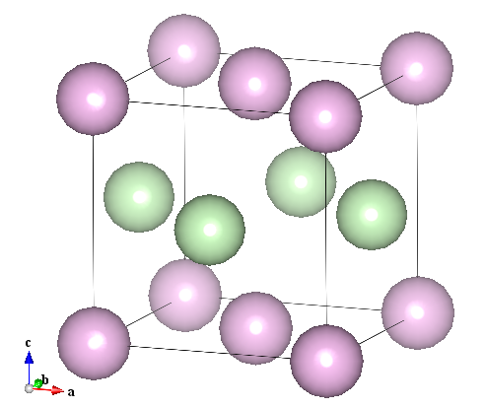
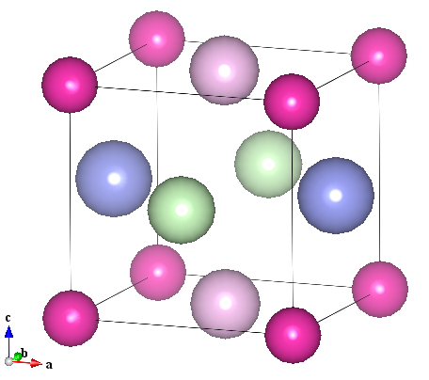
Disordered Modes Group Velocity: Zone-Folding

