Slide 1
evaluation of the virtual crystal approximation
Jason Larkin, Alan McGaughey
Nanoscale Transport Phenomena Laboratory
Carnegie Mellon Department of Mechanical Engineering http://ntpl.me.cmu.edu/
10/10/2012
1

Slide 2
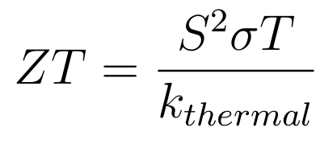
materials for thermoelectric energy conversion
2
Lower thermal conductivity for improved thermoelectric efficiency:
Skutterudites: “electron-crystal, phonon-glass”
What is responsible for low thermal conductivity?
Phonon picture, sub-unit cell effects...
What about simple alloys?

Slide 3
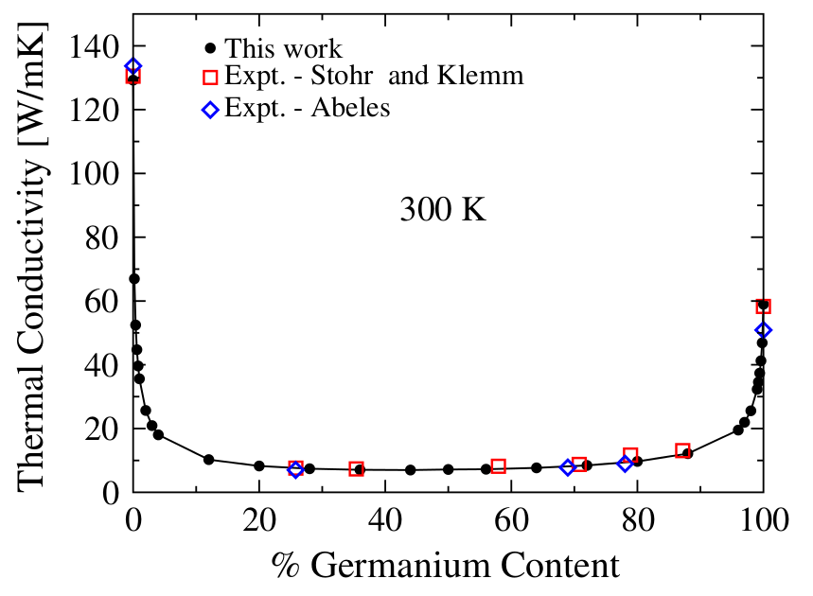
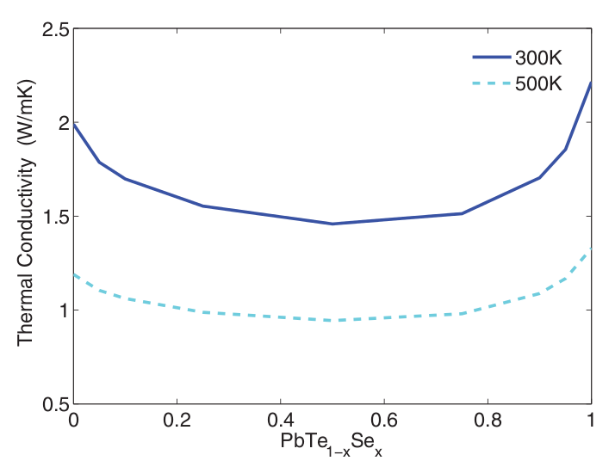
modeling thermoelectric materials
3
anharmonic lattice dynamics + phonon defect lifetime ( ald+taud ).
this approach referred to as virtual crystal (vc) approximation.
ald+taud vc can be computationally cheap, even using ab initio.
is this approach valid?
PRL 106, 045901 (2011)
PHYSICAL REVIEW B 85, 184303 (2012)

Slide 4
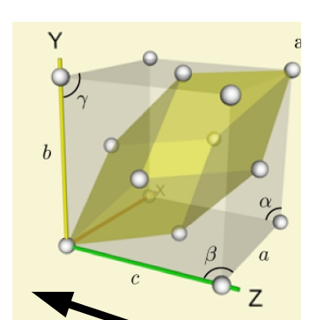
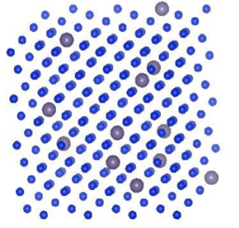
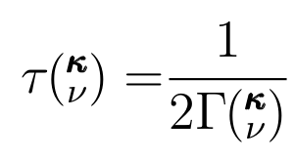
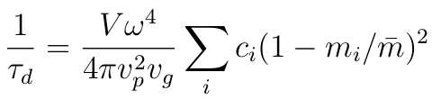



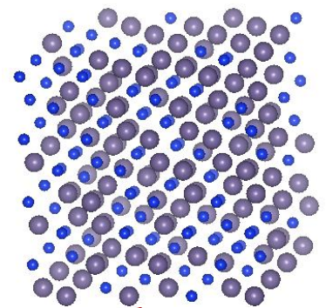
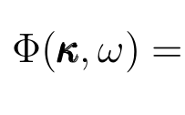
lj alloys using virtual crystal (vc)
4
virtual crystal (vc)
Unit cell
c=0.0
= 1.0
c=0.5
System sizes: up to 4000 atoms, 6 nm
= 2.0
gamma point
Unit cell
= 0
LD : Lattice Dynamics => frequencies, group velocities, eigenvectors for phonon mapping, harmonic disordered thermal conductivity
MD: Molecular Dynamics => Green-Kubo, trajectories for phonon mapping, phonon/diffuson lifetimes
Classical Only: for solids, Force Constant MD can

Slide 5
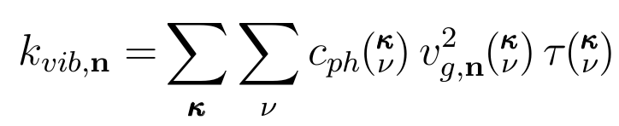

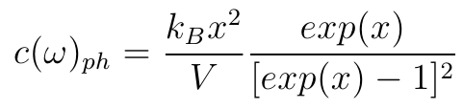
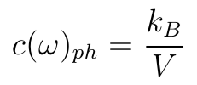
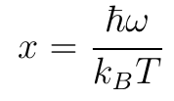
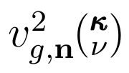



thermal conductivity in ordered systems
5
conductivity in ordered (crystalline) system sum over phonon modes:
relaxation time approximation solution of the BTE.
mode-specific properties:
Property | Model
,
=
Depends on Scattering Mechanisms

Slide 6
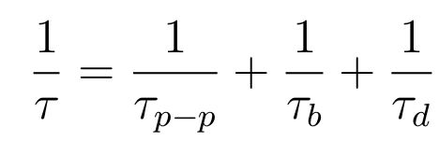
phonon scattering mechanisms
6
Matthiessen rule:
assumes scattering processes are independent.
must be careful about the meaning of mean free path
[1] P. G. Klemens, ed. R. P. Tye, 1969, Vol. 1, Academic Press, London.
[2] Alan J. H. McGaughey and Ankit Jain, Applied Physics Letters, 100(6):061911, 2012.
[3] P. G. Klemens, Proc. Phys. Soc., London, Sect. A, 1955, 68, 1113.
[4] David G. Cahill, Fumiya Watanabe, Angus Rockett, and Cronin B. Vining, Phys. Rev. B, 71:235202, Jun 2005.

Slide 7
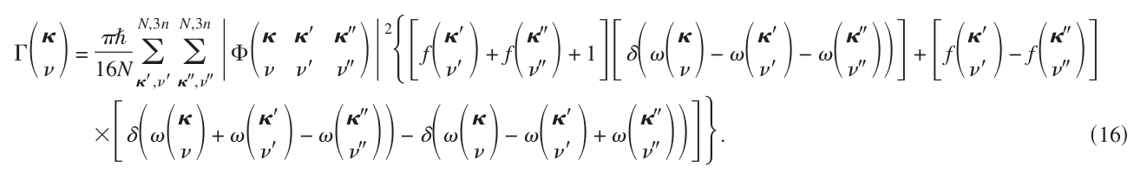

phonon scattering mechanisms
7
Matthiessen rule:
phonon-phonon scattering [1] (ald):
1/
f(freq_hld,eigvec_hld,fc_3)
freq_hld, eigvec_hld = easy
fc_3 = hard
Debye->

Slide 8


phonon scattering mechanisms
8
Defect scattering [3]:
f(freq_hld,eigvec_hld)
freq_hld, eigvec_hld = easy
Debye->
Debye->

Slide 9
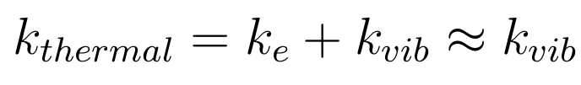
conductivity from md and gk
9
Model Lennard-Jones system:
Molecular Dynamics (MD) simulation and Green-Kubo method.
No vibrational properties are predicted:
Green-Kubo
modes
Predictions show Green-Kubo can capture all effects.
10
MD simulations are classical, no quantum effects.

Slide 10
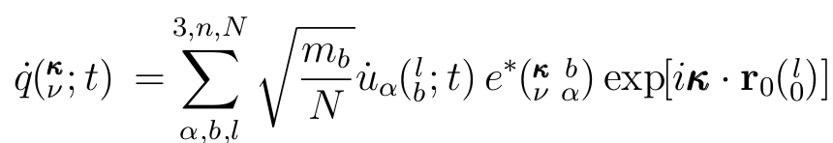
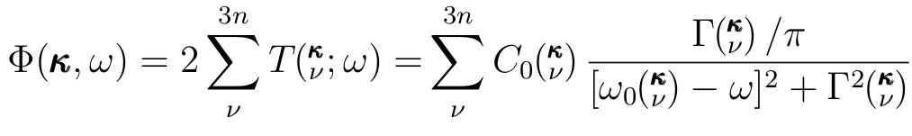
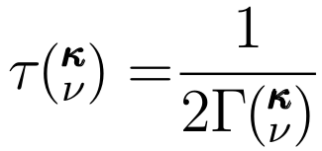
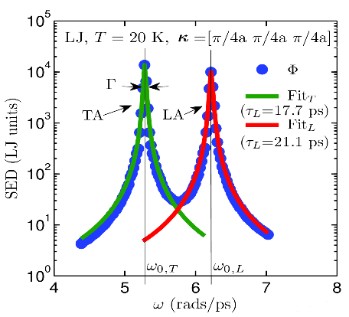
normal mode decomposition (nmd)
10
Phonon Normal Mode Coordinate:
Molecular Dynamics (anharmonic)
Lattice Dynamics (harmonic)
vc vs
gamma
Unit cell?

Slide 11
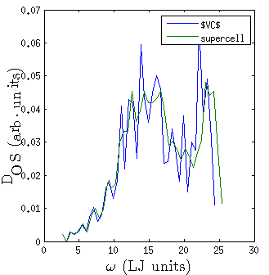
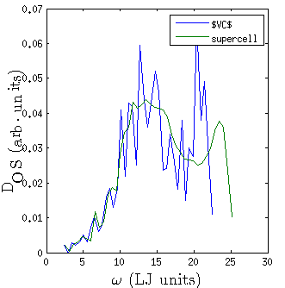
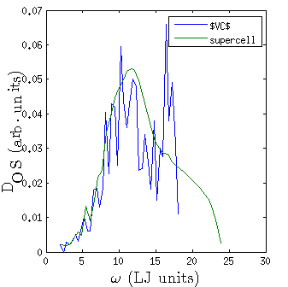
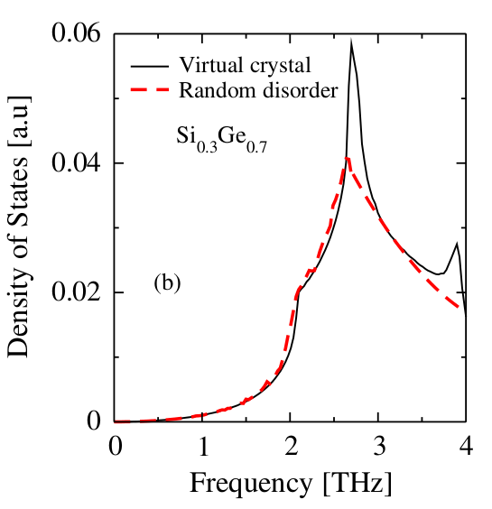
vc vs gamma dos
11
vc and gamma agree well at low frequencies.
at high freq, gamma modes are smeared.
PRL 106, 045901 (2011)

Slide 12
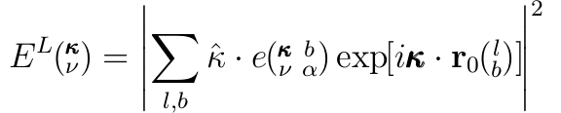
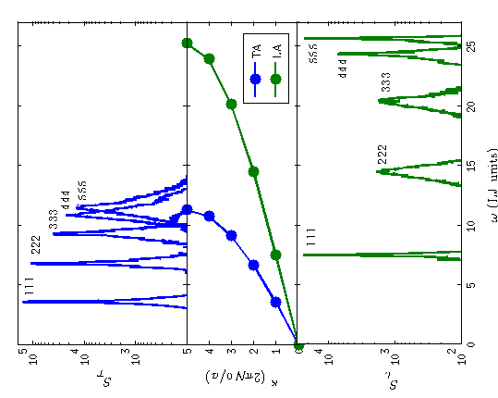
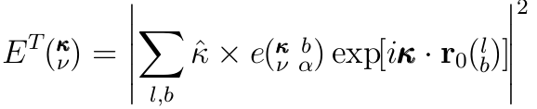
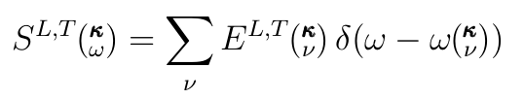
gamma modes plane-wave character
12
c=0.05
gamma
vc
gamma
vc and gamma agree well at low frequencies.
at high freq, gamma modes are smeared.

Slide 13
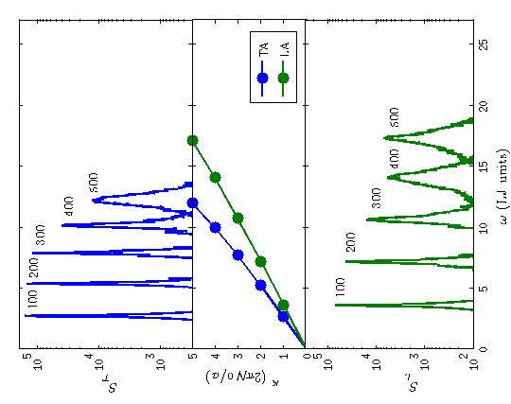
gamma modes plane-wave character
13
c=0.05
gamma modes show anisotropic dispersion

Slide 14
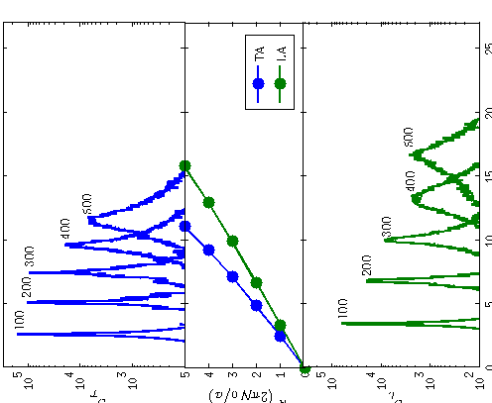
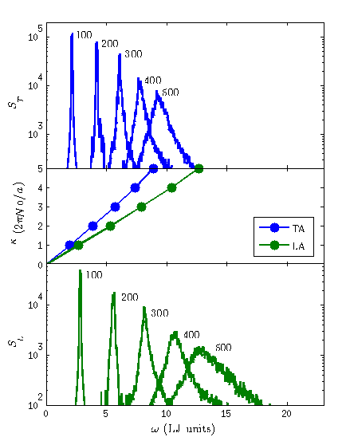
gamma modes plane-wave character
14
c=0.05
c=0.15
c=0.5
= 1.1
= 1.3
= 2.0
gamma modes show effect of increasing vc mass.
gives indication that vc group velocity is appropriate even with disorder.

Slide 15
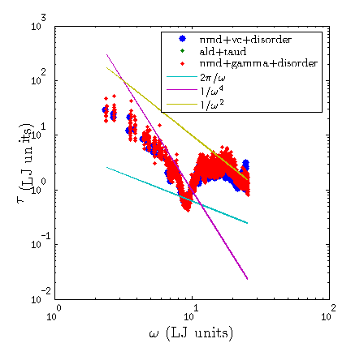
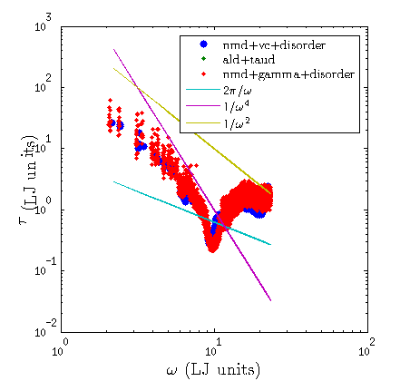
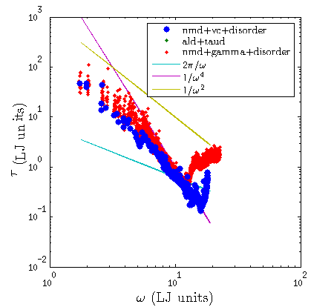
nmd vc vs gamma lifetimes
15
c=0.05
c=0.15
c=0.5
nmd mapping using vc or gamma modes shows very similar results.
lifetimes look good, as do group velocities...

Slide 16
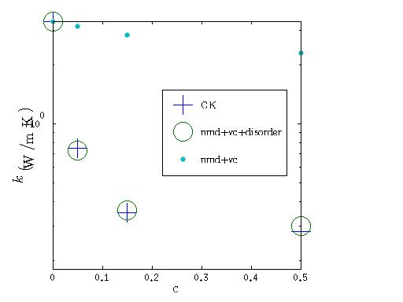
nmd + vc + disorder conductivity
16
nmd mapping using vc predicts conductivity in good agreement with GK.
Results indicate the importance of vc group velocities.
Results indicate the importance of phonon lifetime reduction due to scattering.

Slide 17
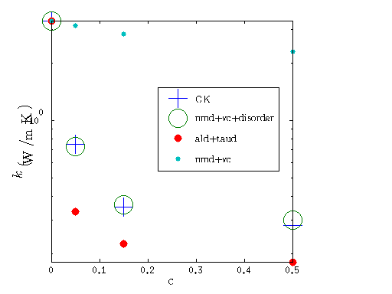
nmd + vc + disorder vs ald+taud conductivity
17
ald+taud under-predicts conductivity for lj.
Need to check si/ge

Slide 18
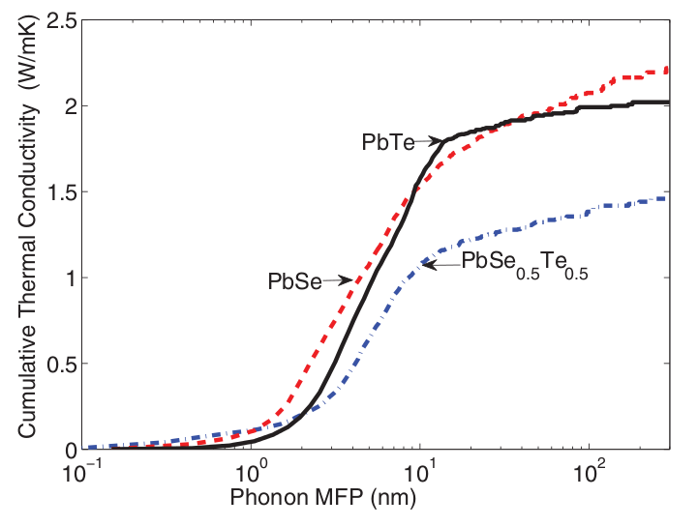
importance of ald+taud
18
ald+taud is cheap, even using ab initio.
It is important to understand any limitations
ald+taud is a valuable tool for predicting thermal conductivity of thermoelectric materials
PHYSICAL REVIEW B 85, 184303 (2012)
current limiation of DFT plane wave:
calc_time_1 = 1 min ( O(100 atoms), Si perfect supercell)
ald_calc_num = O(1000)
ald_calc_time = O(17 hours)
md_calc_num = O(2^20 ~ 1000000)
calc_time_2 = 1000 min
calcultion time_necessary = O( 700 days )

Slide 19
Questions
19

Slide 20
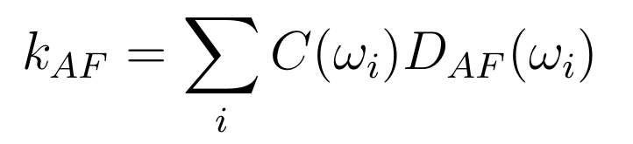
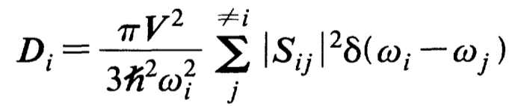
Diffuson Theory
14
Allen Feldman theory of diffusons [1]:
Conservation of energy:
Heat current operator:
Ingredients: harmonic Lattice Dynamics
[1] Philip B. Allen and Joseph L. Feldman. Thermal conductivity of disordered harmonic solids. Physical Review B, 48(17):12581–12588, Nov 1993.

