Slide 1
Evaluation of the Virtual Crystal Approximation for Predicting Thermal Conductivity
Jason Larkin and Alan J. H. McGaughey
Department of Mechanical Engineering
Carnegie Mellon University
http://ntpl.me.cmu.edu/
04/04/13

Slide 2
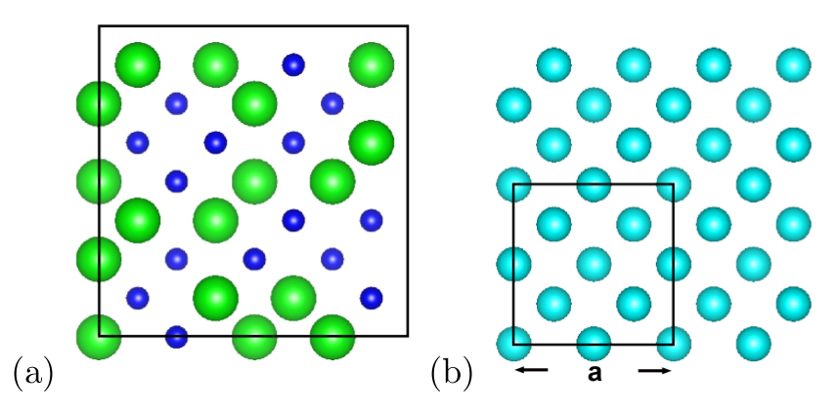
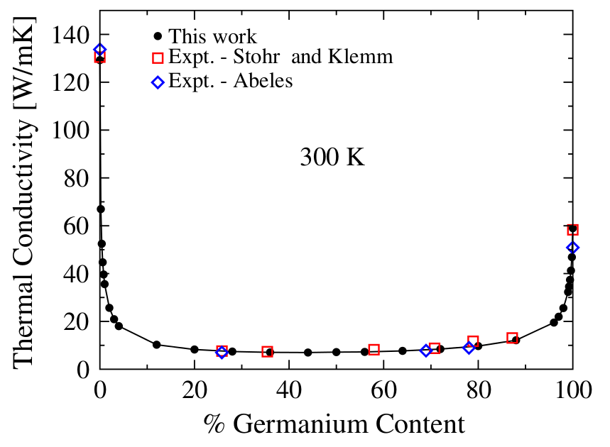
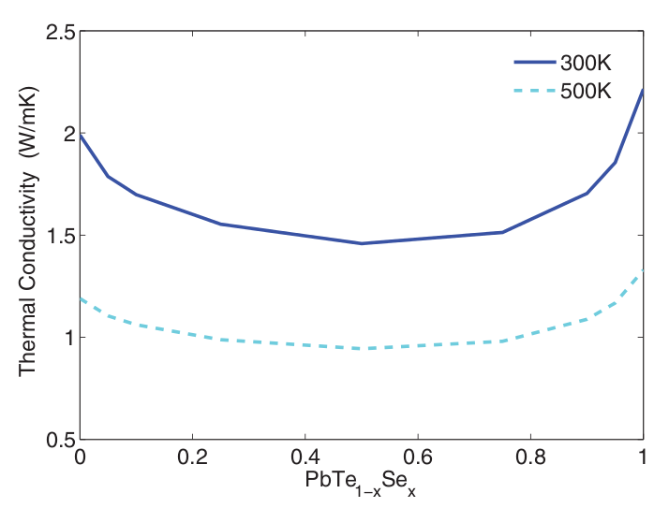
Motivation: experimental accuracy
Expensive Density Functional Theory (DFT): force constants
Anharmonic Lattice Dynamics (ALD): based on unit cell
Alloys: isotopic effects, thermoelectric materials
PRL 106, 045901 (2011)
PHYSICAL REVIEW B 85, 184303 (2012)

Slide 3
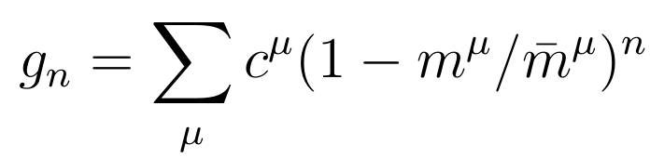

Virtual Crystal Approximation
,
disorder strength:

Slide 4
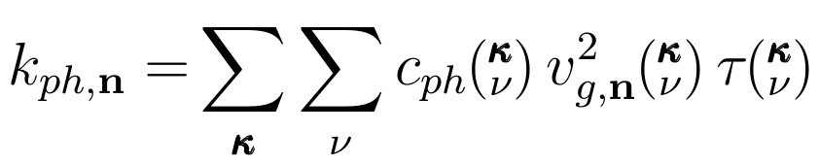
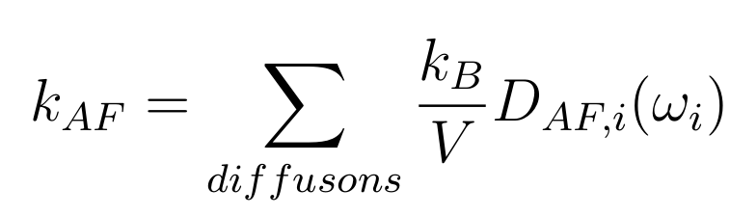
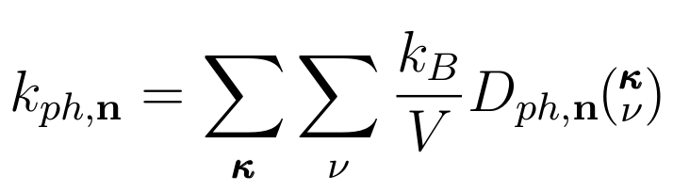
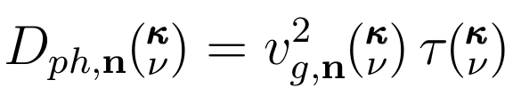
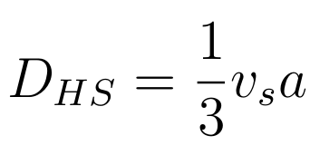
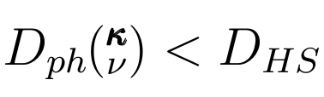
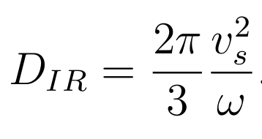
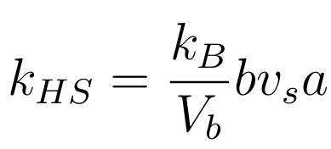
Kinetic Theory for Crystal
single-mode relaxation time approximation + Boltzmann Transport Equation + classical harmonic limit:
mode thermal diffusivity:
Macro-theory: k = \rho C_p \alpha

Slide 5
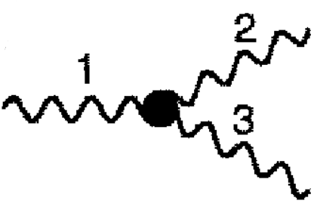
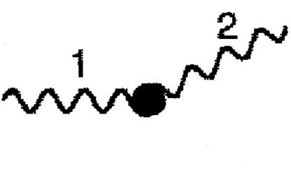

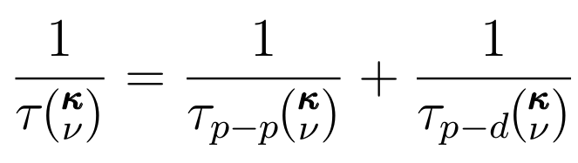


VC Approximation with ALD (VC-ALD)
ALD
Tamura
1/
1/
~
~
Matthiessen's Rule

Slide 6
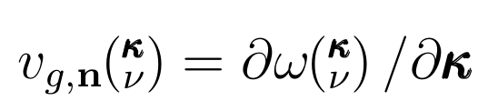
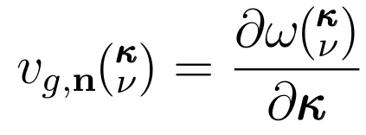

VC Approximation with ALD (VC-ALD)

Slide 7
Explicit disorder: Empirical Potentials
Virtual Crystal frequencies:
Lennard-Jones argon
Stillinger-Weber silicon

Slide 8

Explicit disorder: VC vs Gamma
Gamma
VC
Virtual Crystal frequencies:

Slide 9
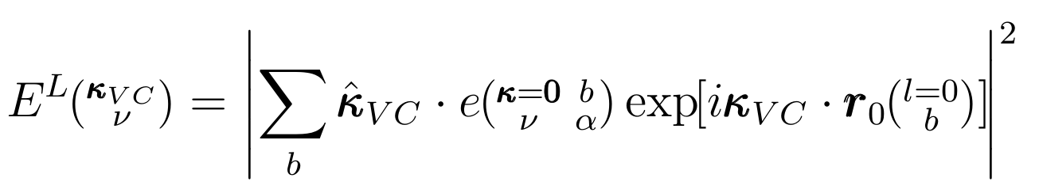
Gamma modes
longitudinal (and transverse) polarizations:

Slide 10
Gamma modes Structure Factor
longitudinal (and transverse) polarizations:
VC group velocity:

Slide 11
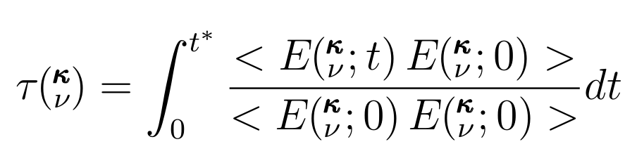
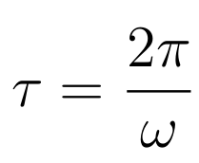
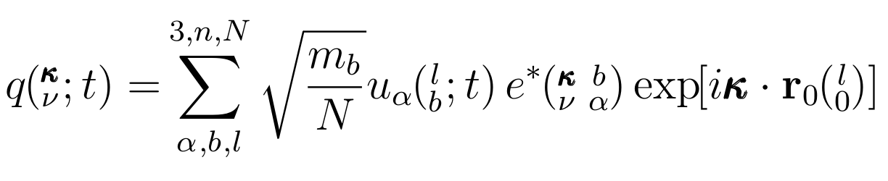
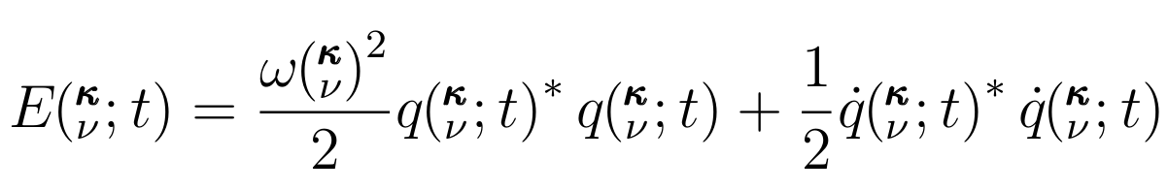
Normal Mode Decomposition (NMD)
Normal mode coordinate:
Normal mode energy:

Slide 12
Allen-Feldman (AF), high-scatter limit
Phonons:
Diffusons:
High-scatter limit:

Slide 13
NMD, VC-ALD, AF thermal diffusivity

Slide 14
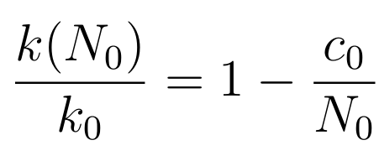
Thermal conductivity: LJ argon alloy
Green-Kubo (GK): top-down
method
High-scatter adjustment*:
amor-Ar

Slide 15
Thermal conductivity: SW silicon alloy
amor-Si

Slide 16
Summary

Slide 17
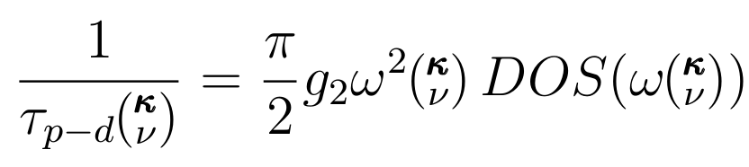

Slide 19
Phonon Spectrum: LJ Ar vs SW Si
MD
ALD
MD
MD-based:
1E4 modes
(7 days)*(100 cpu)
ALD:
1E6 modes
(7 days)*(12 cpu)

Slide 20
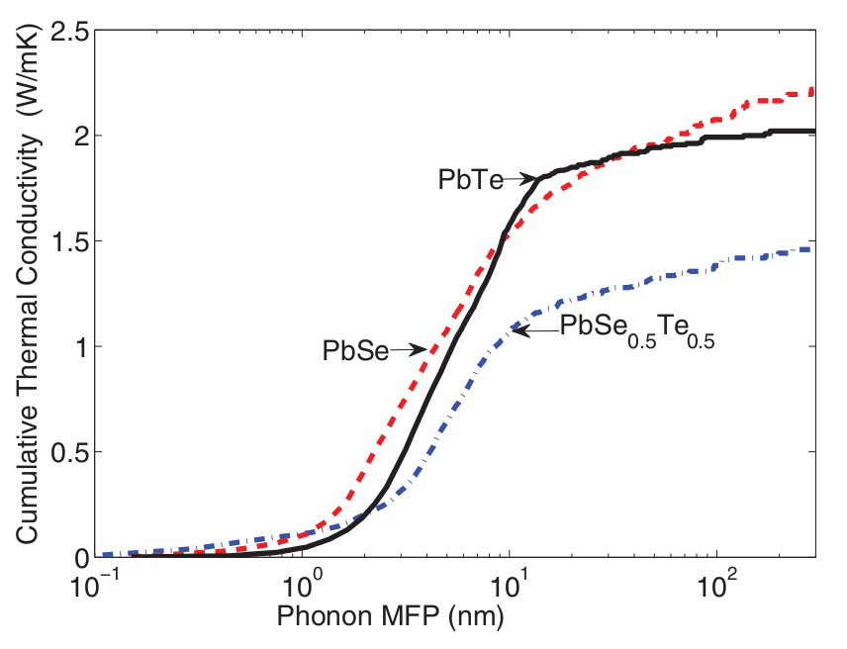
Conductivity Accumulation
SW Si
LJ Ar
PHYSICAL REVIEW B 85, 184303 (2012)

Slide 21
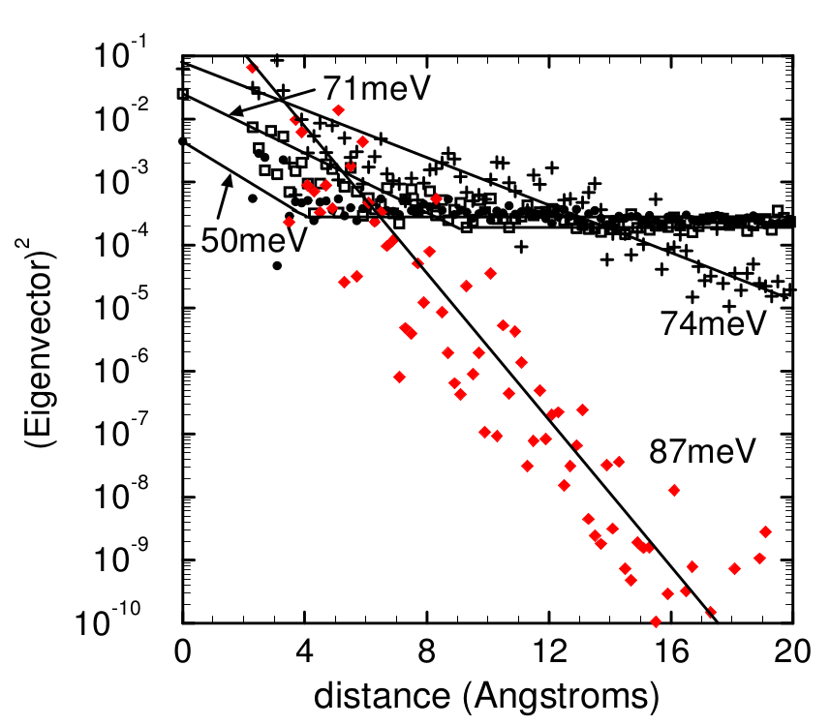
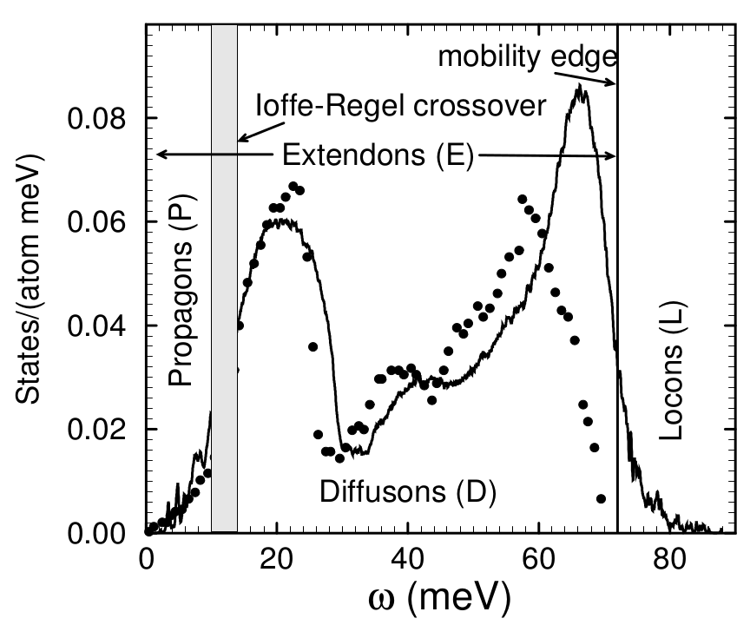
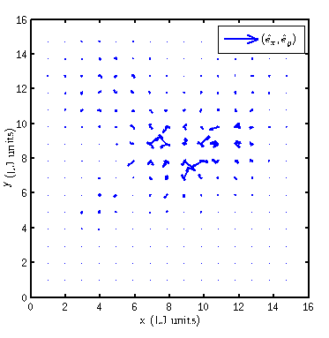
propagons, diffusons, locons
[1] Philip B. Allen and Joseph L. Feldman. Thermal conductivity of disordered harmonic solids. Physical Review B, 48(17):12581–12588, Nov 1993.

Slide 22
Diamond
GaN
si
Si,HS
Si/Ge
PbTe,PbTe/Se, (1/4)Tmelt = 300K
LJ,20K, (1/4)T_melt

