Slide 1
Evaluation of the Virtual Crystal Approximation for Predicting Thermal Conductivity
Jason Larkin and Alan J. H. McGaughey
Department of Mechanical Engineering
Carnegie Mellon University
http://ntpl.me.cmu.edu/
04/04/13

Slide 2
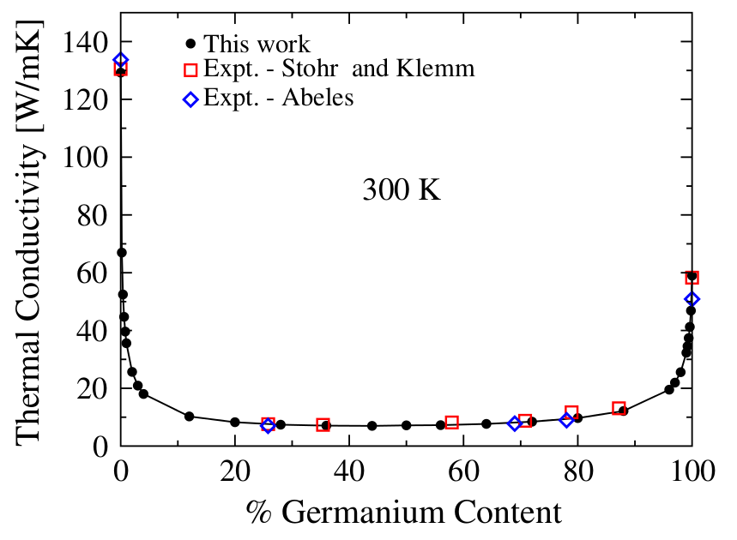
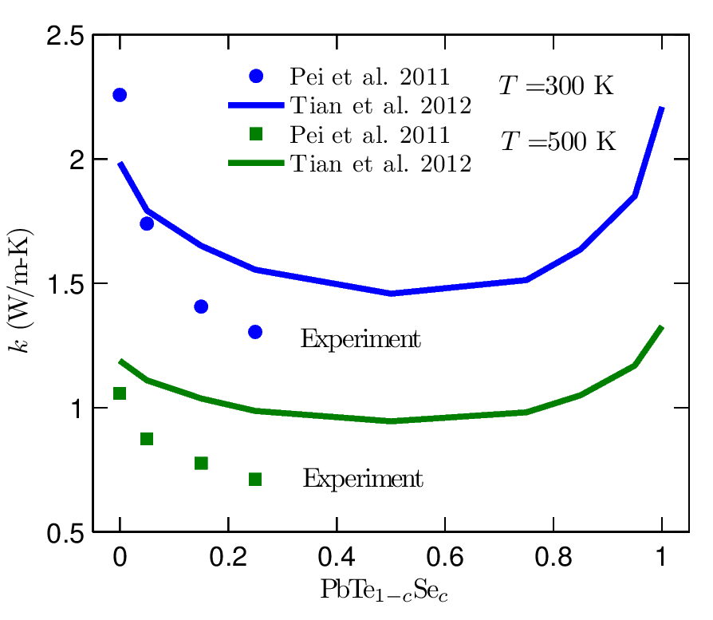
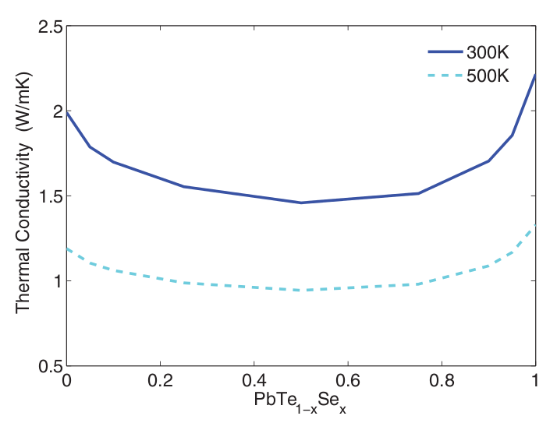
Motivation: experimental accuracy
Expensive Density Functional Theory (DFT) calculations
+
Virtual Crystal (VC) approximation &
Anharmonic Lattice Dynamics (ALD) (VC-ALD)
Alloys: isotopic effects, thermoelectric materials
PRL 106, 045901 (2011)
PRB 85, 184303 (2012)
SiGe

Slide 3
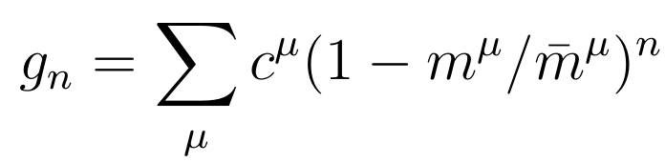

Virtual Crystal Approximation
a
,

Slide 4
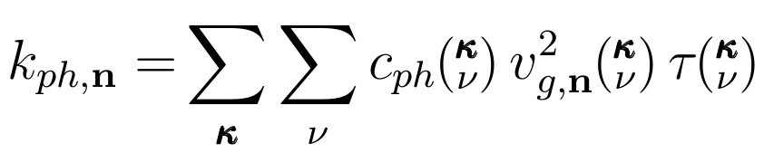
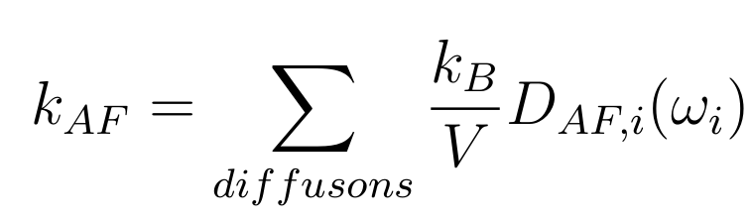
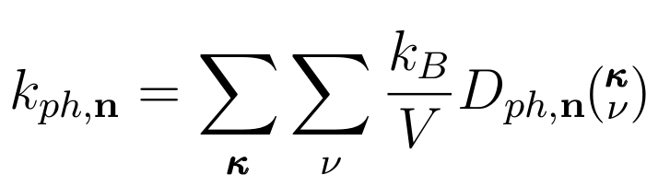
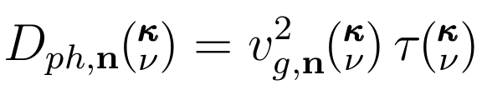
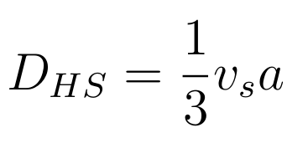
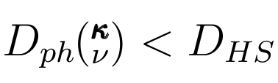
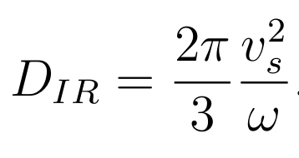
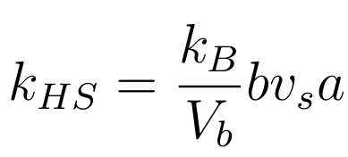
Kinetic Theory for Crystal
Thermal conductivity
Thermal diffusivity

Slide 5
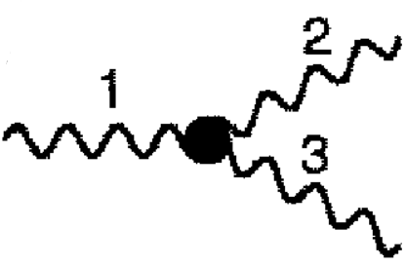
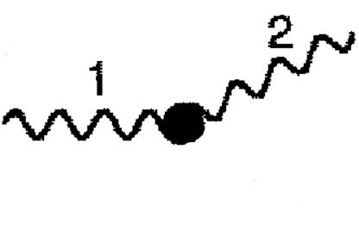
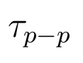

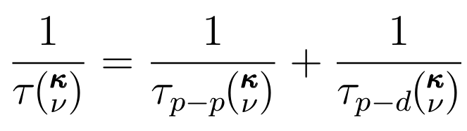

VC-ALD: Lifetimes
ALD
Tamura
1/
1/
~
~
Matthiessen's Rule

Slide 6
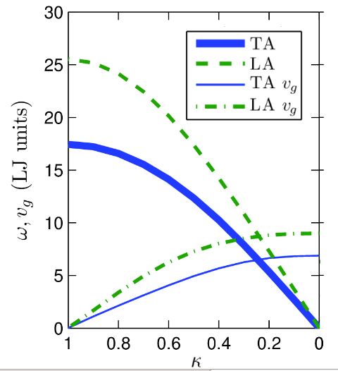
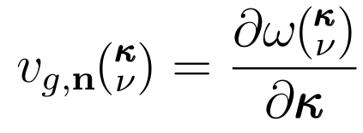
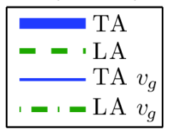

VC-ALD: Group Velocity

Slide 7
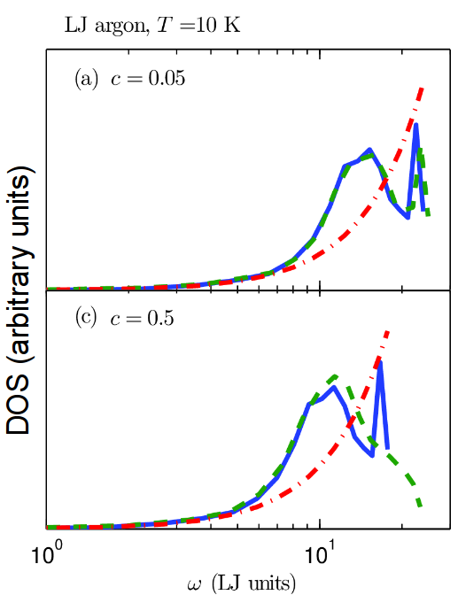
Explicit disorder: VC vs Gamma
DOS (arbitrary units)
Gamma
Computationally-inexpensive empirical potential:
Lennard-Jones argon

Slide 8
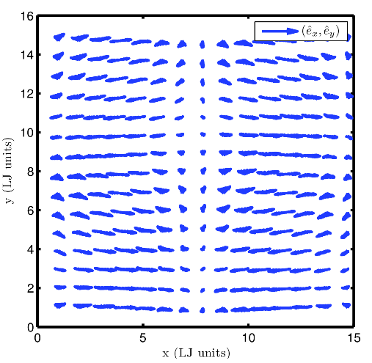
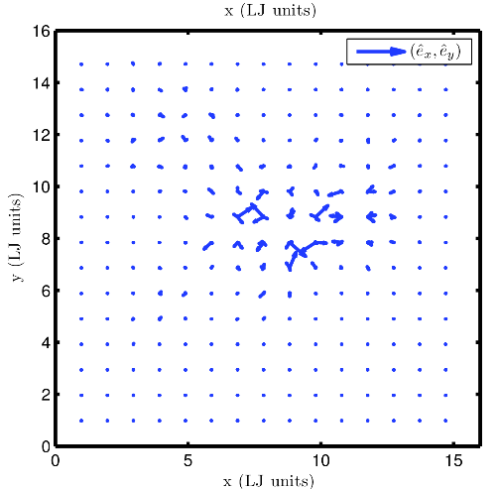
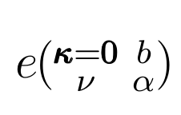
Gamma modes
DOS (arbitrary units)

Slide 9
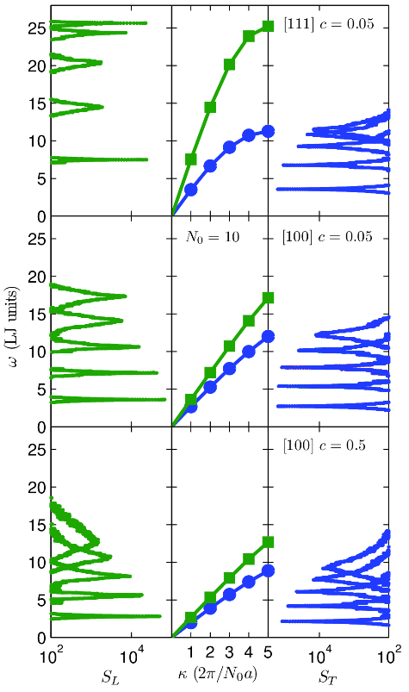
Gamma modes Structure Factor
Gamma
VC
Gamma

Slide 10
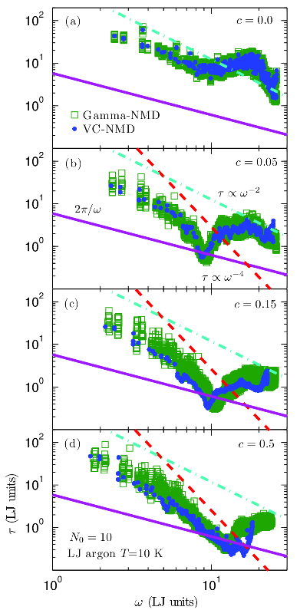


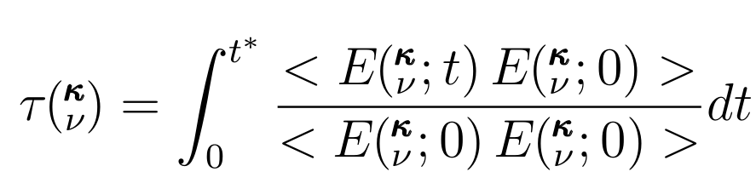
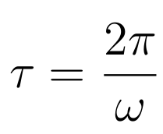


Normal Mode Decomposition (NMD)

Slide 11
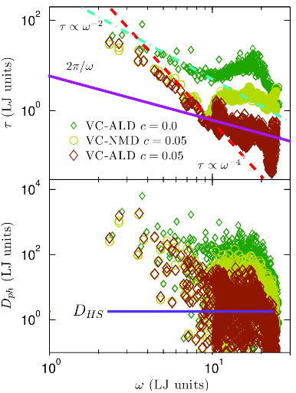
VC Diffusivities

Slide 12
AF Diffusivities

Slide 13
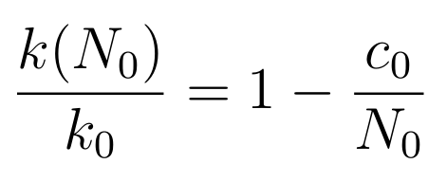
Thermal conductivity
Green-Kubo (GK): top-down
method
Amorphous
High-scatter adjustment*:

Slide 14
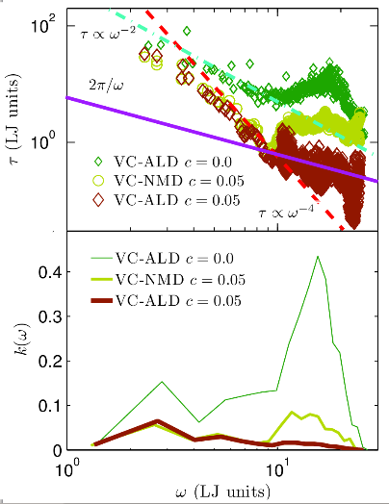
Thermal conductivity spectrum
Amorphous

Slide 15
Summary

Slide 16
HS/IR Limit

Slide 17
Thermal conductivity: SW silicon alloy
amor-Si

Slide 18
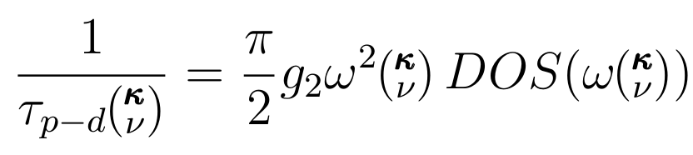

Slide 20
Phonon Spectrum: LJ Ar vs SW Si
MD
ALD
MD
MD-based:
1E4 modes
(7 days)*(100 cpu)
ALD:
1E6 modes
(7 days)*(12 cpu)

Slide 21
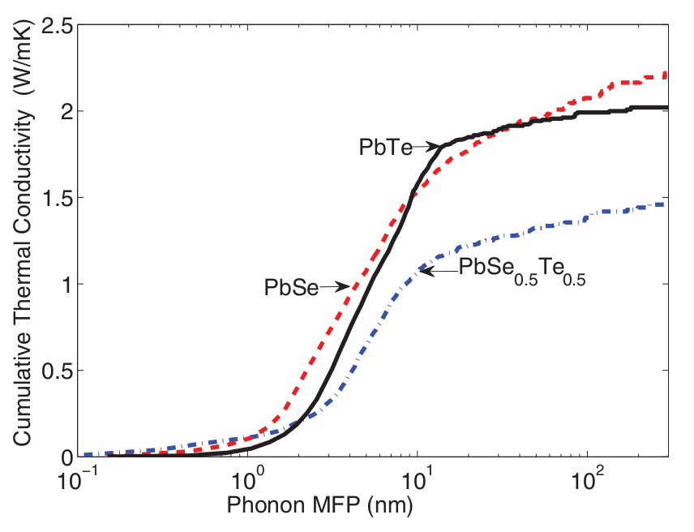
Conductivity Accumulation
SW Si
LJ Ar
PHYSICAL REVIEW B 85, 184303 (2012)

Slide 22
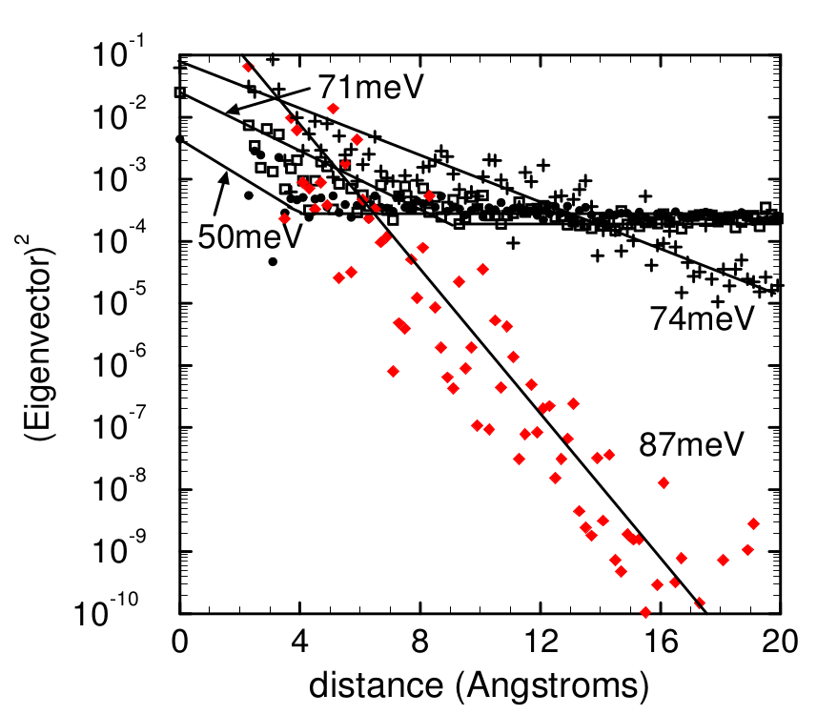
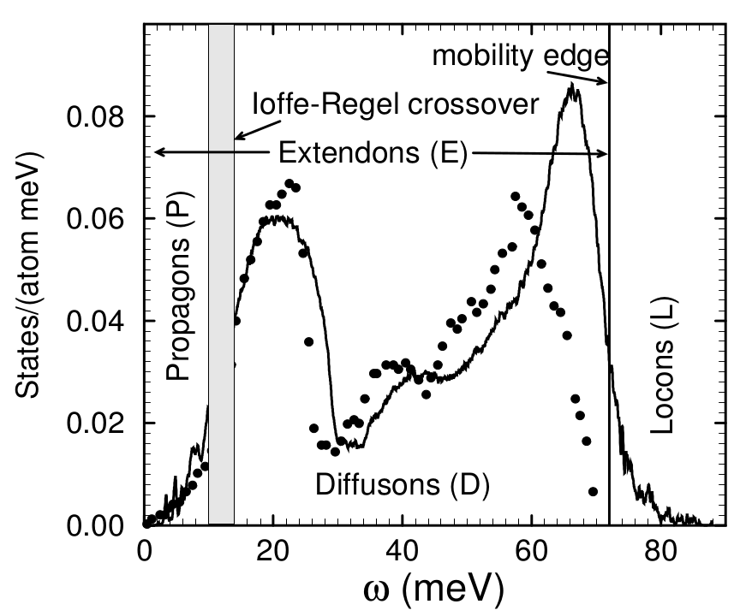
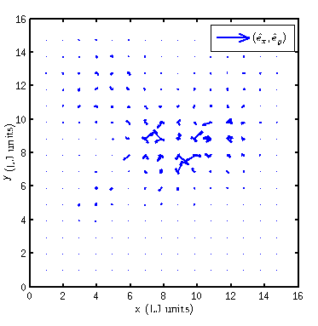
propagons, diffusons, locons
[1] Philip B. Allen and Joseph L. Feldman. Thermal conductivity of disordered harmonic solids. Physical Review B, 48(17):12581–12588, Nov 1993.

Slide 23
Diamond
GaN
si
Si,HS
Si/Ge
PbTe,PbTe/Se, (1/4)Tmelt = 300K
LJ,20K, (1/4)T_melt

Slide 24
Exponential trends in Information Technologies
Moore's Law: 2^{n}
http://boards.straightdope.com/sdmb/showthread.php?t=316530
Human Genome
http://en.wikipedia.org/wiki/Kurzweil_Music_Systems

Slide 25
Exponential trends music: orchestra
1980: $100,000
http://boards.straightdope.com/sdmb/showthread.php?t=316530
2003: $2,000 (my setup
http://en.wikipedia.org/wiki/Kurzweil_Music_Systems

